Slide 1
Automatic Extraction of Performance Metrics from the Scientific Literature with an Extract-and-Verify Loop
Dawn (Mengli) Duan, Michael Guerzhoy
Canadian AI 2025 - LLM Workshop
Notes:
> **Hi everyone—thanks for joining.** Welcome to our recent work on LLM-assisted extraction work.
> Our project asks a simple question: *Can a large-language model read scientific papers and pull out the numbers we care about?*

Slide 2
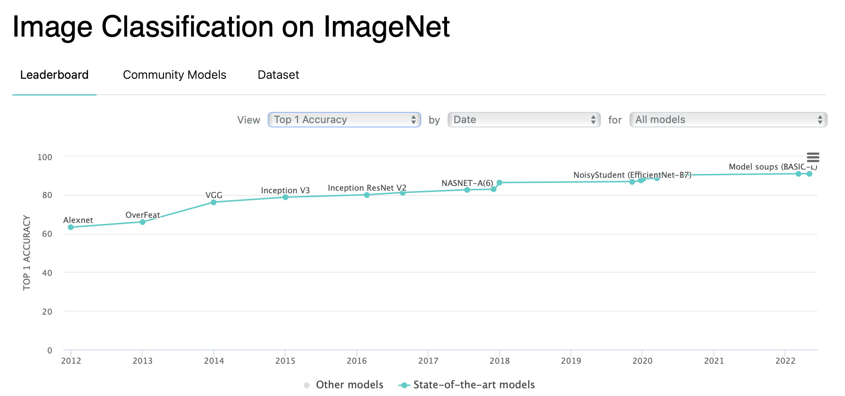
An Motivating Example: Image Classification on ImageNet
You are Computer Vision (CV) researcher trying to submitting your work to top journals
State-of-the-art (SOTA) performances in leaderboard
Submitting your new results
Non-trivial task for SOTA performances extraction!
Manual annotations
Human interpretations
Goal: automate the step with LLM
Notes:
Imagine you are a new CV student preparing a submission.
To show progress you need yesterday’s state-of-the-art—Top-1 accuracy from ImageNet . Those values are scattered across tables, main contents, and sometimes only in figures. Collecting them by hand is slow and error-prone.
First thing is to figure out SOTA performances from the literatures. Particularly Image Classification on ImageNet datasets has been a popular leaderboard since the start of the AlexNet around 2011. Putting together the leaderboard involves lots of manual efforts to extract, verify and consolidate from literatures and these hasn’t been non-trivial efforts.

Slide 3
Motivation & Contributions
Motivation: extracting performance metrics from scientific literatures is HARD!
SOTA performance metrics in CS community
Extract-and-verify use LLMs to extract performance metrics automatically from scientific literatures.
Contributions:
100-paper development with manual labelled Top-1 Accuracy on the ImageNet dataset
Correctly extracts the Top-1 accuracy of 67% on the development set
Notes:
This ties back nicely to our work. Our work focus on the extraction of Top-1 Accuracy reported on ImageNet for Image Classification tasks.
We present EXTRACT-AND-VERIFY, an end-to-end large language model (LLM)
pipeline that automatically extracts performance metrics from scientific papers.
We collect a large dataset of publications that report Top-1 Accuracy on the
ImageNet dataset and manually annotate it.
We report that our system correctly extracts
the Top-1 accuracy in 67% on the development set, slightly outperformning prior work. Though we would report things with more statistical significance reporting results on test set.

Slide 4
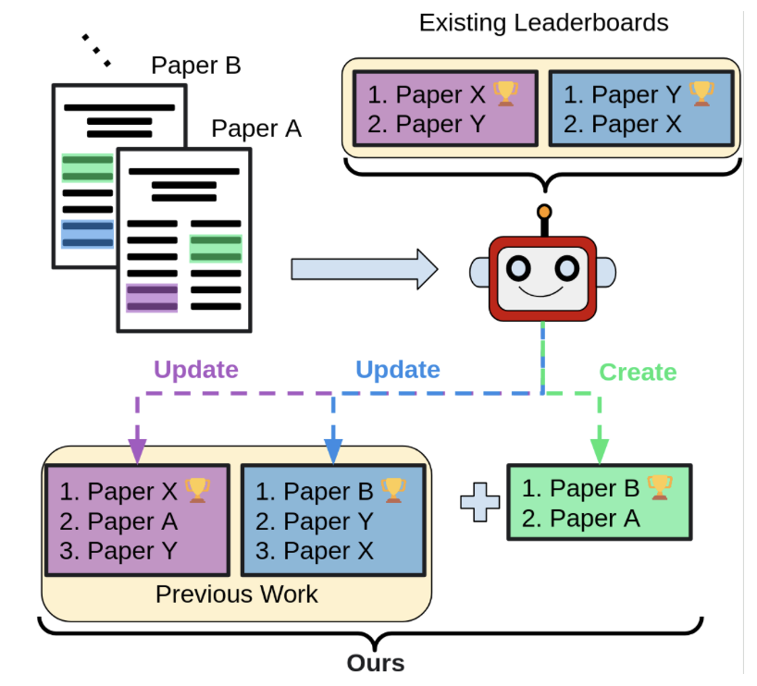
SCILEAD [EMNLP 24]
A manually-curated Scientific Leaderboard dataset (~40 Papers)
An LLM-based framework to construct scientific leaderboards automatically

Slide 5
Related Work
SCILEAD [EMNLP 24’]
Efficient performance tracking: Leveraging large language models for automated construction of scientific leaderboards [Paper][Code]
Manually-curated Scientific Leaderboard dataset (~40 Papers)
[OURS] 100 CV papers (ImageNet), new extract-and-verify loop.
LLM-based framework to construct scientific leaderboards
[1,2,3,4]
Prompting techniques
In-Context Learning (ICT)
Self-Critique
Self-Refine
Notes:
We build on two recent threads.
SCILEAD, submitted in Nov 24 EMNLP, contributes a manual curated scientific leaderboard datsets (around 40 papers). They method is LLM –based method that automatically construct scientific leaderboard.
We are also influenced by recent trends of prompting techiqnues, also discussed from our session 1 intro to LLM. Famous few shot manner, self-critique and self-refine are the major ones.

Slide 6
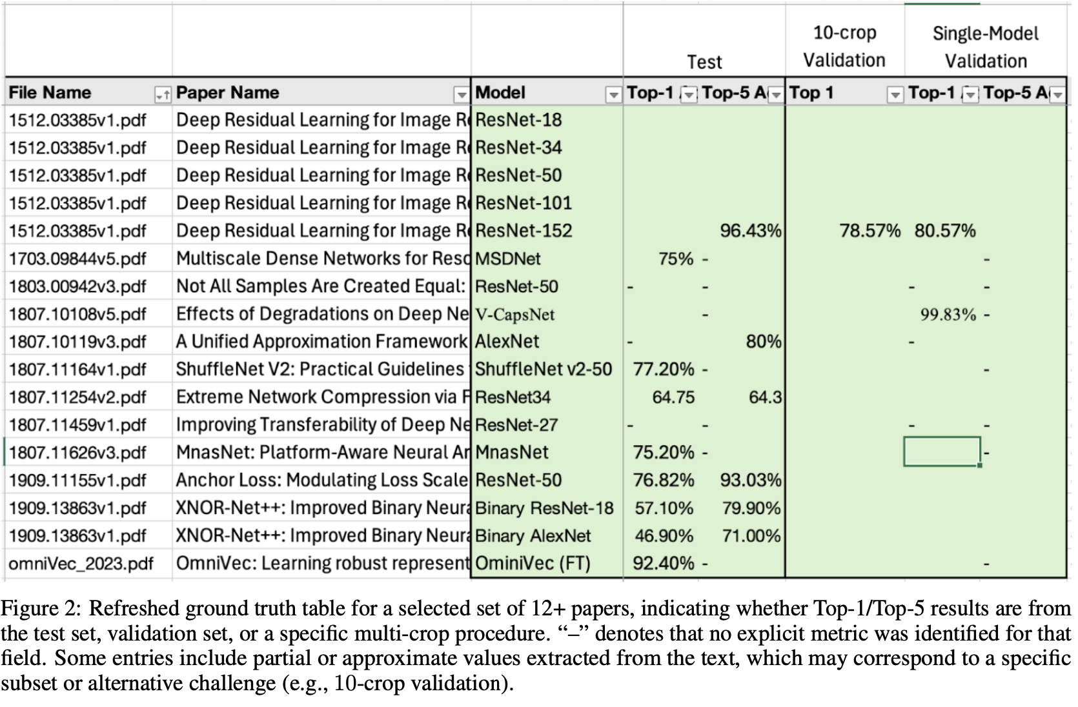
Annotated Development Set
1. Query PaperWithCode API (filter: ImageNet / classification). 2. Manual check → remove non-canonical splits. 3. Label Top-1 sentence + value. Total: 100 papers, 244 pages.
Notes:
Without further do, lets jump into our work. The construction of our development set is through – an automated
crawling pipeline that fetched candidate PDF.
We queried the Paper-with-Code API, filtered for “Image Classification / ImageNet,” and downloaded the PDFs.
Then we manual annotation protocol based on the chosen performance metrics Top-1 Accuracy. Please note that
There are lots of dataset-subset alignment and situations requriers further efforts. Here we leave as a preshadowing to our qualitative analysis in the last piece of our presentation.

Slide 7
Annotated Development Set
Paper Collection
Label-Verification Protocol
Dataset Alignment on ImageNet
Notes:
we describe the construction of our development set. We begin with the automated
crawling pipeline that fetched candidate PDFs, then describe the manual annotation protocol and
finally discuss how metric selection and dataset-subset alignment were intersting across all papers. A preshawing

Slide 8
Annotated Development Set
Notes:
Without further do, lets jump into our work.

Slide 9
Methodology
EXTRACT-AND-VERIFY Algorithm
Prompt Template
Notes:
We will walk through our EXTRACT_AND_VERIFY method in a flow-chart manner and present a glance of our prompt template.

Slide 10
EXTRACT-AND-VERIFY
What is EXTRACT-AND-VERIFY
Leverages an iterative loop: the model first extracts potential accuracy metrics and cites the source sentence, then re‐examines its own outputs to confirm consistency or highlight omissions.
This verification step forces the LLM to reflect on potential errors—especially when multiple snippet extractions conflict.
Why is it import
Particularly effective for discarding spurious references (e.g., baseline or dev‐set accuracies) and ensuring that the extracted top‐1 accuracy indeed matches the final reported performance on ImageNet.

Slide 11
EXTRACT-AND-VERIFY
…
Paper i
1: Sentences/Accuracies
404
Expected Output:\nSentence: "We report top-5 accuracy on the ILSVRC 2010 dataset in Table 2
...
…
…
…
…
404
Expected Output:\nSentence: "ImageNet AlexNet 42.6 19.6
Vote on most common extractions
…
Chunk 1
Chunk 2
Verify: Sentence/Prompt
92.4
Extraction Prompt
Chunk n
n: Sentences/Accuracies
Input
Output
Notes:
Lets’s dive into our system. The input to our system is a set of paper and the output to it is simply a number, the extracted Top-1 accuracy.
We Leverages a loop: the model first extracts potential accuracy metrics and cites the source sentence for various chunk/slice of PDF, then re‐examines its own outputs to confirm consistency or highlight omissions.
This verification step forces the LLM to reflect on potential errors—especially when multiple snippet extractions conflict. Its simple but robust in practice.

Slide 12
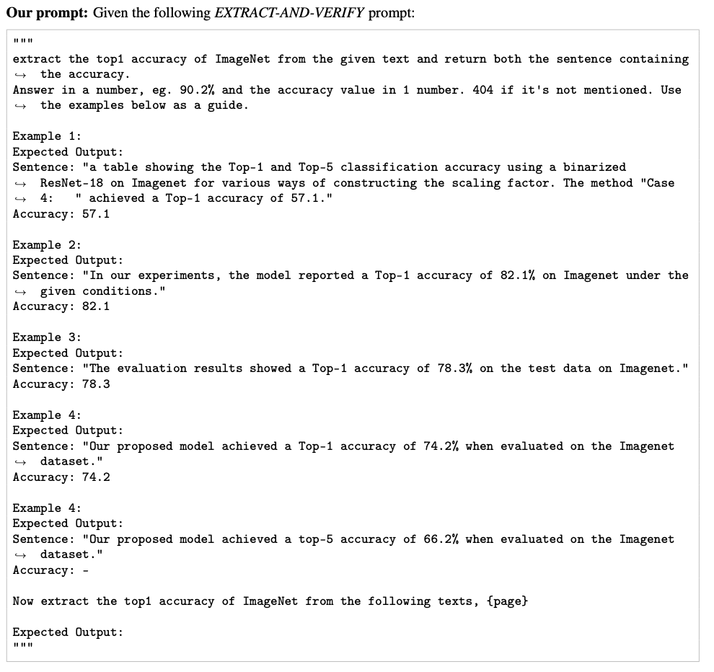
EXTRACT-AND-VERIFY: Prompt template
Notes:
We present the main extraction prompt here. Similar to what we see previously, here the a few shot mannered prompt template highlight a few more source sentence and accuracy pairs.
It shows a source sentence, example Top-1 Accuracies. Then asks the model to return a sentence and an accuracy or “404” if absent.

Slide 13
Experimental Results
EXTRACT-AND-VERIFY vs. SCILEAD
Classification Metrics
Regression Metrics
Notes:
The exciting part is coming – how well we did?
We evaluate our proposed EXTRACT-AND-VERIFY system against SCILEAD on our 100-paper
development set. Two types of evaluation are conducted: (i) classification accuracy—assessing
whether the predicted Top-1 value exactly matches the annotated ground-truth, and (ii) regression-
based metrics—quantifying how close the extracted values are numerically.

Slide 14
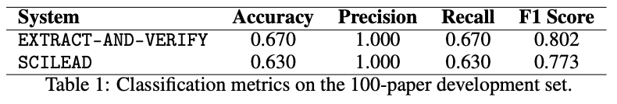
Evaluation Results on Development Set: Classification Metrics
Assessing whether the predicted Top-1 value exactly matches the annotated ground-truth
Notes:
So how extractly the predicted Top-1 value matches with Groundtruth? This brings us back to NLP101 where accuracy precision recall F1 scores are used given an extraction vs groundtruth.
Our EXTRACT-AND-VERIFY pipeline correctly extracts the Top-1 accuracy in 67 out of 100 papers,
compared to 63 by SCILEAD. However, our method yields higher recall and F1 score, reflecting
better overall coverage and extraction consistency. These classification-based findings align with
our regression analysis discussed below.

Slide 15
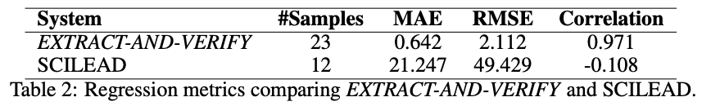
Evaluation Results on Development Set: Regression Metrics
(y* - y) where y -> ground-truth
MAE: avg magnitude of abs error
RMSE: Squared error before avg
No. samples report an extracted value y*
Pearson correlation: the strength and direction of the linear relationship between y* and y
Notes:
Now we are interested in quantifying how close the extracted values are numerically. (finding out how further our extracted values apart from the GT.
Our system shows a lower MAE (Mean Absolute Error (MAE) and RMSE Root Mean Squared Error (RMSE).
compared to SCILEAD, indicating tighter
alignment with the annotated ground-truth values. The high Pearson correlation (r = 0.971) also
suggests that our method better preserves the relative ranking of performance metrics across papers,
whereas SCILEAD shows weak and even negative correlation.

Slide 16
Qualitative Analysis
Straightforward (“Easy”) Examples
Difficult (“Challenging”) Examples
Notes:
We are done with numbers for now.
We illustrate our results with a qualitative analysis of easy and difficult cases.

Slide 17
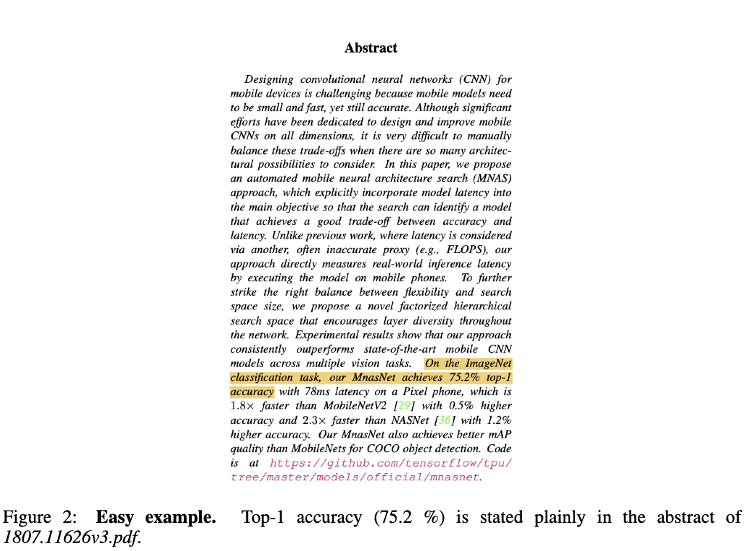
Straightforward (“Easy”) Examples

Slide 18
Straightforward (“Easy”) Example 1
Notes:
Our EXTRACT-AND-VERIFY pipeline correctly extracts the Top-1 accuracy in 67 out of 100 papers,
compared to 63 by SCILEAD. However, our method yields higher recall and F1 score, reflecting
better overall coverage and extraction consistency. These classification-based findings align with
our regression analysis discussed below.

Slide 19
Straightforward (“Easy”) Example 1 cont’d
Notes:
Our EXTRACT-AND-VERIFY pipeline correctly extracts the Top-1 accuracy in 67 out of 100 papers,
compared to 63 by SCILEAD. However, our method yields higher recall and F1 score, reflecting
better overall coverage and extraction consistency. These classification-based findings align with
our regression analysis discussed below.

Slide 20
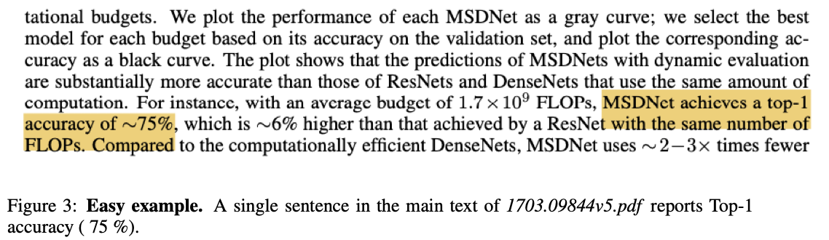
Straightforward (“Easy”) Example 2
Notes:
Our EXTRACT-AND-VERIFY pipeline correctly extracts the Top-1 accuracy in 67 out of 100 papers,
compared to 63 by SCILEAD. However, our method yields higher recall and F1 score, reflecting
better overall coverage and extraction consistency. These classification-based findings align with
our regression analysis discussed below.

Slide 21
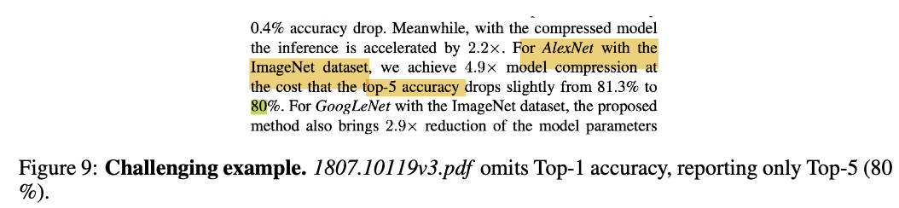
Difficult (“Challenging”) Examples: Top-1 omitted, Top-5 present

Slide 22
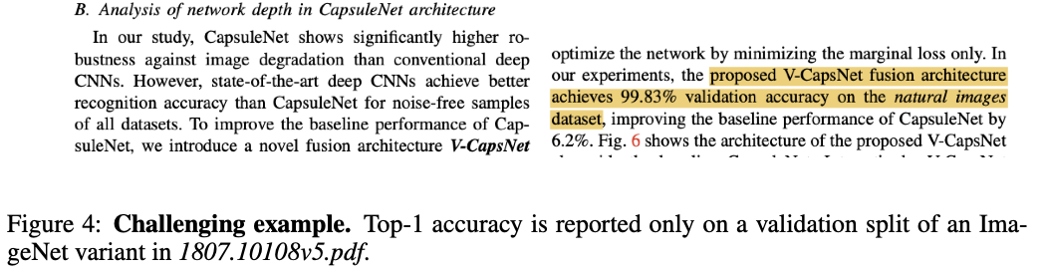
Difficult (“Challenging”) Examples: Alternate dataset variant

Slide 23
Next Steps
Expand dev set (500~1000 papers; multiple domains).
Multi-metric extraction (Top-5, mAP, BLEU).
Fine-tune LLM or add retrieval layer for robustness.
Notes:
Next steps [minor]: Furthermore, we wish to expand on dataset size and report things with more statistical significance with our formal test set. Also we are hoping to fine-tune our pipeline resulting robust results.

Slide 24
EXTRACT-AND-VERIFY
An end-to-end pipeline built on LLMs for automatically extracting Top-1 accuracy metrics from scientific papers.
100-paper development set that report Top-1 Accuracy on the ImageNet dataset and manually annotate it
Correctly extracts the Top-1 accuracy of 67% on the development set, better than prior work
Conclusion
Notes:
I hope this gives you a glance into the exciting advances we’re seeing in our work Extract and Verify. We are an e2e LLM assisted pipeline for automatic extraction of Top-1 accuracy from literatures. We contribute to 100-paper dev set reporting top-1 accuracy on ImageNet publications. Our system is able to correctly extracts Top-1 accuracy 67, better than prior work
I’d be happy to take any questions or discuss further.

Slide 25
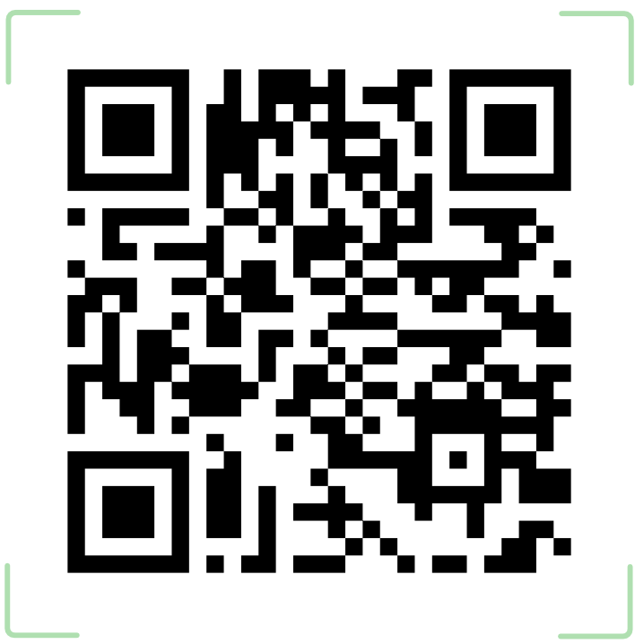
25
Thank you!
Questions? Email us at
guerzhoy@cs.toronto.edu
mengli.duan@mail.utoronto.ca
Notes:
I’d be happy to take any questions or discuss further.

Slide 26
Appendices

Slide 27
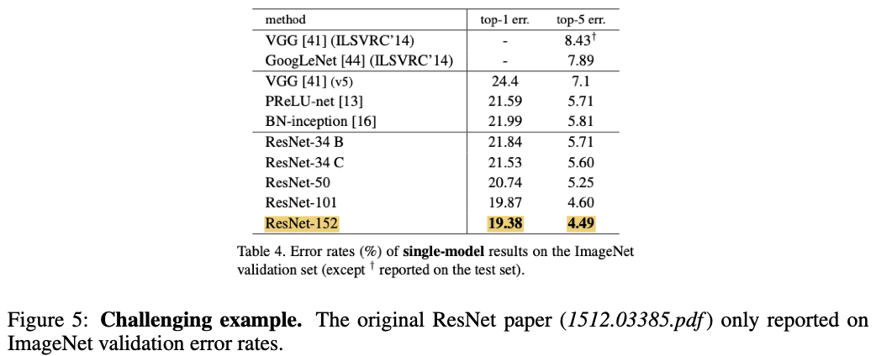
Difficult (“Challenging”) Examples: Table-only reporting

Slide 28
References
Şahinuç, Furkan, et al. "Efficient Performance Tracking: Leveraging Large Language Models for Automated Construction of Scientific Leaderboards." arXiv preprint arXiv:2409.12656 (2024).
Brown, Tom, et al. "Language models are few-shot learners." Advances in neural information processing systems 33 (2020): 1877-1901.
Madaan, Aman, et al. "Self-refine: Iterative refinement with self-feedback." Advances in Neural Information Processing Systems 36 (2023): 46534-46594.
Stechly, Kaya, Karthik Valmeekam, and Subbarao Kambhampati. "On the self-verification limitations of large language models on reasoning and planning tasks." arXiv preprint arXiv:2402.08115 (2024).

