Slide 1

Marvel
BANAPOINT
MARVEL CALENDAR
Co.Ltd
Members:
Dongjun Yang ,Fanyu Mou, Xiangyu Chen, Yitong Liu

Slide 2
Introduction

Slide 3
Background
Nowadays, lots of calendar apps are designed for users. They allow uses to note down arrangements and events. However, some people also want to share events to their friends. It can be a party or a meeting. In this case, we want to design a calendar application to allow users share and arrange events properly.

Slide 4
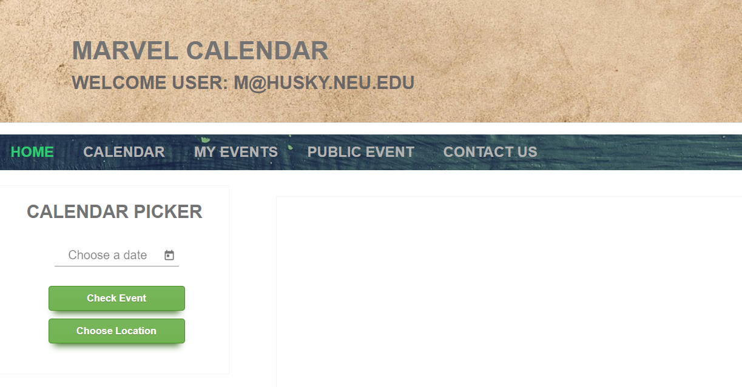
What is Marvel Calendar
Marvel Calendar is an simple web calendar app that is easy to manage events and share events. enables you to create and edit events
Marvel Calendar is a MEAN stack web application using MongoDB, Express, Angular, and NodeJS.
We build a RESTful API and using it to perform CRUD operations on a MongoDB database through an Angular frontend.

Slide 5
Program

Slide 6
Main User Stories
1.As a user, I should have a option to sign up and login to my account, so that I can see what I saved in the Planner.
2.As a user, I want to see a mini calendar that I can click on as a quick link to specific date.
3. As a user, I can add events to the calendar, and can also review, edit and remove them. So I have more flexible control of events.
4.As a user, I want to post public events with address, so my friends around me can see it.

Slide 7
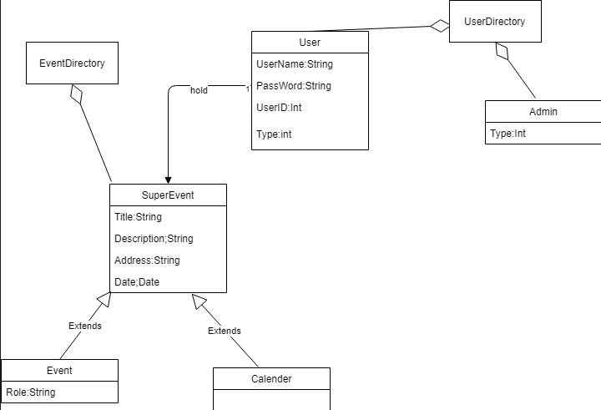
Object-Model

Slide 8
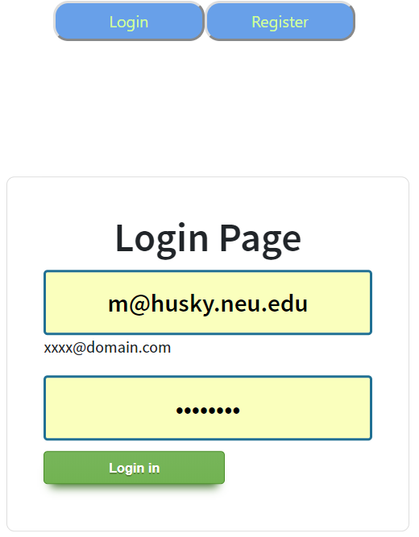
Important Use Case
1.Login

Slide 9
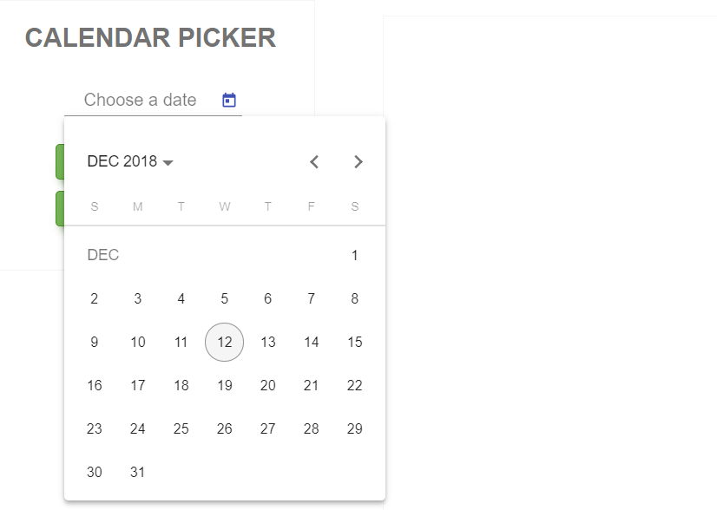
Important Use Case
2.Calendar Picker

Slide 10
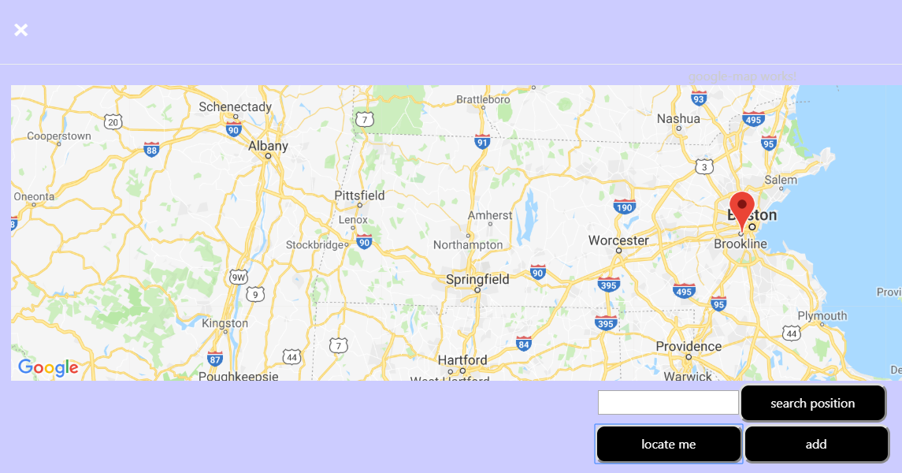
Important Use Case
3. Location

Slide 11
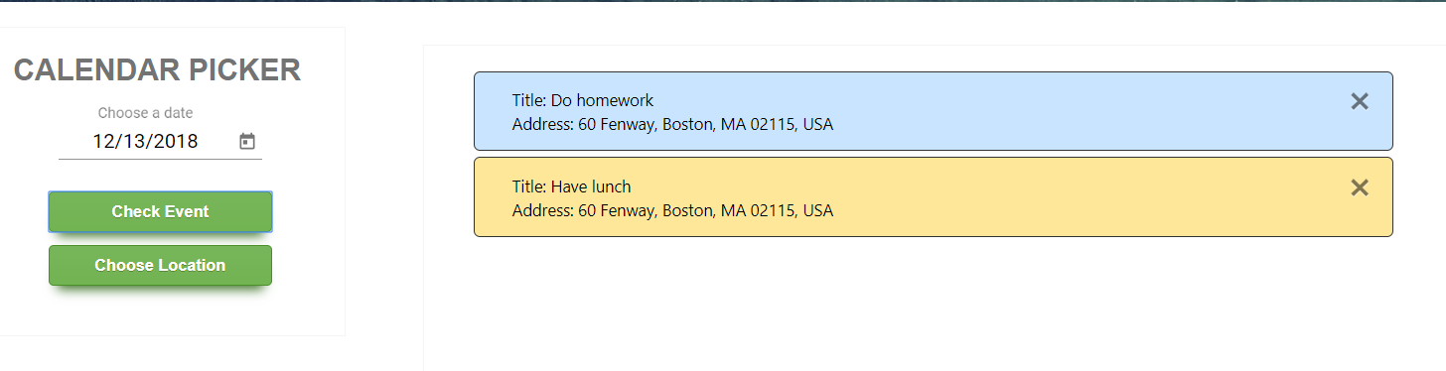
Important Use Case
4. Check events

Slide 12
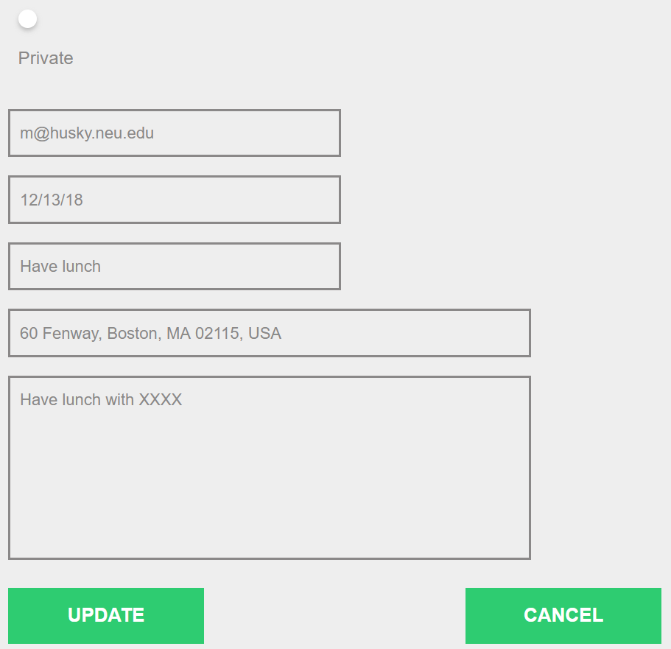
Important Use Case
5. Update Events

Slide 13
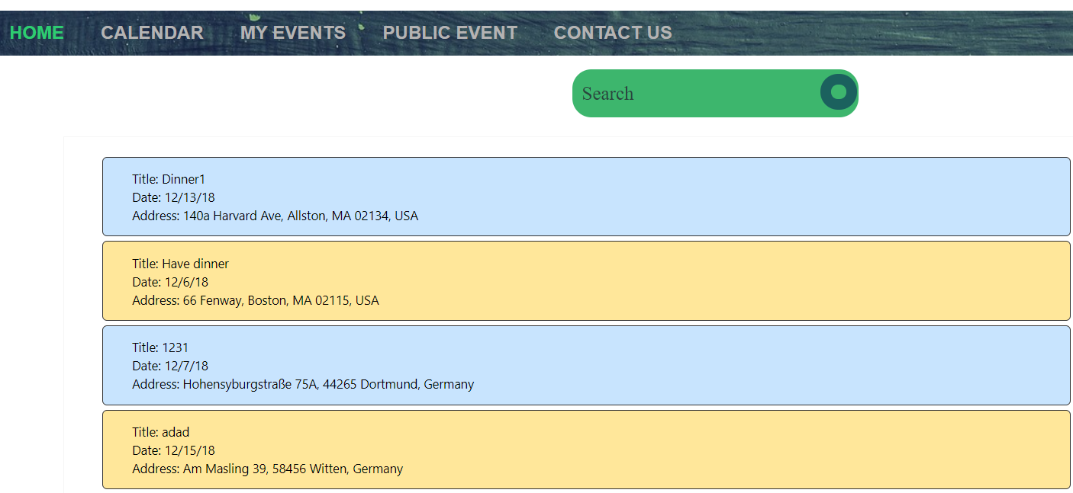
Important Use Case
6.Check and search public events

Slide 14
Next
Let users to send messages to others, especially for public events holder when a public event is updated.
Modify the event UI, let users add different color to events and define the priority, so I can better manage events.

Slide 15
THANKS
BANAPOINT
Co.Ltd

