Slide 1
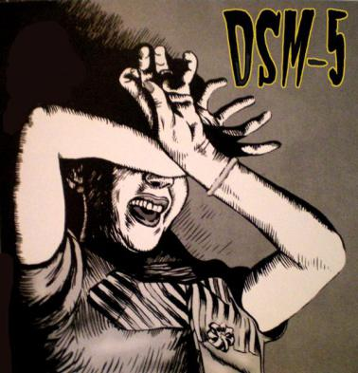
INTRODUCTION TO CRITICAL PSYCHODIAGNOSTICS
Debbie Kaminer Department of Psychology, UCT

Slide 2
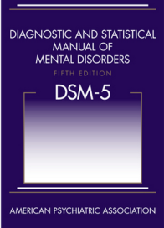
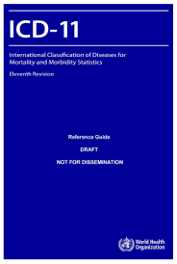
DEFINING MENTAL DISORDER
DSM 5 | ICD 11
American Psychiatric Association (APA) | World Health Organisation (WHO) – ±193 member countries
Official USA classification system, though used elsewhere | Official WHO global classification system, including in low-income countries
Mental disorders only | Includes medical diseases and mental disorders
±R2000 | Available freely on the internet
Clear operational criteria, time frames, exact number of symptoms required (aims at inter-rater reliability) | Description and guidance rather than operational criteria - more room for clinician judgement in making diagnoses
The concept of mental disorder is fundamental to the discipline of clinical psychology (though discipline not confined to only treating ‘disordered’ conditions)
In clinical practice and research, the Diagnostic and Statistical Manual of Mental Disorders (DSM) and the International Classification of Diseases (ICD) classification systems are the primary judges of what is disordered, while remaining theory-neutral about etiology (why)

Slide 3
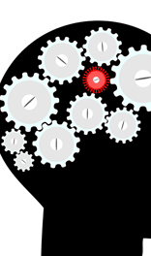
DEFINING MENTAL DISORDER
What do we mean when we say that a psychological condition is not merely a form of normal human distress but a form of ‘mental disorder’?
No biological markers for most mental disorders, only patients’ subjective reports and clinicians’ observations
No consensus/agreement on how to operationally define mental disorder, mainly because there is also no definition of ‘mental order’ (normal, expectable human feelings and behaviour) to set it against
Etiological uncertainty, theoretical fragmentation add to the definitional difficulties

Slide 4
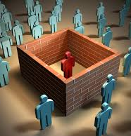
DEFINITIONS OF MENTAL DISORDER
DSM 5 criteria:
A syndrome characterised by clinically significant disturbance in an individual’s cognition, emotion regulation, or behaviour
Reflects a dysfunction in the psychological, biological, or developmental processes underlying mental functioning
Usually associated with significant distress or disability in social, occupational or other important activities
An expectable or culturally approved response to a common stressor or loss, such as death of a loved one, is not mental disorder
Socially deviant behaviour (political, religious, sexual) and conflicts that are primarily between the individual and society are not mental disorders unless the deviance or conflicts result from a dysfunction in the individual

Slide 5
DEFINITIONS OF MENTAL DISORDER
ICD-11:
syndrome characterised by clinically significant disturbance in an individual's cognition, emotional regulation, or behaviour
reflects a dysfunction in the psychological, biological, or developmental processes that underlie mental and behavioural functioning.
usually associated with distress or impairment in personal, family, social, educational, occupational, or other important areas of functioning.
(no criteria that consider cultural or social factors)
DO THE DSM 5 AND ICD-11 DEFINTIONS OF MENTAL DISORDER ADEQUATELY DISTINGUISH NORMAL HUMAN FEELINGS/THOUGHTS/BEHAVIOURS FROM DISORDERED ONES?

Slide 6
BOUNDARIES BETWEEN MENTAL DISORDERS
Comorbidity – presence of co-occurring mental disorders
In clinical practice, comorbidity is the norm rather than the exception (e.g. 74% of people with depression have a comorbid diagnosis; anxiety disorders are frequently comorbid with each other, as are personality disorders)
Many symptoms are non-specific (eg anxiety, poor concentration, impulsivity)
What is the nature of the relationship between comorbid disorders - distinct, additional clinical entities or multiple expressions of the same underlying issue?
Complexities of clinical practice do not fit with rigidity of DSM categories
Artificially splitting a complex clinical issue into several separate pieces can undermine a wholistic understanding of the client and their treatment needs

Slide 7
SOME DIFFERENT POSITIONS ON MENTAL DISORDER
1) Mental disorders are real neurobiological entities and can (or eventually will) be measured/detected accurately through scientific methods (eg current NIH position); DSM disorders just describe what is actually out there
2) Mental disorders are real, but complex; they can’t be neatly ‘carved up’ like the DSM tries to do (e.g. there are probably a “mob of schizophrenic disorders”, rather than just one “schizophrenia”); within this complexity, diagnostic systems provide a useful heuristic (mental short-cut for making clinical judgements) but that’s all
3) Mental disorders are social constructs of particular times and contexts, they are ways of making sense of complex experiences; how we try to describe them (eg DSM diagnostic categories) influences how we see/experience them, and this will change over time and place (see Ethan Watters book “Crazy like us: The globalisation of the American psyche”)
4) While distress/suffering is real, the concept of ‘mental disorder’ was invented as a means of social control and should be rejected outright
5) Although there are some ‘real’ mental disorders, others have been invented in an ongoing process of medicalisation (pathologizing normal human responses) and this medicalisation process benefits some (eg Big Pharma; and neoliberalism, capitalism more broadly) and disempowers/marginalises others (eg previous diagnostic category of homosexuality; current diagnostic category gender dysphoria)

Slide 8
DIAGNOSTIC INFLATION Trend towards increase in number of disorders, and number of people being diagnosed, over time
Edition | Publication date | No. of pages | No. of diagnoses
DSM-I | 1952 | 130 | 106
DSM-II | 1968 | 134 | 182
DSM-III | 1980 | 494 | 265
DSM-III-R | 1987 | 567 | 292
DSM-IV | 1994 | 886 | 297
DSM-IV-TR | 2000 | 943 | 297
DSM 5 | 2013 | 947 | 294
Increase in number of people being diagnosed:
25% (n=60 million) of USA population meets criteria for a DSM mental disorder
ADHD diagnoses have increased 5% per year since 2003
40-fold increase in childhood bipolar disorder in the 10 year period since mid-1990s
20-fold increase in autism rates in past twenty years
Depression rates in US adults more than doubled in twenty years since 1991

Slide 9
DIAGNOSTIC INFLATION What drives these trends?
Increased knowledge, research and awareness about mental disorders
“Medical research has made such enormous advances that there are hardly any healthy people left” (Aldous Huxley)
Technological advances: increased global communication between mental health practitioners
Lowered diagnostic thresholds for some diagnoses
Pharmaceutical industry marketing (especially re. childhood disorders)
Increased diagnosis and prescribing by primary care physicians (90% of anti-anxiety, 80% of anti-depression, 65% of stimulant and 50% of anti-psychotic medication)
A diagnosis is required to access services or to receive financial reimbursement
Perfectionistic societal values and expectations
What else?

Slide 10
DIAGNOSTIC INFLATION
Controversial new diagnoses in DSM 5:
Disruptive Mood Dysregulation Disorder (DMDD)
Mild Neurocognitive Disorder
Binge-eating Disorder
Caffeine withdrawal
Proposed diagnoses for future inclusion:
Attenuated Psychosis Syndrome
Internet Gaming Disorder
Persistent Complex Bereavement Disorder

Slide 11
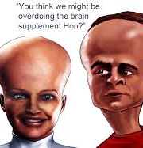
MILD NEUROCOGNITIVE DISORDER (MND)
DIAGNOSTIC CRITERIA:
Evidence of modest cognitive decline from a previous level of performance in one or more cognitive domains (complex attention, executive function, learning, memory, language, perceptual-motor or social cognition), based on:
Concern of the individual, a knowledgeable informant (such as a friend or family member) or the clinician that there’s been a mild decline in cognitive function; and
A modest impairment in cognitive performance, preferably documented by standardized neuropsychological testing or another qualified clinical assessment.
The cognitive deficits do not interfere with capacity for independence in everyday activities (e.g.,complex instrumental activities of daily living such as paying bills or managing medications are preserved, but greater effort, compensatory strategies, or accommodation may be required).
Aim is to identify those at risk for development of
Alzheimers but:
- No real predictive power
- No clear treatment strategies as yet

Slide 12
BINGE-EATING DISORDER
DIAGNOSTIC CRITERIA:
Recurrent episodes of binge eating, characterised by both of the following:
Eating, in a discrete period of time (e.g. within any 2-hour period), an amount of food that is definitely larger than most people would eat during a similar period of time and under similar circumstances.
A sense of lack of control over eating during the episode (e.g. a feeling that one cannot stop eating or control what or how much one is eating).
The binge eating episodes are associated with three or more of the following:
eating much more rapidly than normal; eating until feeling uncomfortably full; eating large amounts of food when not feeling physically hungry; eating alone because of feeling embarrassed by how much one is eating; feeling disgusted with oneself; depressed or very guilty afterward
Marked distress regarding binge eating is present
Binge eating occurs, on average, at least once a week for three months
Binge eating not associated with the recurrent use of inappropriate compensatory behaviours as in Bulimia Nervosa and does not occur exclusively during the course of Bulimia Nervosa, or Anorexia Nervosa methods to compensate for overeating, such as self-induced vomiting.
DSM: “Intended to increase awareness of the substantial differences between binge eating disorder and the common phenomenon of overeating”

Slide 13
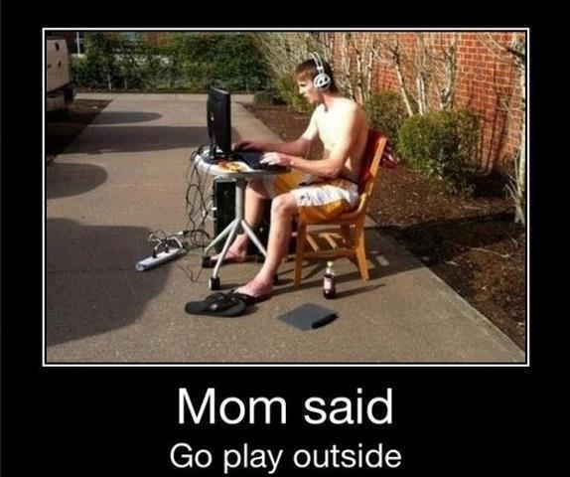
INTERNET GAMING DISORDER (Proposed for inclusion in next DSM)
Persistent and recurrent use of internet-based games, often with other players, leading to clinically significant impairment or distress, as indicated by 5 or more of the following within a one year period:
Preoccupation with internet games (dominant activity and constant anticipation or thinking about gaming)
Withdrawal symptoms when not playing internet games (irritability, anxiety, sadness)
A build-up of tolerance–more time needs to be spent playing the games.
The person has tried to stop or curb playing internet games, but has failed to do so.
The person has had a loss of interest in other life activities
The person continues to overuse Internet games despite being aware of psychosocial problems
The person has deceived others about his or her internet game usage
The person uses Internet games to escape or relieve a negative mood
The person has lost or put at risk a significant relationship, job or educational opportunity because of internet games

Slide 14
PERSISTENT COMPLEX BEREAVEMENT DISORDER (Proposed for inclusion in next DSM)
The individual experienced the death of someone with whom s/he had a close relationship
Since the death, at least one of the following is experienced on more days than not and to a clinically significant degree and has persisted for at least 12 months after the death in the case of bereaved adults and 6 months for bereaved children:
- persistent yearning/longing for the deceased
- intense sorrow and pain in response to the death
- preoccupation with the deceased
- preoccupation with the circumstances of the death
Since the death, at least six of the following are experienced for at least 12 months (adults) or 6 months (children):
- reactive distress to the death (difficulty accepting the death, anger or bitterness, self-blame, avoidance of reminders of the loss)
- social or identity disruption: difficulty trusting others, feeling alone or detached from others, feeling life is empty or meaningless, difficulty planning for the future, feeling that a part of oneself has died with the deceased
Causes clinically significant distress or impairment in functioning
Reaction is out of proportion or inconsistent with cultural, religious or age-appropriate norms

Slide 15
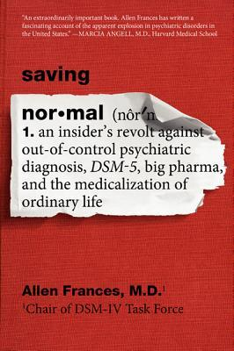
DIAGNOSTIC INFLATION What’s the remedy?
Frances & Widiger (2012) argue for diagnostic conservatism:
A high standard of scientific evidence should be required for entry into diagnostic system or for changes to criteria: rigorous systematic reviews and field trials
Wide and transparent consultation (vs. confidentiality agreements for DSM 5 task team)
Small changes have big consequences (lower thresholds lead to false epidemics of mis-identified pseudo-patients)
Risks and benefits of new diagnoses need to be carefully weighed: Failing to treat those who need intervention vs pathologising and stigmatising variations of normality

Slide 16
CONCLUSIONS
While psychological distress and suffering are universal human experiences, the notion of ‘mental disorder’ (disordered distress/suffering) remains conceptually slippery and contested:
“The concept of mental disorder is so amorphous, protean and heterogenous that it inherently defies definition – leaving a hole at the center of psychiatric classification” (Frances and Widiger, 2012)
Increasing medicalization of normal human behaviours, based on low levels of scientific evidence
The DSM reflects knowledge produced in a particular time and place, by a limited group, representing some voices and excluding others
The DSM should not be used in a technicist (checklist) way, but with critical reflexivity and pragmatism, in the interests of supporting and treating clients effectively
Diagnosis does not equal understanding : symptoms have individual psychological meaning – ‘treat the patient, not the diagnosis’

