Slide 1
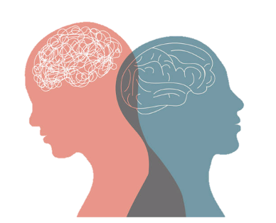

Intellectual Disabilities (ID)
Lecture 3
PSY3011S
22 September
2022
Siyabulela Mkabile, Mpsych, PHD
Room 34,
Child Guidance Clinic
University of Cape Town
Email: s.mkabile@uct.ac.za

Slide 2
Outline
What do we know?
Prevalence of the etiological factors of ID
Explanatory models on causes of ID

Slide 3
What do we know?
We know that;
Intellectual disability is common in low- and middle-income countries (LMICs) than in high income countries.
Globally ID is estimated to be at about 1% of the population.
In low-middle-income countries ID rates are very high - 16.41/1000 population

Slide 4
Prevalence of the etiological factors of ID
Research have revealed that:
Chromosomal disorders,
4 - 8% in mild ID
20 – 40% in severe ID
Single gene disorders
0 – 8 % in mild ID
5 – 20 % in severe forms of ID

Slide 5
Prevalence of the etiological factors of ID
Prevalence of various aetiological factors responsible of ID varies across different regions and countries.
Environmental factors are associated with high levels of ID in LMIC;
Lack of prenatal, perinatal and postnatal care
For example, in India 25% of cases with ID were attributable to environmental factors
Similarly in Brazil 40% - environmental
In a contrary, in Finland only 15% - environmental
35% in Finland were genetic causes

Slide 6
Facts on Aetiological Factors of ID
In many cases of ID aetiology is unknown
From early stages of pregnancy the development and the maturation process of the brain remains vulnerable and sensitive to both internal and external factors.
Favorable conditions facilitate the growth process, maturation and development through adolescence and early adulthood.
Adverse events can cause impairments in the development of intelligence and consequently leading to intellectual disability.

Slide 7
Aetiological Factors of ID
Current trends into causes of ID;
Biomedical
Psycho-social factors
These are important and often interacting

Slide 8
Explanatory models on causes of ID
Possible causes are specific to severities of ID. Certain types of ID are determined by;
Genetic
Biomedical
Environmental factors
Interaction of multiple factors

Slide 9
Explanatory models on causes of ID
Current Approaches on Causes of ID
They are based on;
The timing of the insult
On the type of insult ( Genetic and Environmental)

Slide 10
Explanatory models on causes of ID
Timing of the insult
Prenatal
Perinatal
Postnatal

Slide 11
Explanatory models on causes of ID
Timing of the insult
Prenatal
Perinatal
Postnatal

Slide 12
Explanatory models on causes of ID
Prenatal:
During pregnancy
During the first and second trimester
Most known causes are prenatal and produce delays in development
Chromosomal, neurodegenerative, brain anomaly, specific syndromes

Slide 13
Explanatory models on causes of ID
Perinatal:
Perinatal causes include factors occurring from the third trimester of pregnancy.
These include third trimester pregnancy complications
Perinatal asphyxia, Meningitis with hydrocephalus, hypothyroid, preterm and low birth weight

Slide 14
Explanatory models on causes of ID
Postnatal:
Research estimates less than 10 per cent of ID causes during the postnatal period
These include; viral infections, bacterial infections, tuberculosis and brain traumatic injuries
Other factors associated with cognitive declines include malnutrition and experiential deprivation

Slide 15
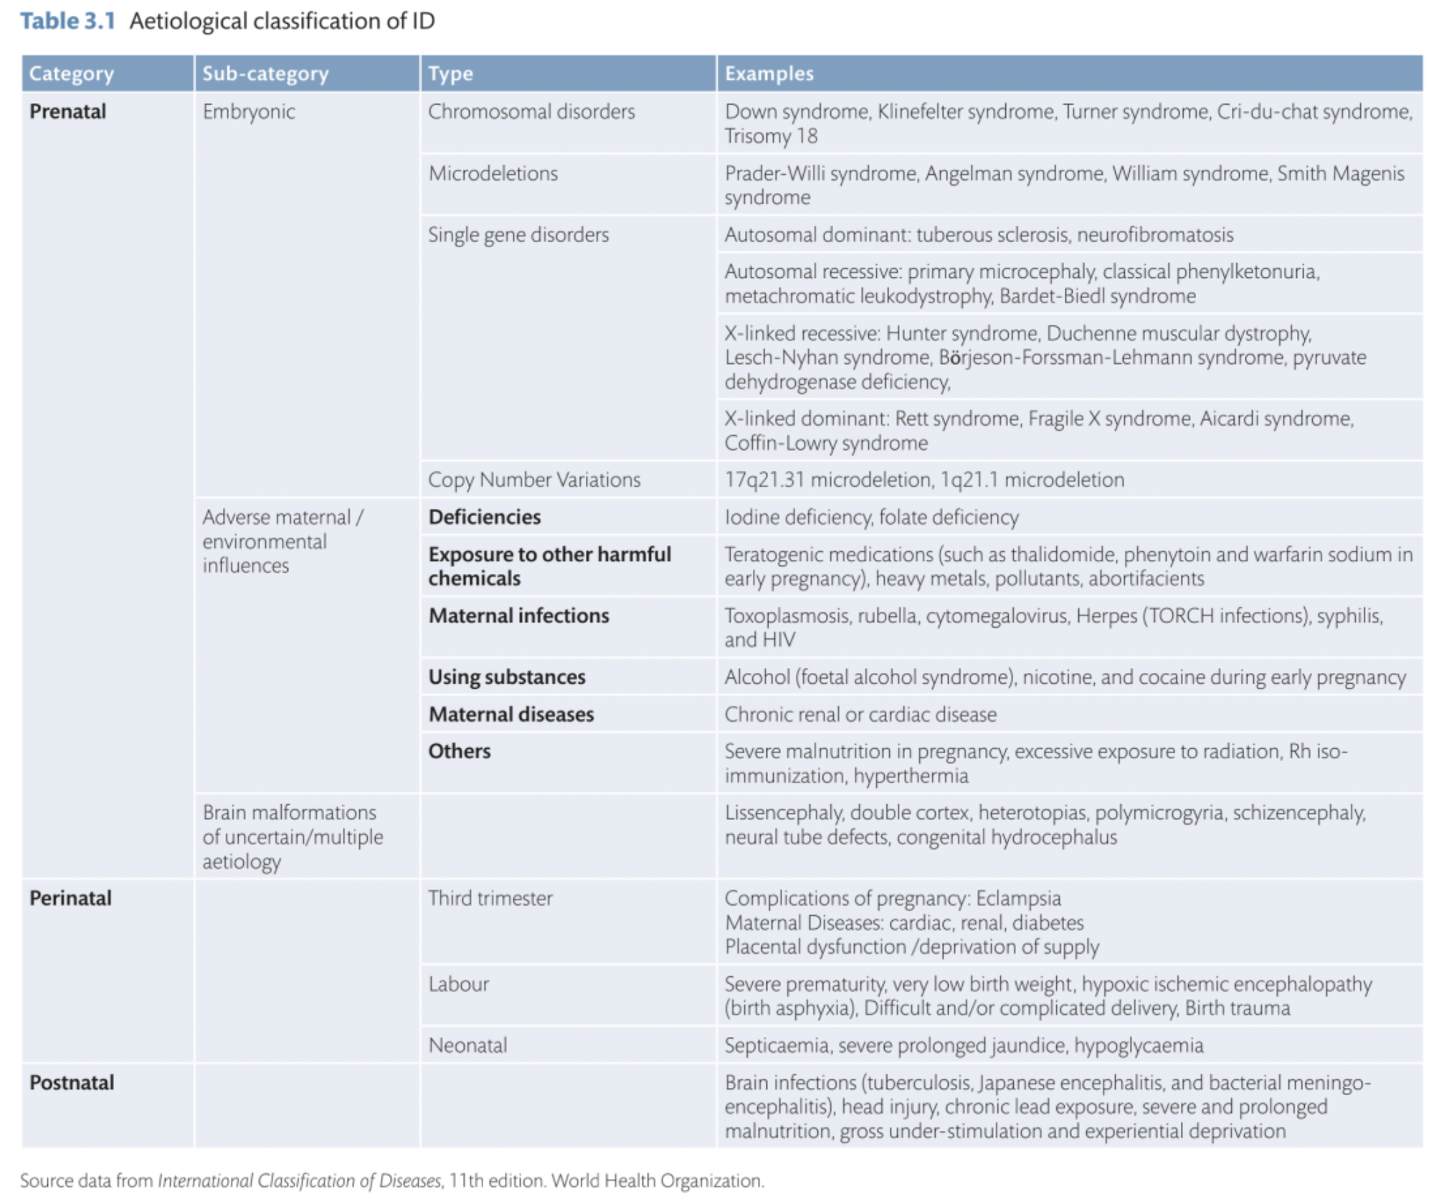
Explanatory models on causes of ID

Slide 16
Explanatory models on causes of ID
Genetic factors
Chromosomal disorders,
Microdeletions,
Single gene disorders and
Newly discovered mechanisms such as copy number variations.

Slide 17
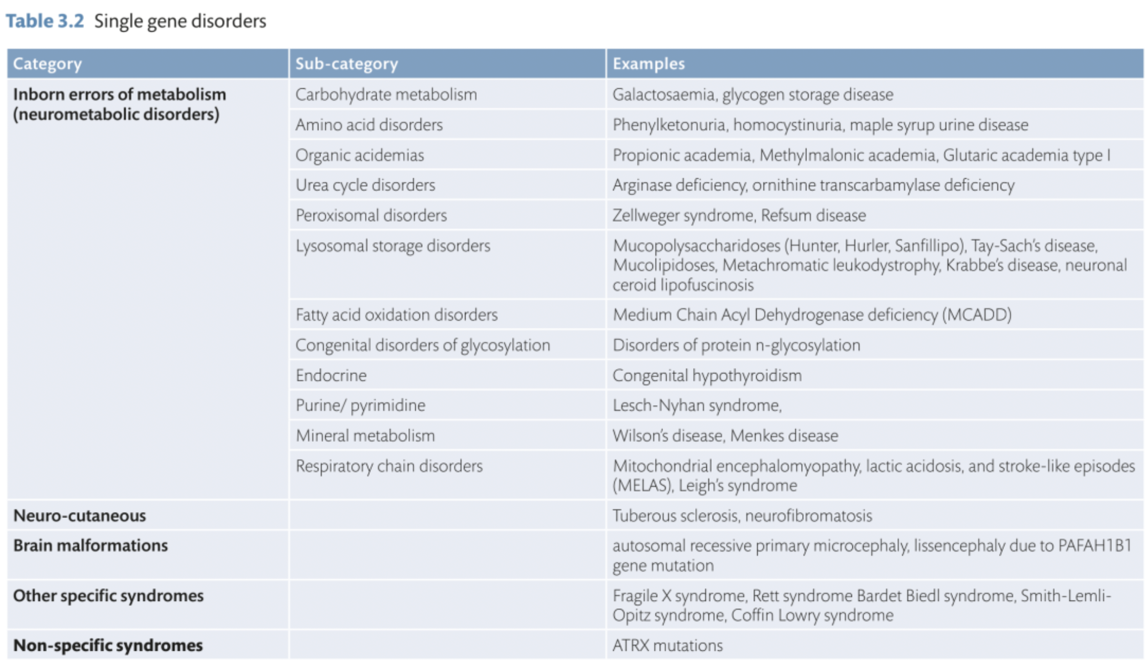
Explanatory models on causes of ID

Slide 18
Explanatory models on causes of ID
Environmental factors
May operate in prenatal,
At perinatal, or
At postnatal periods of development.

Slide 19
Explanatory models on causes of ID
Pathophysiological pathways leading to ID
Involve disruption of neurodevelopment and neuronal functioning,
such as neural proliferation,
migration,
connectivity,
synaptic development,
intra- and inter-cellular signalling pathways,
and metabolism.
Identifying the aetiology has major clinical implications.

