Slide 1

Intellectual Disabilities (ID)
Lecture 4
PSY3011S
23 September
2022
Siyabulela Mkabile, Mpsych, PHD
Room 34,
Child Guidance Clinic
University of Cape Town
Email: s.mkabile@uct.ac.za

Slide 2
Dual Diagnosis
Dual diagnosis in PWID refers to individuals with an intellectual disability who concurrently experience a mental health condition -referred to as ID/MI or IDD/MI.
Exact prevalence of ID/MI is unknown, but it is roughly estimated that at least 35% of PWID also experience mental health challenges.
Important to note that, as with the general population people with ID experience the full range of human emotions and conditions that exist in the world, including life’s joys and challenges and the full spectrum of mental health conditions
Mental health conditions refer to severe disturbances in behavior, mood, thought processes, and/or interpersonal relationships

Slide 3
Dual Diagnosis
Even though dual diagnosis in PWID is not a new concept, it has only been in recent years that the the co-occurrence of ID and mental health conditions has been receiving more attention
Very challenging to diagnose ID/MI in PWID especially those with severe cognitive and communication impairments -frequent occurrence of “diagnostic overshadowing” -the tendency to attribute any behavioral/psychological disturbance to an individual’s ID

Slide 4

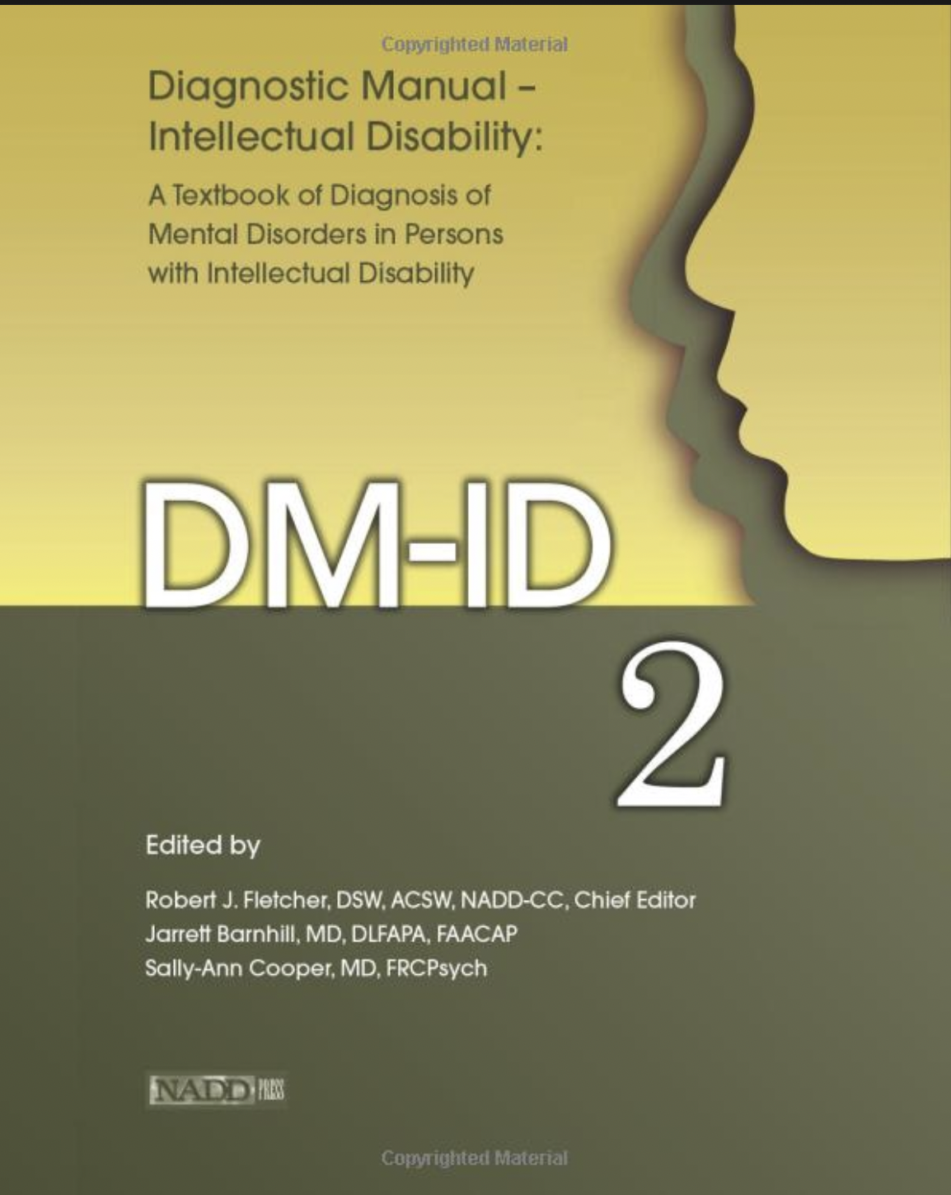
Dual Diagnosis
The Diagnostic manual – intellectual disability (DM-ID) and the DM-ID-2 have been instrumental in the recognition of mental health conditions in individuals with ID, and the DM-ID-2 enables clinicians to recognize and diagnose co-occurring conditions. Accurate diagnoses key to optimal treatment supports that match individual needs
Most common comorbid psychiatric disorders are: problem behavior (18.7%), affective disorder (5.7%), autism spectrum disorder (4.4%), psychotic disorder (3.8%), and anxiety disorder (3.1%) (Kendall and Owen 2015)

Slide 5
Prevalence of Psychiatric Disorders in PWID
Evidence suggests that individuals with ID have a very high risk of developing mental health difficulties
Various studies have estimated the prevalence of MH difficulties up to 50% among individuals with ID.
Although very few studies provide up to date evidence, some studies reported prevalence varies widely between 10 and 39%; however, many methodological problems exist (Deb et al 2001; Cooper et al 2022).
Point prevalence measured to be around 40% (Cooper and Bailey, 2001)

Slide 6
Prevalence of Psychiatric Disorders in PWID
Overall prevalence rates for co-occurring psychiatric symptoms or disorders reported in studies range from 13.9% to 75.2% -wide variation due to sampling (limited geographic and cultural diversity of participants; less use of population-based sampling), and differences in the diagnostic criteria utilized (Cooper et al 2022).
There is evidence that the prevalence of psychiatric disorder is greater in children with intellectual disabilities, compared with children without ID,
Evidence suggests it is higher in both adults and children with severe intellectual disabilities compared with people with mild or no intellectual disability

Slide 7
Prevalence of Psychiatric Disorders in PWID
The rate of problematic behaviour is higher in both adults and children having ID than in non-ID counterparts (Whitaker 2006)
Overall, PWID are much more likely to have co-occurring mental disorders than the general population. Not surprising when considering the likely causes of mental disorders which have biological, social, and psychological risk factors (Cooper 2003).
In addition to common risk factors for mental illness that are relevant for the general population, PWID may have extra risk factors -can be assessed using the “biological-psychological-social-developmental framework”
High prevalence rates of mental health difficulties are indicative of the need for treatment

Slide 8

Treatment of psychological disorders on PWID
One of the approaches that have been explored as a promising practice in managing dual diagnoses is the biopsychosocial approach.

Slide 9
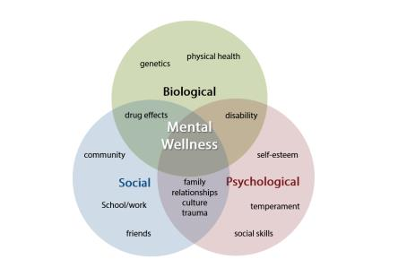

biopsychosocial approach for PWID

Slide 10
Biopsychosocial approach for PWID
This model systematically considers biological, psychological and social factors and their complex interactions in understanding health, illness, and health care delivery for individuals with ID.

Slide 11
Biopsychosocial approach for PWID
This is a whole person approach that considers all potential areas that may impact a person’s response to treatment, with
“Bio” referring to biological factors that may impact an individual including genetics, physical health, medical conditions, medication etc.
“Psycho” refers to the psychiatric and psychological needs of a patient such as mental wellness, psychiatric diagnoses, mood, developmental stages, intellectual abilities, cognitive wellbeing, etc.
“Social” refers to the social determinants of health –socio-economic status, transportation, living conditions, linkage to community resources, food security, employment, family support etc.
Each of these factors work together to determine how a patient responds to treatment for any given area of need.

Slide 12
Social Theories
Culture may influence:
Understanding of ID
Interaction with the clinician
How symptoms are expressed in a clinical setting
Beliefs about of the causes of ID
Help-seeking behaviours
Adherence to recommended treatments
(Kirmayer, 2001)

Slide 13
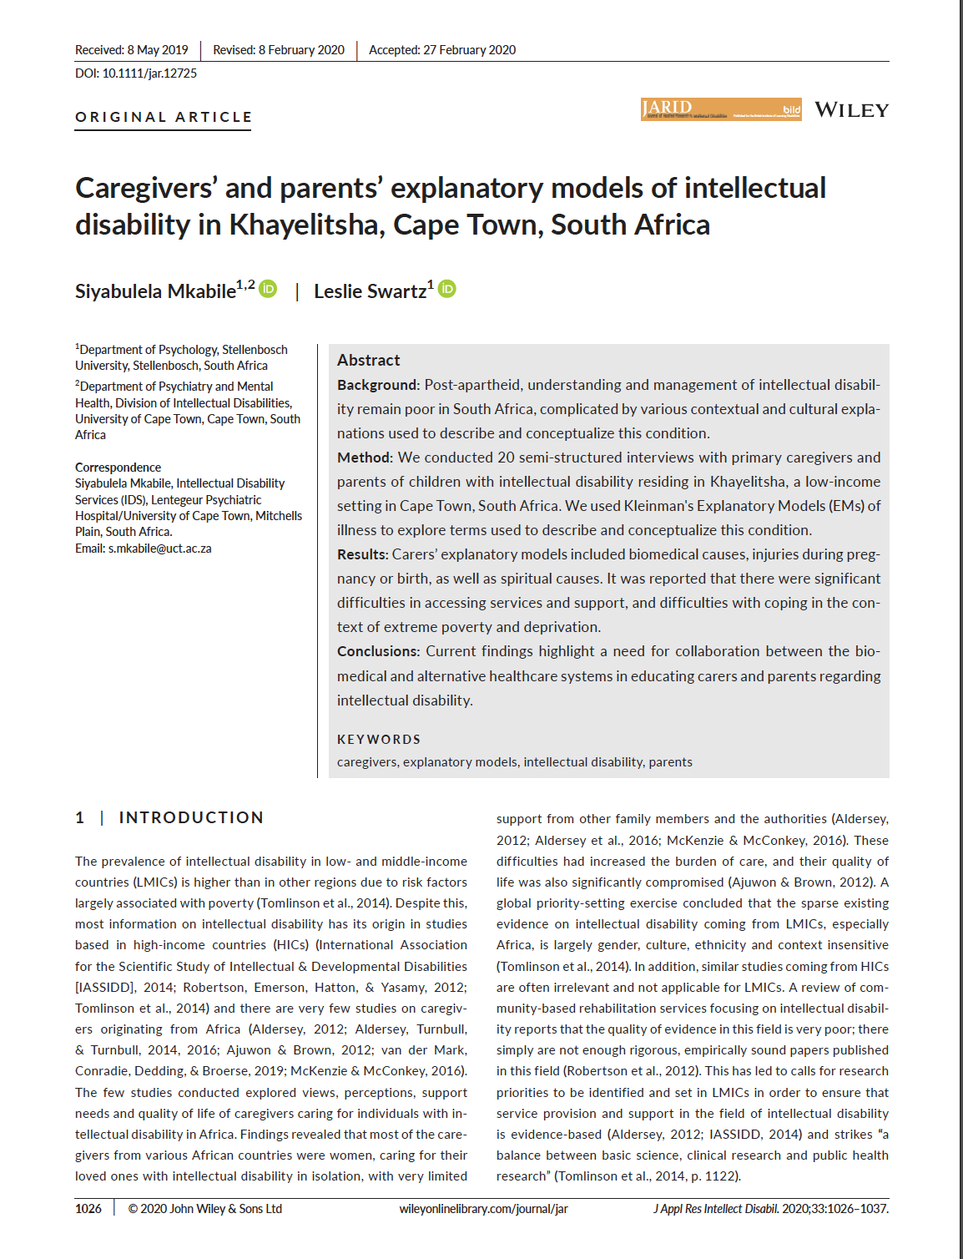
Social Theories

Slide 14
Treatment of MH Disorders in PWID
Drug therapy
Brief Behavioural Activation Treatment
Cognitive therapy
Mindfulness
Dialectical Behaviour Therapy (DBT)
Behavioural Therapy
Psychodynamic

Slide 15
Drug Therapy
Pharmacological treatment for PWID does not differ significantly from that in the general population
But care must be taken with medication interactions, underdosing or overdosing, as well as the potential to worsen comorbid conditions.
Because of complexity of treating PWID with dual diagnosis, additional multidisciplinary support required (Kendall and Owen 2015)

Slide 16
Cognitive Therapy
Effectiveness
Studies that examined the effectiveness of CBT with people who have intellectual disabilities who suffered various psychological difficulties.
These included anger problems, anxiety and depression
Result showed positive outcomes

Slide 17
Mindfulness-Based Cognitive Therapy

Slide 18
Mindfulness-Based Cognitive Therapy
Originally developed from Buddhism and Yoga
Known as a state of focusing on the present moment in a non-judgmental way
Effective with the general population
Also proved to be effective with PWID who struggle with anger difficulties

Slide 19
Mindfulness-Based Cognitive Therapy
Aim – to improve emotional well-being by increasing a person’s awareness of how their automatic cognitive and behavioural reactions can cause distress
Mindfulness skills – learning how to live in the present moment, paying attention to your thoughts, emotions and experiences in the here and now (Chapman et al., 2011)

Slide 20
Dialectical Behaviour Therapy

Slide 21
Dialectical Behaviour Therapy (DBT)
to help individuals who were;
feeling suicidal AND have difficulties with emotional dysregulation
FOCUS OF THERAPY
To help individuals to gain control over their behaviour
Encourages development of new skills
Increase motivation
Enhance skills

Slide 22
Behavioural Therapy

Slide 23
Behavioural therapy
Usually considered for the treatment of behaviour that challenges
Often includes behavioural activation
Exposure
Response prevention

Slide 24
Behavioural therapy
Applied Behavioural Analysis (ABA)
Evidence suggests that ABA has positive outcomes with children with other neurodevelopmental disorders and with ID to manage behaviour that challenges
Uses techniques such like;
differential reinforcement,
extinction, and
antecedent control procedures
(Eikeseth, Smith, Jahr, Eldevik, 2007)

Slide 25
Behavioural therapy
Positive Behavioural support (PBS)
Directly informed by ABA
Takes right of PWID into consideration
focus on meaningful outcomes, normalisation, and selfdetermination
Techniques include the use of antecedent control strategies, which includes the manipulation of environmental conditions
A – B – C

Slide 26
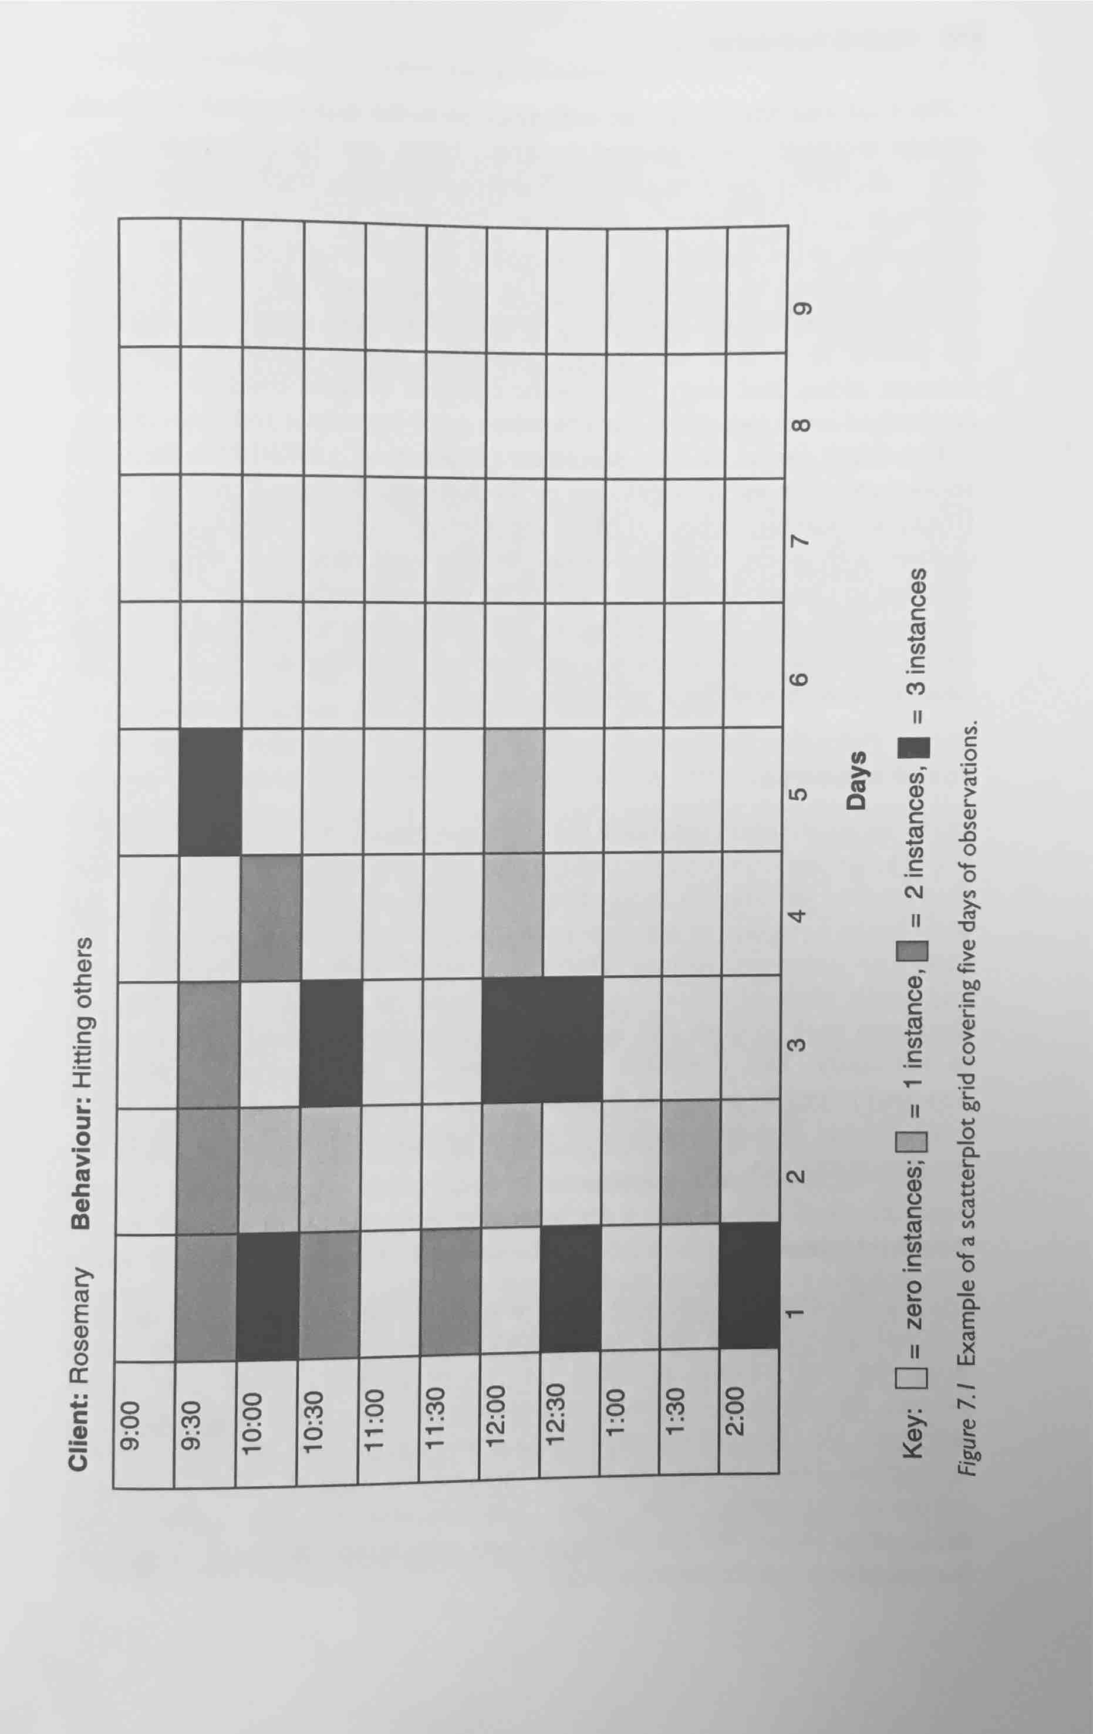
Behavioural therapy

Slide 27
Limitations of ABA
Difficulties with application
Misunderstanding and abuse of the methods
Frequent clinical failures
(remington, 1998)

Slide 28
Limitations of ABA
Difficulties with application
Over emphasis on the behaviour that challenges and language/communication
Less or no emphasis at all other aspects of ID
E.g, self-care/daily living skills, leisure and recreation, health and safety-related behaviour,

Slide 29
Limitations of ABA
Misunderstanding and abuse of the methods
A-B-C APPROACH
LACK OF PROPER TRAINING AND GOOD UNDERSTANDING COULD LEAD TO MISUSE AND LEAD TO THE PAST NON – SCIENTIFIC PRACTICES

Slide 30
Limitations of ABA
Frequent clinical failures
Questionable Reliability
Potential Use Of Aversive Methods

Slide 31
Psychodynamic Psychotherapy
Focus is on the relationship between a client and a therapist
Trusting relationship
Use of attentive listening
Warm and friendly therapist

Slide 32
Psychodynamic Psychotherapy
Challenges:
Therapist’s own Feelings of guilt over disability
Therapist’s lack of understanding of individuals with ID
Positive changes observed but slow
Sense of self efficacy
Reduces secondary handicap

Slide 33
Psychodynamic Psychotherapy
Limitations:
Based on single case studies
No controlled trials
Methodological qualities

