Slide 1
Critical Perspectives on Childhood Disorders Lectures 3 and 4
PSY3011S
Lynn Aupiais
lynn.aupiais@uct.ac.za

Slide 2
Autism Spectrum Disorder (ASD)
Please watch the YouTube video on the Early Signs of ASD by Rebecca Lander from the Centre for Autism and related disorders at the Kennedy Krieger Institute
You can view this video by clicking on the link below. Alternatively, you can view it on the Vula tab for this module (where data is zero-rated)
https://www.youtube.com/watch?v=YtvP5A5OHpU

Slide 3
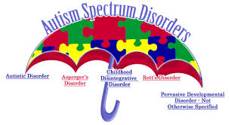
ASD
DSM 5 Controversies

Slide 4
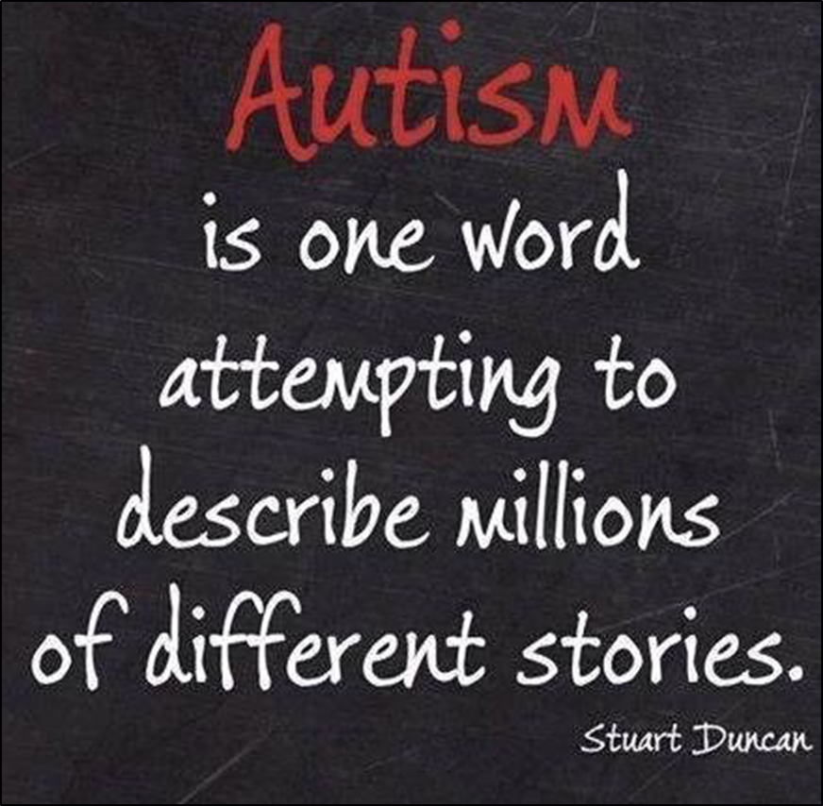
ASD
DSM 5 Controversies

Slide 5
ASD – DSM 5 Diagnostic Criteria
A) Persistent deficits in social communication and social interaction across multiple contexts, as manifested by all of the following, currently or by history
Deficits in social-emotional reciprocity e.g. abnormal social approach; failure to initiate social interactions
Deficits in nonverbal communicative behaviors used for social interaction e.g. abnormalities in eye contact; deficits in understanding and use of gestures; total lack of facial expressions and nonverbal communication.
Deficits in developing, maintaining, and understanding relationships e.g. adjusting behavior to suit various social contexts; difficulties in sharing imaginative play or in making friends; absence of interest in peers.

Slide 6
ASD – DSM 5 Diagnostic Criteria
B) Restricted, repetitive patterns of behavior, interests, or activities, as manifested by at least two of the following, currently or by history
Stereotyped or repetitive motor movements, use of objects, or speech
Insistence on sameness, inflexible adherence to routines, or ritualised patterns of verbal or nonverbal behavior
Highly restricted, fixated interests that are abnormal in intensity or focus
Hyper- or hyporeactivity to sensory input or unusual interest in sensory aspects of the environment
C) Symptoms must be present in the early developmental period
D) Symptoms cause clinically significant impairment in social, occupational, or other important areas of current functioning.

Slide 7
ASD – DSM 5 Diagnostic Criteria
Note:
Individuals with a well-established DSM-IV diagnosis of autistic disorder, Asperger’s disorder, or pervasive developmental disorder NOS should be given the diagnosis of autism spectrum disorder.
Individuals who have marked deficits in social communication, but whose symptoms do not otherwise meet criteria for autism spectrum disorder, should be evaluated for social (pragmatic) communication disorder.
Severity is based on social communication impairments and restricted, repetitive patterns of behavior (level of support needed)

Slide 8
ASD
DSM 5 Controversies - Why this radical diagnostic change?
Categories were used inconsistently by clinicians – not reliable
Diagnoses had risen markedly (for all autism, but esp. PDD-NOS). 1 in 2,000 children (1970s & 1980s); 1 in 68 currently
Occurred as diagnostic criteria were broadened and as these conditions became linked to provision of public support
Parents of children with milder Asperger’s concerned that classifying the disorder as ASD would increase stigma
Some observers welcomed what they saw as an overdue correction to overpathologizing normal range eccentricity and social ineptness. However, the overriding concern was that public support for special education might be withdrawn from those who would no longer qualify for diagnosis (Wakefield et al. 2016)

Slide 9
ASD in South Africa
The challenges facing the diagnosis and treatment of ASD in South Africa
The importance of addressing these challenges
“Early intensive behavioral intervention for young children with ASD has been shown to reduce the severity of core ASD symptoms and has demonstrated significant long-term improvements in language acquisition, social skills, cognitive abilities, and adaptive behaviors” (Guler et al, 2017)

Slide 10
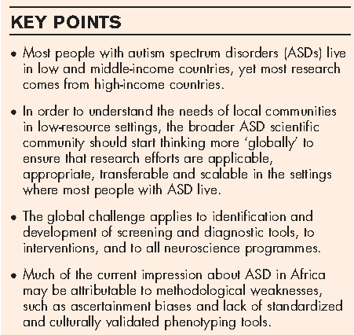
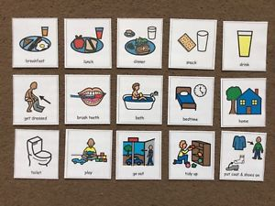
ASD in South Africa
The need for research on ASD low and middle income countries (LMICs), including South Africa (SA)
(de Vries, 2016)

Slide 11
ASD in South Africa
Challenges – Access to services
In 2015, there were about 50 specialist child and adolescent psychiatrists in Africa, and a much smaller number of developmental paediatricians
Very few specialist resources and educational facilities
There are currently more than 500 children on the “autism waiting list” in the Western Cape Province for public sector special education services with a waiting time of over 3 years for enrolment in ASD-specific schools
No government pre-schools for children under 7 years
(de Vries, 2016; Guler et al. 2017)

Slide 12
ASD in South Africa
Challenges – Access to services
Waiting list of 1 to 6 months for low-intensity interventions (One 30 min session of OT or ST per month), some don’t receive this
Private sector: services are costly and vary in quality many are not evidence-based
Lack of policies and good practice guidelines for assessment, treatment, education and adult support for individuals with ASD
Awareness has increased but baseline knowledge remains low in across all levels of African society, from public, to education and social care sectors, health and governments
(de Vries, 2016)

Slide 13

ASD in South Africa
Challenges – Screening and Diagnostic Tools
Many tools costly and are copyrighted and require permission and payment for translation into other languages
Many tools have not been adapted for use in South Africa
Training practitioners to use these instruments is costly
Training only provided in a few expert centres
In South Africa, a child will typically wait 18 months for a basic diagnostic assessment in a specialist clinic with first diagnosis at 45-57 months. These delays occur at the time that best-evidence interventions are most effective
Diagnostic instrument (e.g. ADOS-2)
(de Vries, 2016)

Slide 14
ASD in South Africa
Challenges – Interventions for ASD
Identifying infants and children with ASD without providing access to interventions has little purpose and may be unethical
Very few services in Africa are able to provide even basic psycho-education and referral to specialist schools
Almost no standardised psycho-education or parent skills training programmes in Africa that have received systematic programme evaluation
Lack of skilled practitioners providing individual support
Need research into parent/carer-led interventions, and using nonexpert ‘coaches’ for training and facilitation
(de Vries, 2016)

Slide 15
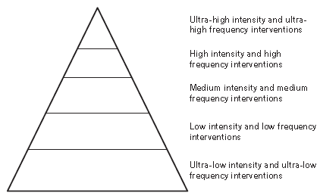
ASD in South Africa
Addressing the need for interventions
FIGURE 1. Global interventions for ASDs: A schematic representation of an ideal range of global interventions for ASD, from ultra-low intensity parent education and coaching, to highly expert ultra-high intensity interventions. The majority of interventions should be ultra-low and low intensity, with delivery by nonexpert facilitators or coaches. Based on clinical need and available expertise, higher intensity and higher frequency interventions may be delivered by higher-skilled, professional staff. Staff with greater expertise should also play a role in supervision and development of lower-level interventions in local settings
(de Vries, 2016)

Slide 16
ASD in South Africa
Benefits of using a task-shifting approach to deliver interventions
Cost-effective and increases access to services
Makes services more accessible to people in rural areas who don’t have the resources to travel long distances to access services
Service users may be more accepting of non-specialists if there is a lack of trust in government health services
Service users may view community health workers as more understanding and empathic
Allows the integration of locally-identified leaders, specifically faith healers and traditional healers, into the treatment process
(Mendenhall et al., 2014 & Okyere et al., 2017)

Slide 17
ASD in South Africa
Challenges of using a task-shifting approach to deliver interventions
Overcoming logistical barriers e.g. transport, private spaces for meeting, supervision, funding for training and remuneration
Creates additional work and responsibilities for primary health care workers and community workers
Imprecise task allocation or a lack of training and supervision may compromise the effectiveness of the services delivered
Community health care workers may be viewed as unqualified
Disagreement about who should train non-specialists as specialists may not always be perceived as suitable trainers due to their limited experience in community and primary health care settings
(Mendenhall et al., 2014 & Okyere et al., 2017)

Slide 18
ASD in South Africa
Addressing the need for interventions
Naturalistic Developmental Behavioural Interventions (NDBIs)
Working with infants early during the unfolding of ASD risk characteristics
Emphasis on social learning as a tool for language and emotional development
Helping infant develop skills across social, communication, learning and other developmental domains
Implement naturalistic interventions with socially and contextually appropriate naturalistic rewards and reinforcers
Use parents/carers as the natural treatment partners
(de Vries, 2016)

Slide 19
ASD in South Africa
Addressing the need for interventions
Naturalistic Developmental Behavioural Interventions (NDBIs)
Differs from Applied Behaviour Analysis (ABA) approach to interventions in that they occur in child’s naturalistic setting
Skills are usually not taught discretely or in isolation, but rather in the course of the child’s typical daily interactions, experiences, and routines, with multiple materials and by multiple people
Child-initiated teaching episodes - respond within the context of a child-chosen or child-preferred activity or familiar routine
Setting up the environment so that the child must initiate or interact with the adult in order to obtain a desired outcome e.g. access to preferred materials or participation in preferred routine
(Schreibman et al., 2015)

Slide 20
ASD in South Africa
Addressing the need for interventions
Naturalistic Developmental Behavioural Interventions (NDBIs)
Natural reinforcement – reinforcement that is intrinsic/related to the child’s goals e.g. continued access to a preferred toy compared to a reward such as a token or sweet
Modelling used to teach target skills
Involving family members in the intervention
Using naturalistic setting increase likelihood that child will generalise newly learned skills across multiple environments and circumstances and be less over-dependent on prompts
(Schreibman et al., 2015)

Slide 21
ASD in South Africa
Interventions – importance of caregiver involvement
Cost-effective means of providing services and addressing the capacity barrier
Emerging evidence supports the effectiveness of caregiver-mediated early ASD interventions in low-resource settings
Caregiver has insight into the needs of their children, their families, and the broader ASD community
(Guler et al., 2017)

Slide 22
ASD in South Africa
Challenges facing caregivers
Emotional and economic impact of care
High rates of caregiver stress
Coping with their own emotional distress
Family routines and quality of life
Lack of family support and service-provider support
Stigma and shame regarding their child’s condition
Influence of traditional medicine on treatment received
Healthcare system – delayed diagnosis and treatment
(Guler et al., 2017)

Slide 23
ASD in South Africa
Interventions – contextual factors that need to be considered
Guler et al. (2017) explored contextual factors relevant to adaptation of a caregiver-mediated early ASD intervention in a low-resource South African setting
Four focus groups; interviews with 28 caregivers
Eight contextual factors emerged as important
Overall, caregivers reported a preference for an affordable, in-home, individualised early ASD intervention, where they have an active voice in shaping treatment goals
Distrust of community-based health workers and challenges associated with ASD-related stigma were identified
(Guler et al., 2017)

Slide 24
ASD in South Africa
Interventions – contextual factors that need to be considered
Eight contextual factors
Culture
Language
Location of treatment
Cost of treatment
Type of service provider
Support
Parenting practices
Stigma
(Guler et al., 2017)

