Slide 1
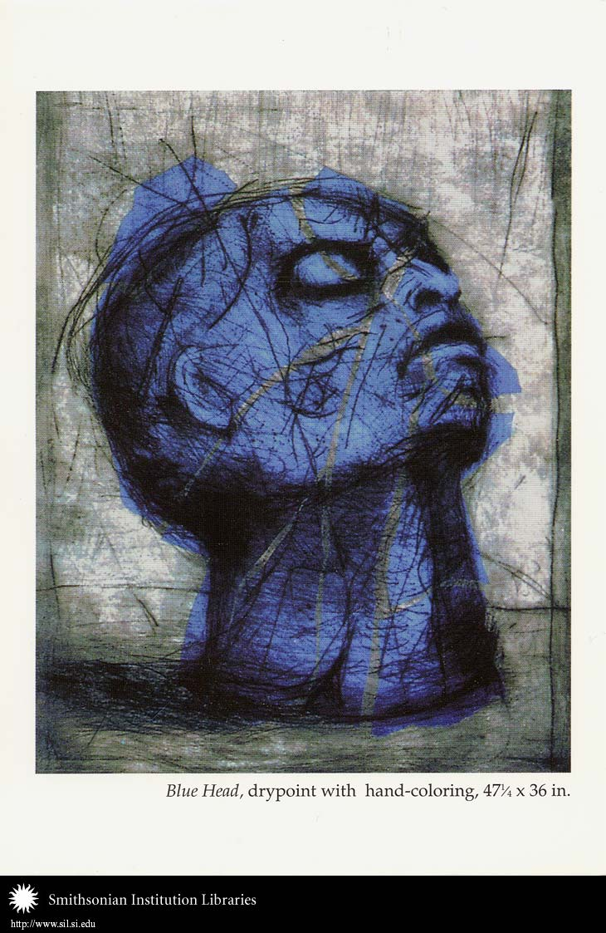
TRAUMATIC STRESS DISORDERS: CRITICAL PERSPECTIVES Debbie Kaminer Department of Psychology UCT

Slide 2
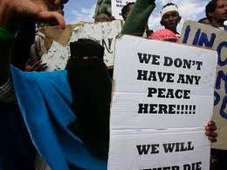
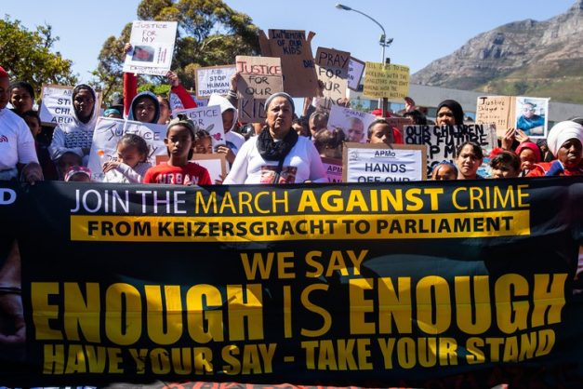
PREVALENCE OF TRAUMA EXPOSURE
A national prevalence study of SA adult population found that :
75% has experienced a trauma
(70% in USA)
56% have had multiple traumas
(52% in USA)
38% have been victimised by some form of violence
Intimate partner violence 24% (but up to 50% in some studies)
Sexual assault 3.5% (but up to 25% in other studies)
Child abuse 12% (but up to 42% in some studies)
Physical assault 25%
Trauma exposure is the norm, not the exception

Slide 3
POSTTRAUMATIC STRESS DISORDER (PTSD) DIAGNOSTIC CRITERIA IN DSM-5 AND ICD-11
A) Experienced an event that involved actual or threatened death, serious injury
or sexual violence (direct experience, witnessed, heard about event experienced
by a family member or close friend)
B) Re-experiences the trauma in some way (e.g. flashbacks, nightmares,
intrusive thoughts and images)
C) Avoidance of traumatic reminders (behavioural and cognitive)
D)Hypervigilance (poor sleep and concentration, startle response, scanning
for danger)
E) DSM-5 ONLY: Negative changes in cognition and mood (reduced
interest in usual activities, feelings of detachment from others, restricted
range of feelings, exaggerated negative beliefs about oneself, persistent
negative emotional state)
F) Symptoms last at least 4 weeks (DSM) or ‘several weeks’ (ICD)
G) Symptoms cause significant distress or impairments in daily functioning
Temporary symptoms of above are common and normal in trauma survivors, who often return to equilibrium naturally
A minority go on to develop PTSD, but this varies by country:
8% of USA adult population has had PTSD in their lifetime, but only 2.4% of SA population – WHY? (HOLD THAT THOUGHT…..)

Slide 4


HISTORY OF PTSD AS A DIAGNOSTIC CATEGORY: TWO COMPETING NARRATIVES
PTSD as recognition of a disorder that has always existed
(see Judith Herman, Trauma and Recovery)
Trauma has always had damaging effects, but these have often been
denied by society (e.g. Freud’s theories of sexual abuse; World Wars;
Vietnam war)
PTSD entered the DSM system in 1980
“ PTSD is merely the re-naming of an age-old condition”
1970s:
Rise of feminism and war veterans support groups in USA created a political environment that was more open to recognising the damaging effects of violence and abuse

Slide 5
HISTORY OF PTSD AS A DIAGNOSTIC CATEGORY: TWO COMPETING NARRATIVES
The cultural “invention” of PTSD?
(See Allan Young, The Harmony of Illusions)
Historically documented traumatic stress syndromes did not have the same symptoms as PTSD (e.g. intrusive and avoidance symptoms not prominent)

Slide 6
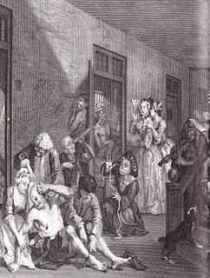
Railway spine (1860’s)
SYMPTOMS:
Anxiety
Nightmares
Forgetfulness
But also prominent physical or somatic symptoms (headaches, hearing problems, numbness of arms, legs etc.)

Slide 7
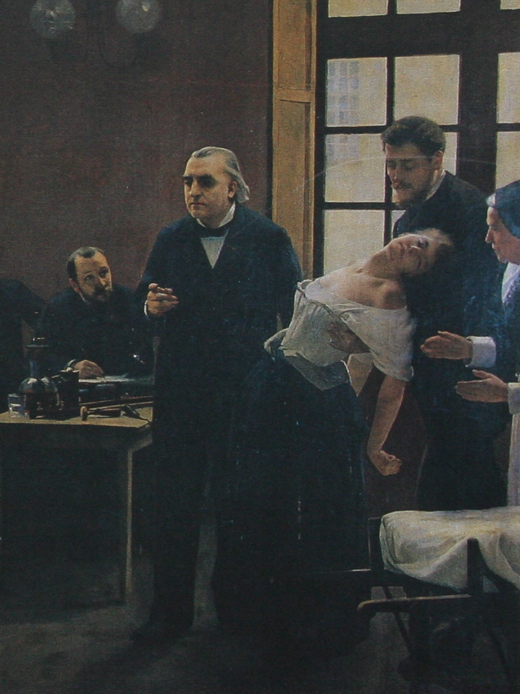
Hysteria (late 1800’s)
SYMPTOMS:
Paralysis,seizures,
blindness with no
organic cause
Emotional
excitability
More consistent with
Conversion Disorder and
the ‘feminine’
personality disorders
(borderline, histrionic) in
the current DSM system
Associated with repressed,
rather than intrusive,
memories

Slide 8
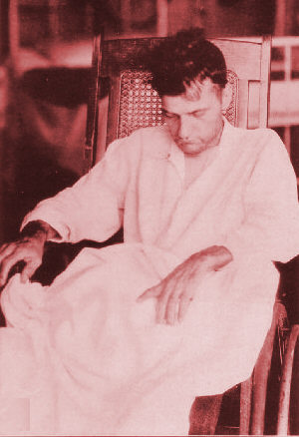
Shell Shock (WWI) and Combat Fatigue (WWII)
SYMPTOMS:
Nightmares
Restlessness,
Irritability
But also prominent somatic
symptoms (paralysis, seizures,
muteness and blindness with no
no organic basis)

Slide 9
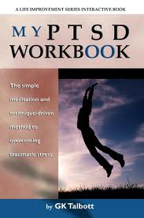
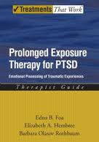
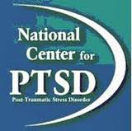

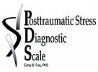
PTSD has not always existed- in recent decades it has become culturally available and culturally codified as an acceptable and recognisable way to express traumatic stress in Northern/Western contexts
Development of a “PTSD industry”: PTSD Research Centres, scales to assess PTSD, and treatments developed specifically for PTSD serve to “glue” the diagnosis together

Slide 10
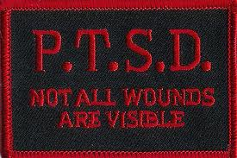

BENEFITS OF THE PTSD DIAGNOSIS
Acknowledgement and normalisation
Reduces victim blame and isolation
Allows access to treatment and resources
Facilitates development of targeted treatments
Reduces social and financial costs of
unrecognised and untreated trauma

Slide 11



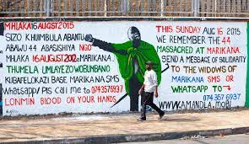

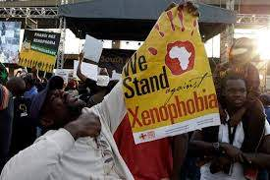
RISKS OF THE ‘MEDICALISATION OF SUFFERING’
Locating pathology in the individual disguises systemic and political oppression of specific groups (e.g. children, women, refugees, politically oppressed groups, workers)

Slide 12
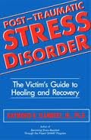
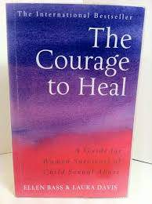
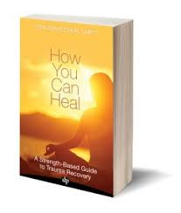
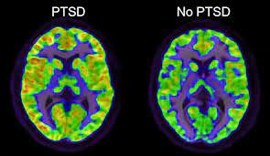
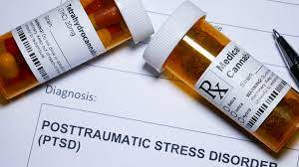
RISKS OF THE ‘MEDICALISATION OF SUFFERING’
Derek Summerfield and others argue that:
the effects of trauma are symptoms of power imbalances in society, not of individual illness
A trauma diagnosis constitutes an apolitical, decontextualised
understanding of trauma and violence that marginalises
survivors’ experiences of injustice and exploitation
A trauma diagnosis implies that the individual is
responsible for recovery, thereby maintaining
social inequalities

