Slide 1
Critical Perspectives on Eating Disorders Lecture 1
PSY3011S
Siyabulela Mkabile
s.mkabile@uct.ac.za

Slide 2



The Classification of Eating Disorders
DSM-III (1980)
Anorexia and Bulimia appeared in the DSM for the first time
Classified as a subtype of Disorders Usually First Diagnosed in Infancy, Childhood or Adolescence
DSM-IV (1994)
A separate diagnostic category was created for eating disorders
DSM-5 (2013)
Binge-eating disorder added to the DSM
Anorexia Nervosa - amenorrhea no longer a requirement for diagnosis

Slide 3

Anorexia Nervosa - DSM-5
Restriction of energy intake, leading to a significantly low body weight
Intense fear of gaining weight or of becoming fat, or persistent behavior that interferes with weight gain
Disturbance in the way in which one’s body weight or shape is experienced, undue influence of body weight or shape on self-evaluation or lack of recognition of the seriousness of low body weight
BMI below 17
Prevalence
Females – 0.4% ; 10 x more common in women

Slide 4
Bulimia Nervosa - DSM-5
Self-evaluation unduly influenced by body shape and weight
Recurrent episodes of binge eating
Sense of lack of control over eating during the episodes
Recurrent inappropriate compensatory behaviours to prevent weight gain
Occurs at least once a week for 3 months
Prevalence
Females – 1% - 1.5%; 10 x more common in women

Slide 5
Binge-Eating Disorder - DSM-5
Recurrent episodes of binge eating
Sense of lack of control over eating during the episode
The binge-eating episodes are associated with three (or more) of the following:
Eating rapidly, feeling uncomfortably full, eating when not hungry, eating alone (embarrassed), feeling disgusted, depressed or guilty
Occurs at least once a week for 3 months; causes distress
Prevalence
Females – 1.6%; Males – 0.8%

Slide 6
Historical Perspectives on Eating Disorders (12th C to 19th C)
Saints – ‘holy anorexia’ – denial of one’s needs revered, viewed as a means to achieve sainthood / a holy state
Witchcraft – women refusing to eat (deviating from social norms) were thought to be possessed by the devil; not possible to survive without nutrition
Insanity / Madness – refusal to eat was viewed as inexplicable and a sign that the person must be experiencing insanity
Disease – physicians examined women and tried to find physical causes for the phenomenon of refusing to eat
Mental Disorder – no physical cause found. Thus, refusal to eat viewed as a form of psychopathology

Slide 7
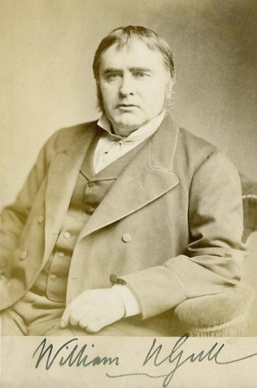
Anorexia as a Mental Disorder
Sir William Gull (1816-1890)
British physician interested in the scientific study of dysfunction of the gastric system
1874 – Gull made the first reference to anorexia nervosa
No physical cause found for loss of appetite and emaciation
Concluded that anorexia nervosa is a psychiatric phenomenon resulting from psychopathology

Slide 8
Anorexia as a Mental Disorder
Deviant
Deficient
Inherently Irrational
Mentally perverse (stubborn)
Emotionally unstable
Confinement, invasive treatments
Condition affecting women – grounded in the discourse of femininity
Dominant medical discourses reproduced oppressive social conditions

Slide 9
Psychoanalytical Theories
Sigmund Freud (1915-1917)
Impairment in the nutritional instinct was related to the person’s inability to come to terms with sexual excitation
Hysteria – the refusal to eat is symptom of hysteria
Many client’s reported a history of sexual abuse but this was viewed as derived from fantasy
The individual is pathologised and the problem is located within the person’s attitude towards their sexuality

Slide 10
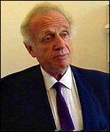

Psychoanalytical Theories
Arthur Crisp (1980)
Phobic avoidance
Psychobiological regression
Adaptive as it protects the individual if the maturational process is experienced as overwhelming
Allows the person to avoid the ‘existential challenge’ of puberty
Weight and shape become meaningful and threatening

Slide 11
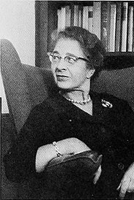
Psychoanalytical Theories
Hilde Bruch
Relentless pursuit of thinness
Caused by abnormal family patterns of interaction
The media plays an important role in the development of eating disorders
Enmeshment hypothesis
Controlling parents and over-compliant daughters
A struggle for independence in the face of parental control
Uses starvation and domination of bodily desires to search for control and identity
Food and her body is the only thing that she can control

Slide 12
Disenchantment with Psychiatry
1960s – anti-psychiatry movement
Recognised that social factors play an important role in the development of psychological disorders
Laing (1964) – the social origins of schizophrenia
Goffman (1968) –described the inhumane practices that were taking place in St Elizabeth’s Psychiatric Hospital in Washington D.C.
1970s – Feminist perspectives on the aetiology of eating disorders emerged

