Slide 1
Critical Perspectives on Eating Disorders Lecture 2
PSY3011S
Siyabulela Mkabile
s.mkabile@uct.ac.za

Slide 2


Early 1900s to 1960s
Social roles changing
Women’s Suffrage – the right to vote
World War I and II – women entered the workforce
Post-WWs – women expected to return to the domestic sphere
Women’s Liberation Movements

Slide 3
Feminist Perspectives
Emerged in the 1970s
First major challenge to the medical model
Introduced a conceptualisation of anorexia nervosa that drew directly on women’s experiences of themselves and their social relationships
Explored the interrelationships between women’s experience of living in Western societies, the effects of a subordinate social position and the denial of food by women
Anorexia viewed as a form of social protest and an expression of conflicting social roles and identities

Slide 4
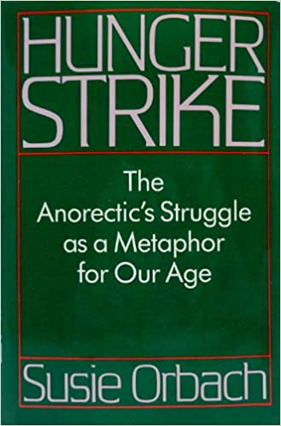
Feminist Perspectives
Susie Orbach – Hunger Strike (1986)
Food refusal
Denial of emotional needs
Gain control over one’s body (by ignoring your own needs)
Control of food as a form of protest
Anorexia as a metaphor for our time
Attempts to negotiate passions and desires at a time of extraordinary confusion
Many social roles to choose from but women still enter the world as guests
Contradictory pulls – the needs of others vs. your own needs

Slide 5
Feminist Perspectives
Susie Orbach – Hunger Strike (1986)
Changing social roles
Definition of a ‘good mother’ keeps changing
Reappraisal of the all-providing wife and mother
Acceptable to work but primarily responsible for child-rearing
Liberation vs. guilt
Mother-daughter relationship
Daughter’s needs stir the mother’s unmet needs
Results in inconsistent parenting
Separation vs. individuation
Anorexia is a way for the daughter to return to her mother

Slide 6
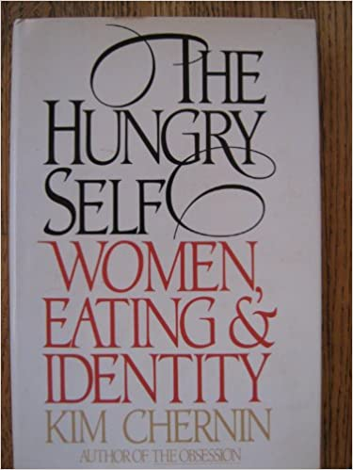
Feminist Perspectives
Kim Chernin (1986)
Changing social roles
Conflict between new social roles and traditional roles
Feeling of ambivalence and guilt about moving into the ‘male sphere’ of self-development
‘terror of female development’
Women transform their bodies due to guilt over transforming their lives and personalities
Life is consumed by the obsession with food refusal in place of freedom

Slide 7
Feminist Perspectives
Kim Chernin (1986)
The mother-daughter relationship
Eating disorders are an expression of identity confusion
The search for identity and self-hood
The daughter’s struggle to separate from the mother
Self-development = surpassing your mother
Mother is ambivalent about her daughter’s opportunities (rage vs. guilt)

Slide 8
Feminist Perspectives
Shifting the focus of therapy from the individual onto the social context in which the symptoms emerged
Creates an understanding of food refusal
Recognises that eating disorders are the result of oppression of women within our culture
Explores contradictory social roles
Explores overidentification with caretaking roles
Explores identification with cultural ideal of thinness
Emphasises the need for social change

Slide 9
Poststructuralist Perspectives
Julie Hepworth (1999): A Critique of Feminist Theories
First major challenge to the medical model
Acknowledges the need to focus on social, cultural and political factors
Gave women with anorexia a voice
Drew attention to the distress women experience
Highlighted the ways in which the medical paradigm limited rather than facilitated recovery from anorexia
Psychoanalytic-based analyses contributed to a failure to establish a shift away from a psychomedical epistemology

Slide 10
Poststructuralist Perspectives
Julie Hepworth (1999): A Critique of Feminist Theories
“The anorectic cannot tolerate feelings”
“Anorexia Nervosa is both a serious mental illness… and a metaphor for our age”
“The anorectic woman encompasses in her symptom…”
“she defeminizes her body”
“She has agreed to take up only a little space in the world”

Slide 11
Poststructuralist Perspectives
Julie Hepworth (1999): A Critique of Feminist Theories
The centrality of the mother-daughter relationship
Father-daughter relationship excluded
The relationship between eating disorders and sexual abuse not examined
‘family’ is equated with ‘mother’
Women still positioned as the bedrock of domestic life
Mothers remain the central link in explaining pathology

Slide 12
Poststructuralist Perspectives
Julie Hepworth (1999): A Critique of Feminist Theories
Anorexia Nervosa as a problem of identity
Locates the pathology within the individual
Reduces the explanation to an ‘identity crisis’
‘failure’ to cope with the transition into adulthood
The individual is expected to change rather than society

Slide 13
Poststructuralist Perspectives
Julie Hepworth (1999): A Critique of Feminist Theories
Anorexia Nervosa and the anorexic
Use of medical language in feminist writings
The meaning and utility of the term is not questioned
Reproduced explanations of anorexia as a psychiatric category
Something that you can ‘be’
‘anorectic woman’ – separates them from other women

