Slide 1
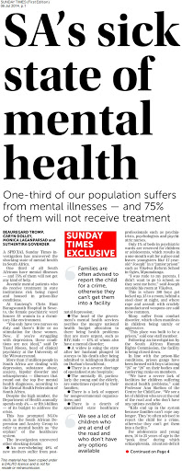
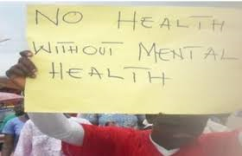
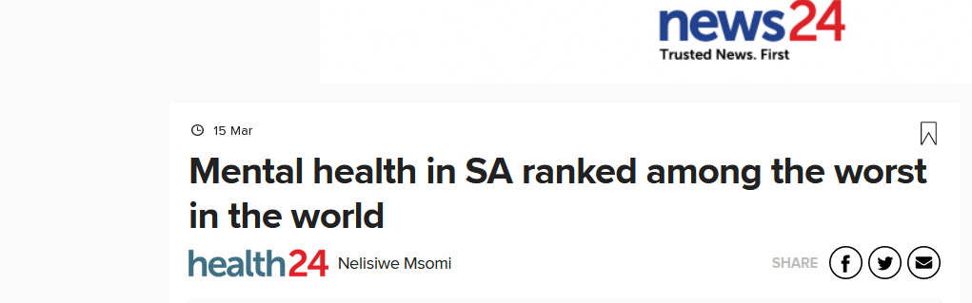
THE CONTEXT OF MENTAL HEALTH IN SOUTH AFRICA:
MENTAL HEALTH NEEDS

Slide 2

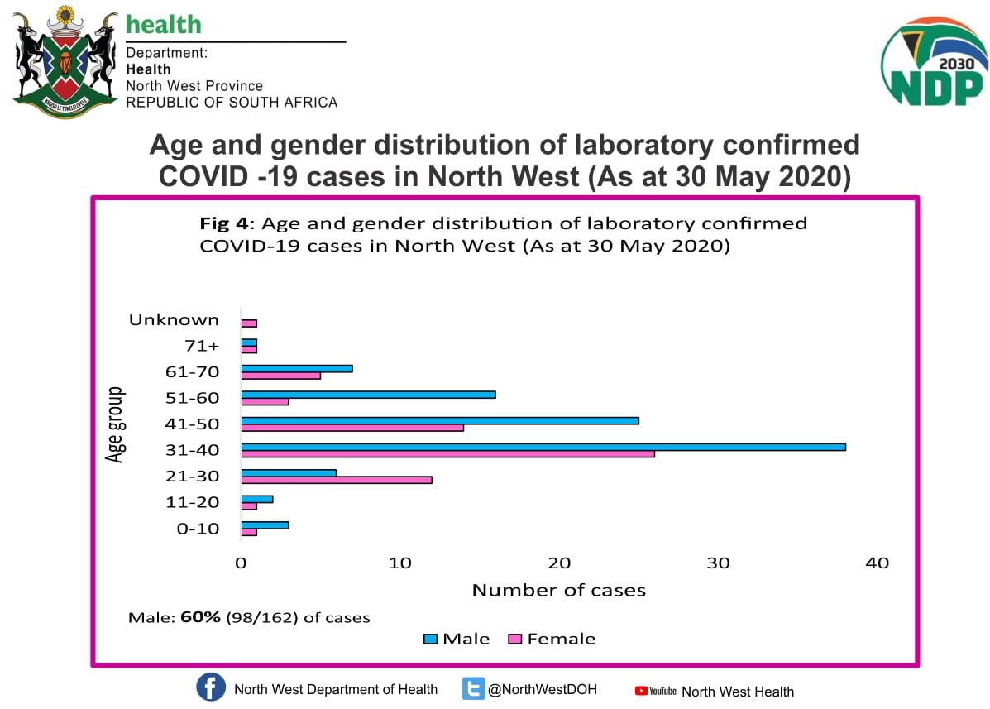
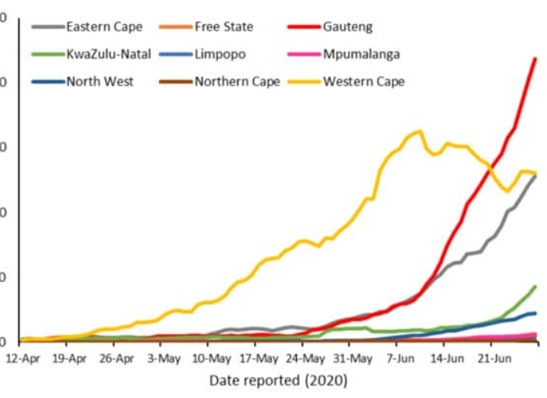

PREVALENCE OF MENTAL ILLNESS IN SOUTH AFRICA
Prevalence: proportion of population with a specific characteristic/health condition in a given time period
In public health, reliable data on prevalence and risk factors is needed to inform interventions and allocation of resources
Where are the charts and graphs for mental illness in SA??

Slide 3

Where can mental health prevalence and risk data come from?
National prevalence studies
Provincial prevalence studies
Community prevalence studies
Clinic studies
Other practitioners/service providers
NGOs
Schools
Where else?
Each source of data has benefits and limitations
so a combination is ideal

Slide 4
National prevalence study of mental health in South Africa: THE SOUTH AFRICA STRESS AND HEALTH (SASH) STUDY
Conducted from 2002 – 2004
First and only prevalence study of mental illness in Sub-Saharan Africa
Nationally representative sample of 4351 adults from randomly selected households
Participants assessed using the CIDI (Composite International Diagnostic Interview), based on DSM-IV diagnoses
Only common mental illnesses (CMIs) were assessed: depression, anxiety and substance disorders
CIDI translated into six languages

Slide 5
THE SOUTH AFRICA STRESS AND HEALTH (SASH) STUDY
Most common lifetime disorders in SA adult
population:
Alcohol abuse 11.4%
All substance disorders 13.3%
Major depressive disorder 9.8%
Anxiety disorders 15.8%
One lifetime mental illness 30%
Two lifetime mental illnesses 11%
Stein, D. J., Seedat, S., Herman, A., Moomal, H., Heeringa, S. G., Kessler, R. C., & Williams, D. R. (2008). Lifetime prevalence of psychiatric disorders in South Africa. The British Journal of Psychiatry, 192(2), 112-117.

Slide 6
THE SOUTH AFRICA STRESS AND HEALTH (SASH) STUDY
Most common current disorders in SA adult
population:
Major Depressive Disorder 4.9%
Any anxiety disorder 8.1%
Alcohol abuse 4.5%
All substance abuse disorders 5.8%
Any current anxiety, mood or substance disorder:
16.5%
Of which: 26% are severe cases, 31% are moderately
severe
Williams, D. R. et al. (2007). Twelve-month mental disorders in South Africa: Prevalence, service use and demographic correlates in the population-based South Africa Stress and Health Study. Psychological Medicine, 38, 211-220

Slide 7
TREATMENT GAP
In the SASH study, 75% or 3 out of 4 SA adults with a current mental illness have not received any treatment (medical or alternative / traditional) in the past year
Irrespective of severity of mental illness
Irrespective of socio-demographic factors
A 2016/17 study found that 92% of uninsured SA
adults with a mental illness have not accessed
treatment
WHY THE HUGE TREATMENT GAP?

