Slide 1
Evaluation of Classification Algorithms for Machine Learning in Advertising Technology (the nutshell edition)
Vangie Shue
2014
New York University

Slide 2
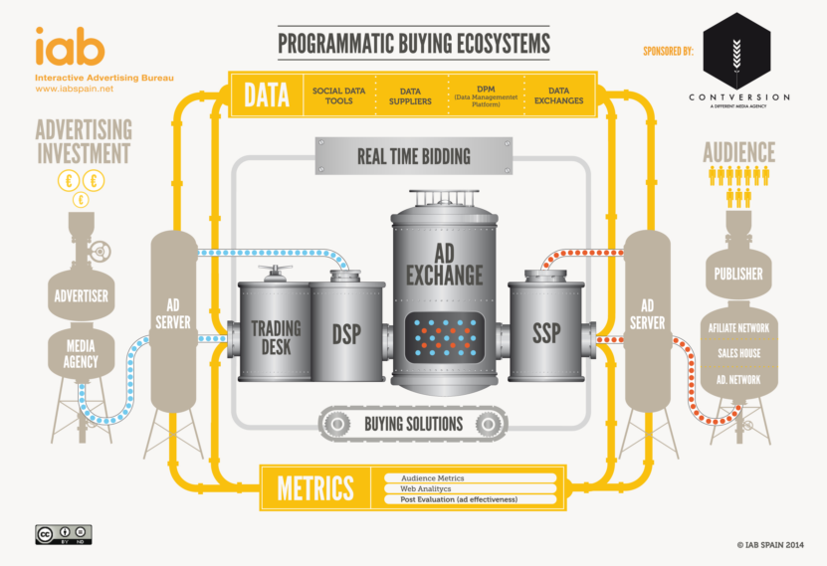
Background: AdTech

Slide 3

The Problem
Large amount of training data
“Infinite” feature space
Need to score large datasets
Models need to be updated regularly

Slide 4
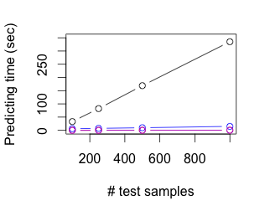
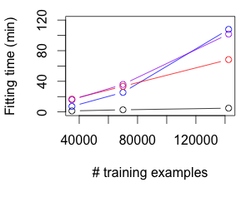
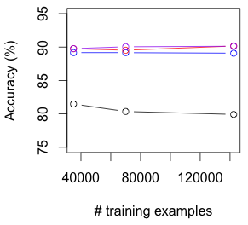
Results

Slide 5
Conclusion?
 | Accurate | Fast to Model | Fast to Predict
Naïve Bayes | No | Yes | No
Support Vector Machines | Yes | No | Eh
Gradient Boosted Model | Yes | Eh | Yes
Logistic Regression | Yes | No | Yes

