Slide 1

Acoustic-Driven Generation of mFDA
Clinical Speech Reports with Flan-T5
Dawood Aijaz
M.Sc. Artificial Intelligence
Supervisor: Dr.-Ing. Arias-Vergara
3 August 2026

Slide 2
Agenda
Motivation & reference
Evaluation methodology
Limitations & conclusion
01
02
03
04
05
Data, pipeline & model
Results & key finding

Slide 3
From Biomarkers
to Clinical Reports

Slide 4
Why automate mFDA speech assessment?
Parkinson’s speech is rarely assessed formally.
– mFDA scale: 7 categories, expert-rated — subjective, slow, inconsistent
– Acoustic biomarkers are objective, but need signal-processing expertise to read
– Goal: an LLM bridges biomarkers → a readable clinical report

Slide 5
Reference study: Arias-Vergara et al., 2025
Frames report generation as text-to-text.
– 7 biomarkers → fine-tuned LLM → mFDA report
– Compared T5, Flan-T5, GPT-2, LLaMA-7B, Mistral-7B, DeepSeek-7B
– Headline: BLEU 0.79 (PD) / 0.84 (HC) for the best 7B systems
– Our focus: Flan-T5 — compact, single-GPU, deployable on-prem

Slide 6
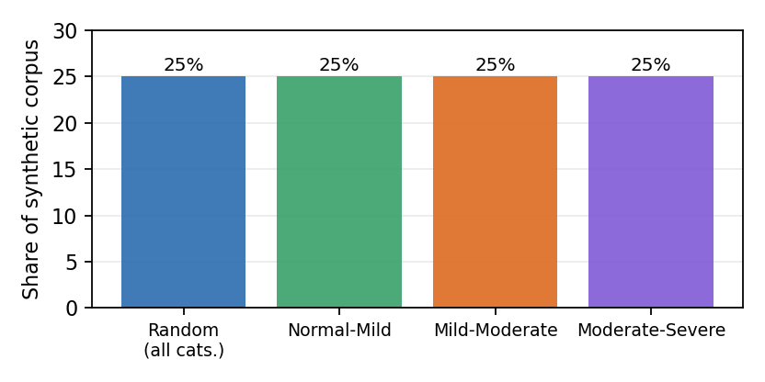
Data: PC-GITA + synthetic augmentation
Only 100 real reports — so we simulate the rest.
– 50 PD + 50 HC speakers, 4 speech tasks
– 248 acoustic biomarkers → 7 mFDA categories
– Simulate ~110k synthetic biomarker–report pairs
– Real reports used only for testing (96 held out)

Slide 7
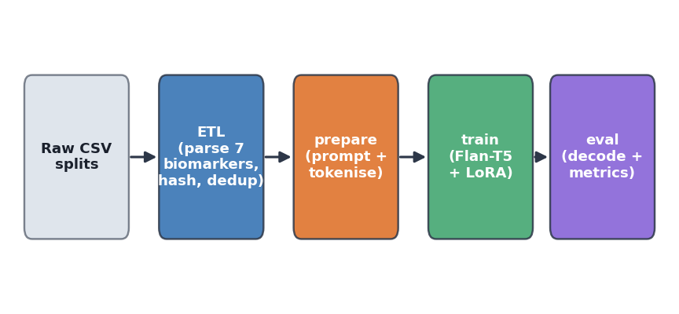
A reproducible, three-stage pipeline
One ETL core parses every biomarker, once

Slide 8
What is Flan-T5?
Google’s instruction-tuned, encoder-decoder transformer family.
– T5 frames every NLP task as text-to-text — exactly the shape of our problem
– Flan-T5: further tuned on 1,000+ instruction-phrased tasks
– Five sizes: Small 80M, Base 248M, Large 780M, XL 3B, XXL 11B — ours is Base

Slide 9
Best model: B17 = Flan-T5-base + LoRA
google/flan-t5-base, 248M parameters.
– 5 epochs full fine-tune, then rank-32 LoRA for 3 more epochs (merged)
– Prompt: “Generate a report for:” + compact 7-score input
– Learning rate 5e-4, weight decay 0.01 — selected by decode quality, not loss

Slide 10
Experiment setup: compute & scripts
NHR@FAU TinyGPU cluster.
– A100 (40GB) GPUs, V100/RTX 3080 fallback
– Slurm batch scheduler, up to 24h wall time per job
– Conda env + offline-cached Hugging Face weights
One script pair per experiment.
– train_flan_t5_*.slurm + eval_flan_t5_*.slurm
– 39 scripts, one per experiment ID (B12–B24, ...)
– Fixed main.train / main.eval_decode entry points

Slide 11
Why two evaluation scripts?
“BLEU” isn’t one number — word vs. character can differ 2×
Honest ruler — model selection.
– Word-level SacreBLEU-4
– BERTScore, lang=en
– Deterministic beam search (beam 3)
– Standardised, widely comparable
Author-parity ruler — vs. the paper.
– Character-level BLEU-2 (paper’s exact code)
– BERTScore, lang=en
– Paper’s sampling decode (temp 0.7, top-k 50)
– Used only to compare against the reference

Slide 12
B17 results: two rulers, one model
0.559
Honest AVG — model selection
0.649
Author-parity AVG — paper’s ruler
~0.68
Paper’s best 7B systems
Under the paper’s own metric, a 248M model lands beside systems ~28× larger

Slide 13
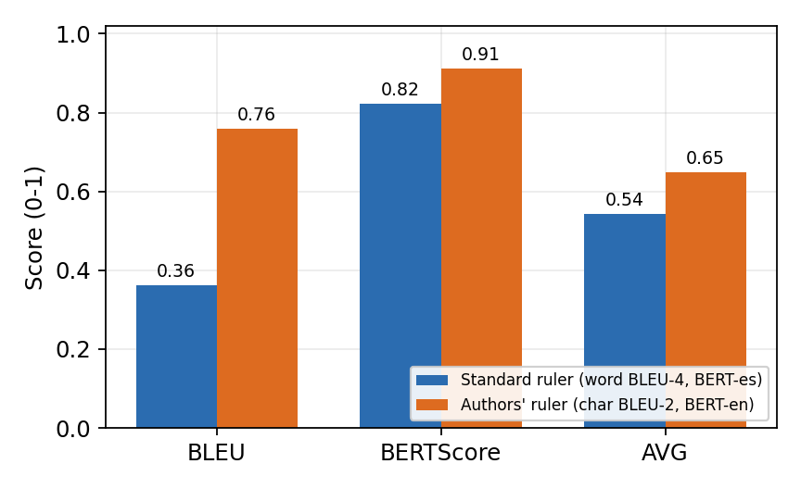
The “gap” is mostly the metric, not the model
Same B17 output, scored two ways.
– Word BLEU-4 vs. character BLEU-2: nearly 2× apart
– BERTScore backbone language (es → en) also mattered
– Neither changes a single generated word

Slide 14
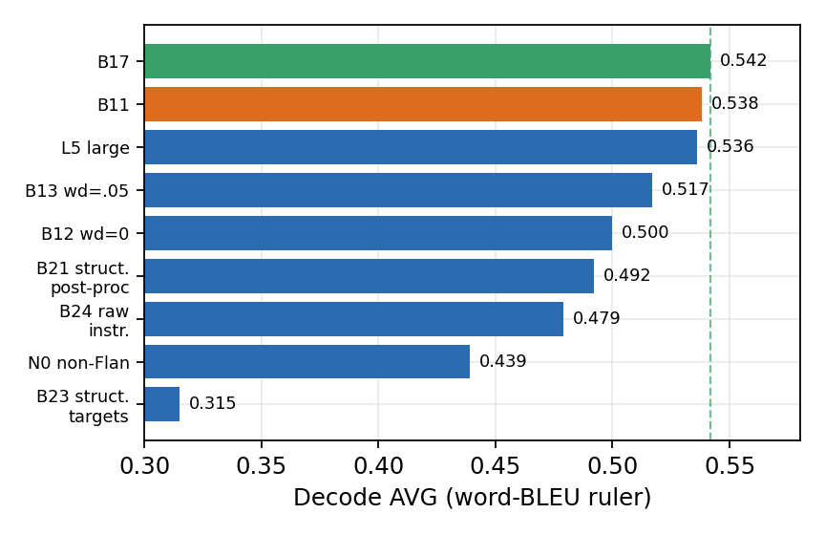
What we tried — and closed
20+ controlled experiments on Flan-T5-base.
– Learning rate = the single biggest gain
– LoRA rank, epochs, weight decay: small, closed increments
– Structured targets, raw-instruction input, scale-up: all regressed

Slide 15
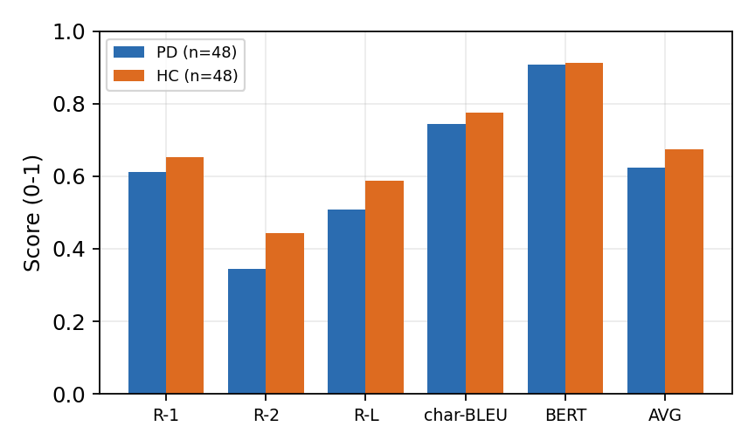
Persistent gap: PD reports are harder
HC is consistently the easier case.
– Easier than PD on every metric — matches the paper
– Structure coverage: 14% of generations contain all 7 slots (refs: 100%)
– Forcing structure hurt fluency, not just coverage

Slide 16
Limitations & clinical considerations
Metrics measure text overlap, not clinical correctness.
– Synthetic training data is highly templated (duplicate rate 0.95)
– Single corpus, single language — Colombian-Spanish speakers only
– Small real test set (96 reports) — treat PD/HC gaps cautiously
– Positioning: a decision-support drafting aid, never autonomous diagnosis

Slide 17
Conclusion & next steps
B17 is final for the Flan-T5 track.
– Under the paper’s own metric, a 248M model is competitive with 7B systems
– Next: constrained / template-guided decoding for full slot coverage
– Next: richer, less-templated synthetic training data
– Next: scale to a 7B decoder (LLaMA / Mistral) to beat 0.79 / 0.84

Slide 18
Bottom line
Under the paper’s own metric, a 248-million-parameter model lands beside systems roughly 28 times larger — the gap was the ruler, not the model.

Slide 19
Thank you
for your attention!

