Slide 1
Polymorphism

Slide 2
Polymorphism
The term "Polymorphism" is the combination of "poly" + "morphs" which means many forms. It is a greek word. In object-oriented programming, we use 3 main concepts: inheritance, encapsulation, and polymorphism

Slide 3
Real Life Example Of Polymorphism
A lady behaves like a teacher in a classroom, mother or daughter in a home and customer in a market. Here, a single person is behaving differently according to the situations.
Polymorphism is the ability for a data or message to be processed in more than one form. It is a concept by which a single operation can be performed in multiple different ways

Slide 4
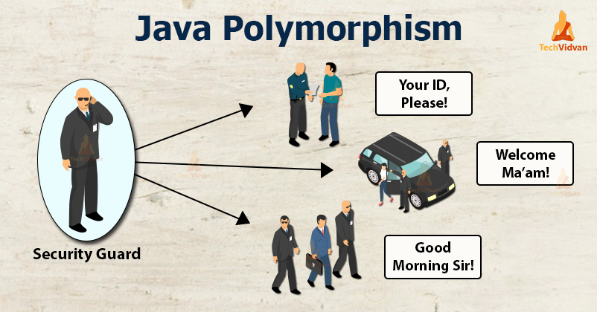
Real Life Example Of Polymorphism

Slide 5
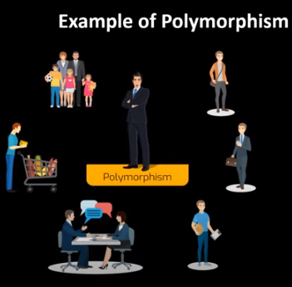
Real Life Example Of Polymorphism

Slide 6
Real Life Example Of Polymorphism
A security guard outside an organization behaves differently with different people entering the organization. He acts in a different way when the Boss comes and, in another way when the employees come. When the customers enter, the guard will respond differently. So here, the behavior of the guard is in various forms, which depends on the member who is coming.
Another example is the sound of animals. We can have a common method sound but with this method, we are using sounds of different animals. The method sound will behave differently with respect to different animals.

Slide 7
What is Java Polymorphism?
The virtue by which the same action can be performed by objects of different classes and each object responds in a different way depending on its class is called Polymorphism.

Slide 8
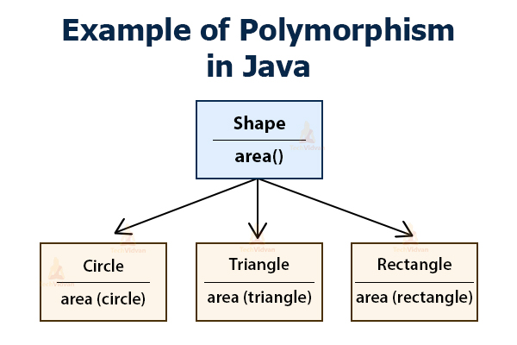

Slide 9
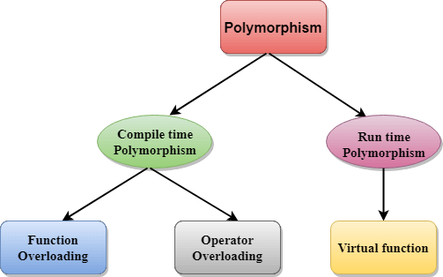

Slide 10
Static/Compile-Time Polymorphism
When the compiler resolves the polymorphism during the compilation of the program, then we call such polymorphism as compile-time polymorphism or static polymorphism. Sometimes we also call it static binding.
In Java, we can implement or achieve the compile-time/ static polymorphism with the help of Method /Function Overloading.

Slide 11
what is Method Overloading:
When a class has two or more than two methods which are having the same name but different types of order or number of parameters, it is known as Method overloading.
Java allows a function to have the same name if it can distinguish them by their number and type of arguments. For example, the following functions are different in Java

Slide 12
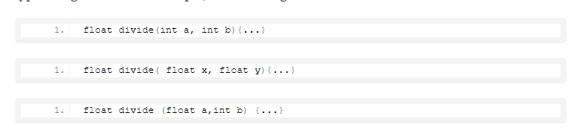
what is Method/Function Overloading

Slide 13
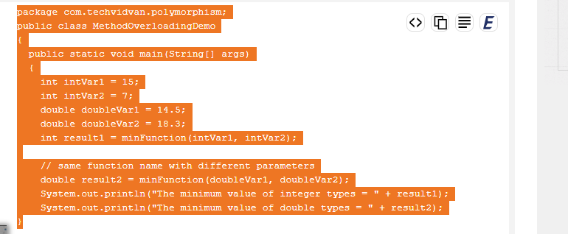
Code to illustrate Method/function overloading:

Slide 14
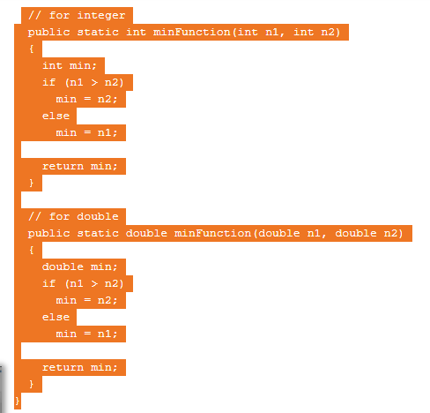

Slide 15
Dynamic/Run-Time Polymorphism
Runtime or dynamic Polymorphism is the polymorphism which resolves dynamically at the runtime rather than compile-time is called. We can also call it as dynamic binding or Dynamic Method Dispatch. Since the method invocation is during runtime and not during compile-time, this type of polymorphism is called Runtime or dynamic polymorphism.
In an object-oriented language, Method overriding occurs when a derived class provides a specific definition of the method that is already present in its parent class. We say that the function in the base class is being overridden

Slide 16
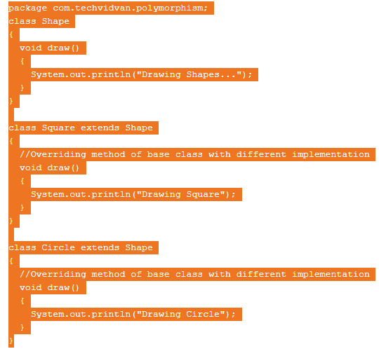
Dynamic/Run-Time Polymorphism

Slide 17
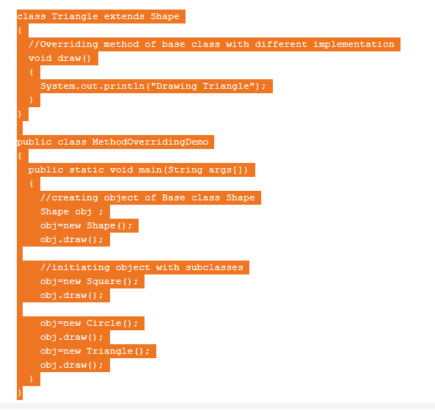
Dynamic/Run-Time Polymorphism

Slide 18
Differences b/w compile time and run time polymorphism
Compile time polymorphism
Run time polymorphism
The function to be invoked is known at the compile time.
It is also known as overloading, early binding and static binding.
Overloading is a compile time polymorphism where more than one method is having the same name but with the different number of parameters or the type of the parameters.
The function to be invoked is known at the run time.
It is also known as overriding, Dynamic binding and late binding.
Overriding is a run time polymorphism where more than one method is having the same name, number of parameters and the type of the parameters.

Slide 19
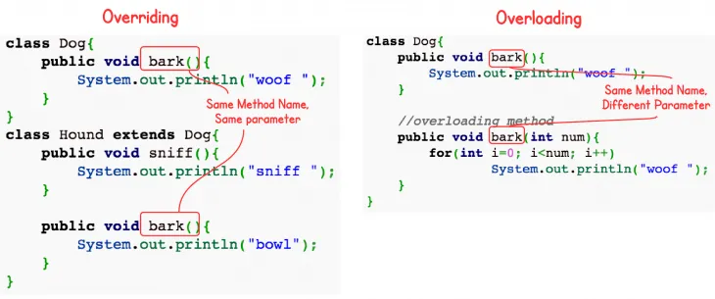

Slide 20
Why Java Polymorphism?
With Polymorphism, it is possible to write a method that correctly processes lots of different types of functionalities with the same name. Polymorphism also allows gaining consistency in our code.
Suppose we need to execute the animalSound() method of both Dog and Cat. To do so, we can create an ‘Animal’ class and extend two subclasses Dog and Cat from it. In this case, it makes sense to create a method with the same name animalSound() in both these subclasses rather than creating methods with different names.
In our method overloading example, for achieving consistency, we have used the same method name minFunction() to find the minimum of two different types of numbers, that is, int and double types.

Slide 21
Characteristics of Polymorphism in Java
There are many other characteristics of Polymorphism in Java other than Method Overloading and Method Overriding. They are as follows:
Coercion
Operator Overloading
Polymorphic Variables or Parameters

