Slide 1

Two-Level Hybrid Frameworks: Optimizing Project Management for Data-Driven Analytics
A Case Study in Credit Score Classification

Slide 2
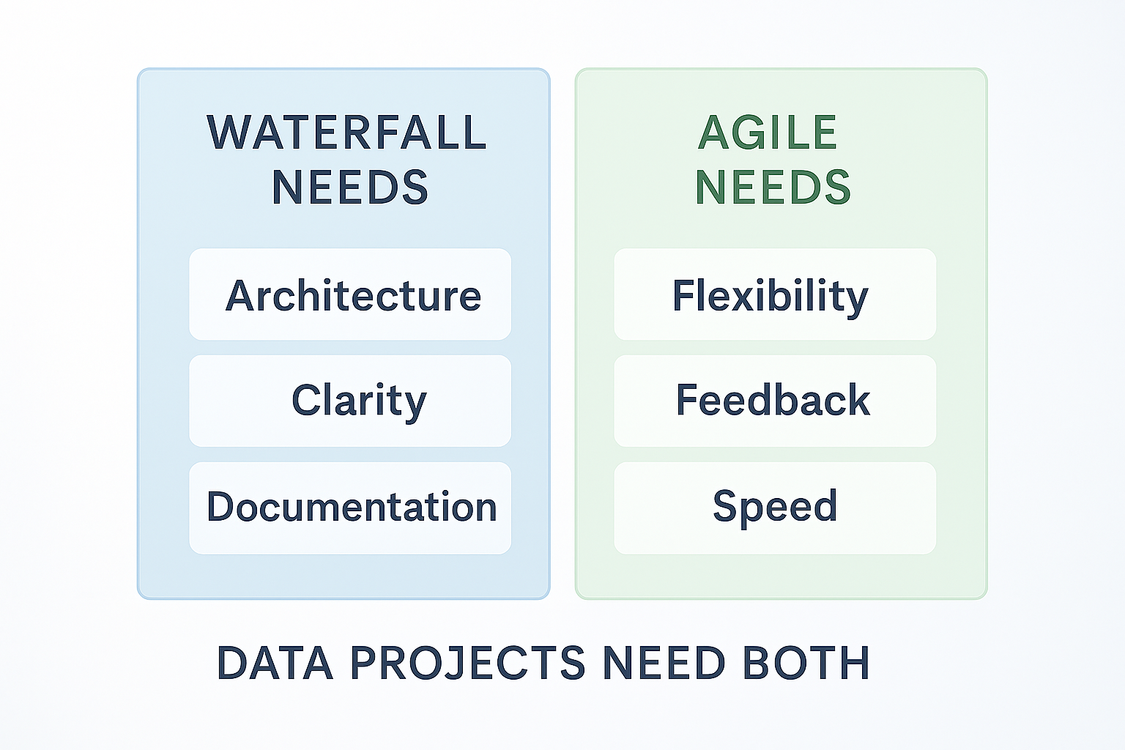
The Challenge: Managing Data Analysis Projects
The Problem: Organizations face a false binary choice between Waterfall structure and Agile flexibility.
Data Projects Are Different: They require both upfront clarity (data schemas, analytical methods) and adaptive problem-solving (unexpected patterns, emerging insights).\
Real Example: Credit score analysis project with 100,000 observations across 28 variables.
Key Tension: Delivering incremental insights while maintaining documentation and reproducibility

Slide 3
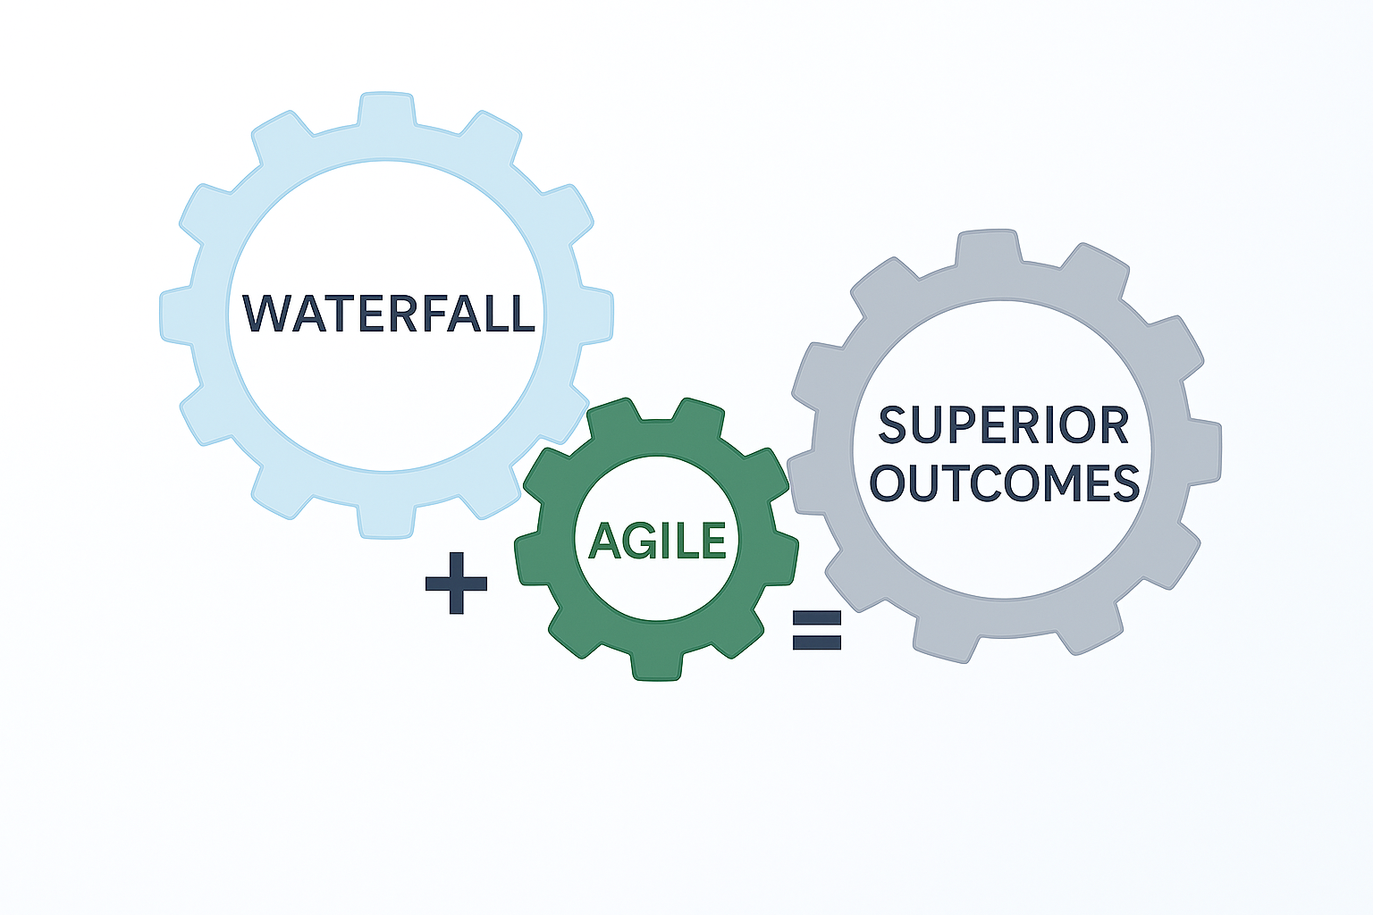
The Thesis: Integration Over Binary Choice
"Optimal project management for data analysis initiatives requires thoughtful integration of Waterfall's structural discipline and Agile's adaptive flexibility, rather than exclusive commitment to either methodology.“
Three Key Claims:
Waterfall Provides Essential Architecture
Clear requirements and phase gates prevent scope drift
Documentation discipline enables knowledge transfer
Quality checkpoints reduce downstream problems
Agile Enables Continuous Learning
2-week sprint cycles catch issues early
Sprint reviews maintain stakeholder alignment
Incremental value delivery sustains engagement
Integration Yields Superior Outcomes
Better project predictability (phase gates)
Better analytical rigor (continuous improvement)
Better stakeholder satisfaction (regular feedback)

Slide 4
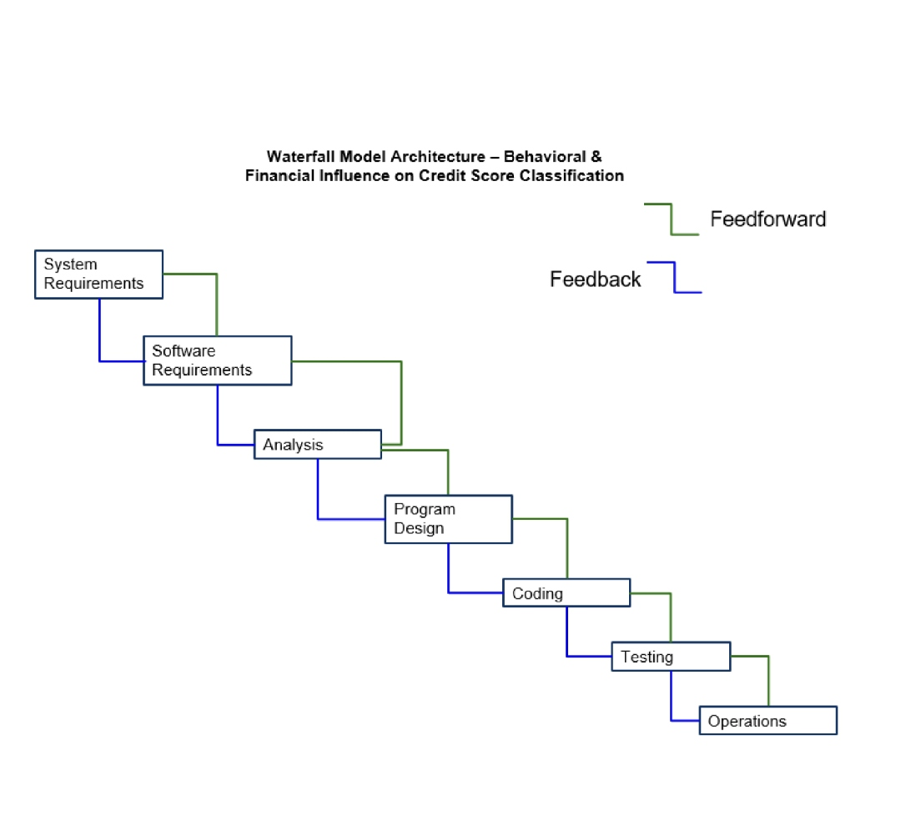
Waterfall Architecture: Seven Phases
Phase Overview (Brief):
Phase 1: System Requirements - Define research questions and success metrics
Phase 2: Software/Project Requirements - Data exploration and quality assessment
Phase 3: Analysis Planning - Select statistical methods and analytical approach
Phase 4: Program Design - Specify data transformation, modeling, and visualization pipelines
Phase 5: Coding & Implementation - Execute analysis scripts and build models
Phase 6: Testing & Verification - Validate outputs and assess model performance
Phase 7: Operations & Maintenance - Document findings and prepare knowledge transfer

Slide 5
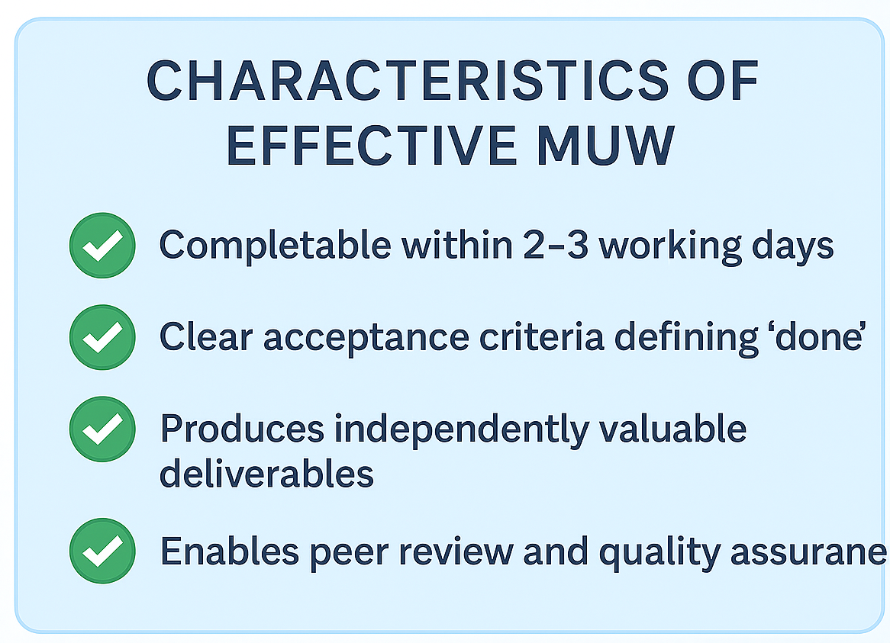
Agile at the Tactical Level: Minimum Units of Work
MUW #1 - Payment Delay Analysis (2-3 days):
Objective: Determine if payment delays significantly impact credit score classification
Tasks: Exploratory analysis → Kruskal-Wallis test → Post-hoc Dunn's test → Boxplot visualizations
Result: Statistical evidence that delays are highly significant (p<0.001)
Value: Clear understanding enabling stakeholder decisions
MUW #2 - Age Demographics Analysis (2-3 days):
Objective: Understand how age influences credit scores
Tasks: Feature engineering (5 life-stage categories) → Chi-Square test → Distribution visualizations
Result: Significant association (χ²=362.12, p<0.001), middle-aged groups show 40% more Good scores
Value: Demographic segmentation insights for lending strategy
MUW #3 - Credit Utilization Analysis (2-3 days):
Objective: Examine if utilization ratios differ across score categories
Tasks: Exploratory analysis → ANOVA testing → Summary statistics → Visualization
Result: Optimal range 21-30% for Good scores; >40% associated with Poor classification
Value: Actionable threshold guidance for consumers

Slide 6
Agile Execution: Sprint Ceremonies Within Phases
Daily Stand-ups (5 minutes)
1
What was completed yesterday?
What will be completed today?
What obstacles emerged?
Example: When exploratory analysis revealed income distribution skewness of 26.252, immediate log transformation was applied within the same sprint, preventing downstream model corruption
Sprint Reviews (Every 2 weeks)
2
Demonstrated completed analysis to stakeholders
Gathered feedback on preliminary findings
Example: Payment delay analysis sprint review showed Kruskal-Wallis results and boxplots; stakeholders asked "Can you compare all three score pairs?", prompting Dunn's post-hoc tests
Sprint Retrospectives (Every 2 weeks)
3
Reflected on what worked, what didn't
Accumulated lessons over project lifecycle
Example: "Small sprints enabled early detection of data quality issues; peer code review caught calculation errors; need visualization templates earlier"
Sprint Structure: 2-week cycles with consistent ceremonies

Slide 7
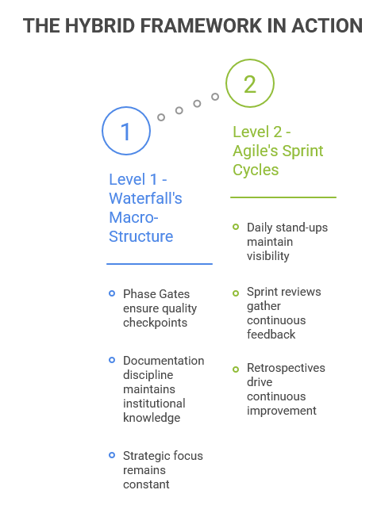
The hybrid framework operates on two integrated levels that work synergistically. Rather than viewing Waterfall and Agile as competing methodologies, this model demonstrates how they complement each other perfectly for data analysis projects.
Why This Works:
The credit project Phase 3 (Analysis) illustrates this integration perfectly. The phase contained four sequential sprints: EDA and method selection, payment delay analysis, age demographics analysis, and credit utilization analysis. Each sprint produced independently valuable insights that could be shared with stakeholders. Yet all four sprints remained bounded by Phase 3's exit gates—no sprint could proceed to implementation without all analytical methods being finalized and approved.

Slide 8
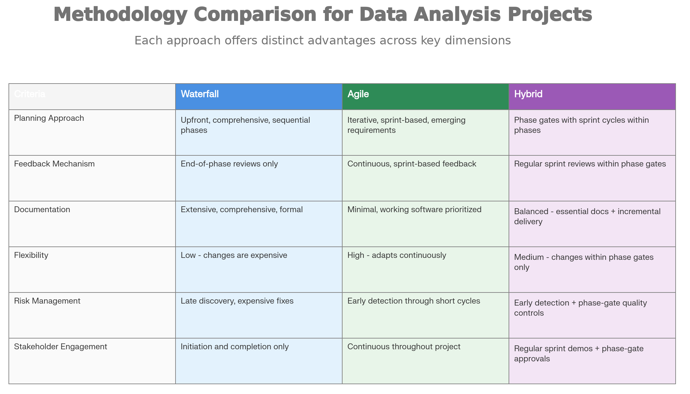
Research by Serrador & Pinto (2015) analyzed 400+ projects. Hybrid approaches consistently outperformed pure implementations across every metric: schedule adherence (78% vs 65-71%), budget management (82% vs 68-70%), stakeholder satisfaction (85% vs 60-75%), and project quality (88% vs 80-82%).
Why Hybrid Excels:
Data projects need both structure AND flexibility. Early uncertainty demands Agile's iteration, yet without Waterfall's architectural scaffolding, efforts scatter. Pure approaches alone create problems:
• Waterfall alone: Too rigid; can't adapt when data patterns differ from expectations • Agile alone: Too scattered; lacks direction; creates documentation debt • Hybrid: Combines phase gates (strategic focus) with sprint cycles (rapid feedback)

Slide 9
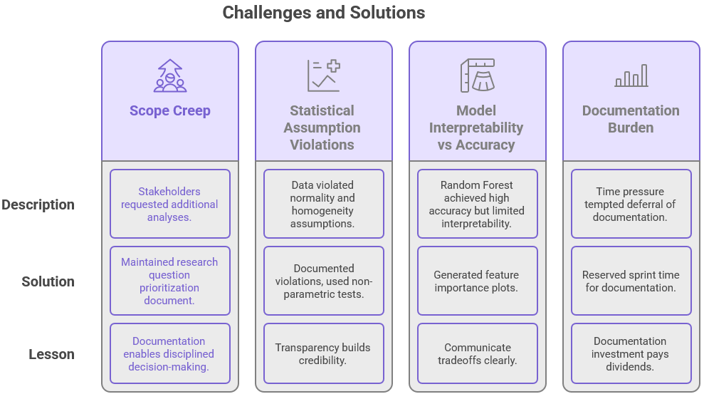

Slide 10
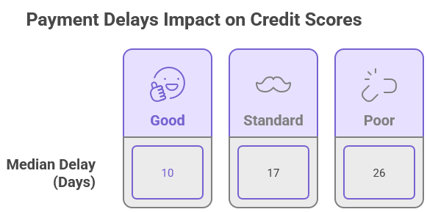
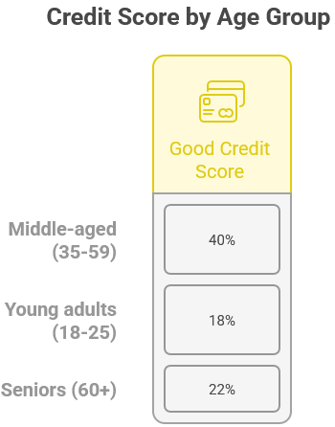
Credit Score Analysis: Key Findings

Slide 11
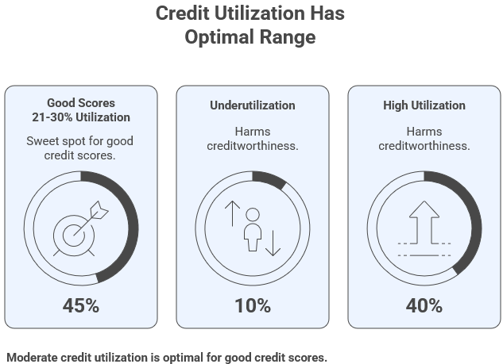
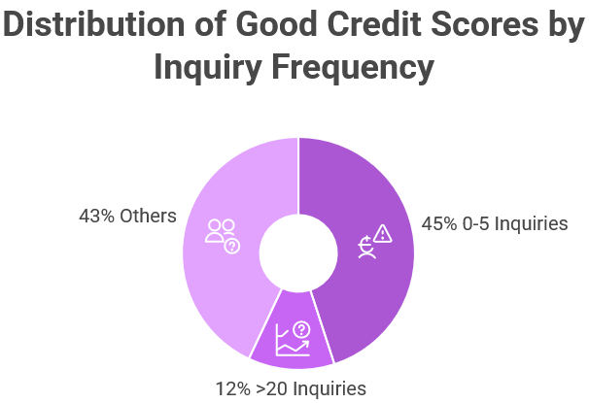
Credit Score Analysis: Key Findings

Slide 12
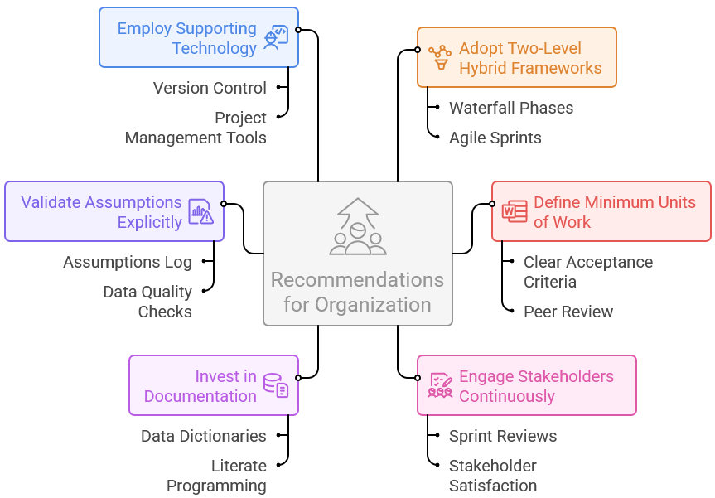
Recommendations for Organizations

Slide 13

Limitations and Future Directions
Key Limitations:
• Correlational, Not Causal: Analysis shows associations, not causation. Payment delays correlate with poor scores, but causal mechanisms aren't definitively established. • Model Interpretability: Random Forest provides strong accuracy but limited transparency. Simpler models sacrifice accuracy for interpretability. • Statistical Assumptions Violated: ANOVA analyses violated normality assumptions (Shapiro-Wilk p<0.001). Large sample size provides robustness, but violations merit acknowledgment. • Missing Variables: No debt-to-income ratios, employment stability, bankruptcy history. Model accuracy plateaus at 72.8% due to missing explanatory factors. • Potential Bias: Dataset composition may not represent complete borrower population.
Future Research Directions:
• Fairness auditing—do scores discriminate across demographics? • Real-time behavioral integration—enhance scoring with spending behavior. • Macroeconomic effects—how do rates, inflation, cycles affect credit? • Explainability improvements—SHAP values for per-prediction transparency. • Variable expansion—employment history, income trends, alternative data. • Temporal analysis—credit pattern evolution over time.

Slide 14
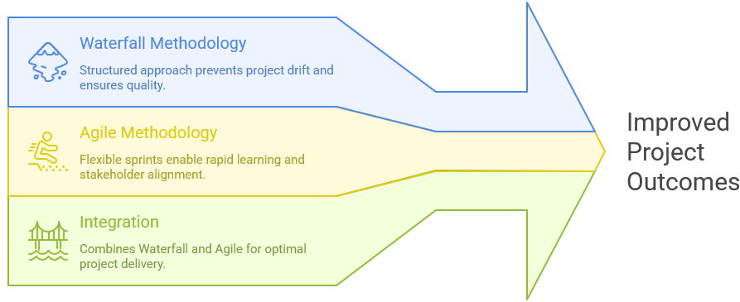
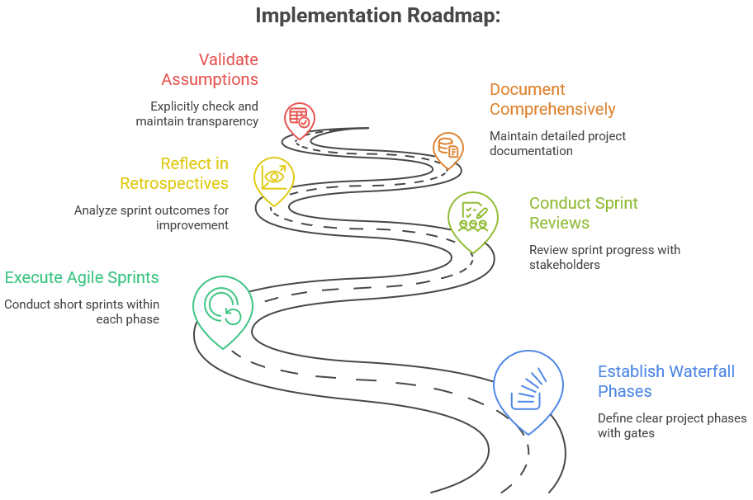
Conclusion: Hybrid Approaches Win
Managing complex data analysis projects requires integrating Waterfall's structural discipline with Agile's adaptive flexibility. Neither methodology alone suffices; integration captures complementary strengths.

Slide 15
Thank you
Presentation By: Dharshan amin netid: dhamin2

