Slide 1
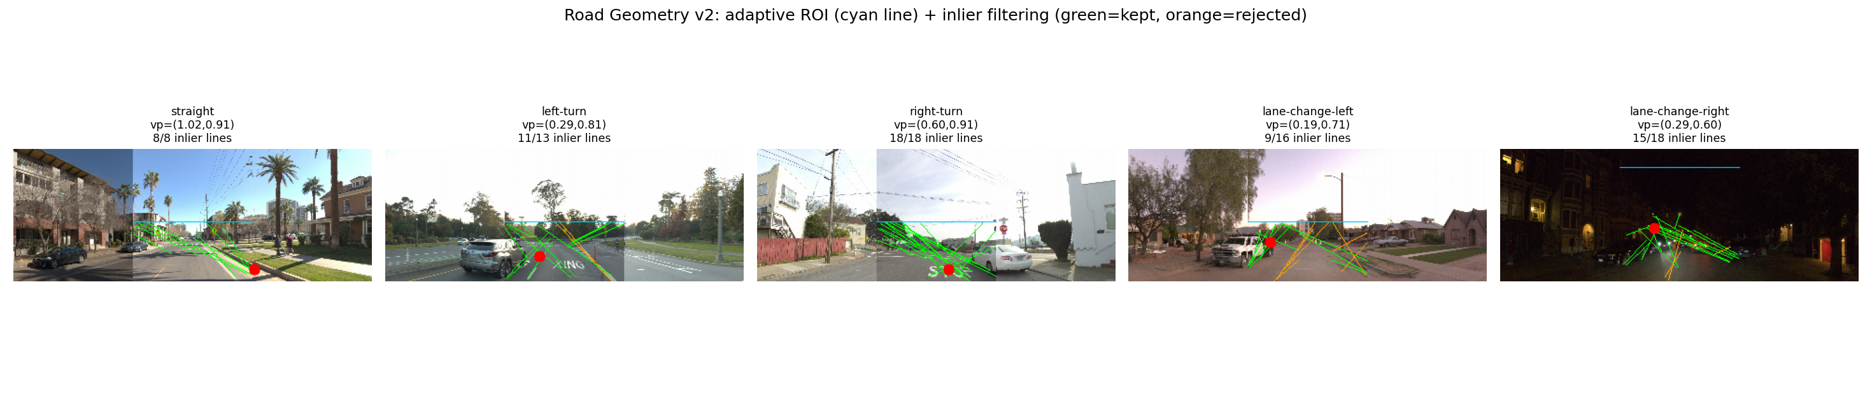
Road Geometry v2
Fixing the Hough+VP camera-stitch bug — one example per maneuver class
Bug fixed
Filtering works
But…
Front-center only
Inliers reject noise
Accuracy unchanged
v1 ran Hough+VP across the full 3-camera stitched panorama. v2 restricts to the front-center segment, so vanishing points land inside frame bounds every time.
Right-turn keeps 18/18 converging lines; lane-change-left drops to 9/16, correctly rejecting power lines and tree branches.
SVM matches v1 to 3 decimals (0.657) either way. Road segmentation, not Hough/VP, was already carrying the signal.
Notes:
For this update, we went back and fixed a real bug in our road geometry feature. Our panoramic camera frame is actually three stitched camera views, and our original pipeline was running line detection across all three at once, mixing lines from different camera perspectives into one vanishing-point estimate -- which is why some vanishing points landed outside the image. We fixed it by restricting to the front-center segment and filtering lines by convergence. Right-turn keeps nearly all its lines; lane-change-left correctly throws out power lines and tree branches. Honest result: geometry is correct now, but accuracy didn't move -- SVM matches the old version to three decimals. Road segmentation, not the line/VP part, was already carrying the signal.

Slide 2
Pretrained CNN Embeddings
YOLOv8s (main CNN) + MobileNetV2 + ViT-B/16 — real SVM/RF accuracy
01
MAIN CNN
02
CLASSIFICATION
03
SELF-ATTENTION
YOLOv8s Backbone
MobileNetV2
ViT-B/16
Detection-pretrained (COCO). Already powers the YOLO+Position feature elsewhere in this pipeline.
ImageNet-1k pretrained. Global-avg-pooled last conv layer as the embedding.
ImageNet-1k pretrained. Pre-logits CLS token after patch self-attention.
512d
SVM .533
RF .565
1280d
SVM .571
RF .597
768d
SVM .535
RF .559
Best individually
No new structure
Ceiling holds
MobileNetV2 (0.597 RF)
Same non-class UMAP split
0.657 SVM — unchanged
Edges out the YOLOv8s backbone (0.565 RF) and ViT (0.559 RF) — a classification objective may transfer slightly better here.
All three embeddings show the same bimodal split, uncorrelated with maneuver class — likely lighting, not decision-relevant.
All three stacked together still cap at 0.657 SVM, same as YOLO alone. Architecture choice isn’t the bottleneck.
Notes:
We tested three pretrained CNN embeddings. YOLOv8's backbone is our main one since we already run YOLO for detections elsewhere -- this embedding is essentially free. Compared against MobileNetV2 (lightweight, classification-pretrained) and ViT-B/16 (global self-attention instead of convolutions). Individually, MobileNetV2 edges out both YOLO and ViT (0.597 vs 0.565 and 0.559 RF) -- weak evidence a classification objective transfers a bit better here. But stack all three together and accuracy still caps at exactly 0.657 SVM, same as YOLO alone. Architecture choice isn't the bottleneck.

Slide 3
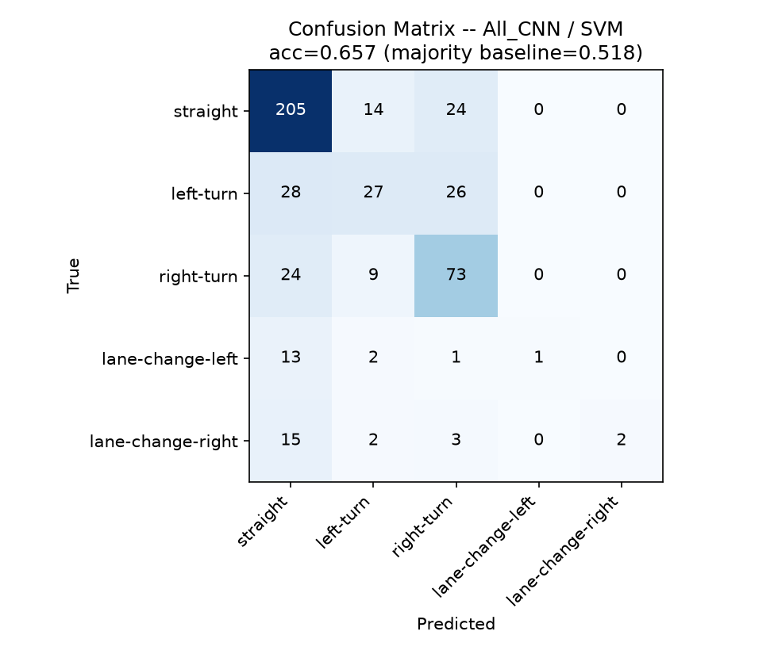
Where the Model Is Failing
Confusion matrix — best model so far (All_CNN / SVM, acc=0.657)
Learned well
Straight & right-turn
Recall 0.84 / 0.69 — the majority classes dominate correctly.
Confused
Left-turn ↔ other classes
Recall only 0.33; splits almost evenly across straight and right-turn.
Barely learned
Lane-changes predicted as straight
Recall 0.06 / 0.09; precision 1.00 on the rare hits — not confused, just never confident enough to predict.
Road v2, vehicle occupancy, and 3 pretrained CNNs all plateau at 0.657 — more single-frame feature engineering isn’t the lever. Focus next: more lane-change training examples, or multi-frame temporal context (v2 / future work).
Next steps
Notes:
Where does that 0.657 come from, and where does it break down? Straight and right-turn are learned reasonably well (recall 0.84 / 0.69). Left-turn is a real weak spot at 0.33 recall -- basically a coin flip with straight or right-turn. The real story is the two lane-change classes: recall 0.06 and 0.09, the model almost never predicts them, but precision is a perfect 1.00 on the rare hits -- it's not confused, just never confident enough. Combined with everything else tested this week (road geometry, three CNNs, vehicle occupancy), nothing moved past this ceiling. This isn't a feature-engineering problem anymore -- it's a data problem (not enough lane-change examples) or a scope problem (single-frame only this term). Multi-frame context is the next lever, scoped for v2.

Slide 4
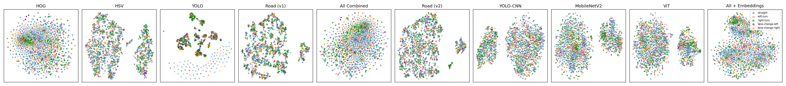
t-SNE: Feature Separability by Class
All 10 feature sets, same 1,875 sequences — perplexity=30
Consistent finding
Notable exception
Bottom line
No feature shows class clusters
YOLO clusters — but not by class
t-SNE agrees with the SVM/RF baseline
All 10 feature sets — from raw HOG to CNN embeddings — produce the same overlapping blob across all 5 maneuver classes. No color separation anywhere in the row.
YOLO's sparse 32-dim vector forms tight little clusters from repeated detection patterns, but each cluster mixes all 5 classes — it's grouping by scene content, not maneuver.
Not a projection artifact: the 0.657 accuracy ceiling and these flat plots tell the same story — a real feature-information limit for single-frame classification.
Notes:
This is the visual confirmation of everything just said -- t-SNE on all ten feature sets, same 1,875 sequences, colored by maneuver class. Every panel shows the same overlapping blob with no class separation. YOLO's panel looks different at first -- tight little clusters -- but those clusters mix all five classes; it's clustering by scene content, not maneuver. Not a projection fluke -- it's the same story the classifier numbers tell. This looks like a real information ceiling for single-frame classification, not a modeling gap -- which is what points toward multi-frame context as the next real lever.

