Slide 1
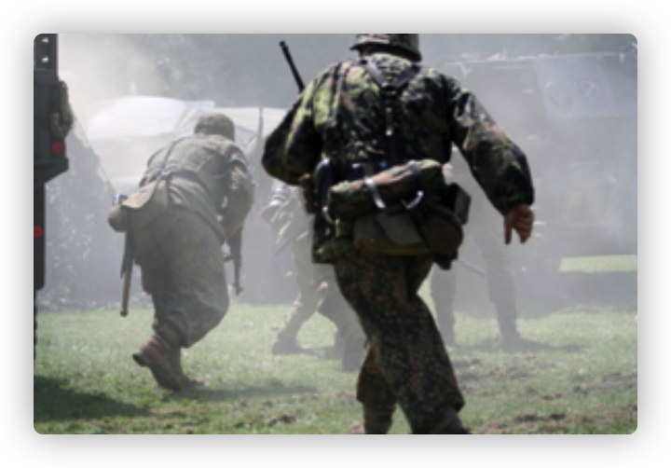
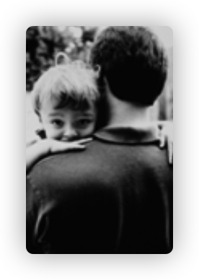
Smith and Luis
War and Peace

Slide 2
Abstract
contents
Words
Text Study
Smith and Luis

Slide 3
Abstract
残酷的战争中，
路易和史密斯偶然相识，
史密斯把路易当作自己的儿子对待。
但，一
段时间后，史密斯接到命令要离开，
却无法
带路易走。
战争结束后，
史密斯想方设法，
却再也找不到那个小男孩了。
去世前，史密
斯仍然放不下路易，
死后便将这件事委托给
了他的孩子。
Smith and Luis

Slide 4
Words
dispatch vt. 派遣、发送、派送
n. 派遣、急件、报道
He dispatched him, then took a moment and touched the breast pocket that held the photo of his wife and two young sons.
Smith and Luis

Slide 5
Words
deploy vt. 部署、调度（军队或武器）
使用、利用
It had been more than a year since he'd been deployed and last seen them.
Smith and Luis

Slide 6
Words
supervise vt. 监督、管理、指导
Luis giggled when Smith carried him aloft on his shoulders and soon began riding along in the jeep down to the beach, where Smith supervised the unloading of freight from the ships and took inventory.
Smith and Luis

Slide 7
Words
plead vi. 恳求、请求、央求
v. 申诉、答辩、辩护、抗辩
In his final will, Smith instructed his children to continue where he had left off, pleading with them to find Luis.
Smith and Luis

Slide 8
Phrases
tear sth. apart 损毁、摧毁、撕裂
France was a country torn apart by the bombs of the war and then pieced back together again.
Smith and Luis

Slide 9
Phrases
leave off 中断、放弃（活动）
pleading with sb. ( to do sth. )
恳求…做…
In his final will, Smith instructed his children to continue where he had left off, pleading with them to find Luis.
Smith and Luis

Slide 10
Text Study
Part 1(para1-4) :the beginning
Part2(para5-14) :How Smith and Luis become friends
Part3(para15-16):the turning point(转折点)
Part4(para17-19):the end
Smith and Luis

Slide 11
Text Study
Overnight, a military camp had sprung to life on the empty field just below his home in Normandy.（para1 L2-3）
一夜之间，在诺曼底他家下面的空地上，一个军营矗立了起来。
Smith and Luis

Slide 12
Text Study
Now he watched, wide-eyed, as jeeps road up the road and men scrambled about, emptying trucks loaded with guns, ammunition, food, and giant army bags.（para2 L1-2）
现在，他眼睛睁得大大的看着吉普车咆哮着沿路而上，士兵们来回奔忙，正在从卡车上卸载枪支，弹药，食物和巨大军用口袋。
Smith and Luis

Slide 13
Text Study
It had been more than a year since he’d been deployed and last seen them.
他上次见到他们后，被派到这里已经过了一年多了。
Smith and Luis

Slide 14
Text Study
This little guy looked like he could use a good meal, and the camp had more than enough food. In his halting French, Smith invited Luis to have lunch.
这个小家伙看起来可以在这儿饱餐一顿，营地有足够多的食物。史密斯用他结结巴巴的法语邀请路易斯去吃午餐。
Smith and Luis

Slide 15
plenty of
lots of
a great many
Text Study
许多，大量
Inside, dozens of young soldiers ate and talked. Smith piled two plates high with roast beef, carrots, and apple pie sprinkled with sugar.
帐篷里，一群年轻的士兵在边吃边聊，史密斯给他盛了两盘堆得高高的烤牛肉，胡萝卜，还有撒着糖的苹果派。
Smith and Luis

Slide 16
all of the time 总是，一直
Text Study
Henceforth, Luis ate with Smith all of the time. The other soldiers didn’t mind; in fact, the boy helped ease their homesickness.
从此以后，路易斯就整天和史密斯一起吃饭了。其他士兵也不介意，事实上，这个小男孩可以帮助减轻他们的思乡之苦。
Smith and Luis

Slide 17
Text Study
The two had grown so close amongst the trials of war, and Smith knew he would never forget the boy. What Smith could never have imagined was that he would never see Luis again.
在战争的磨难中两人变得愈发亲近，史密斯知道自己是永远不会忘记这个男孩的。但是史密斯绝对没有想到的是他再也见不到路易斯了。
Smith and Luis

Slide 18
Text Study
最后一个段落（17-19）主要内容：战争结束后史密斯多次回去找路易斯，但却没有找到。在遗愿里，将寻找路易斯这个愿望托付给自己的孩子
Smith and Luis

Slide 19
Text Study
fail 1.失败
2.辜负...
His repeated failures haunted him as he repeatedly asked himself punishing questions: Why have I failed Luis? What could I have done differently?（17段最后三排）
每次史密斯问自己，为什么我会辜负了路易斯？我还能做什么？史密斯以往不断的寻找失败总是会萦绕在他的心头。
Smith and Luis

Slide 20
Text Study
In his final will, Smith instructed his children to continue where he had left off, pleading with them to find Luis.（19段）
在路易斯最后的遗愿里，史密斯指导他的孩子继续去到那些他停止离开的地方，并请求他们继续寻找路易斯。
Smith and Luis

Slide 21
One More Thing

Slide 22


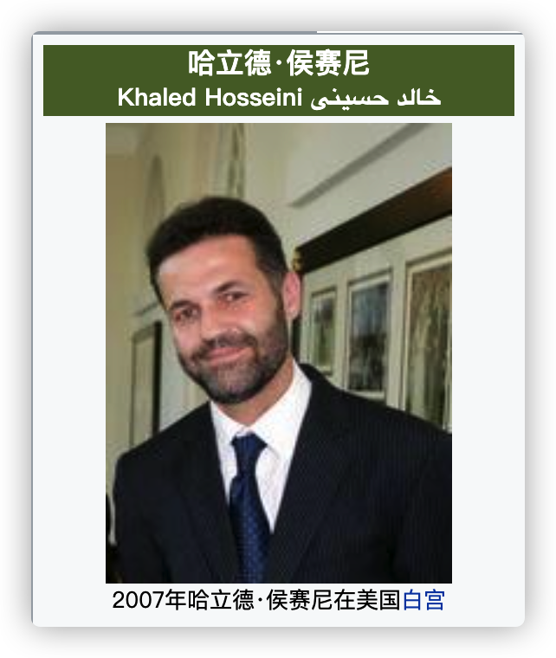

阿米尔（主角）因为自己的懦弱和嫉妒，逼走了自己的好友（阿桑）。由于战争的原因，自己离开了阿富汗。自己心理的那份愧疚一直留存在心里。二十多年以后再次回去找阿桑时，却再也找不到阿桑了。。。
《灿烂千阳》
《追风筝的人》
《群山回响》
War and Peace

Slide 23
1、得到了再失去，总是比从来就没有得到更伤人。
内心的痛苦和愧疚
升华主题———反对战争、热爱和平
本文的浅层主题———作者对路易斯的愧疚和当初没有能带走路易斯的痛苦
2、许多年过去了，人们说陈年旧事可以被埋葬，然而我终于明白这是错的，因为往事会自行爬上来。
内心的痛苦和愧疚
3、大漠荒草生息不绝，反教春花盛放凋零。
对战争的厌恶
4、为你，千千万万遍。
对和平的渴望和内心释然的解脱
War and Peace

Slide 24
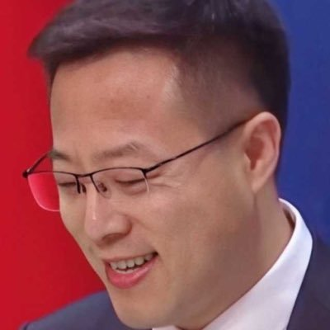

中国外交部发言人——赵立坚
stigma： 耻辱、污名
solidarity : 团结
rumor：谣言

