Slide 1
Three Wechat Groups
If you can only keep three Wechat groups, what is your
choice?

Slide 2
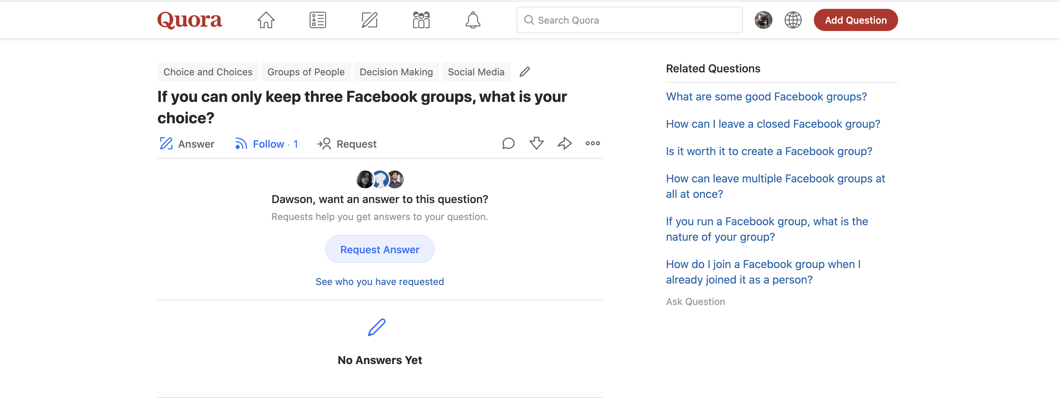
https://www.quora.com/unanswered/If-you-can-only-keep-three-Facebook-groups-what-is-your-choice

Slide 3
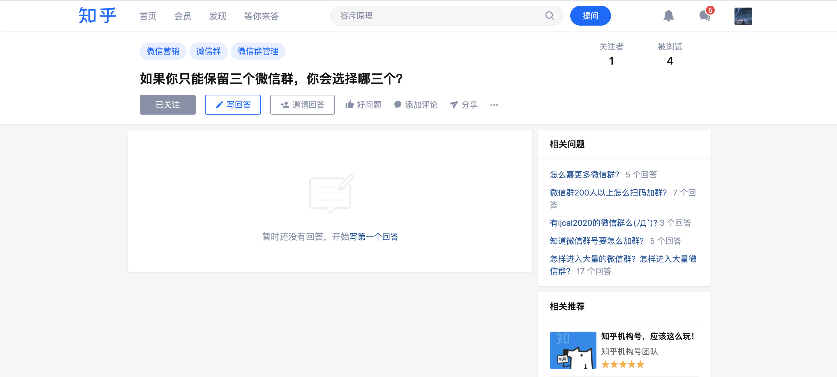
https://www.zhihu.com/question/456085201

Slide 4
I try to find similar questions

Slide 5
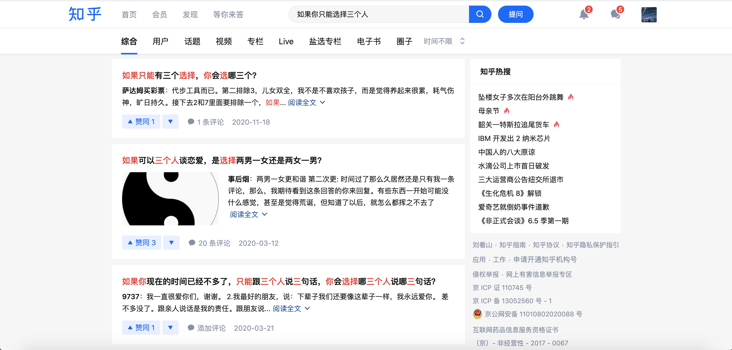

Slide 6
Your choice is related to something you care about most
Family
Health
Friendship
Work
and so on.

Slide 7
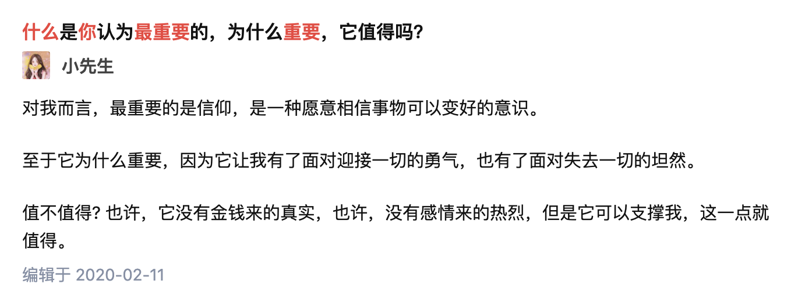
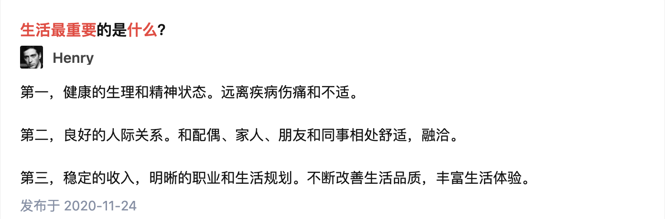

Slide 8
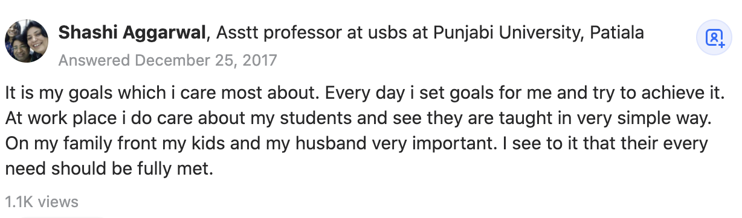
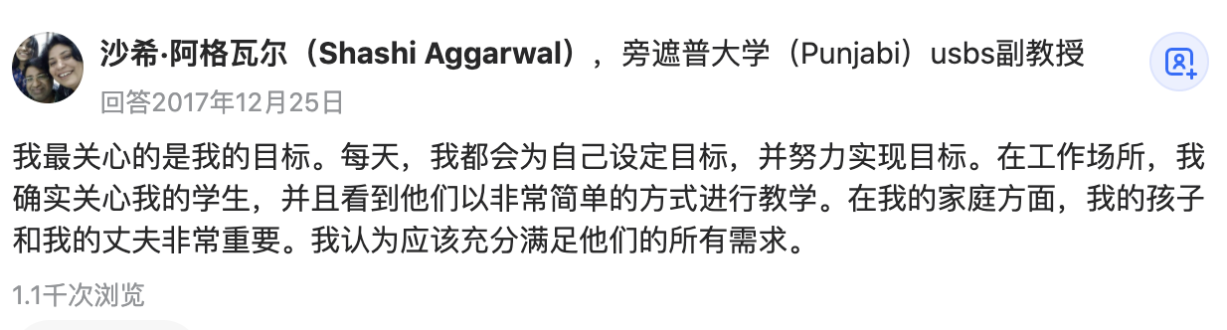

Slide 9
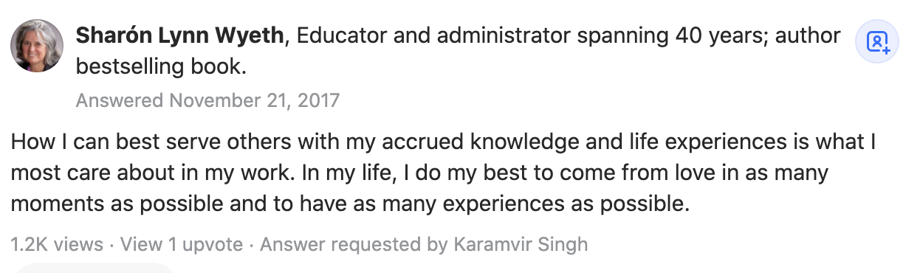
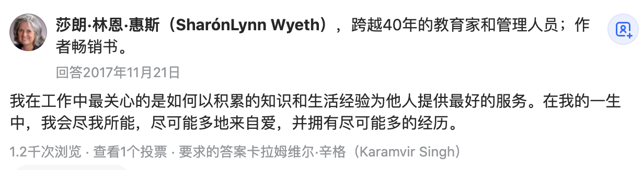

Slide 10
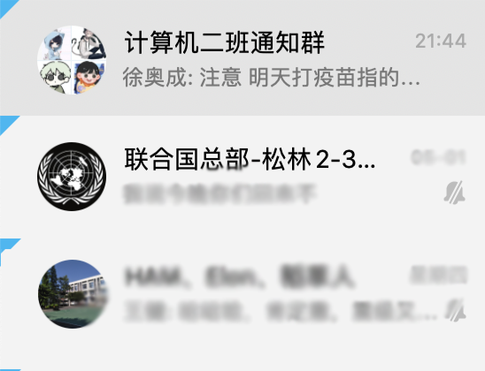
Work
Friendship
Friendship
Work , friendship and love are most invaluable for me
This’s my answer

