Slide 1
T-LAS Development RFP Release Decision Point Brief
Team 3PO
Dawson Friesenhahn, Jeff Spencer, Oung Kyaw Sann, & Anjanette Turner
FAM Class 24Q
Notes:
1
Jeff
Purpose of brief: To present an Acquisition Strategy at the Development RFP Release Decision Point. Remember, this is only to get approval to release and RFP. This is NOT source selection or a MS-B decision.
Stick closely to the template. The red text identifies parts of the presentation that need to be filled in. Feel free to change it back to black.
The expectation is that the team will divide the presentation up evenly. Everyone should have an opportunity to brief a portion of the ASP. This is a good opportunity to practice briefing. It is also ok to have notes in front of you during the presentation.
Although the intent is to mimic an actual ASP Panel brief, well timed and non-offensive humor is ok… just don’t go overboard.

Slide 2
Bottom Line Up Front
Decisions:
Approve Acquisition Strategy and RFP Release
Sign Acquisition Decision Memorandum
Major program issues or concerns:
Issue - Money: 3 of 4 companies are projected to bust the Presidents Life-Cycle budget.
Concern - Draco has limited production experience; schedule may be unrealistic
Notes:
2
Dawson:

Slide 3
Program Overview
Requirements/Direction
Using Organization(s): AFSOC
MS-B Contract Award: 01 January 2025
Decision Authority
MDA: USD (A&S)
PEO: AFLCMC/EB
SSA: SAF/AQ
ACAT Level: 1D
Financial Data
Est. RDT&E Total Program - $78M
Est. Proc. Total Program – $47M
Est. O&S Total Program- $3,281.52M
Est. Life Cycle Cost – $3,402.52B
Strategy
Contract: Competitive
Maintenance: Partnership
Contract Type: EMD- CPIF, LRIP-FPIF , FRP- FFP
Overall Risk Level: Medium
Next DOD 5000 event/milestone: Enter Milestone B
Notes:
3
Anjie:

Slide 4
Program Description
Countries are developing Theater Ballistic Missiles that surpass our current ground-based defense capabilities. T-LAS is an Airborne Laser (ABL) system that improves ballistic missile defense.
Notes:
4
Jeff:
Keep to top-level background only. Consider what you’d tell an MDA (decision maker) in 2 minutes or less, to understand your program (i.e. what are you buying? how many? why? etc.).

Slide 5
Program Description
Linked Programs:
C-130
JSTARS
AWACS
Link-16
Notes:
5
Sann:
This slide can be completed at any time.
You will need information from the CDD and RFI tabs of the T-LAS Worksheet.
Linkage to other systems: Is the development and/or operational use of this system dependent on the development or continued operation of another system/systems or programs? If so, identify the nature of the dependency. (Hint: List materiel solutions that your program may be dependent on. DO NOT list people or organizations as they belong with stakeholders.)

Slide 6
Program Description
Stakeholders
Leadership
Financial
Contracting
Logistics
Test
Cyber
PCO
Buyer (AFSOC)
Lead development and operational testing center
JITC
Notes:
6
Anjie:
JITC- Joint Interoperability Test Command
Identify organizations (ex. AFMC) and/or key stakeholder position (such as MDA) that contribute to or are impacted by your program. Focus on primary and secondary stakeholders (those involved directly with the program). Don’t identify broad stakeholders (Russia, Army, etc.) Make sure you think about stakeholders in different phases of T-LAS, post MS-B.

Slide 7
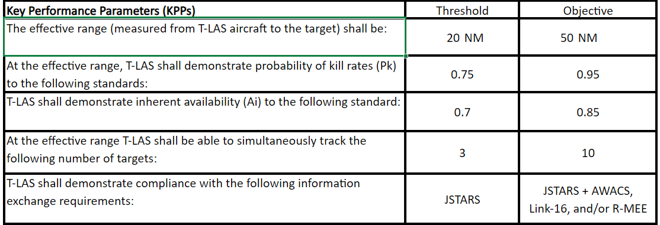
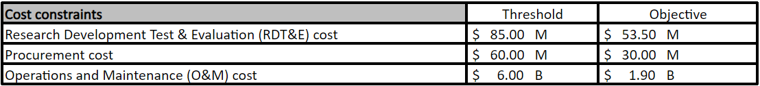
Program Parameters
Key Performance Parameter in order of priority:
1.
2.
3.
4.
5.
Cost Parameters:
?
?
Schedule Parameter:
?
Notes:
Dawson:

Slide 8
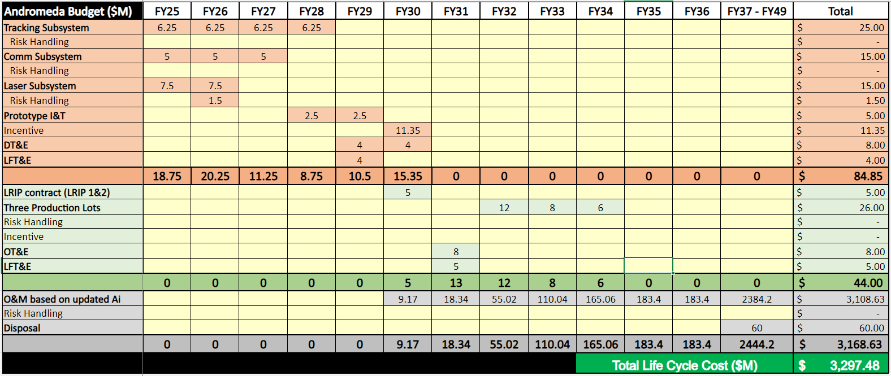
Lifecycle Budget Best Case - Andromeda
Notes:
Sann:
Delete the placeholder graphic above and paste in the results from the Budget tab for the T-LAS worksheet. NOTE: The best case is the contractor with the LOWEST Total Life Cycle Cost.

Slide 9
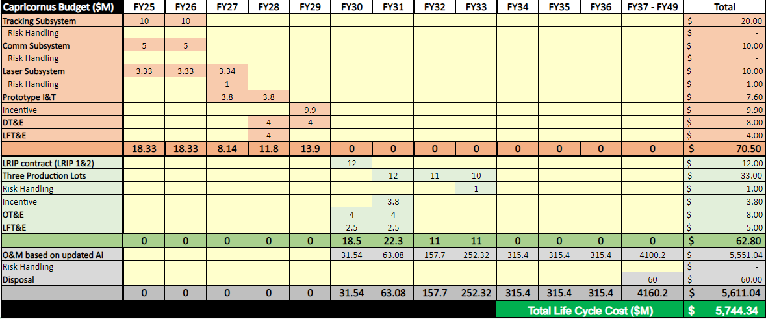
Lifecycle Budget Worst Case - Capricornus
Notes:
Notes:
Anjie:

Slide 10
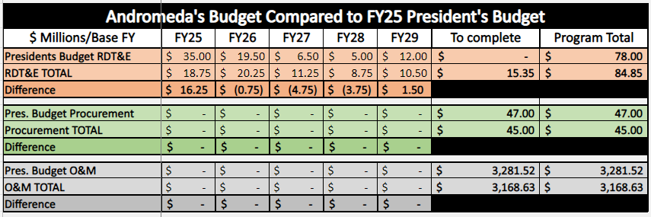
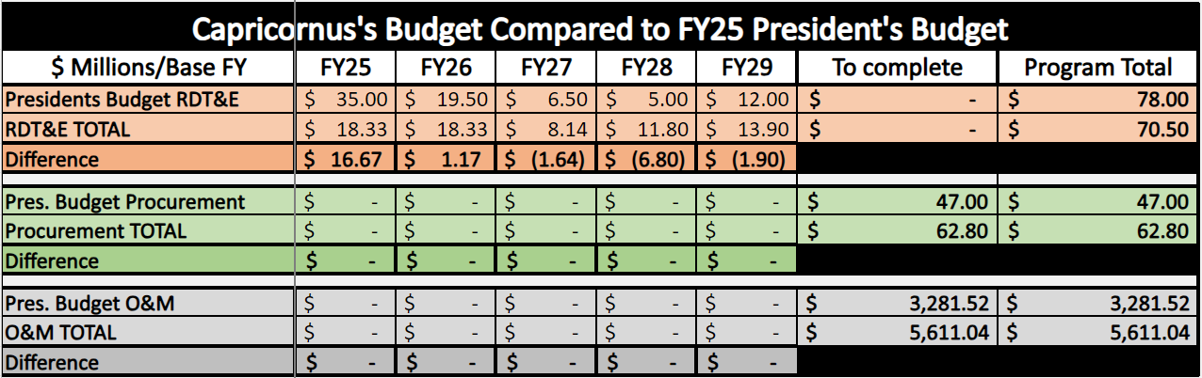
Program Objective Memorandum and Program Office Estimates
Notes:
Who would you engage to fix your funding issues?
PEM to PEO to Congress
What will you ask them to do (Adjust the POM, transfer funds to/from another program, request the contractor delay or advance work)?
Receive funding approval from Congress (ATR) to request PEMs to adjust the POM
Notes:
Everyone:
Budget difference:
President budget & Program budget

Slide 11
FY25
FY26
FY27
FY28
FY29
FY30
FY31
FY32
FY33
FY34
FY35
FY36
Draco
Laser
CDR
FRP
IOC
FOC
Comm
PCA
Tracking
Prototype I&T
FCA
Prod Contract Award
LRIP Contract Award
Dev Contract Award
DT&E
LRIP
Production
LFT&E
OT&E
MSB
MSC
LFT&E
Pegasus
Laser
DT&E
LRIP
PCA
Comm
OT&E
Production
Prototype I&T
LFT&E
Tracking
CDR
LFT&E
FCA
Prod Contract Award
IOC
FOC
Dev Contract Award
LRIP Contract Award
MSB
MSC
FRP
Notes:
Jeff/ Dawson:
Speak to the key dates
FCA: Functional Configuration Audit. Demonstrates that Engineering and Manufacturing Development product is sufficiently mature for entrance into LRIP.
PCA: Physical Configuration Audit. Conducted around FRP decision and confirms that the manufacturing processes, quality control system, measurement, and test equipment, and training are adequately planned, tracked, and controlled

Slide 12
Budget & Schedule Analysis
How do the Best Case and Worst Case budgets compare to AFSOC’s funding constraints?
Best (Andromeda) is $109.04M less than the presidential budget. Worst (Capricornus) is $2337.82M more than the Presidential total life cycle cost budget.
How do the Best Case and Worst Case schedules compare to the Program Schedule?
IOC Threshold: 1 May 2033 Objective: 28 Feb 2030.
Draco IOC date: 27 March 2030 - close to objective!
Pegasus IOC date: 20 Feb 2033
What are the Critical Paths for the Best Case and Worst Case schedules?
Best Case (Draco): Tracking (Threat Receiver), Comm (Encryption Device), I&T
Worst Case (Pegasus): Laser (Lens Component), Prototype I&T, DT&E
Why are the Critical Paths important?
Any slip on critical paths will cause the overall schedule to slip
Notes:
Jeff:

Slide 13
Risk Assessment and Management – Draco
Low
Mod
High
 | Consequence Negligible Critical 1 2 3 4 5
99% 5%
5
4
3
2
1
R2
Probability
R1
R1
Notes:
13
This slide should be completed after the risks have been completed (Risk lesson).
You will need information from the Risk tab of the T-LAS Worksheet.
R1 – Contractor’s 1st risk
R2 – Contractor’s 2nd Risk.
The arrow shows how the risks changes from pre-risk to post risk w/handling. Example above should Risk 2 (R2) going from High (red) to Low(green) after risk mitigation.

Slide 14
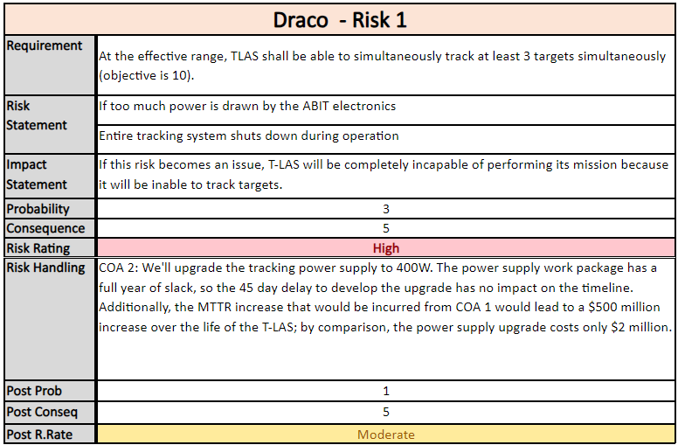
Draco Risk 1 Handling Plan
Notes:
14
This slide can be completed after the Risk Management lesson.
You will need information from the Risk tab of the T-LAS Worksheet.
Be prepared to brief this from top to bottom.

Slide 15
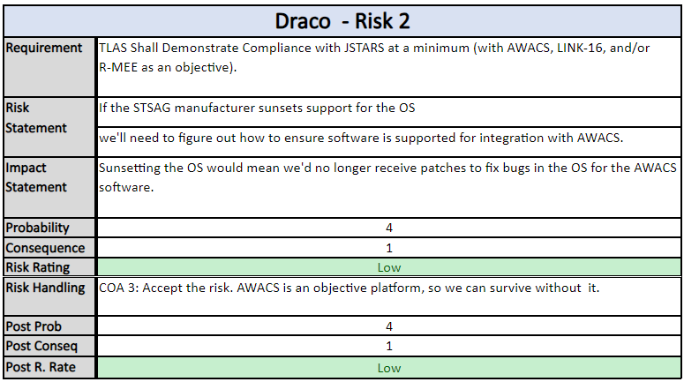
Draco Risk 2 Handling Plan
Notes:
15
This slide can be completed after the Risk Management lesson.
You will need information from the Risk tab of the T-LAS Worksheet.
Be prepared to brief this from top to bottom.

Slide 16
Risk Assessment and Management – Capricornus
Low
Mod
High
 | Consequence Negligible Critical 1 2 3 4 5
99% 5%
5
4
3
2
1
Probability
R2
R1
R2
R1
Notes:
16
This slide should be completed after the risks have been completed (Risk lesson).
You will need information from the Risk tab of the T-LAS Worksheet.
R1 – Contractor’s 1st risk
R2 – Contractor’s 2nd Risk.
The arrow shows how the risks changes from pre-risk to post risk w/handling. Example above should Risk 2 (R2) going from High (red) to Low(green) after risk mitigation.

Slide 17
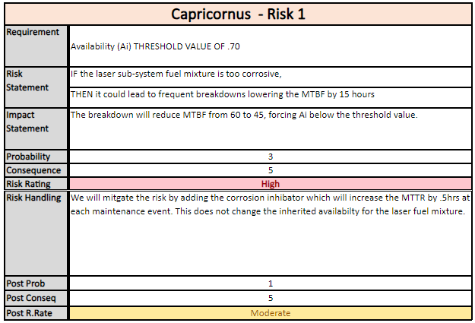
Capricornus Risk 1 Handling Plan
Notes:
17
This slide can be completed after the Risk Management lesson.
You will need information from the Risk tab of the T-LAS Worksheet.
Be prepared to brief this from top to bottom.
The corrosion fuel that highly corrosion – more detail – root cause **** for both

Slide 18
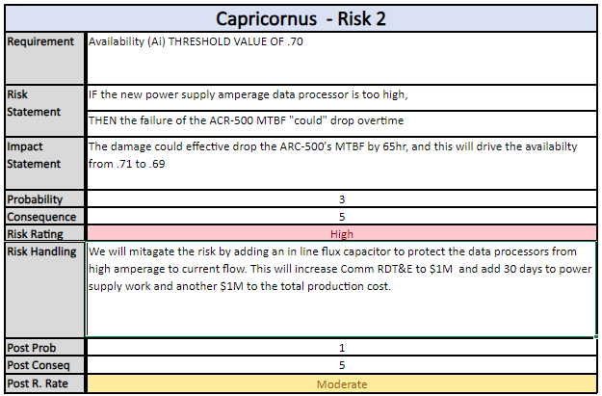
Capricornus Risk 2 Handling Plan
Notes:
18
This slide can be completed after the Risk Management lesson.
You will need information from the Risk tab of the T-LAS Worksheet.
Be prepared to brief this from top to bottom.

Slide 19
Risk Assessment and Management – Andromeda
Low
Mod
High
 | Consequence Negligible Critical 1 2 3 4 5
99% 5%
5
4
3
2
1
R2
Probability
R1
R2
R1
Notes:
19
This slide should be completed after the risks have been completed (Risk lesson).
You will need information from the Risk tab of the T-LAS Worksheet.
R1 – Contractor’s 1st risk
R2 – Contractor’s 2nd Risk.
The arrow shows how the risks changes from pre-risk to post risk w/handling. Example above should Risk 2 (R2) going from High (red) to Low(green) after risk mitigation.

Slide 20
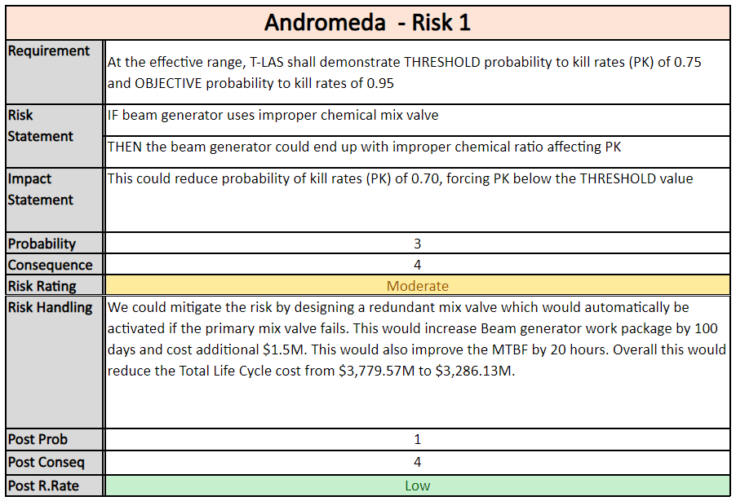
Andromeda Risk 1 Handling Plan
Notes:
20
This slide can be completed after the Risk Management lesson.
You will need information from the Risk tab of the T-LAS Worksheet.
Be prepared to brief this from top to bottom.

Slide 21
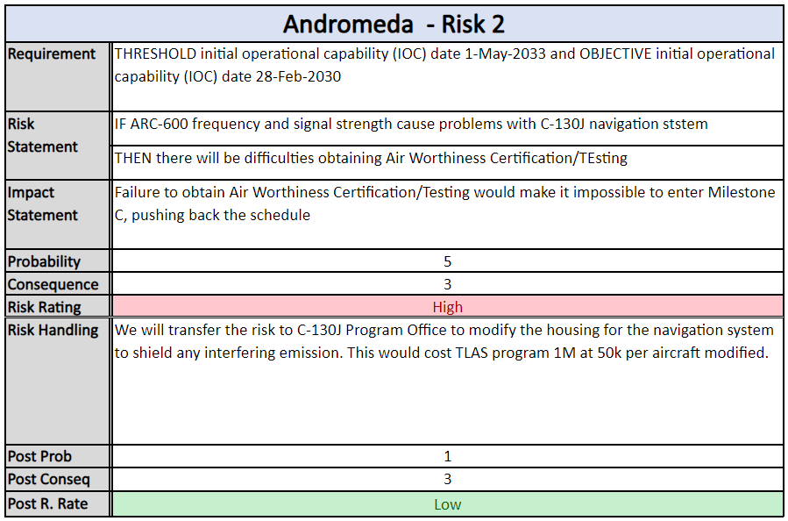
Andromeda Risk 2 Handling Plan
Notes:
21
This slide can be completed after the Risk Management lesson.
You will need information from the Risk tab of the T-LAS Worksheet.
Be prepared to brief this from top to bottom.

Slide 22
Risk Assessment and Management – Pegasus
Low
Mod
High
 | Consequence Negligible Critical 1 2 3 4 5
99% 5%
5
4
3
2
1
R2
R1
R1
Probability
R2
Notes:
22
This slide should be completed after the risks have been completed (Risk lesson).
You will need information from the Risk tab of the T-LAS Worksheet.
R1 – Contractor’s 1st risk
R2 – Contractor’s 2nd Risk.
The arrow shows how the risks changes from pre-risk to post risk w/handling. Example above should Risk 2 (R2) going from High (red) to Low(green) after risk mitigation.

Slide 23
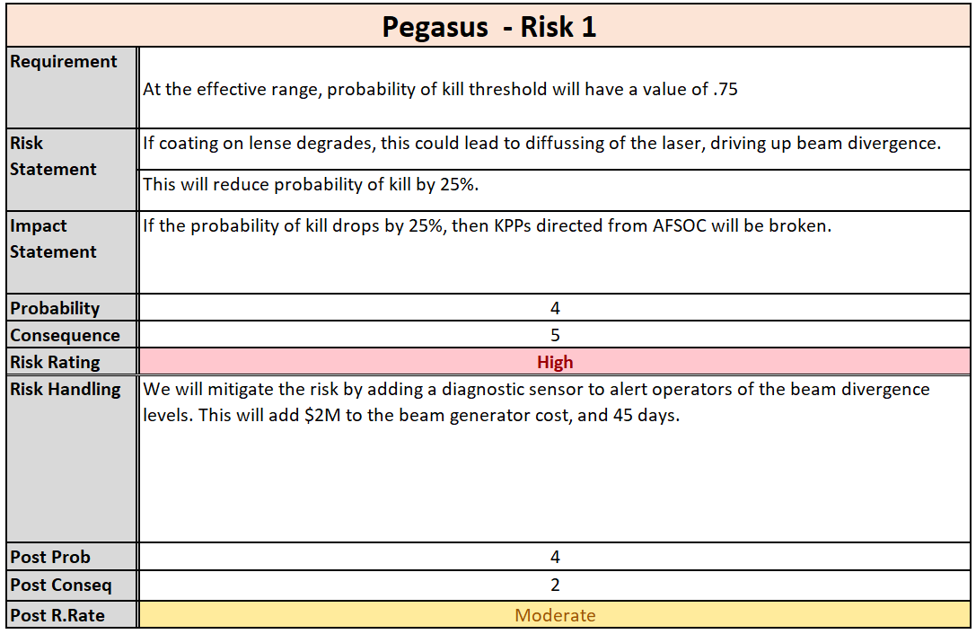
Pegasus Risk 1 Handling Plan
Notes:
23
This slide can be completed after the Risk Management lesson.
You will need information from the Risk tab of the T-LAS Worksheet.
Be prepared to brief this from top to bottom.

Slide 24
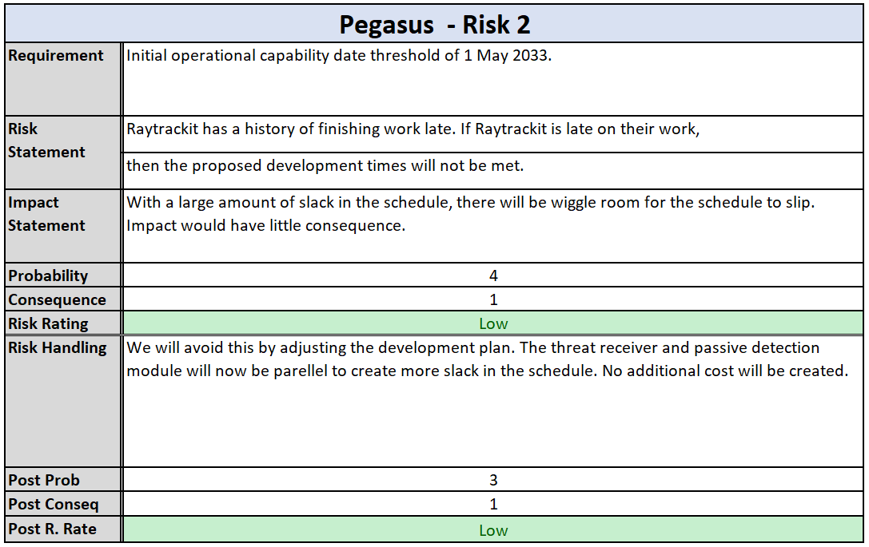
Pegasus Risk 2 Handling Plan
Notes:
24
This slide can be completed after the Risk Management lesson.
You will need information from the Risk tab of the T-LAS Worksheet.
Be prepared to brief this from top to bottom.

Slide 25
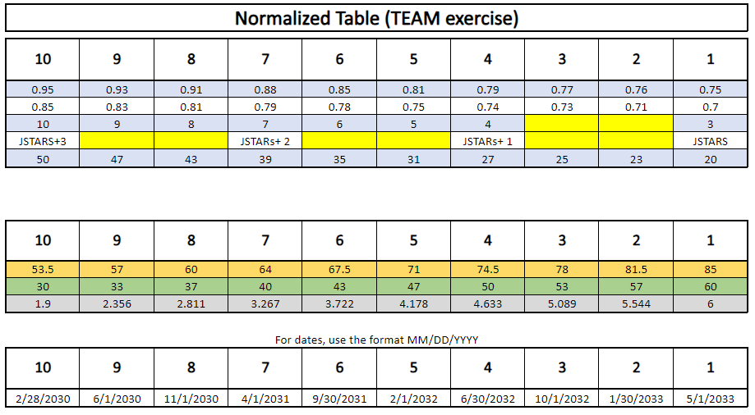
Trade Study Matrix
Notes:
Sann:

Slide 26
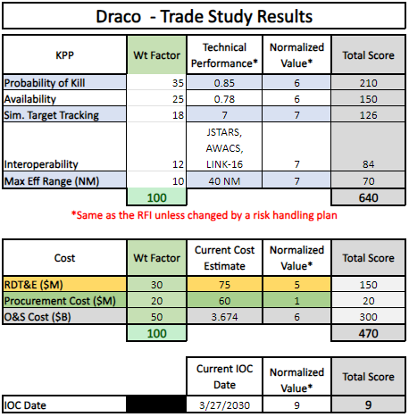
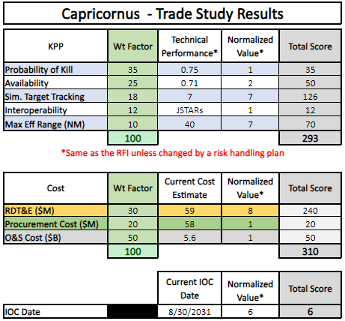
Trade Study Results
Notes:
Sann:

Slide 27
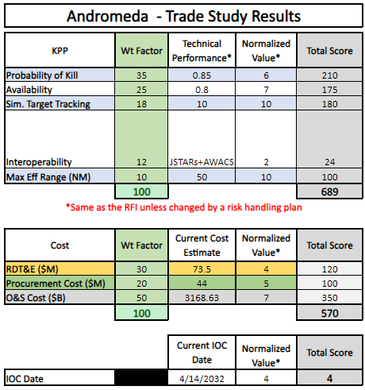
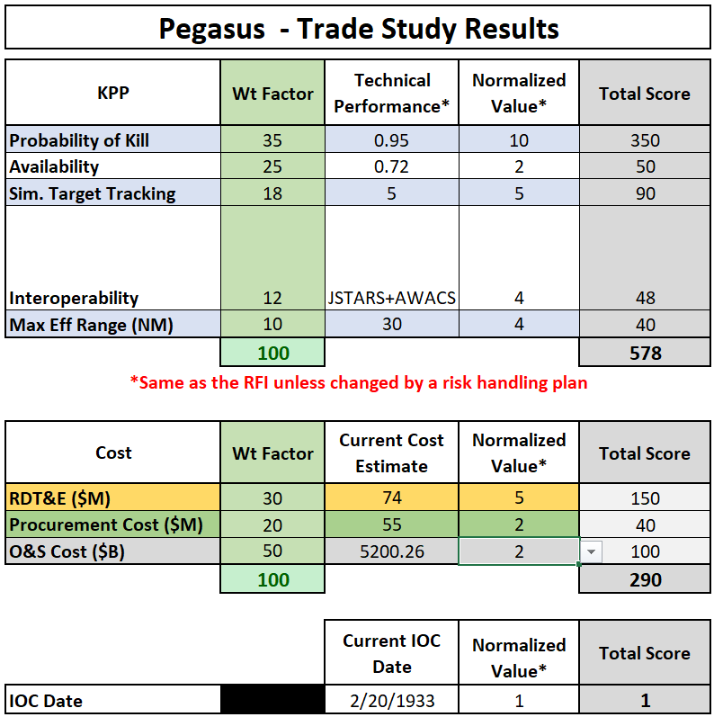
Trade Study Results
Notes:
Sann:
Copy the trade study results tables from the TStudy tab of each of your T-LAS Worksheets. Put two per slide.

Slide 28
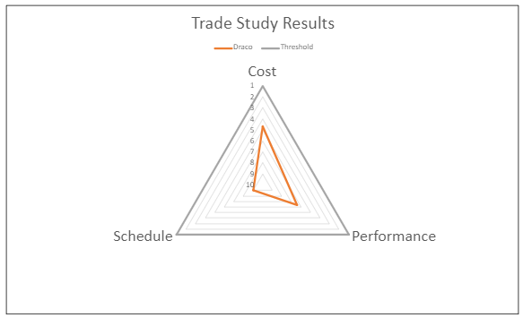
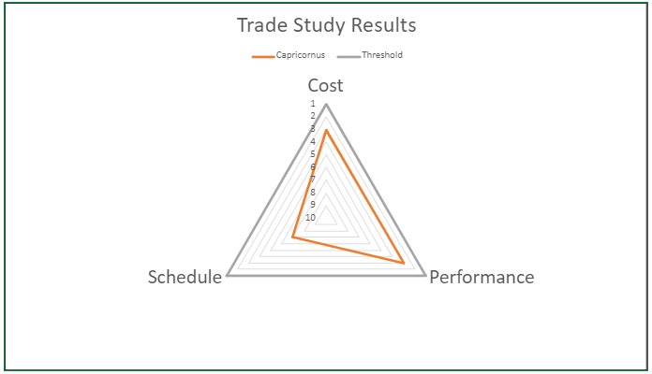
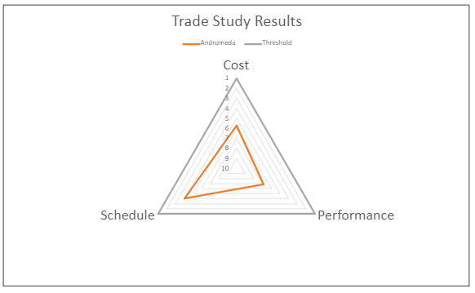
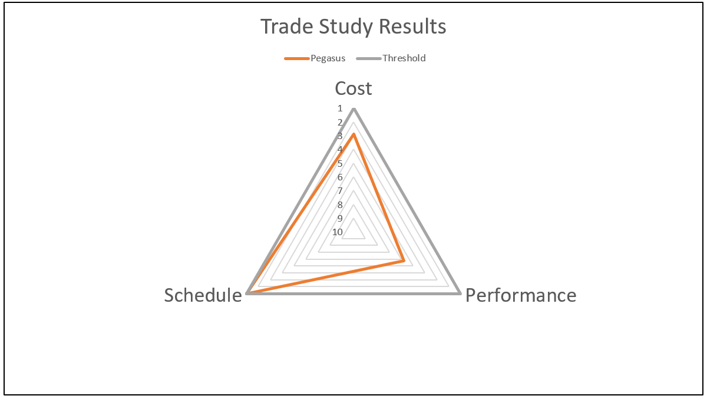
Trade Study Results
Draco
Capricornus
Andromeda
Pegasus
Notes:
Sann:
Cost threshold here is using AFSOC's budget, not the president's

Slide 29
Systems Engineering
 | Draco | Capricornus | Andromeda | Pegasus
Laser Subsystem | KOI TRL 6 | Kale TRL 6 | KOI TRL 6 | Kale v3 TRL 6
Tracking Subsystem | APQ-74D TRL 4 | APQ-74D TRL 4 | APQ-75 TRL 4 | APQ-74B TRL 7
Comm Subsystem | AN/ARC-600B TRL 9 | AN/ARC-500 TRL 9 | AN/ARC-600 TRL 6 | AN/ARC-600 TRL 6
Overall System | TRL 4 | TRL 4 | TRL 4 | TRL 6
Notes:
29
Anjie:

Slide 30
Systems Engineering
Which Technical Performance Measures (TPMs) will you track at the program level?
Beam Divergence
Directly correlates with Probability of Kill KPP
Sensor Sensitivity
Directly correlates with Maximum Effective Range KPP
Contractor will test the systems and we will add CDRLs to the requirement to track them
Notes:
30
Dawson:

Slide 31
Systems Engineering
Identify who will define and manage interfaces
Internal interfaces
Laser to Tracking – contractor-managed
Tracking to Comm – contractor-managed
Comm to Laser – contractor-managed
External interfaces (e.g. TLAS to JSTARS, etc.)
Government-managed
What process are you going to use to manage interfaces (meetings, documents)?
Interface Control Working Group
Interface Control Document
Notes:
31
Sann:
Determine if the program will pay the contractor to design and develop internal and/or external interfaces. Alternatively, the government could dictate the interface specifications that the contract needs to develop to. You don’t have to give any specific contractor or government names. We just want to know if the “contractor” or “government” is defining/managing the interface. Be prepared to explain why one or the other was chosen.

Slide 32
Systems Engineering
Which Technical Reviews will you use and when they will take place?
Critical Design Review (CDR) - ensure documentation is adequate to begin production of initial test articles
Functional Configuration Audit - ensure and verify that actual performance of system meets that requirements stated
Physical Configuration Audit – compare actual physical configuration to requirements
What major test event will verify that the requirements has been met?
DT&E: verifies that the system complies with engineering requirements and specifications
Which major test event will validate that the customer’s capability gap has been closed?
OT&E: validates that the system meets the needs of the stakeholders
Notes:
32
Jeff:
Tech Reviews: In addition to CDR, choose at least two other post-Milestone B technical reviews. Explain what the CDR and the other two reviews are for. Ensure they all appear in the schedule slide (slide 11). Read the Tech Review email to get an idea of some of the common government technical reviews.
FCA: Functional Configuration Audit. Demonstrates that Engineering and Manufacturing Development product is sufficiently mature for entrance into LRIP.
PCA: Physical Configuration Audit. Conducted around FRP decision and confirms that the manufacturing processes, quality control system, measurement, and test equipment, and training are adequately planned, tracked, and controlled

Slide 33
Test & Evaluation Concept
Program Scope: USAF/Joint Service
Lead DT&E Organization: 96th Test Wing
Operational Test Agency: AFOTEC
Joint Interoperability Testing:
Is it required? Yes
Who will participate? JITC, PM, CDT, PTO ALC & Contractor
Special tester: JITC
Test Assets: What kinds of assets, range space, etc.
Eglin Gulf Test Range
Mission Support Aircraft
Range Instrumentation
Short Range Ballistic Missiles
Live Fire Test & Evaluation (LFT&E) required? Yes!
Notes:
33
Anjie:

Slide 34
Contract Type
Contract Type for EMD
Contract Type: CPIF
Cost Share Ratio (Gov/Ctr): 70/30
Incentives considered:
Performance
Pk: $500k for every .05 over 0.75, max $2M
Effective Range: $300K for every 5NM above 20NM, max $1.8M
Simultaneous Tracking: $200K for every additional target after 3, max $1.4M
Contract Type for LRIP
Contract Type : FPIF
Cost Share Ratio (Gov/Ctr): 30/70
Contract Type for FRP
Contract Type: FFP
Notes:
34
Sann:
For incentives: PK top priority
Highest risk in EMD. Lower risk in LRIP, then fairly low risk in FRP

Slide 35
Product Support Strategy
Configuration | Reliability (hrs) MTBF | Maintainability (hrs) MTTR | Availability A_{i}
Draco | 29 | 8 | .78
Capricornus | 28 | 11 | .71
Andromeda | 32 | 8 | .80
Pegasus | 26 | 10 | .72
Notes:
35
Dawson: Threshold is 0.7
Numbers provided from cost break down

Slide 36
Product Support Strategy
Performance Based Logistics for T-LAS systems
Operational Availability: Target 62%
Turnaround Time: 2 days
Depot Maintenance Concept for T-LAS systems
Laser Subsystem - Contractor
Comm Subsystem - Organic
Tracking Subsystem - Interim Contractor Support
Intermediate-Level Support for T-LAS systems
Laser Subsystem - Interim Contractor Support
Comm Subsystem - Organic
Tracking Subsystem - Interim Contractor Support
Organizational-Level Support for T-LAS systems
Laser Subsystem - Interim Contractor Support
Comm Subsystem - Organic
Tracking Subsystem - Organic
Notes:
36
Dawson:

Slide 37
Summary
T-LAS Recommendation
Approve Acquisition Strategy and RFP Release
Will we have competition? Yes!
Do we have too much risk to proceed into EMD? No.
Is technology maturation sufficient? Except tracking system, all systems are at TRL 6 and we can say technology maturation is sufficient
Are the user’s constraints defined and understood? Yes!
Sign Acquisition Decision Memorandum
Notes:
Jeff:
You did it! Not really… there is one more slide after this.
The questions on this slide are not rhetorical. We expect you to answer them.

Slide 38
Lessons Learned
What did the team learn during this exercise?
Dawson is a master multi-tasker.
Anjanette dominates slides.
Sann is a sushi expert.
Jeff is team dad
What did you learn from the class?
The complexities from start to finish of a new military system. (what info is needed, how many different organizations are needed, etc.)
Which foundational competencies were reinforced during the course? Resource Management! Asking others for help
Notes:
This slide will NOT be briefed during the ASP presentation, but you are still required to fill it out before submitting the presentation in Canvas.
You will brief this slide during the T-LAS De-Brief which typically happens the last day of class after quiz 3. Be ready to describe/explain your lessons learned to the rest of the class.

