Slide 1

Dawson Brookes – Capstone One Presentation - Analyzing the Global Threat of Terrorism

Slide 2
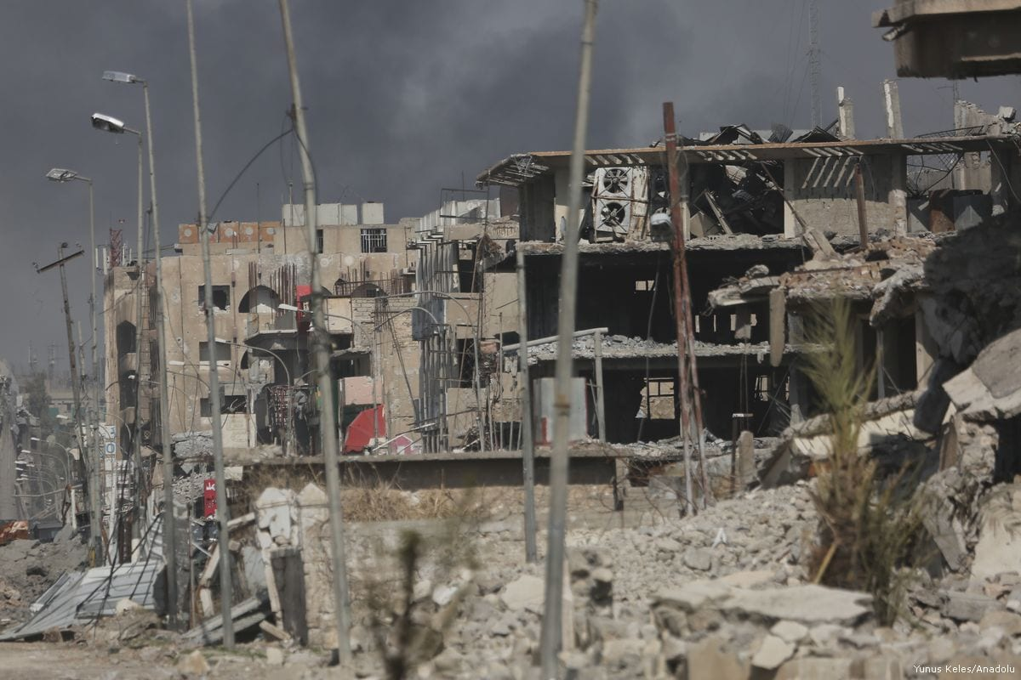
Terrorism has become a major global concern with devastating consequences for both individuals and society as a whole
What is the overall trend of terrorist attacks from 1970 t0 2017- Did attacks increase or decrease?
What Countries are most affected by terrorism. Are there hotspots or clusters of attacks?
What are the types of methods and weapons mostly used in terrorist attacks?
What are the most common types of attacks and targets?
What is the impact of terrorist attacks on life, are there differences in the impact based on the type of attack or target?

Slide 3
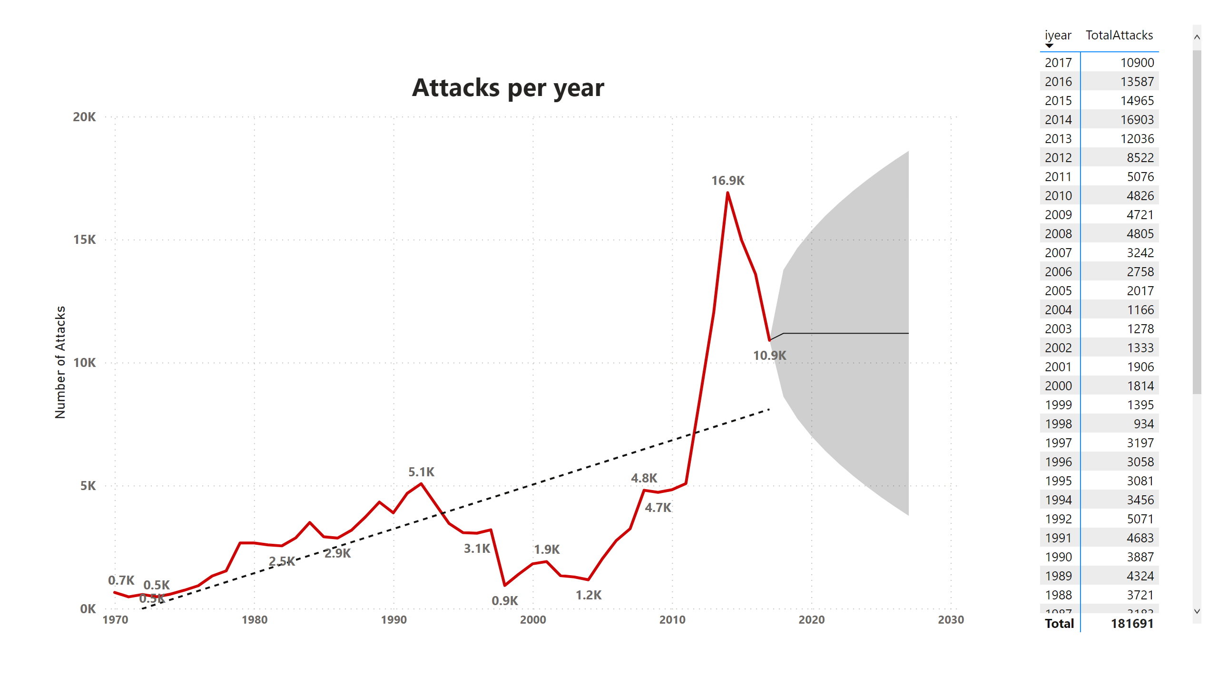
Trend of attacks over time
Notes:
I utilized time series analysis, a statistical method for analyzing and modeling time-dependent data, to create a line graph showing the trend of the number of attacks over time and forecasting future trends. From our analysis, we observed that the number of attacks has significantly increased over time, with 2014 recording the highest number of attacks at 16,903 since 1970, when the number of attacks was 651. Additionally, we added a trendline to the line graph, which allowed us to visualize the overall pattern of the data and identify any long-term trends or patterns. The trendline shows a clear upward trend in the number of attacks over time, indicating that the frequency of attacks has been increasing steadily. However, we can expect the number of attacks to remain in the five-digit range in the future, given the total number of attacks from 1970 to 2018 is 181,691.

Slide 4
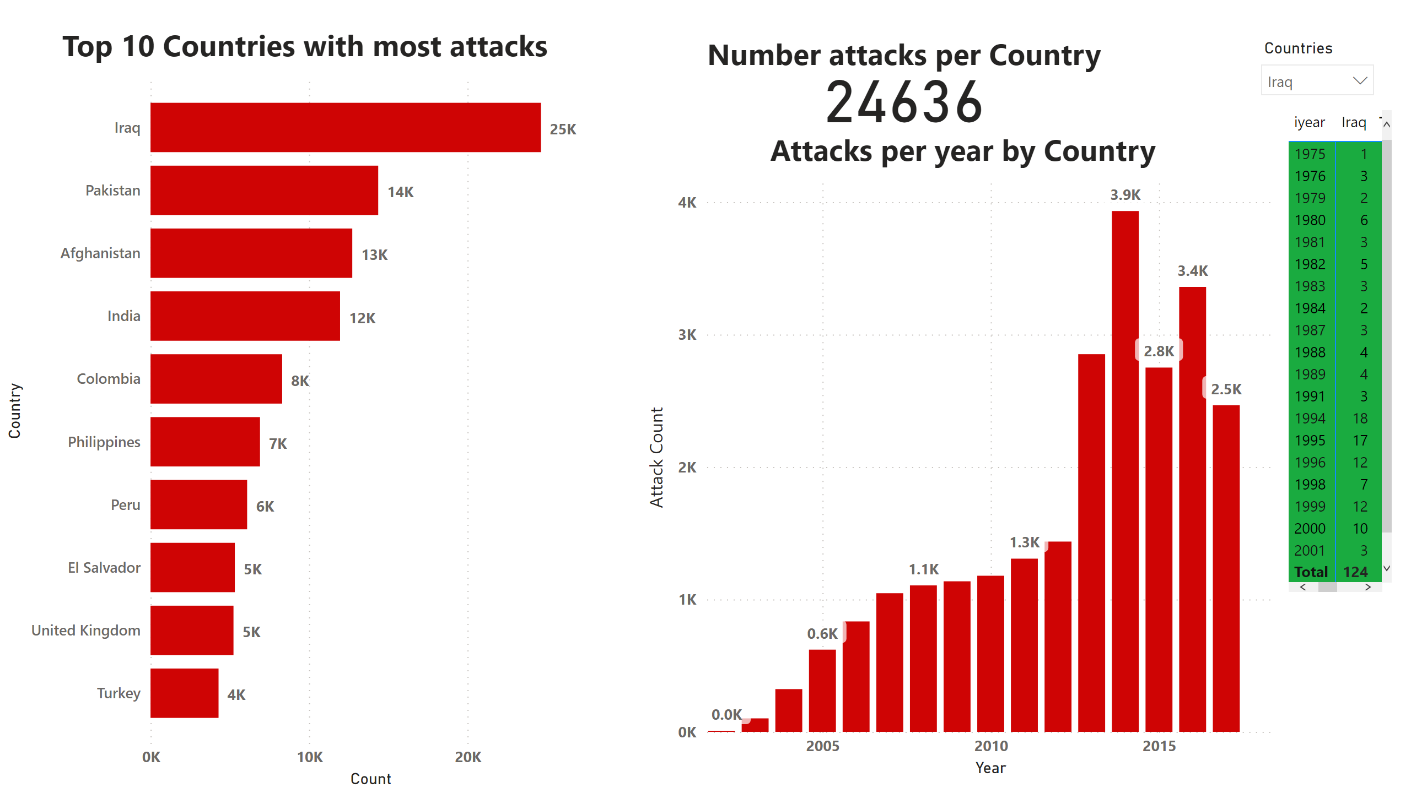
Attacks by Country
Notes:
I created a stacked bar chart using descriptive statistics to show the top ten countries that have experienced the most terrorist attacks. Iraq had the most attacks, with a significant increase after the US invasion in 2003. Pakistan, Afghanistan, India, and Colombia joined Iraq as top contenders also indicating. The top ten countries accounted for 54% of the overall attacks, emphasizing their significance in the global context of terrorism. This provides us with a good insight as to where the distribution of terrorist attacks and can help policymakers and security professionals develop more effective strategies to prevent and respond to terrorist threats.

Slide 5
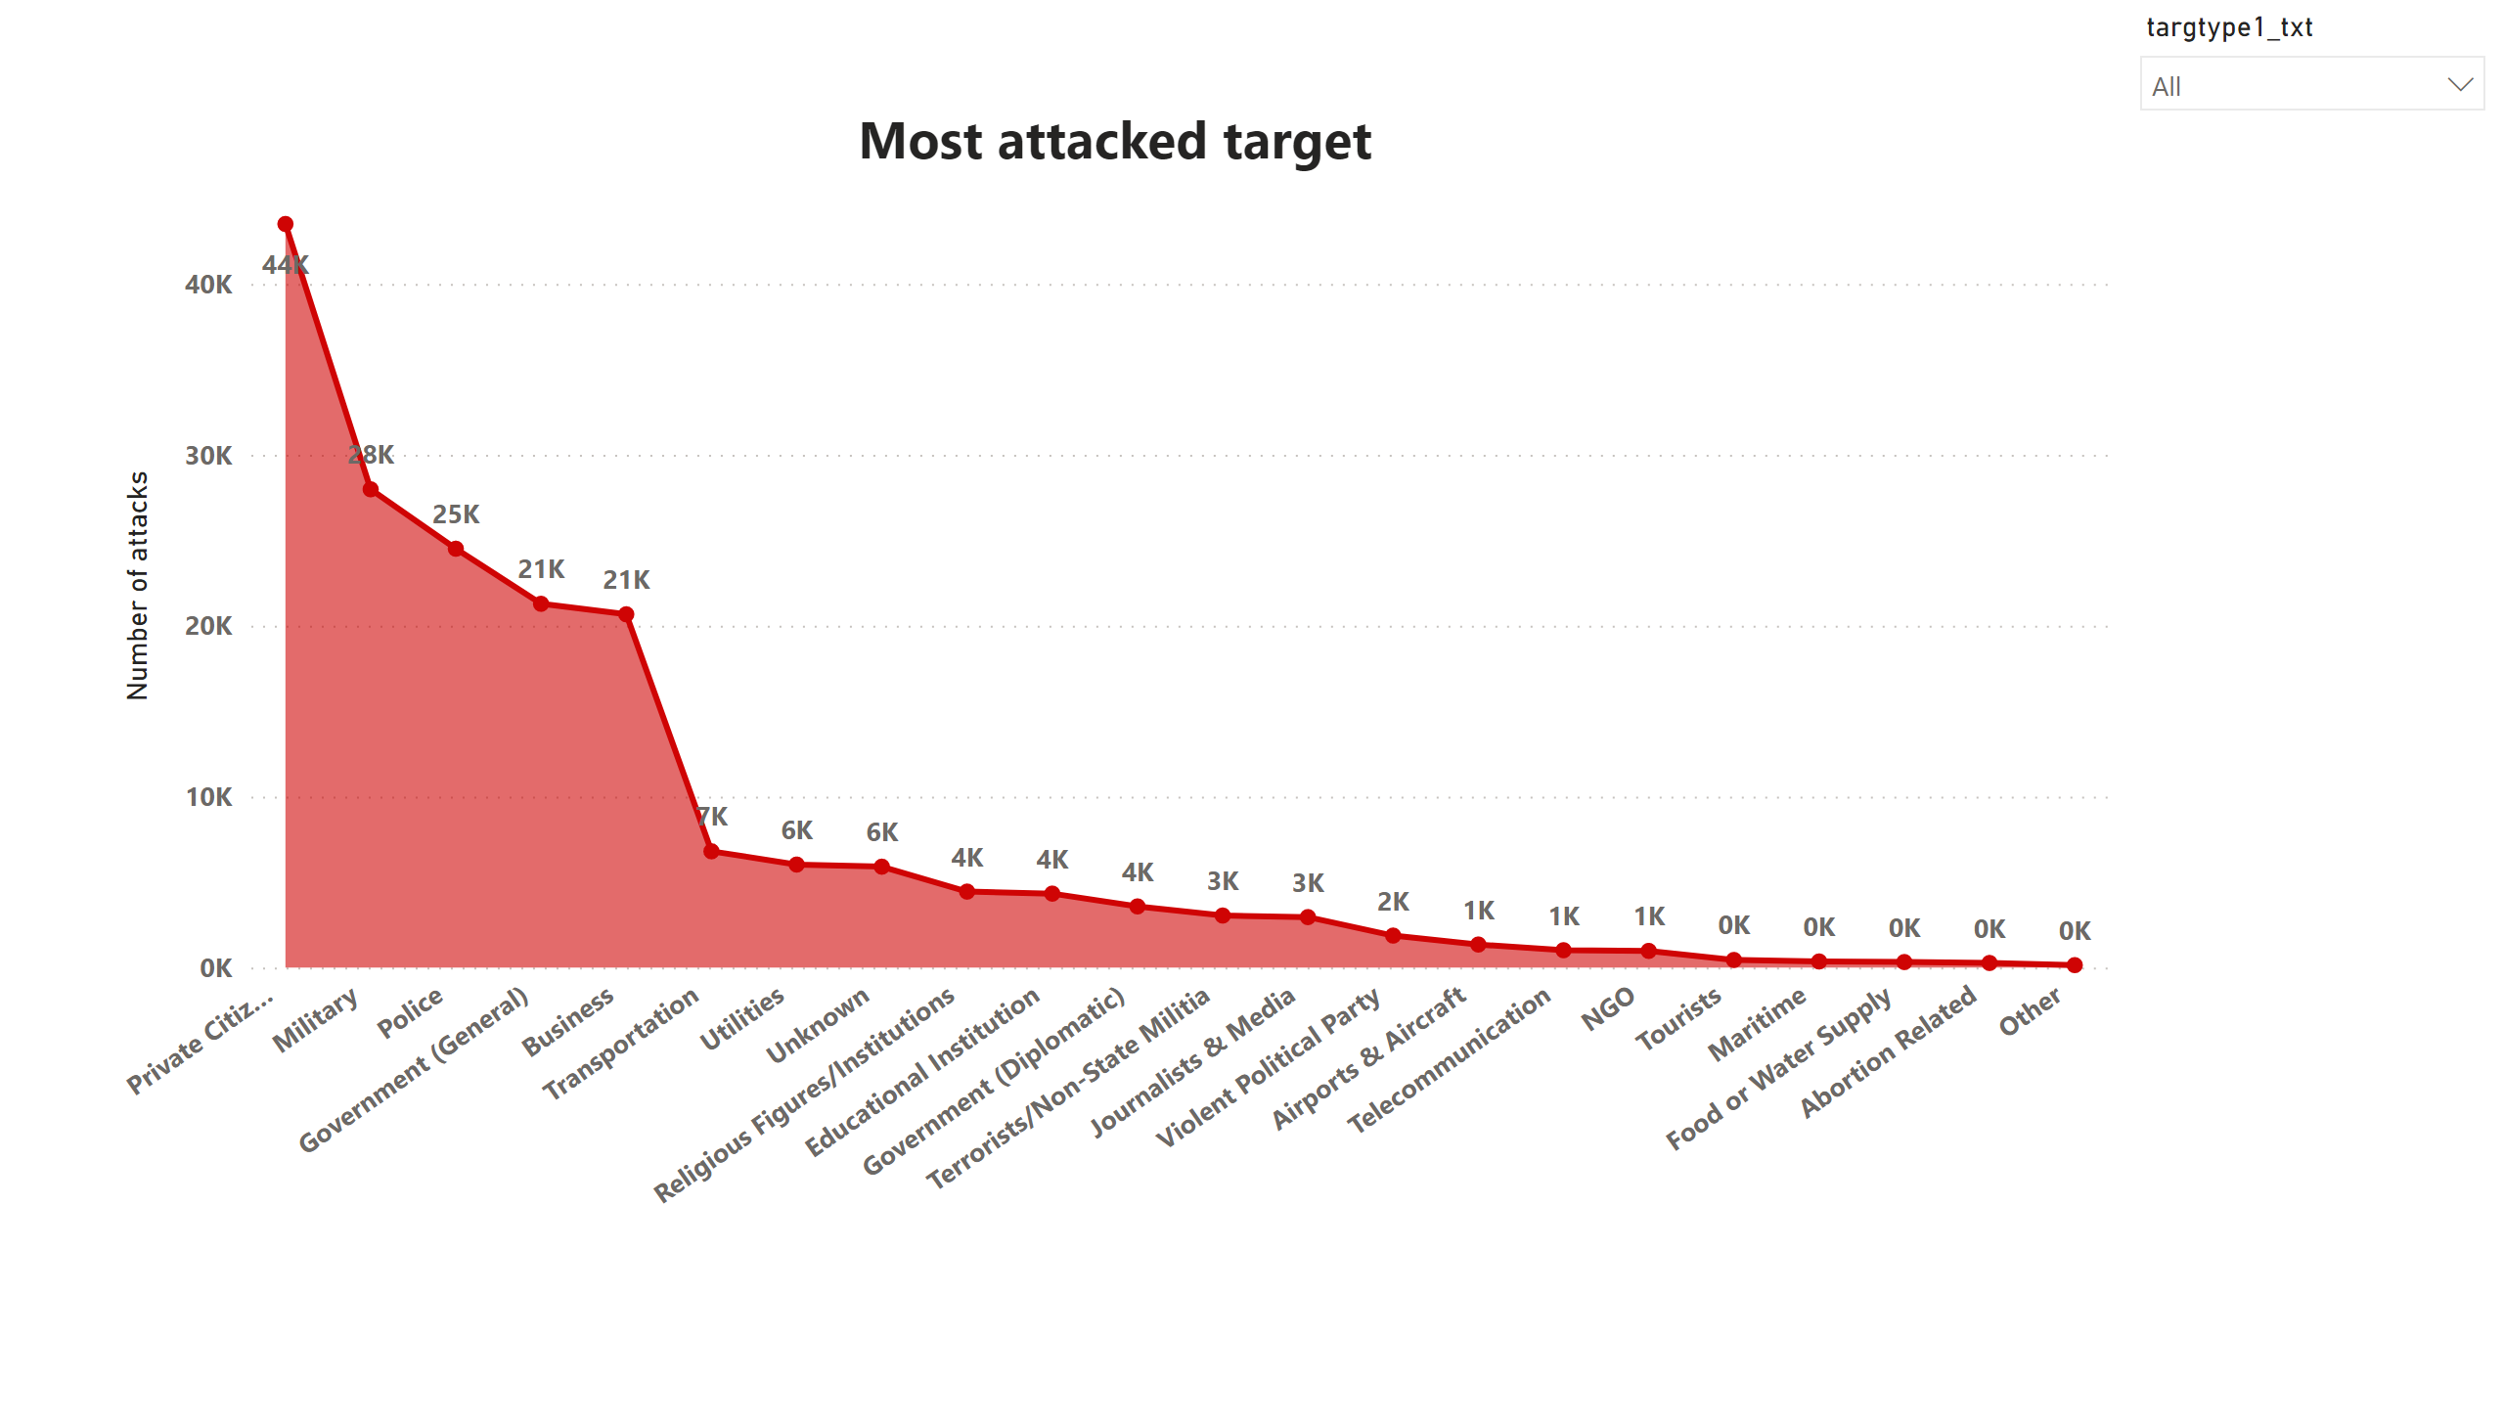
Target Type per Attacks
Notes:
Private citizens, Military, Police, Government and Businesses were the most attacked targets. These made up almost 75% of targeted attacks, targets reasons such as Symbolism – Visibility - Strategic Importance – Retaliation – Ideology, are often the reason they these groups are targeted . It is important to note that the motivations and tactics of terrorist groups can be complex and multifaceted, and may vary widely depending on the group, the context, and the specific circumstances of the attack.

Slide 6
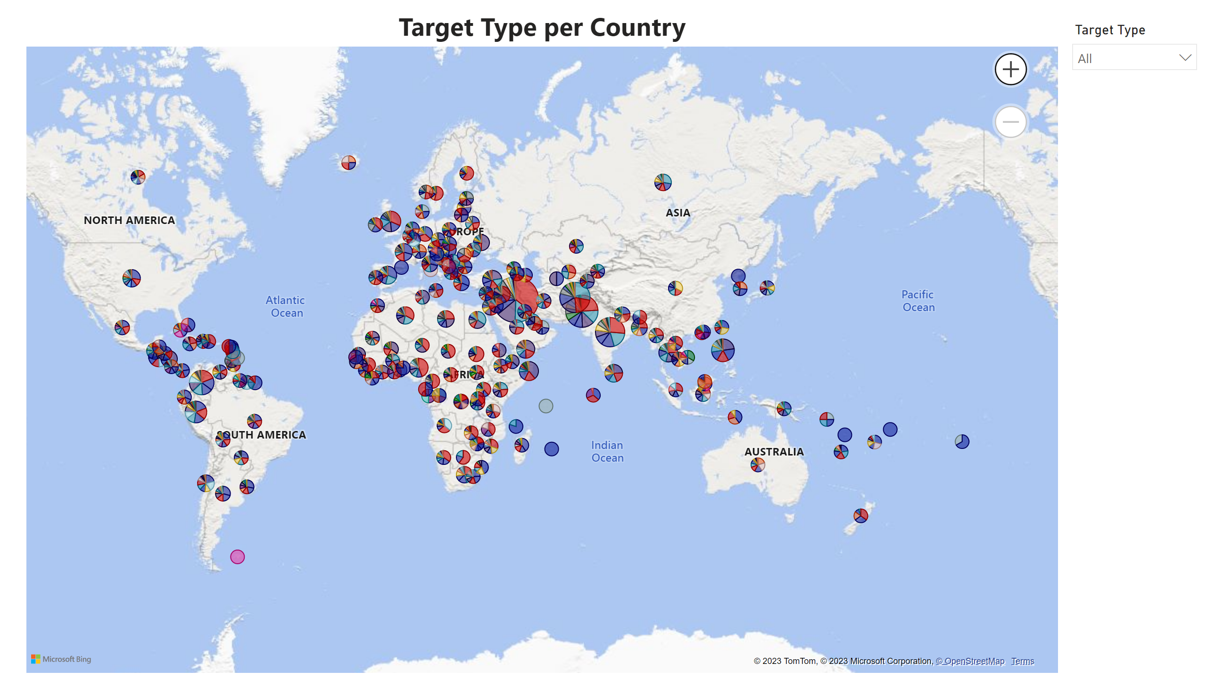
Map of attacks
Notes:
World map data shows most attacks were centered around the middle east and Africa area, with Europe and South America just behind – Data also showed United Kingdom had the most attacks in Europe with Abortion related attacks as the main attacks in the US

Slide 7
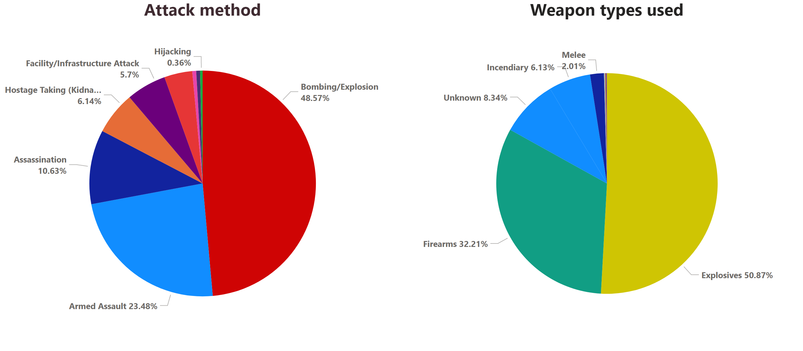
Attack methods used
Notes:
My analysis of terrorist attacks using descriptive statistics and pie charts revealed that explosives are the most used weapon, accounting for 51% of attacks. Bombs were the most common attack method, accounting for 49% of all attacks. The widespread use of explosives in attacks poses a significant threat to public safety and security and requires a comprehensive response from governments and law enforcement agencies

Slide 8
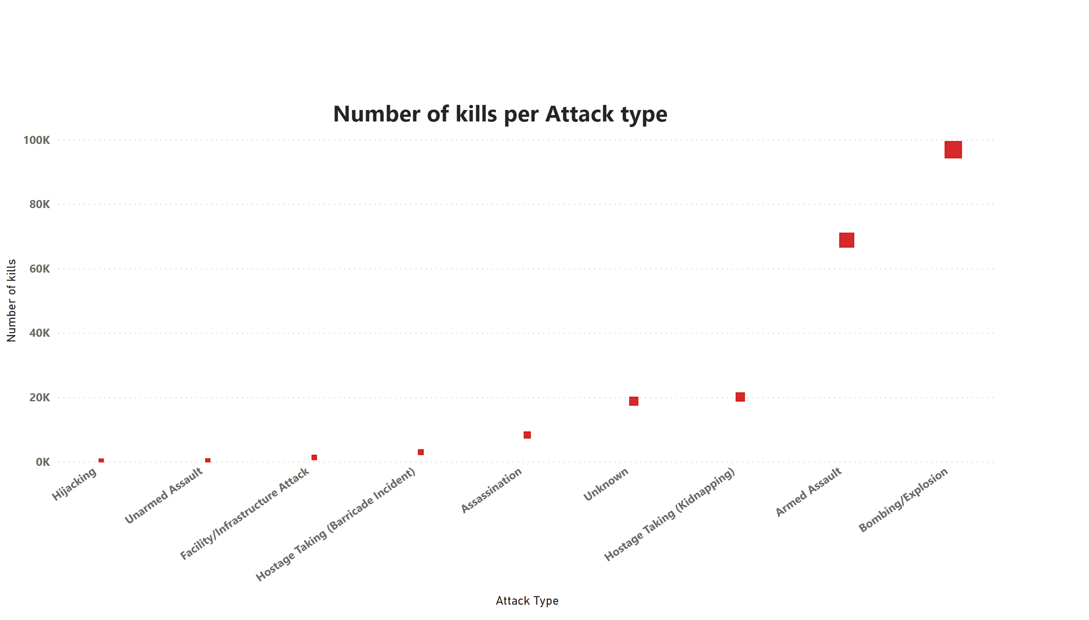
Number of kills per attack type
Notes:
The analysis, which utilized a scatter plot and statistical data, revealed a clear correlation between the method of killing used and the number of lives lost. Bombing and explosions resulted in the deaths of 97,000 people, while armed assault led to the loss of 69,000 lives. This indicates that the more violent the methods are, the higher number of fatalities. Inferential statistics that analyzes the relationship between two variables: type of attack (independent variable) and the number of killings (dependent variable was utilized to show some correlation In this case, as the attack method changes from armed assault to bombing, the number of killings tends to increase, representing a positive correlation. Overall, these findings emphasize the importance of addressing the root causes of conflicts and seeking peaceful solutions to prevent the loss of lives caused by violent methods."

Slide 9
Conclusions:
Terrorist attacks has significantly increased over time, with 2014 recording the highest number of attacks since 1970.
The trendline indicates a clear upward trend in the frequency of attacks.
We recommend that policymakers address the root causes of terrorism and implement effective counterterrorism measures while promoting tolerance and international cooperation.

Slide 10
Iraq had the highest number of terrorist attacks, followed by Pakistan, Afghanistan, India, and Colombia.
The top ten countries accounted for over half of the overall attacks, highlighting their significance in the global context of terrorism.
As a recommendation, policymakers and security professionals can prioritize the development and implementation of effective counterterrorism strategies in the top ten countries to prevent and respond to terrorist threats.
This may involve addressing the underlying factors that contribute to terrorism, such as political instability, religious extremism, and social inequality. Continuing history of conflict and instability, have also created conditions that are conducive to the emergence and proliferation of terrorist groups. Additionally, factors such as poverty, corruption, and weak governance may also contribute to the prevalence of terrorism in these regions. Therefore, addressing these underlying issues can play a crucial role in preventing and mitigating terrorist attacks

Slide 11
Private citizens, military, police, government, and businesses were the most targeted groups, accounting for almost 75% of all targeted attacks.
Symbolism, visibility, strategic importance, retaliation, and ideology were the most common reasons why these groups were targeted.
Policymakers, security professionals, and businesses should prioritize the protection of these vulnerable groups and address the root causes of terrorism.
International cooperation and information sharing are crucial in preventing and responding to terrorist attacks, as many terrorist groups operate across borders and pose a global threat.

Slide 12
The Middle East and Africa had the highest number of attacks.
The United Kingdom had the most attacks in Europe, and abortion-related attacks were the main attacks in the US.
Explosives were the most used weapon in terrorist attacks, with bombs being the most common attack method.
The widespread use of explosives in terrorist attacks could be their availability and relative ease of use. Explosives are readily accessible and can be made using relatively simple ingredients, making them an attractive weapon for terrorist groups with limited resources. Additionally, the high level of damage that can be inflicted by explosives makes them an effective tool for instilling fear and causing significant harm to civilians and property.

Slide 13
There is a clear correlation between the method of killing used and the number of lives lost.
Bombing and explosions resulted in the highest number of fatalities, followed by armed assault.
The more violent the methods used, the higher the number of fatalities.
As a suggestion, policymakers and security professionals should prioritize the use of non-violent and peaceful methods to address conflicts and prevent the loss of lives caused by terrorist attacks. This may involve addressing the root causes of conflicts, such as political instability, social inequality, and religious extremism, and promoting dialogue, tolerance, and understanding among different groups.
Additionally, governments and law enforcement agencies can prioritize counterterrorism efforts that address the widespread use of violent methods in attacks by implementing comprehensive strategies that include intelligence gathering, disruption of supply chains, and coordination among law enforcement agencies.

Slide 14

Sources
"Global Terrorism Database- Full Data File 1970-2017, July 2018 Released".
(https://www.kaggle.com/datasets/START-UMD/gtd

Slide 15
Questions?

