Slide 1

Dds-Analytics CASE STUDY 2
DAWSON

Slide 2
Overview
DDSAnalytics: Specializes in talent management solutions for Fortune 100 companies.
Talent management is defined as the iterative process of developing and retaining employees.
Task: Predict employee turnover
Perform EDA of existing employee data.
Provide Job Role insights
Identify Top 3 Contributors & Predict Attrition (Sensitivity & Specificity > 66%)
Predict Monthly Salary (RMSE < $3000)

Slide 3
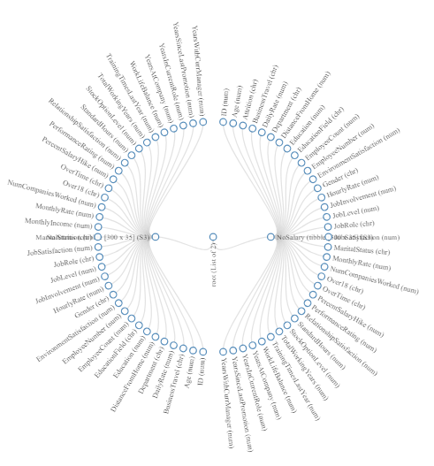
Data
41% Missing Attrition & Salary
Rows | 1,470
Variables | 41
Discrete Variables | 15
Continuous Variables | 26
All missing Variables | -
Total missing values | 900
Complete rows | 870
Total observations | 60,270
Memory usage (kb) | 424,008

Slide 4
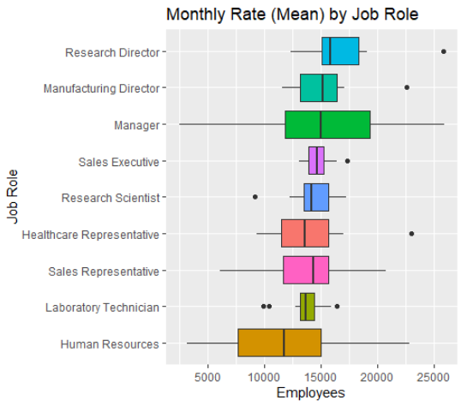
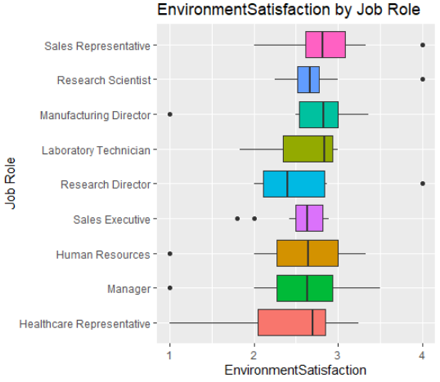
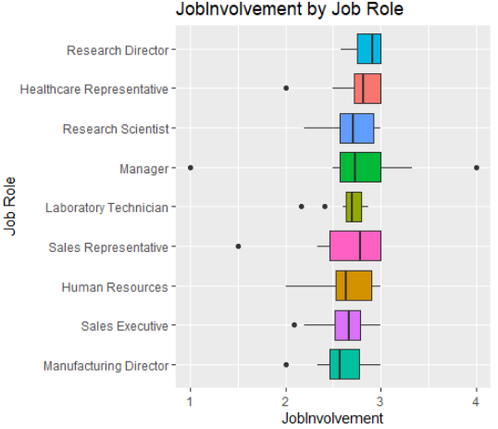
EDA: Job Role
Over 50% of Monthly Salary Expenditure R&D
Negative impact on Attrition
Work Life Balance (Level 4)
Job Involvement & Satisfaction: Managers, HR, & Sales Exec
Low pah by position correlates

Slide 5
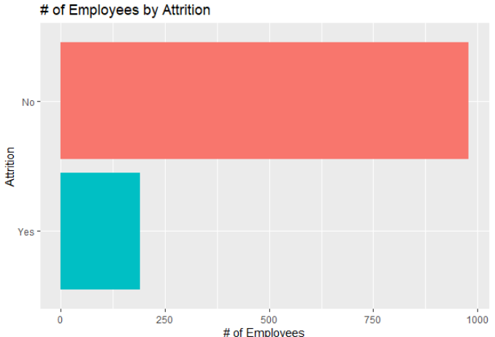
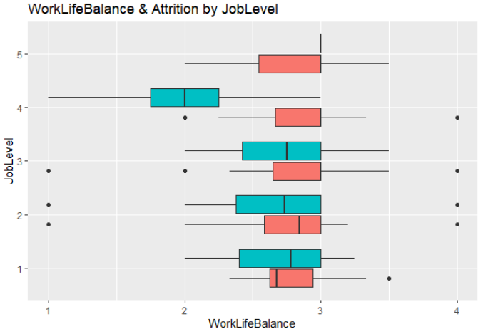
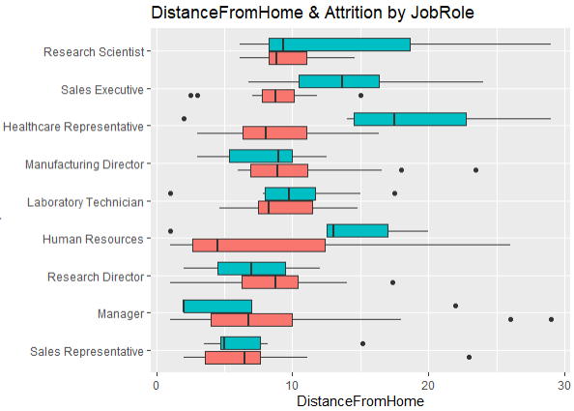
EDA: Job Role
18% Attrition Rate Overall
Work Life Balance affects Attrition drastically for Job Level 4 and nominally expected across others, except for Job levels 5 & 1
Distance from home is positively correlated with Attrition except for Job Levels > 4, which have the opposite effect

Slide 6
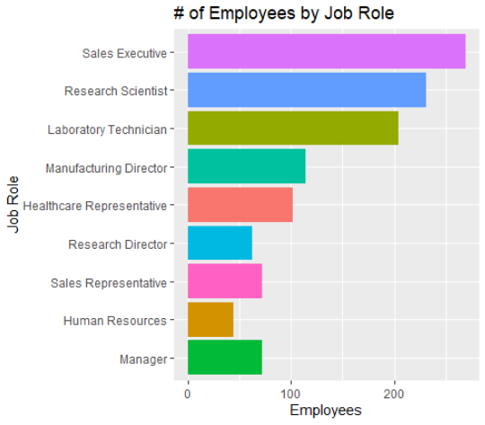
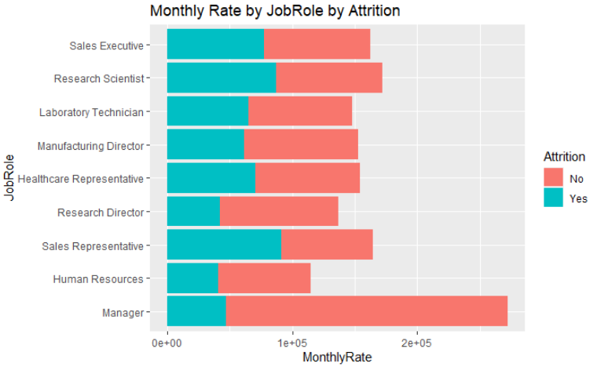
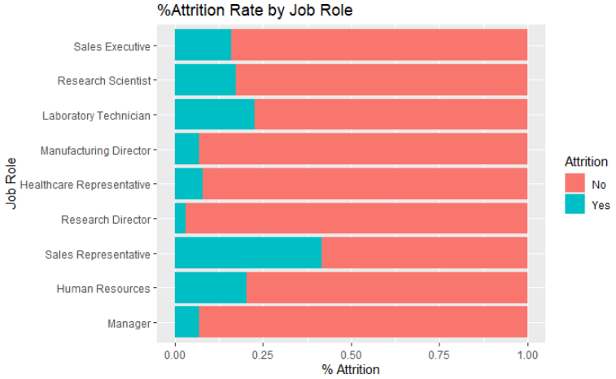
EDA: Job Role
1/4th Employees are in Sales & Highest Rate of Attrition
Over 50% of Monthly Rate R&D Department
Managers, HR, and Research Directors have High Attrition rate @ lower pay for the Role; while slightly higher pay is correlated for Sales Rep.s

Slide 7
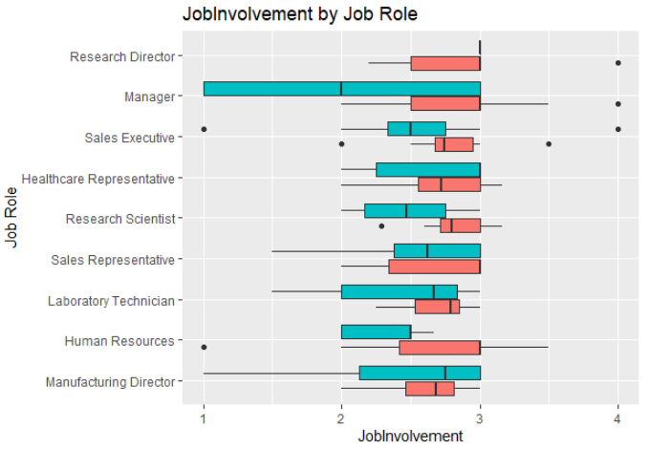
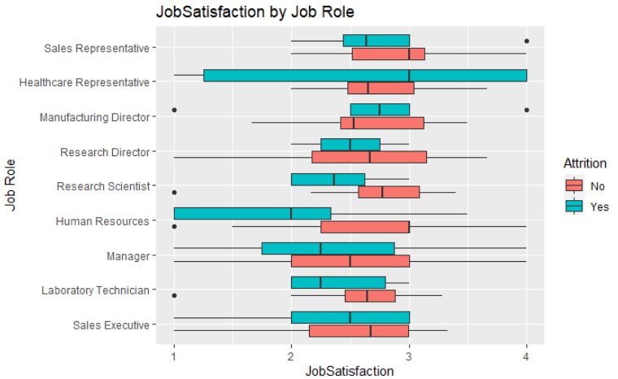
EDA: Job Role
Sales Executives & Healthcare Reps have the lowest median Job involvement, while Directors and Lab Technicians have the highest.
Job Satisfaction is lowest amongst Managers and affects attrition drastically in addition to those in Sales.

Slide 8
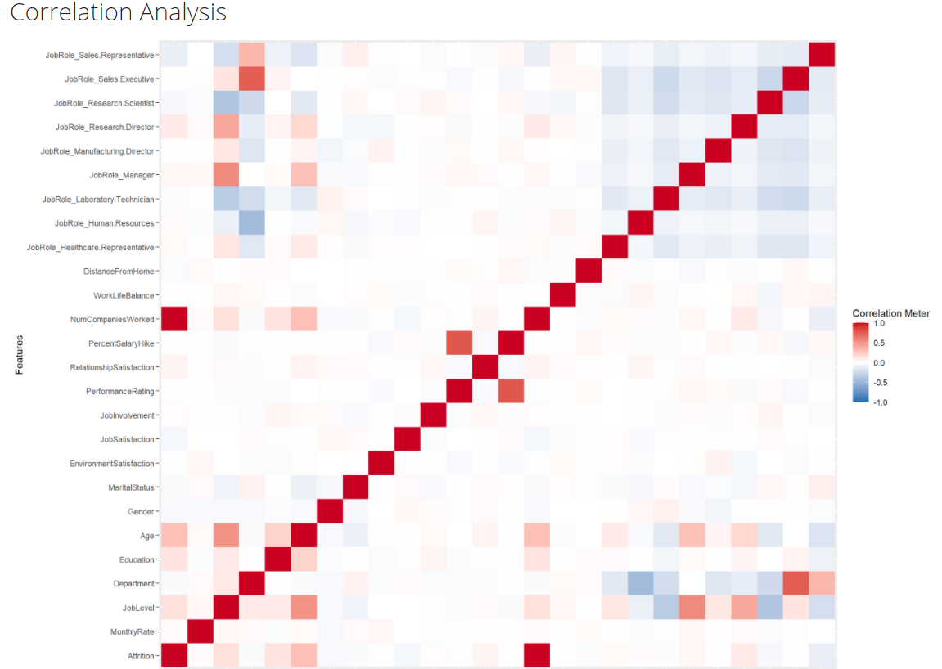
Attrition (Knn)
Top 3 Factors
Monthly Income (-0.198619642)
Job Involvement (-0.187793409)
Total Working Years (-0.167206122)
Model
Job Role
Department (Sales)
Distance From Home
Job Satisfaction
Marital Status

Slide 9
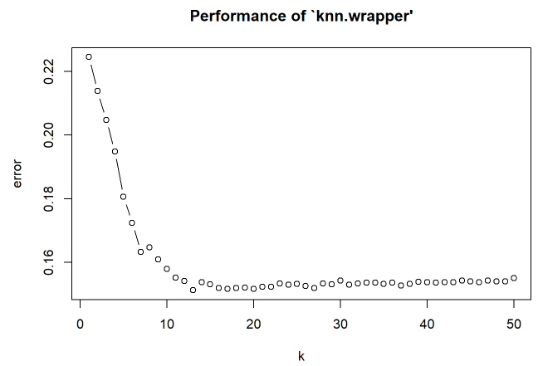
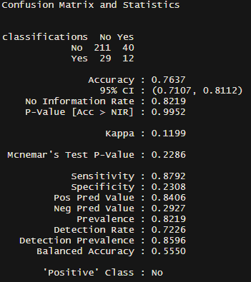

Attrition (Knn)
Based on 2 Groups – Nearest Neighbor Classification
Sensitivity 88%
Specificity 23%
Factors:
WorkLifeBalance
JobInvolvement
MaritalStatus
DistanceFromHome
OverTime
LogAge
LogYearsWithCurrManager
LogJobLevel
PerformanceRating
EducationField
NumCompaniesWorked
Attrition

Slide 10
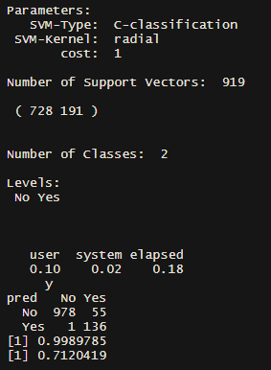
Attrition (Svm)
Support Vector Machines: Type of Non-Linear Classification using distance calculations and Regression Modeling combined
Sensitivity 99%
Specificity 71%

Slide 11
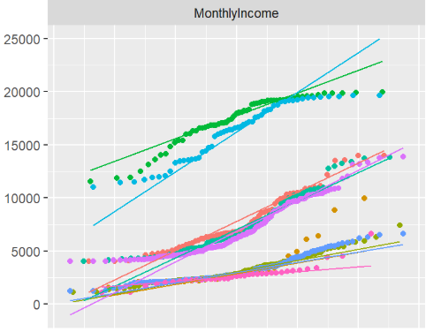
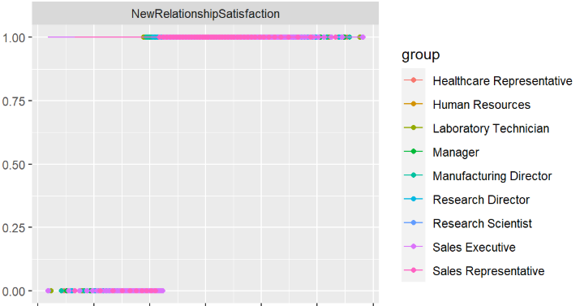
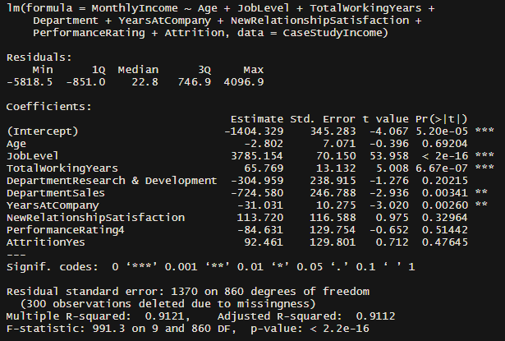
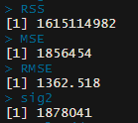
Salary (mlr)
Most influential factors:
Job Level
Total Working Years
Years At the Company
Department (Sales)
Explaining Variance
Relationship Satisfaction
Performance Rating
Results
Statistically Significant & Good Fit (p-value <2.2e⁻¹⁶ & R² = 91%)

Slide 12
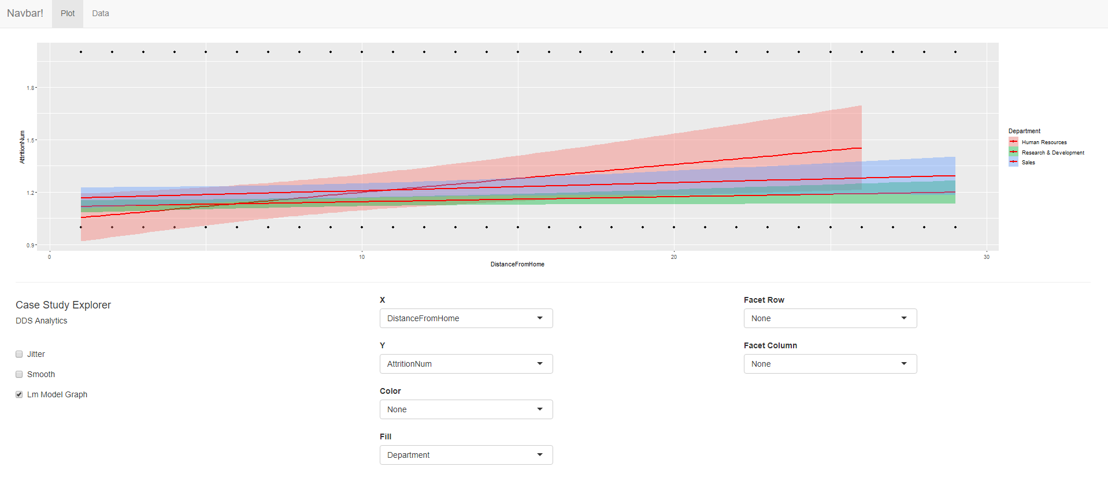
R-Shiny EDA
https://dawson-data-science.shinyapps.io/DDSCaseStudy2/
GITHUB: https://github.com/dawsond-smu/Analytics/tree/master/DDSAnalytics

Slide 13
Conclusion
Explore the disparities:
Attrition across Sales Department
Monthly Salaries within Management & HR are strong indicators of Attrition
Job Satisfaction is a good indicator of possible Attrition
Take a good look further at Marital Status
Neural Network with XGBoost would be slower, but more Specific as tool for classification

