Slide 1
BEACON OF HOPE FOUNDATION
Restoring Hope, Rebuilding Lives
Technology for a nonprofit protecting survivors of abuse and trafficking
Presented by Team Beacon • April 2026

Slide 2
What We'll Cover
1
Speaker A
4 min
The Mission & the Problems
2
Speaker B
5 min
The Platform & Live Demo
3
Speaker C
7 min
Machine Learning Deep Dive
4
Speaker D
4 min
Security & Closing

Slide 3
THE MISSION
Protect and rehabilitate girls who are survivors of abuse and trafficking.
Beacon of Hope operates safe homes across Guam, funded entirely by donations. A small team manages multiple safehouses, counseling, education, health services, and reintegration, all for the most vulnerable population imaginable.
Everything we built serves this mission.

Slide 4
PROBLEM 1
Girls Are Falling Through the Cracks
Staff don’t know who is progressing and who is being ignored
No insight into which interventions are actually working
Can’t tell when a resident is ready for reintegration, or being moved too soon
With limited staff across multiple safehouses, there is no system to track the full journey from intake to reintegration.

Slide 5
PROBLEM 2
Donors Are Drifting Away
Don’t know which donors are at risk of lapsing
No way to stay top of mind when donors are ready to give again
No way to show donors the specific impact of their giving
The organization depends entirely on donations to operate. Losing donors without understanding why is an existential threat.

Slide 6
PROBLEM 3
Social Media Isn’t Working
Efforts aren’t effective
No bandwidth to do it at all
They post, but don’t know what content or timing actually drives donations vs. just getting likes.
The team has no marketer. Writing posts, designing graphics, and scheduling takes time they don’t have.
Social media is their primary way to reach donors, but both the strategy and the execution are broken.

Slide 7
PROBLEM 4
A Small Team with Sensitive Data
Non-technical staff, no IT support
Data involves at-risk minors
The system has to be intuitive enough that safehouse staff can use it every day without training or a help desk.
A data leak means physical danger for abuse survivors. Security isn’t a feature. It’s a safety requirement.
We built a platform that’s both powerful enough for complex case management and simple enough for non-technical daily use.

Slide 8
OUR APPROACH
Every Problem Mapped to a Solution
Girls falling through cracks
→
Full-stack workflow engine + ML readiness & risk models
Donors drifting away
→
Churn prediction + fund allocation tracking
Social media not effective
→
Content & timing optimization ML pipelines
No bandwidth for outreach
→
AI social media agent + auto-newsletter
Small team, sensitive data
→
Natural-language chatbot + intuitive UX + RBAC, CSP, GDPR

Slide 9
ARCHITECTURE
How It All Connects
React 19 SPA
TypeScript • Vite • Vercel CDN
▼
.NET 10 Backend
AI Harness
◀▶
Minimal APIs • EF Core • Identity • Azure App Service
FastAPI • GPT-4o • Agentic Loops • NL-to-SQL Chatbot • Azure
▼
▼
▼
reads
Azure Blob
Azure PostgreSQL
SECURITY & CI/CD
Photos • Graphics
49 tables • The shared data hub for everything
3 GitHub Actions workflows HTTPS/TLS everywhere CSP • HSTS • RBAC • CORS Cookie auth • Account lockout Staff scoped to safehouses
▲
writes predictions
ML Pipeline • Python • 8 models • GitHub Actions nightly at 3 AM

Slide 10
THE PLATFORM
A Workflow Engine, Not a Database
Trauma Occurs
Referral
Intake & Admission
Residential Care
Reintegration Assessment
Pathways & Placement
Post-Care & Closure
→
→
→
→
→
→
↑ ML
↑ ML
Incident prediction
Readiness scoring
This isn’t a record-keeping system.
It guides staff through every step of the care lifecycle, from the moment a girl is referred to the day she’s safely reintegrated and beyond.
Automated todo items, calendar events, recurring check-ins, and ML predictions embedded at the moments that matter most.

Slide 11
DAILY OPERATIONS
What Staff See Every Day
Education
Health
Counseling
Enrollment, grade tracking, tutoring schedules
Medical records, appointments, medication tracking
Session notes, voice transcription, goals
Incidents
Visitation
Conferences
Reporting, ML risk alerts, follow-up workflows
Scheduling, consent, supervision logs
Case reviews, ML-flagged agenda items, outcomes
Every track generates automated todos. Staff can also ask the AI chatbot questions about their data in plain English.

Slide 12
THE PLATFORM
Ask Your Data Anything
Staff type plain English. The AI returns answers, tables, and charts.
Plain English Question
→
Vanna AI + OpenAI
→
Secure SQL Generation
→
PostgreSQL (read-only)
→
Answer + Chart
Least-Privilege
Auto-Visualization
Zero SQL Required
Staff only see their assigned safehouses
Bar charts, line graphs, and tables on demand
Built for a team with no IT support
Vanna AI • OpenAI • FastAPI microservice • 49 tables • Read-only connection • Deployed on Azure

Slide 13
DONOR NURTURING
The AI Social Media Manager
1
2
3
4
5
→
→
→
→
Capture
Generate
Approve
Schedule
Publish
Staff snap photos throughout the week
LLM drafts posts from org-level data
Staff reviews and approves drafts
ML picks the optimal timing
Auto-posted to social platforms
Staff only touches two steps: snap a photo and approve a draft.
Uses only org-level data, never resident records.
No-photo posts get auto-generated branded graphics.
GPT-4o with agentic tool-use loops • Content pillars balanced automatically • Consent required for every photo

Slide 14
DONOR NURTURING
Automated Monthly Newsletter
Engage Current Donors
Nurture Potential Donors
Stays top of mind so donors give again when they’re ready. Monthly updates show real impact and fund allocation, without ever revealing resident data.
Prospective supporters who’ve shown interest get a tailored drip of content that builds trust, educates, and ultimately converts them into real donors.
Social media brings them in. The newsletter keeps them engaged.
Together with ML-driven churn prediction, the entire donor lifecycle is automated, from first awareness to long-term retention.

Slide 15
LIVE DEMO
Public Site → Admin Portal → ML in Action

Slide 16
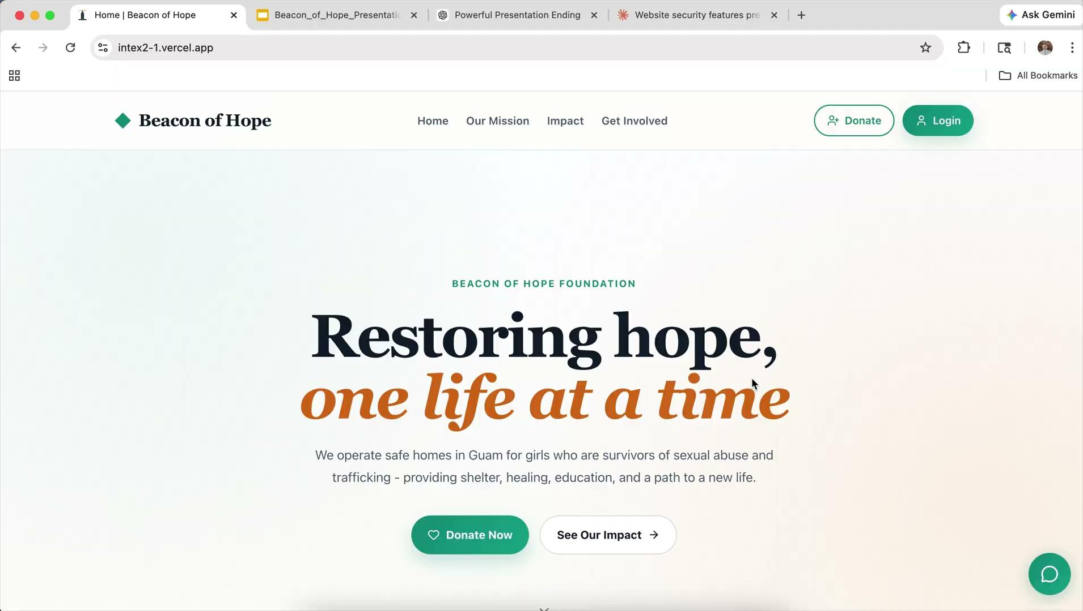
LIVE DEMO
Public-Facing Experience
• Homepage & mission
• Donation flow
• Impact dashboard

Slide 17
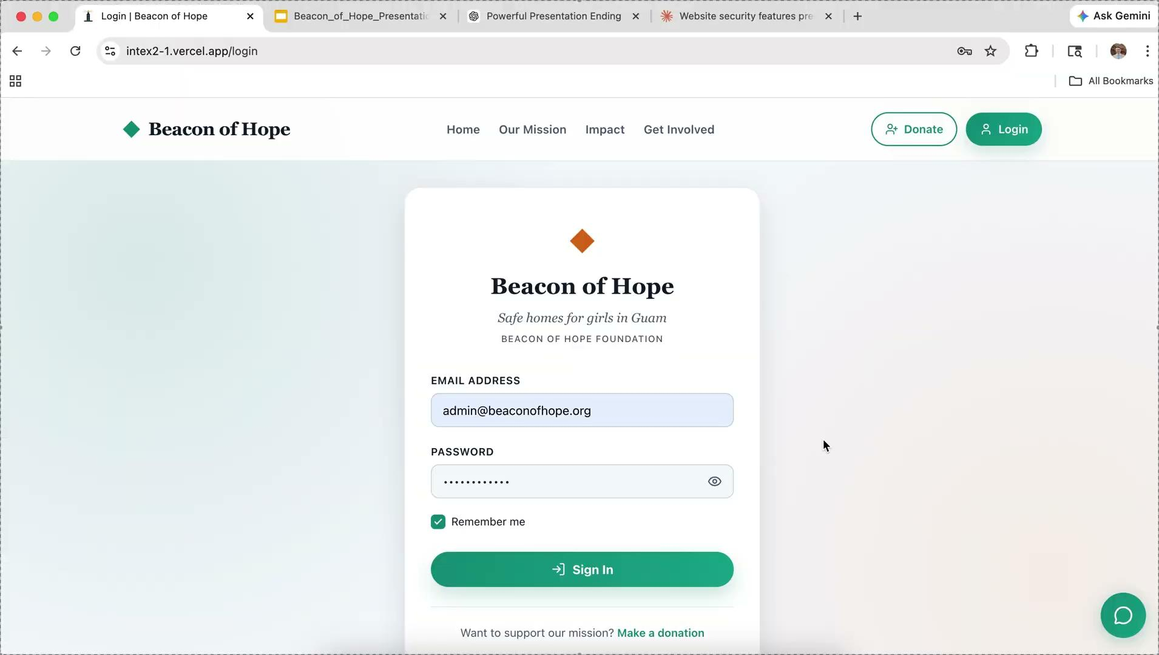
LIVE DEMO
Admin Command Center
• Dashboard KPIs
• Workflow & case management
• NL-to-SQL chatbot for ad-hoc queries
• ML predictions in context

Slide 18
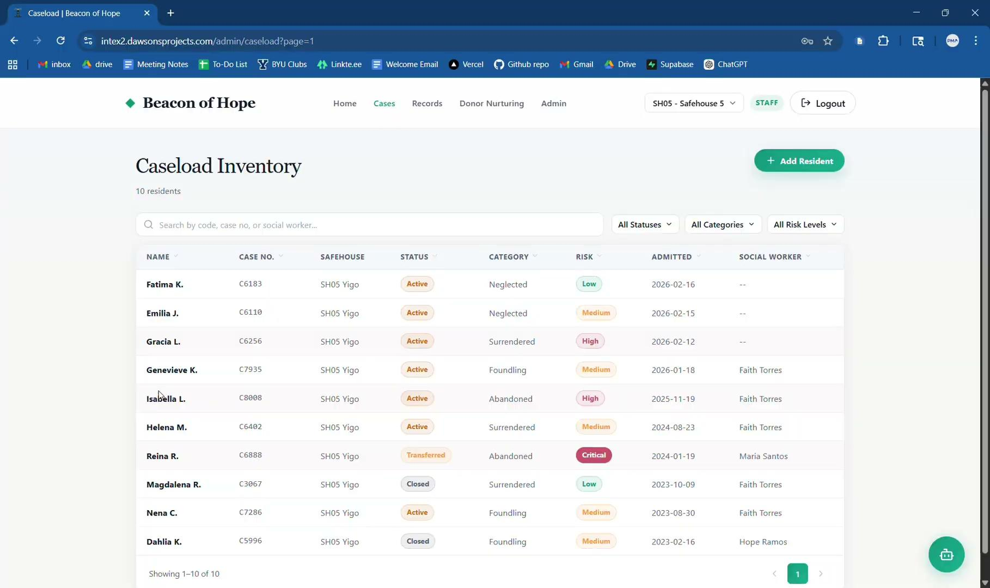
LIVE DEMO
A New Girl Arrives
• ML risk scoring at intake
• Staff claims case and reviews risk factors
• One-click add to case conference
• Auto-flagged if no progress in 3 weeks

Slide 19
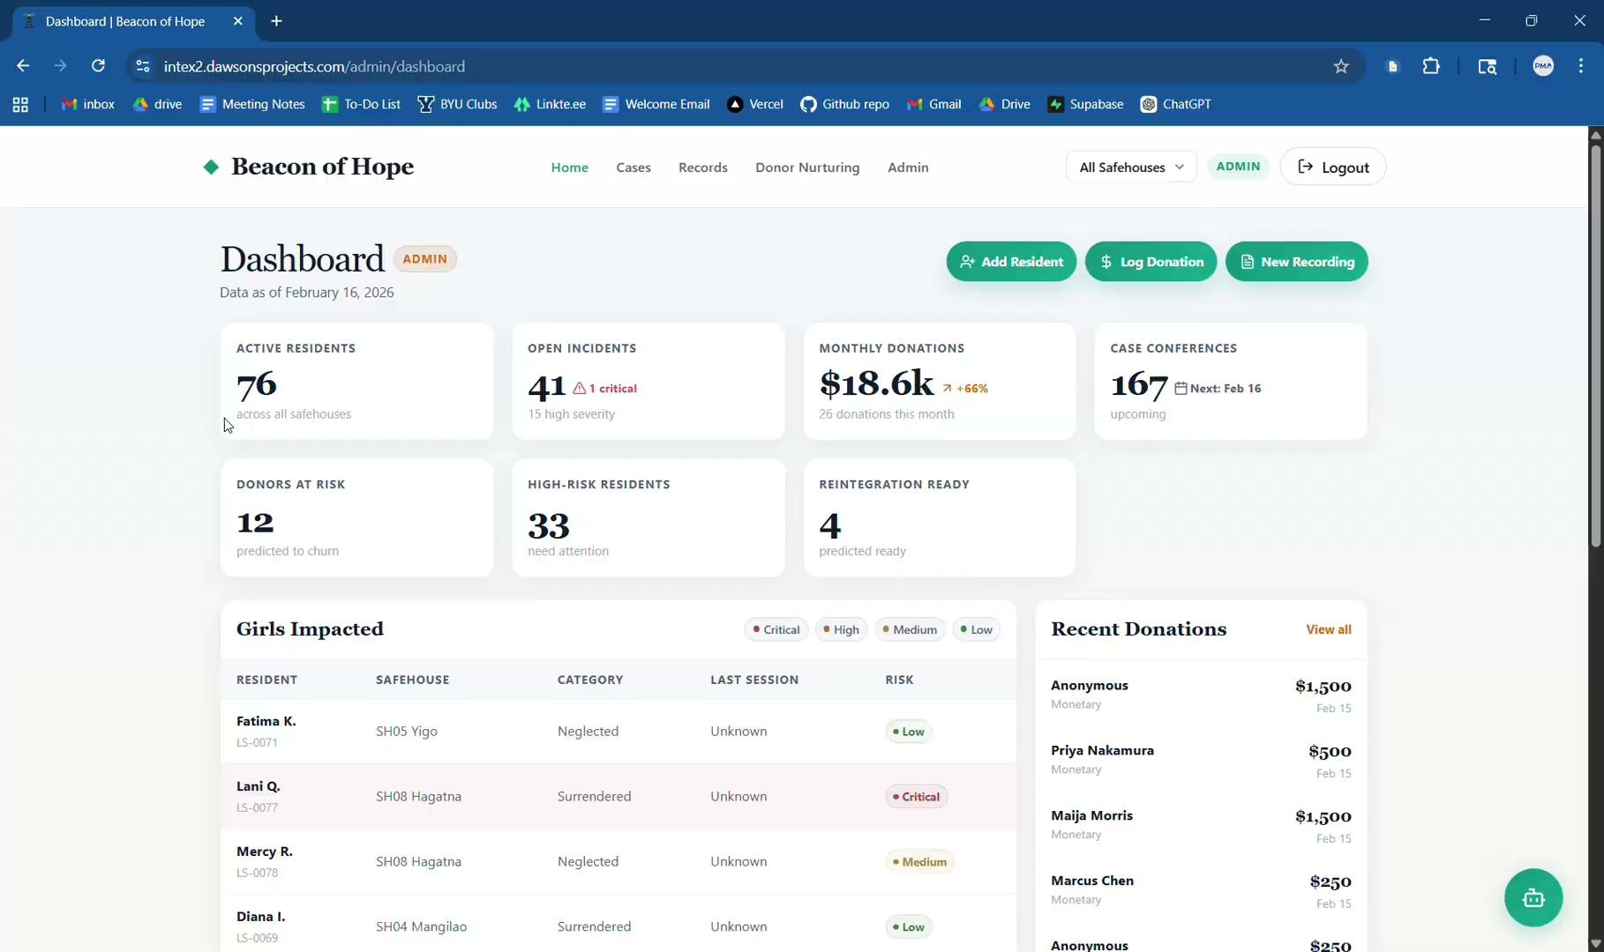
LIVE DEMO
Social Media + Donors
• AI-generated posts from a single photo
• ML-optimized posting time and content
• Donor churn prediction with risk scores
• One-click personalized outreach email

Slide 20
MACHINE LEARNING
8 Pipelines Across 3 Domains
RESIDENT OUTCOMES
DONOR INTELLIGENCE
SOCIAL MEDIA STRATEGY
Reintegration Readiness
Donor Churn Prediction
Content Optimization
Reintegration Drivers
Donor Churn Drivers
Timing Optimization
Incident Early Warning
Incident Risk Drivers

Slide 21
OUR PROCESS
Full Pipeline, Every Time
1
→
2
→
3
→
4
→
5
→
6
Problem Framing
Data Prep & Exploration
Modeling
Evaluation
Feature Selection
Deployment
Prediction vs. Explanation
Every pipeline explicitly states its goal and chooses the right model for that goal.
Paired Pipelines
Each question gets both: a predictive model (what will happen) and an explanatory model (why).
Deployed, Not Notebooks
Every model serves predictions through a live API endpoint integrated into the web app.

Slide 22
DATA CONSTRAINTS
Where We Are vs. Where This Goes
Current Reality
As the System Grows
• 76 active residents, 71 donors, 812 social posts
• Every interaction feeds new data into the pipelines
• Small samples limit statistical power in resident and donor models
• Nightly retraining (GitHub Actions, 3 AM) catches drift automatically
• Some models show high variance across CV folds
• Larger samples unlock richer explanatory models
• Donor churn drivers constrained to 2 features by EPV rule
• Social media models already benefit from 812 posts and show strong results
• Test sets of 12 records make point estimates noisy
• Architecture is built to scale, predictions stabilize with volume
The pipelines are production-ready. The data just needs time to accumulate.

Slide 23
DONOR INTELLIGENCE
We Know Who Is About to Stop Donating
75%
Test accuracy • 71 donors • Naive Bayes
Widening donation gaps nearly double churn odds
Logistic Regression explainer • EPV-constrained to 2 features • Threshold 0.4

Slide 24
RESIDENT OUTCOMES
Reintegration Readiness & Incident Warning
Reintegration Readiness
Incident Early Warning
Stacking Ensemble | Test AUC 1.0 | 8 features
Decision Tree | Self-harm CV AUC 0.77 | 100% recall
• Predicts which residents are ready for safe reintegration
• Dual model flags self-harm and runaway risk before incidents occur
• Top drivers: reintegration assessments, visits per month, total visits
• Sexual abuse history is the dominant self-harm predictor (46x odds, p<0.001)
• Courses completed inversely correlated (p=0.006), signals resident not yet ready
• Initial risk score drives runaway prediction (5.1x odds, p=0.002)
• OLS explainer: Adj R² 0.31, psych checkups approach significance (p=0.099)
• Explainer CV AUC: self-harm 0.91, runaway 0.82

Slide 25
SOCIAL MEDIA STRATEGY
We Know What Content Works
7.3x
More donation referrals from resident stories • 812 posts • p<0.001
Findings feed directly into the AI content engine
OLS (content, Adj R² 0.29) • Gradient Boosting (timing, R² 0.46, MAE 3pp)

Slide 26
MODEL PERFORMANCE
8 Pipelines, 3 Paired Domains
Pipeline
Model
Key Metric
Standout Insight
Reintegration Readiness
Stacking
Test AUC 1.0
8 features after iterative PFI
Reintegration Drivers
OLS
Adj R² 31%
Courses completed (p=0.006)
Donor Churn
Naive Bayes
Acc 75%
17 features, threshold 0.4
Donor Churn Drivers
Logistic
OR 1.93
Gap trend nearly doubles odds
Incident Warning (SH)
Decision Tree
CV AUC 0.77
100% recall, 3 features
Incident Warning (RW)
Decision Tree
Recall 100%
12 features, age + trauma
Social Media Content
OLS
Adj R² 29%
Resident stories = 7.3x referrals
Social Media Timing
Gradient Boost
R² 46%
MAE 3.0 pp, post hour r=0.44
Every domain pairs a predictive model (what will happen) with an explanatory model (why), selected from 10+ candidate algorithms.

Slide 27
ML IN THE APP
Where Users See Predictions
Resident Profile
Admin Dashboard
Donor Management
AI Chatbot
Readiness score + risk badge on every resident’s page
Priority case queue ranked by incident risk
Churn risk flag on each donor profile
Natural-language queries against the database with charts and graphs

Slide 28
SECURITY
Protecting Vulnerable Data
HTTPS / TLS
Authentication
RBAC
Valid cert, HTTP → HTTPS redirect
ASP.NET Identity, strong passwords
Admin, staff, donor roles gate access
CSP Headers
GDPR Compliance
Credentials
Script/style/img sources restricted
Functional cookie consent + privacy policy
Secrets in .env / Azure config, zero in repo
Additional: Account lockout, React data sanitization, password hashing, EF SQL Parameterization

Slide 29
THE IMPACT
What This Means
8
76
100%
ML pipelines
Active residents
Donor outreach automated
3 domains, all deployed live
Full care lifecycle tracked
AI content, newsletter, churn alerts

Slide 30
“I never thought I could have a future. Beacon of Hope gave me one.”
A Beacon of Hope graduate • Successfully reintegrated after participation in our program

Slide 31
❤
Thank You
Questions?
Team Beacon • April 2026

Slide 32
TRY IT YOURSELF
Open a Link to Explore the App
Each link logs you in automatically. Pick any account.
Admin
INTEX Judge 1
INTEX Judge 2
Full access, all safehouses
Elena Cruz - SH01
Rosa Garcia - SH02
bit.ly/4tdWqDG
bit.ly/3Q2pGyH
bit.ly/4c3xusJ
Donor
INTEX Judge 3
INTEX Judge 4
Donor portal only
Ana Reyes - SH03
Carmen Bautista - SH03, SH04
bit.ly/4tHnsU8
bit.ly/4tE4GNo
bit.ly/4dETafW
Type any link into your browser. Explore while you deliberate.

