Slide 1
Why Should Kroger Pursue
Data Science?
Kroger is in a small margin industry, an increment improvement can mean the difference between being in the red or in the black
Wal-Mart, Walgreens, Tesco, others are leveraging big data and data science … making those incremental improvements
Kroger has the data and the technology to exploit their vast amounts of data, but how much are they leveraging their big data tools?
  Any attempts to use machine learning to predict customer behavior?
  Any real-time predictions used to provide prescriptive advice on logistics?
Notes:
Tesco’s has stumbled in Data Science: http://blogs.gartner.com/jake-sorofman/tescos-fall-grace-big-data-blind-spot/
Traditional retail playing “catch-up” to Online retailers: http://www.bloomberg.com/news/2014-06-03/retailers-use-big-data-to-turn-you-into-a-big-spender.html

Slide 2
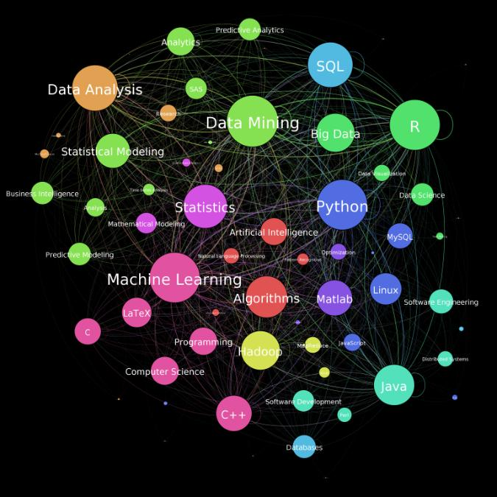
Data Science
Notes:
I think the Venn diagram is better

Slide 3
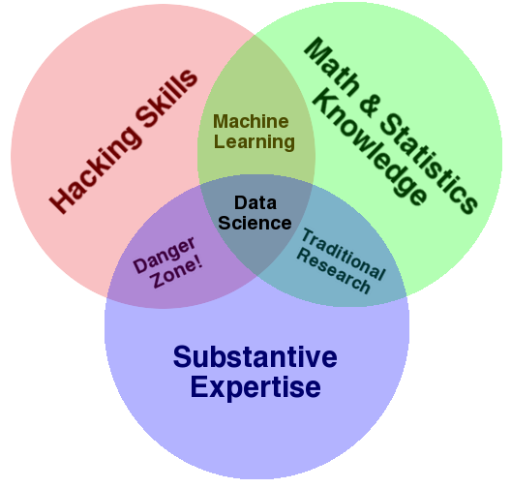
What is Data Science?
Notes:
Not sure how to put this on here. Ideas are below:
Danger Zone – without some statistical rigor, your model has a poor foundation and can lead you down the wrong path. The point is that the ability to get the program to work, doesn’t mean you’ll get “good actionable advice” out
Traditional Research – This is where actuaries live with respect to big data. Most don’t have the Hadoop, Spark, MR… (big data hacking skills). This is where a stats professor is that works with a business as well. This may be where some at DH live as well. I think they are a primarily SAS shop.
Machine Learning – the whole point is to create value in business and that takes understanding on the business at a minimum.

Slide 4
Data Science vs Traditional Business Intelligence (BI)
What
should we do?
Machine Learning
What will happen?
Data Science
Data Maturity
Statistics
Why did it happen?
Was that good or bad?
Traditional BI Reporting
What Happened?

Slide 5
How Does Data Science Do it?
By applying statistics, probability and machine learning techniques to a business problem through the use of tools like SAS, R, Python,…
  Statistical methods like principal component analysis can point you to the most important factors of an event (why did it happen)…
  Forecasting (time series), regression models… are but a few techniques that can help one predict future events (what will happen)…
  Combine the two prior bullets into a linear program and suggest a course of action that maximizes the probability of success (what should we do)…

Slide 6
Data Science and
The Data Explosion
Today the Velocity of the data being generated has led to an explosion in the Volume of data being collected
  Traditional statisticians and budding data scientists are forced to “sample” the data in order to get it to fit in memory of their machine.
  This leads to loss of valuable insight
Weblogs, social media, weather data, video… the Variety of data is far beyond what a traditional database can handle
  Many of these sources of valuable data are simply lost and go unsued
  If they are used, the volume and velocity can grow exponentially
Notes:
Should we add the fourth V, Veracity?

Slide 7
Data Science at Scale
Hadoop provides a platform that allows for linear scalable storage of almost any form of digital data (traditional tables, json weblogs…)
The Cloudera Hadoop Platform at Kroger has the Data Science tools that scale:
  Hive/Pig/Impala – similar to SQL queries (traditional BI)
  Mahout/Spark – machine learning
  Python/Java via MapReduce – statistics and machine learning

Slide 8
Why ILW for Data Science?
ILW is a Cloudera Partner and a Known Vendor to Kroger
  ILW brought the Hadoop cluster up and continues to play a major role in Big Data at Kroger
  Know Hadoop and specifically the data cluster at Kroger
  Personnel on staff capable of leveraging Hadoop to answer the Big questions using all of the data
ILW started as Department of Defense Contractor
  Rigorous client screening to ensure consultants are trustworthy (security clearance)
  This is important because data scientists will have access to large amounts of internal data
Notes:
May need to add a slide that we ILW can provide training or help DunnHumby translate their DS to the cluster (Nick mentioned this).

Slide 9
ILW Consultant - Mark Nichols
Passed Cloudera’s DS-200 Exam (Fundamentals of Data Science)
  Python, R, MapReduce, Tableau, Hadoop…
  Current participant in Cloudera Data Science Challenge
Top Graduate from University of Cincinnati’s Master of Science in Business Analytics
  Developed a Mixed Integer Linear Programming Model to prescribe production sequence to industrial manufacturer. Resulted in a 50% decrease in production time and eliminated all overtime
  Developed model to simulate scheduling practices and test revisions at UC Health Clinic, resulted in 25% reduction in new patient waiting time
  MS-BA Student of the Year, 4.0 GPA at a top-20 Data Science program
Notes:
DS – Challenge Problems:
1 – analyzed all major airline flights in US for 1-year to create a logistic regression model to predict flight delays. The model improved delay prediction by 36% (Hive, MapReduce, Hadoop, Python, Spark)
2 – analyzed weblogs for an internet site. Created a bot filter to eliminate any non-human data from the logs. Used the data to determine which marketing campaign and color scheme was more effective (based on book sales, adclicks and signups). Also applied statistics to determine how many days of data were required to get to 99% confidence that one model was better than the other (Hive, MapReduce, Hadoop, Python)
3 – analyzed a social network in order to recommend users to follow. Made half of recommendations using Mahout’s item recommender and the other half using custom algorithm based on page rank, in-degree, out-degree… It is setup for anaylsis in order to determine the best recommender and get data to calibrate the custom recommender. (Hive, MapReduce, Hadoop, Python, GraphX, Mahout)

Slide 10
ILW Consultant - Mark Nichols
Commander of 613th Engineering Facilities Detachment
  Lead a team of engineers responsible for design and quality assurance for all Kentucky Army National Guard troop labor projects
  Registered Professional Engineer (OH and AL licenses)
  Over $1 Billion in total government/commercial project management experience
Qualified Navy Nuclear Engineer (Submarine)
  Entrusted by US Navy for operations and oversight of nuclear reactor
  Highest technical score on nuclear engineer’s exam of all division officers from the submarine base (8 hour written and 2 hour oral interviews)
  Top Secret Clearance
Notes:
Both of those should speak to trust and responsibility. Most don’t know too much about the nuclear navy, but qualifying engineer is easily the most intellectually challenging thing I have undertaken.

Slide 11
ILW Consultant - Mark Nichols
Ideal Day
  The reason for going back and getting the MS-BA at the University of Cincinnati is my love for data and the puzzles, problems and solutions it can provide.
  Breakdown of Ideal Day:
    30% developing and testing predictive and prescriptive models
    15% breaking the results from the modeling down to present to others
    15% learning new tools to help make all of the other tasks go more smoothly (or training others in the tools)
    15% statistically analyzing the data in order to direct the modeling efforts
    15% use of data mining techniques to discover the next issue/problem to solve
    10% rinse and repeat, prefer to prototype, explain methods and transition to developer if management decides there is value there

Slide 12

Can parallels be drawn to AFRL
Discovery Process in a Nutshell
Adaptive PMO Management extends compliance value
Can parallels be drawn to AFRL
Discovery Process in a Nutshell
Adaptive PMO Management extends compliance value

