Slide 1
Kroger & Data Science
Why Should Kroger Pursue Data Science?

Slide 2
Why Should Kroger Pursue Data Science?
Kroger is in a small margin industry, an increment improvement can mean the difference between being in the red or in the black
Wal-Mart, Walgreens, Tesco, others are leveraging big data and data science … making those incremental improvements
Kroger has the data and the technology to exploit their vast amounts of data, but how much are they leveraging their big data tools?
  Any attempts to use machine learning to predict customer behavior?
  Any real-time predictions used to provide prescriptive advice on logistics?

Slide 3
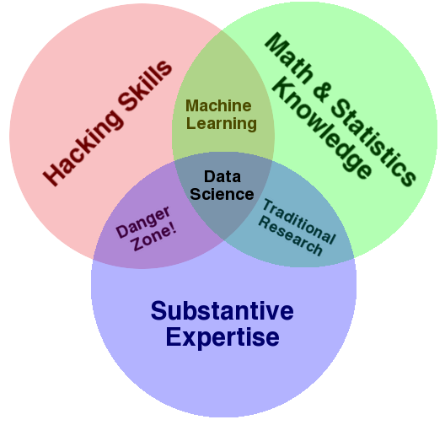
What is Data Science?

Slide 4
Data Science vs Traditional BI
What
should we do?
Machine Learning
What will happen?
Data Science
Data Maturity
Statistics
Why did it happen?
Was that good or bad?
Traditional BI Reporting
What Happened?

Slide 5
How Does Data Science Do it?
By applying statistics, probability and machine learning techniques to a business problem through the use of tools like SAS, R, Python,…
  Statistical methods like principal component analysis can point you to the most important factors of an event (why did it happen)…
  Forecasting (time series), regression models… are but a few techniques that can help one predict future events (what will happen)…
  Combine the two prior bullets into a linear program and suggest a course of action that maximizes the probability of success (what should we do)…

