Slide 1
Who-Brew
Gurneet Singh | William Chow | Dawson Tilley | Hacqueem Bolton | Amanda Govan

Slide 2
Elevator Pitch

Slide 3
The Concept
A cool and simple application using 'Open Brewery DB' and 'Google Maps' APIs to give user the capability to search for breweries in the area. The application is interactive, it gets user's location through a modal window and searches for breweries in the area and displays the Google Maps iFrame with pins/markers depicting locations of breweries.
AS A User
I WANT TO search for breweries in my city
SO THAT I can get directions and plan my visit to have a good time

Slide 4
Technologies
HTML
Javascript
Bulma, CSS
Open Brewery DB API
Google Maps API
Git

Slide 5
Work Breakdown
Basic HTML layout and CSS
Enhanced CSS using Bulma
Home page
Modal
Search Results page
Integrate Open Brewery DB API
Integrate Google Maps API
Integrate multiple JS i.e. share data using Local Storage
Add ’Get Directions’ feature

Slide 6
Challenges/ Success
Git conflicts / Branching Strategy
Multiple JS files / Local Storage
User Experience / Modal Journey
API restriction to US data only / Error Handling
Different formats for City name / String methods

Slide 7
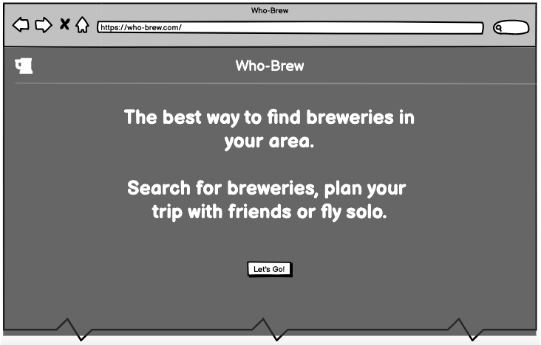
Wireframes
Landing Page
Enter Zip Code modal
Search Results page

Slide 8
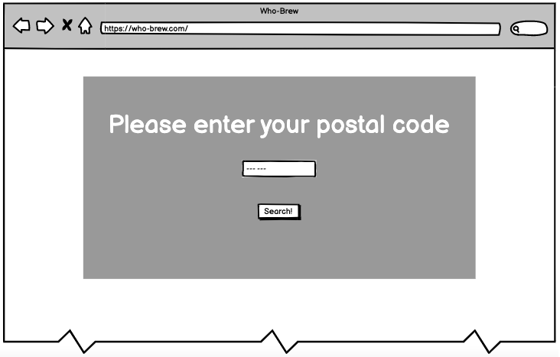
Wireframes
Landing Page
Enter Zip Code modal
Search Results page

Slide 9
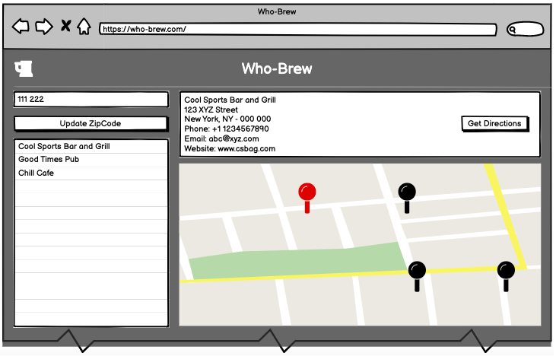
Wireframes
Landing Page
Enter Zip Code modal
Search Results page

Slide 10
Demo https://dawsontilley.github.io/who-brew/ https://github.com/dawsontilley/who-brew

Slide 11
Down the Road - Better UI - Expand Geographic Locations to outside US - More Google Map API integrations ex. Uber/Taxi, Google Reviews

Slide 12
Q&A

