Slide 1

Meta Visit
“Those who initiate change will have a better opportunity to manage what is inevitable” - William Pollard
Valens Solutions
Presented by Nathan Castle, Marco Ling, Dawu Liu
November 20th, 2021

Slide 2
Executive Summary
Goal
Key Considerations
Impact
Create an accurate predictive model to identify potential power users of MetaVisit’s digital healthcare platform
Bottlenecks of mainstream healthcare services (MSP vs. Non-MSP)
Health Empowerment and Increased Accessibility
High investment demand and dependence in digital healthcare capabilities
Company and Revenue Growth
Customer Demand for Virtual Healthcare and BC’s Technology Gap
Marketing Campaign to Develop Strong Client Base
Notes:
Key Statistic: 41% of Canadians would like have video visits with their health care provider but just 4% of family physicians offer this option.2

Slide 3
Objectives
Create Predictive Model to Identify MV Power Users
Specifically aimed to target patients requiring Non-MSP services
Derive power user characteristics
Refine Power User Profile to Target New Patients
Hone in on target segments and understand their needs
Develop cost structures and marketing strategy/partnerships
Develop Actionable Marketing Campaign for MetaVisit
Social media ads, partnership and transit route ads
Analyze capture results and optimize and personalize website

Slide 4
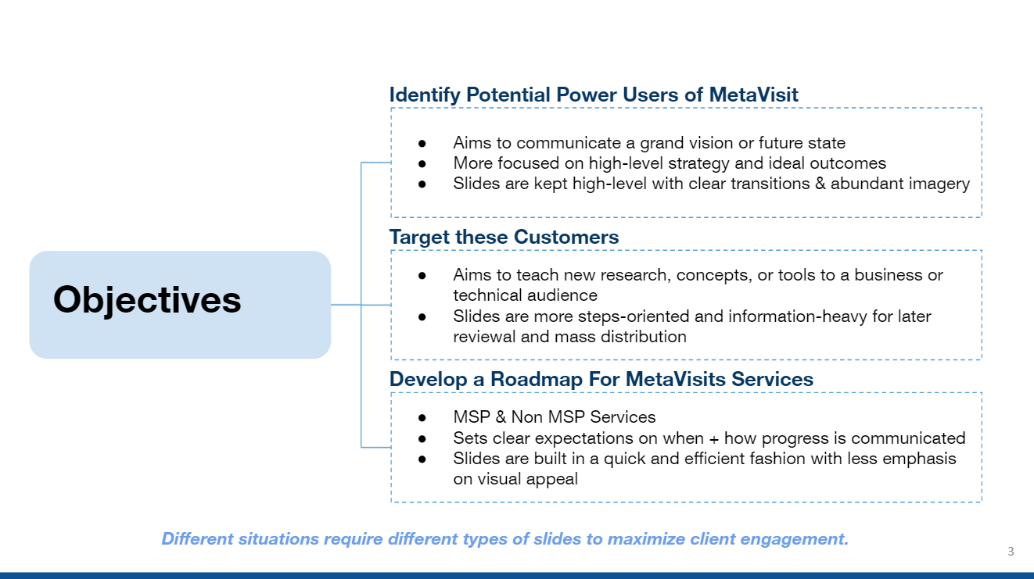
Opportunity to serve ~370,000 British Columbians
Notes:
Financial outcome, growth, and increased house accessibility figures (KPI’s) frontloaded
41% of Canadians would like have video visits with their health care provider but just 4% of family physicians offer this option.2

Slide 5
Opportunity to serve ~370K British Columbians
Capture a portion of the Non-MSP Market Potential of ~$25M
Notes:
Financial outcome, growth, and increased house accessibility figures (KPI’s) frontloaded
41% of Canadians would like have video visits with their health care provider but just 4% of family physicians offer this option.2

Slide 6
Opportunity to serve ~370K British Columbians
Capture a portion of the Non-MSP Market Potential of ~$25M
Long-Term Revenue Growth ~ $7M
Notes:
Financial outcome, growth, and increased house accessibility figures (KPI’s) frontloaded
41% of Canadians would like have video visits with their health care provider but just 4% of family physicians offer this option.2

Slide 7
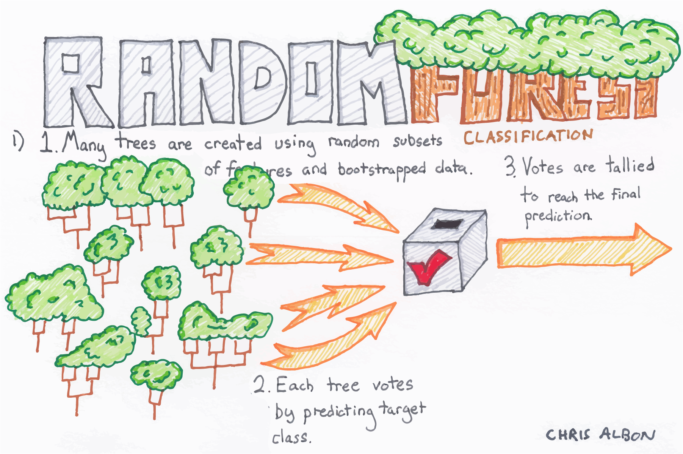
Decision Tree and Random Forest
Insight: Predictive modelling aids in validating our dataset
Image link: https://gaussian37.github.io/ml-concept-RandomForest/

Slide 8
Non-MSP Services
1
THERAPY AND COUNSELING
2
PRENATAL SERVICES
3
PHYSIOTHERAPY
4
NON-REFERRAL DIETICIANS

Slide 9
Non-MSP Services
Survey Health Predictors
1
THERAPY AND COUNSELING
MENTAL HEALTH STATUS
RECENT CHILDBIRTH
2
PRENATAL SERVICES
REPEATED INJURIES
3
PHYSIOTHERAPY
PERCEIVED WEIGHT
4
NON-REFERRAL DIETICIANS
DIABETES

Slide 10
A closer look: Who are our power users?
FSA Geodemographics
Insurance Premium Spending
Direct Health Cost Spending - Self Reported Spending
Key Age Groups
30 - 59
75+
Additional Considerations
Post Pandemic Adoption
Shortage of Specialists in Remote BC Areas
Out of Country Users
Notes:
Insurance premiums, AGE, $ above avg direct cost expenditure

Slide 11




Next Steps
In 1 Month
5 Month Range
Plan Marketing Campaign
Analyze Results
Revisit capture rates and identify targeting strategy improvements
Refine target segments, hotspots, customer profile
Predictive Model
Attract New Power Users
Scale Metavisit
Leverage best model with highest capture rate for power users
Social Media ads, physical advertisements, SMS and email marketing
Additional: Personalize and Empower MV Website
Revenue & Social
Impact
In 3 Months
8 Month Onwards
Notes:
Add benefits to each step to be more clear
Insights
ERP
What are the future opportunities at the end

Slide 12
Opportunity to serve ~370K British Columbians
Capture a portion of the Non-MSP Market Potential of ~$25M
Long-Term Revenue Growth ~ $7M
Notes:
Financial outcome, growth, and increased house accessibility figures (KPI’s) frontloaded
41% of Canadians would like have video visits with their health care provider but just 4% of family physicians offer this option.2

Slide 13
Thank you.

Slide 14
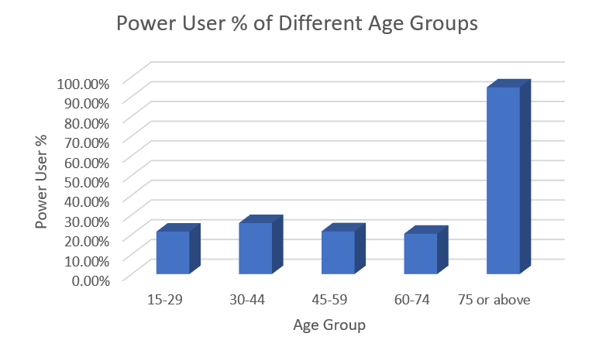
“Those who initiate change will have a better opportunity to manage what is inevitable”
William Pollard
Appendix B: Power User % of Different Age Groups

Slide 15
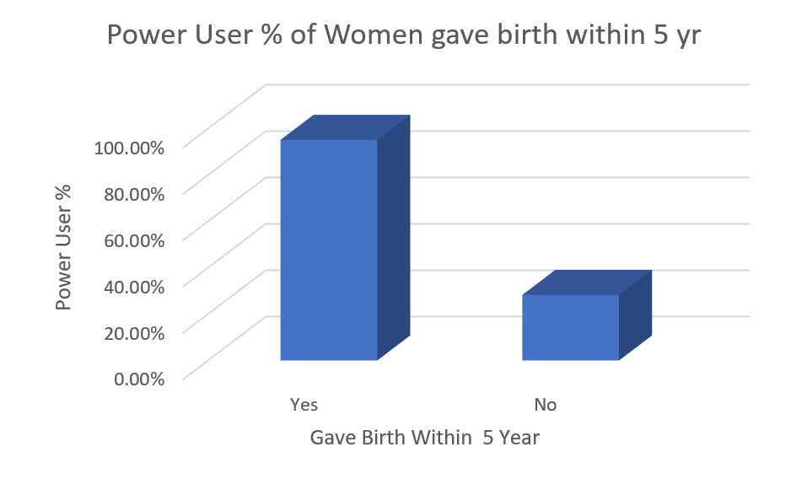
Appendix C: Power User % of Women gave birth within 5 years

Slide 16
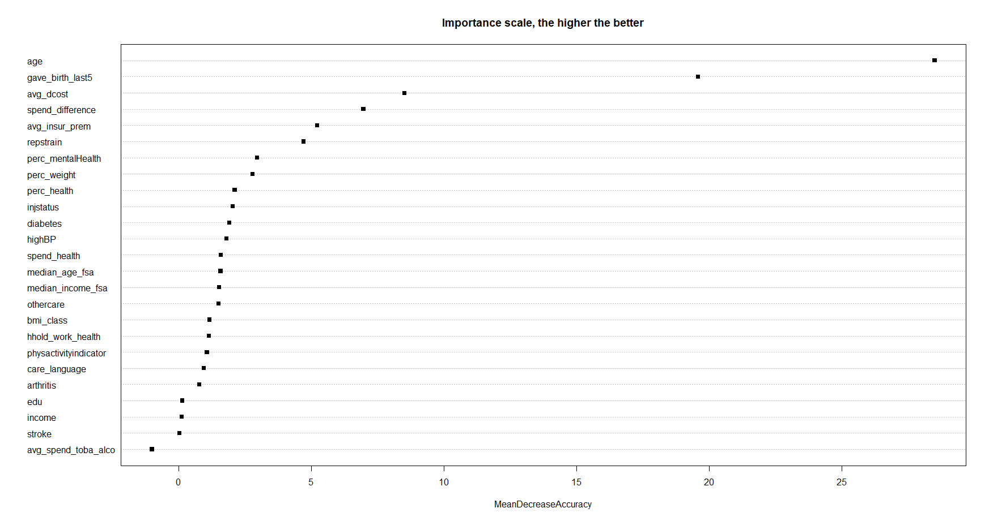
“Those who initiate change will have a better opportunity to manage what is inevitable”
William Pollard
Appendix D: Importance Plot

Slide 17
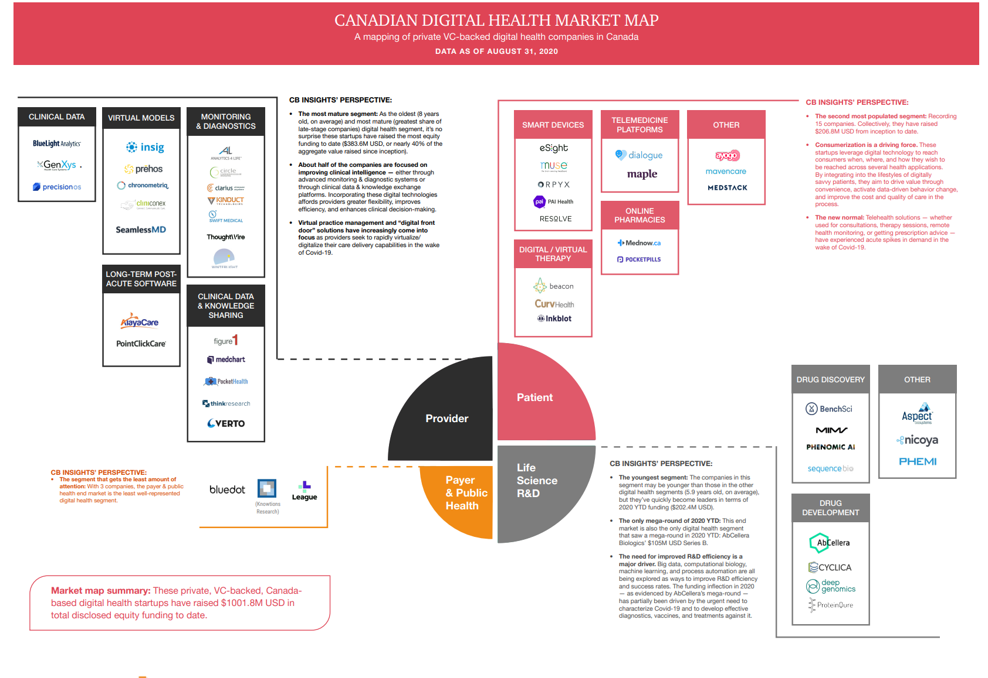
“Those who initiate change will have a better opportunity to manage what is inevitable”
William Pollard
Appendix D: Digital Healthcare Roadmap(PWC, 2020)

Slide 18
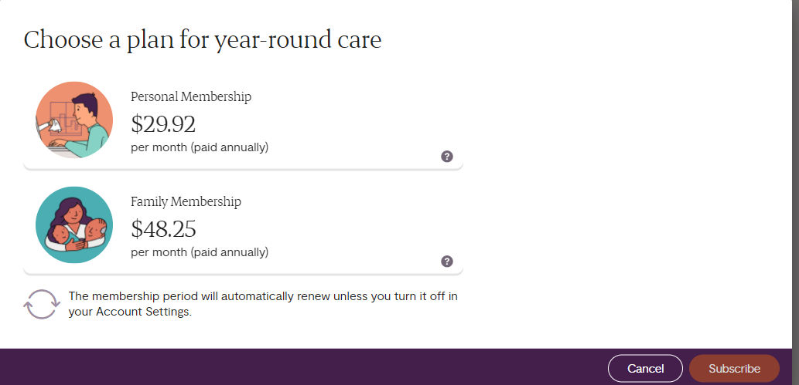
“Those who initiate change will have a better opportunity to manage what is inevitable”
William Pollard
Appendix E: Competitor Learnings (Maple)

Slide 19
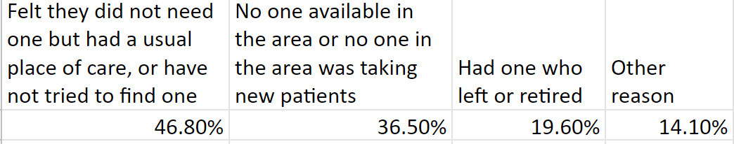
“Those who initiate change will have a better opportunity to manage what is inevitable”
William Pollard
Appendix F: External BC Healthcare Statistics

Slide 20
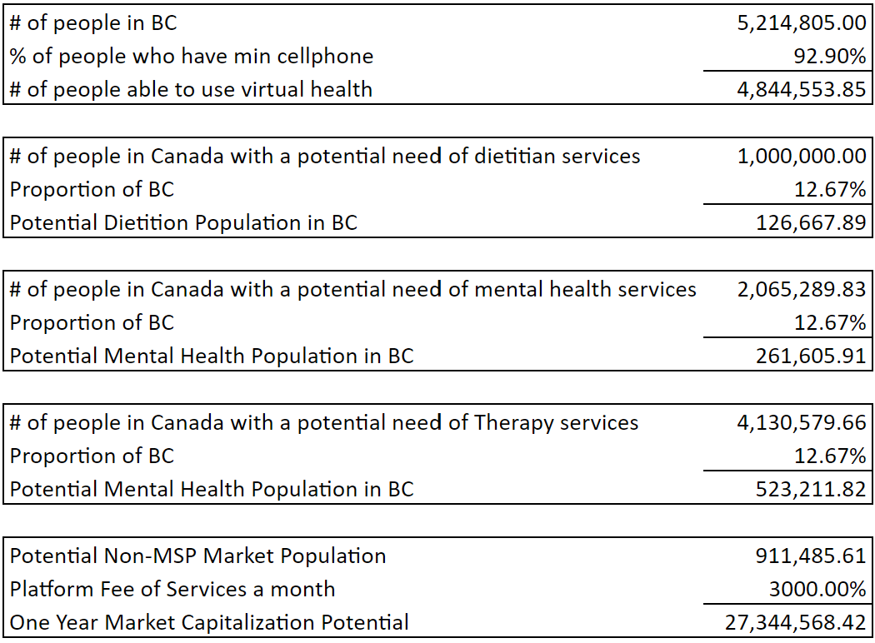
Appendix G: Market Cap

Slide 21
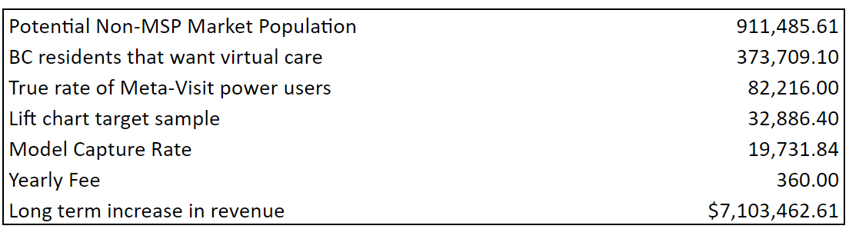
Appendix G: Projected Revenue Growth With Marketing Campaign

