Slide 1
Write Scenarios (TESTERS)
Write BDD Steps (DEVS)
Automation (TESTERS)
Regression (TESTERS)
Test Spec (TESTERS)
Golden data + test
What? Scenarios
When? For each feature.
What? Assertion steps
What? Excecute test.
What? Run it all.
When? Per deployment
When? Daily
When? Per scenario.
DPP Platform
What should automation testing look like?
Features have
multiple scenarios
Of
Given……..
When……..
Then…….
And……..
----> Regression pack
Automated
Regression
Pack

Slide 2
How can we apply BDD Automation?
Feature files { scenarios 1 -4 }
Source component
Scenario 1/4:
Setup + load Golden data
- S3
- UM
- API
- SFTP
- KAFKA
Ingestion (JSCONNECT)
Scenario 2/4:
Run JSConnect
Transformation (EDIE)
Scenario 3/4:
Destination component
Scenario 4/4:
Run YAMLS
Post conditons?
Assertions.
Tear down.
ADD
JSCONNECT INT. TESTS
ADD TEST YAMLS USING EDIE
Current state of test automation -> Isolated tests-> No setup & tear down
Manual steps
JSCONNECT INT. TESTS
Scala test (framework) + Docker containers.
TEST YAMLS
EDIE as test runner
Manual setups

Slide 3
Feature with scenario - Gherkin
Feature: PianoStream normal data folder structure
Check is PianoStream job creates the correct file/directory structure
for the collected pianoStream data
Scenario: processing data from feed with product type Household
Given a file with theme piano_feed containing the following lines
| type |
| Household |
When I run the PianoStream job
Then the following directory structure should be created:
| Household/ |
And folder 'Household/' should contain following files:
| part-00000-00000 |
Scenario: processing data from feed with product type from Household and Bakery
Given a file with theme piano_feed containing the following lines
| type |
| Household |
| Bakery |
When I run the PianoStream job
Then the following directory structure should be created:
| Household/ |
| Bakery/ |
And folder 'Household/' should contain following files:
| part-00000-00000 |
And folder 'Bakery/' should contain following files too:
| part-00000-00001 |
How it runs tests?
### INSTALL DOCKER
+ GRADLE,
+ JSConnect
+ EDIE
+ KAFKA
+ SFTP
+ JMS
+ S3
+ Golden data.
+ Features files.
#### RUN TESTS
CMD gradle cucumber
Few minutes later………..

Slide 4
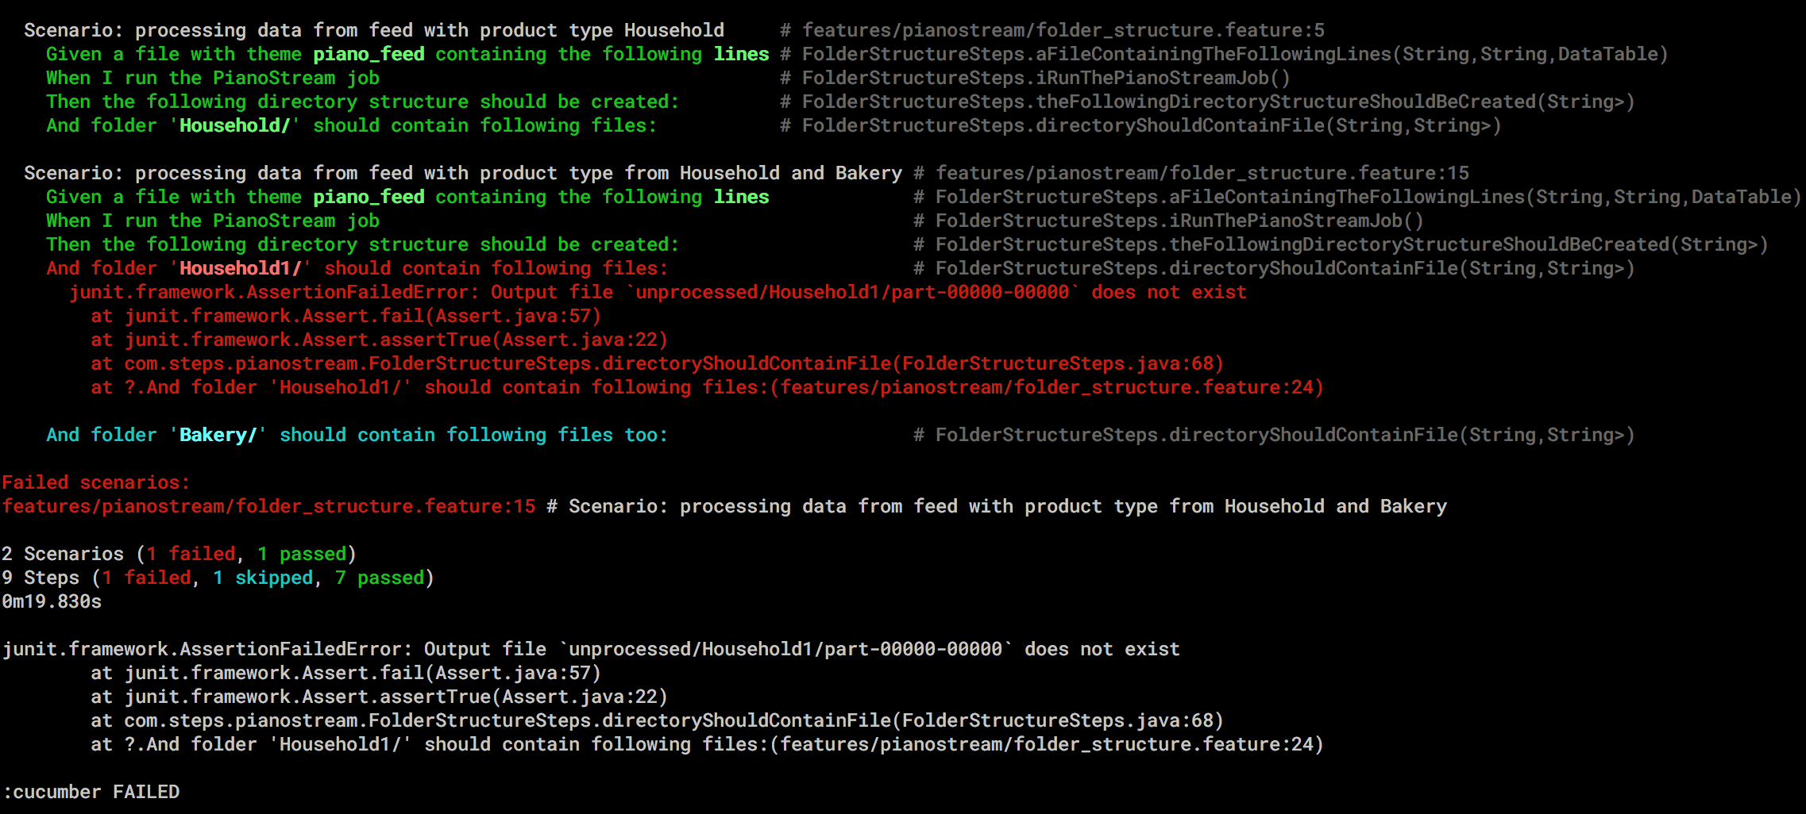
Test Report

