Slide 1
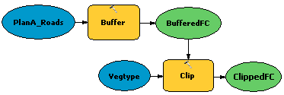
Model Builder

Slide 2
Python Script
arcpy.Clip_analysis("parks","zip", "L:/Python/FinalPrepEx5/Exercise05/Results/parks_Clip.shp")
from arcpy import env
env.workspace="L:/Python/FinalPrepEx5/Exercise05"
arcpy.Buffer_analysis("facilities.shp", "Results/facilities_buffer.shp", "500 METERS")
arcpy.Buffer_analysis("facilities.shp", "Results/facilities_buffer.shp", "500 METERS","", "" , "ALL")

Slide 3
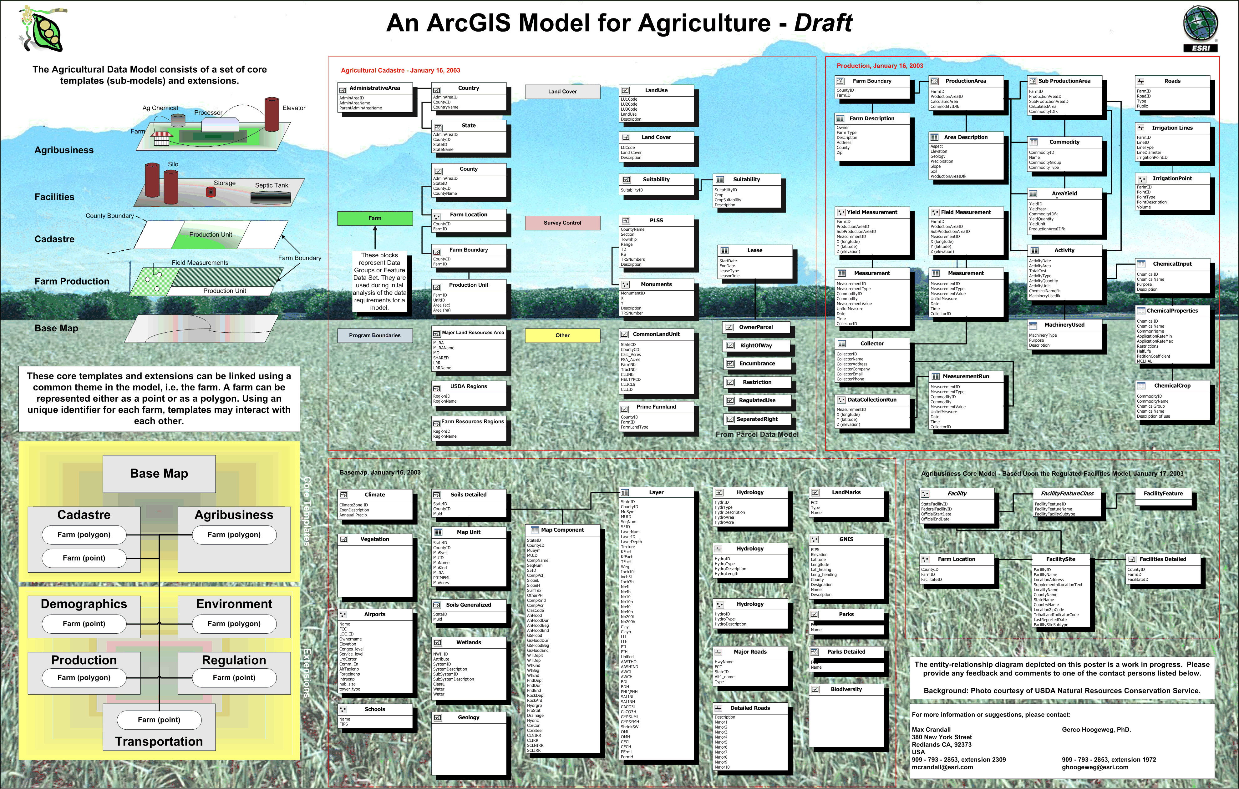
Planning is key when constructing a database

Slide 4

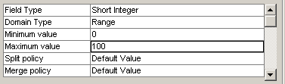
Setting up Proper Domains Is Important
Rules about what can go in attribute fields
Reduces data entry and consistency errors
Coded domains
Set up a list of allowable values
Range domains
Set up a range of allowable values
Pipe size: 1”, 3”, 6” or 12”
Percent: 0-100
Notes:
Mastering ArcGIS
Chapter 13

Slide 5
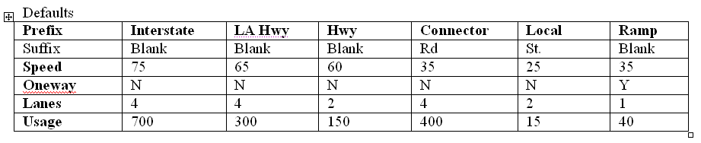
Subtype defaults
Different default values can be specified for each subtype.
This saves a lot of editing of attributes. Although there may be exceptions to the defaults (65mph in urban interstates) these can be edited if needed. Overall, editing is reduced.
Each of the attribute fields may in turn have domains.
14-<number>
Notes:
Mastering ArcGIS
Chapter 13

Slide 6
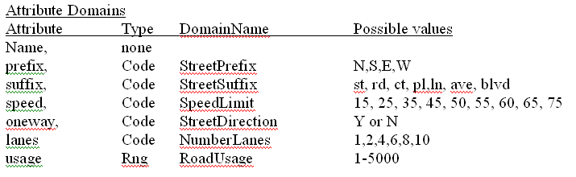
Domains for subtype fields
14-<number>
Notes:
Mastering ArcGIS
Chapter 13

