Slide 1

Renewable Energy Production
By Team Sunshine: Boris Kletser, Maya Miller-Vedam, Geoff Stirling & Laura Williams
W205-2, Fall 2016
Notes:
Images off pixabay - no attrib req

Slide 2

How does weather affect energy production?
Research Questions: 1. How do weather fluctuations impact energy production from solar fields? 2. Given the weather patterns in a given location, would a solar field make sense as an addition to current energy production methods? Would a plant benefit from additional storage solutions? 3. Can we predict energy production from existing solar panel fields from real time weather data?
Potential Clients:
Power Companies, Government Agencies, Investors, Energy Traders, Regulators
Notes:
Geoff
Focusing on solar data, radiation
NREL - has a very complex model.. very relevant… small version of what they’ve done Lay person’s access to understanding issues and DM ability to make decisions from simplified view
How is our q relevant, doable, justification of scale

Slide 3
Data Ingest
Source | Format | Frequency & Volume | Variables
National Oceanic and Atmospheric Administration | RESTful API Limit 1000 requests/day CSV or TXT | 5 min 20 cols numeric data | Solar Radiation & Cloud cover from weather stations across the country.
Energy Information Administration | (Modified RESTful) API (JSON or XML both available) | Monthly aggregates Small tables of numeric data. | Solar Fields production since 2000.
National Renewable Energy Laboratory | JSON API 1000 requests/hr | Monthly, daily, hourly. | Photovoltaic Site Metadata and raw data .
Notes:
Laura
JSON and XML available, CSV files also available
Haven’t figured out the size yet.
Also add larger historical dumps
http://www.eia.gov/tools/faqs/faq.cfm?id=767&t=3 - monthly historic
Other sets: https://hangouts.google.com/hangouts/redirect?dest=http%3A%2F%2Fen.openei.org%2Fwiki%2FMain_Page
NOTES
Getting weather data near solar locations - 10-20 cols of numeric data
BTU = energy production unit for coal (can convert to KJ)
Re net generation tables from eia (SEGS)... production levels in megawatt hrs, ‘prime movers’ represents the type of generator that is fed by the solar field (eg steam turbine)

Slide 4
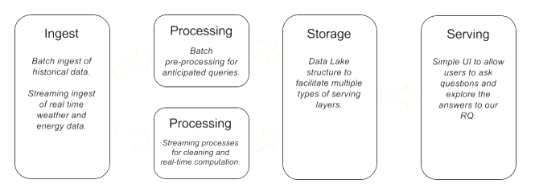
Lambda Architecture
Notes:
Maya
Not 100% there on each point, but thinking Lambda

Slide 5
Workflow
Part of Workflow | Description | Technology | Reason Chosen
Historic Logs Ingest: Monthly Plant Data Real-Time Weather Data | API calls to get the necessary data | ? | Contains the values the we need and allows us to call for specific variables with least bandwidth used.
Processing: Machine Learning: Streaming | We train the system to predict output based on historic fluctuation/output correlations. | Architecture: Lamba Processing: EC2 DB: ? ML: Scikit-learn Python Package | Because our data updates every 5 minutes and is used for long term decisions, we don’t need to have instant pulls, just a merging of the data. Large simple DB
Storage: | Write logs so don’t need to recompute as far back | AWS S3/EBS | Easy to scale, pay for what we use
Serving: | 1. List of sites as a table 2. Website with dashboards showing real-time predicted output, need for storage, and fluctuations. | TBD: Possibilities: R->Web EIA Visualization Library | Simplest solution with least overhead.
Notes:
Maya
Focus on part of workflow/descr

Slide 6
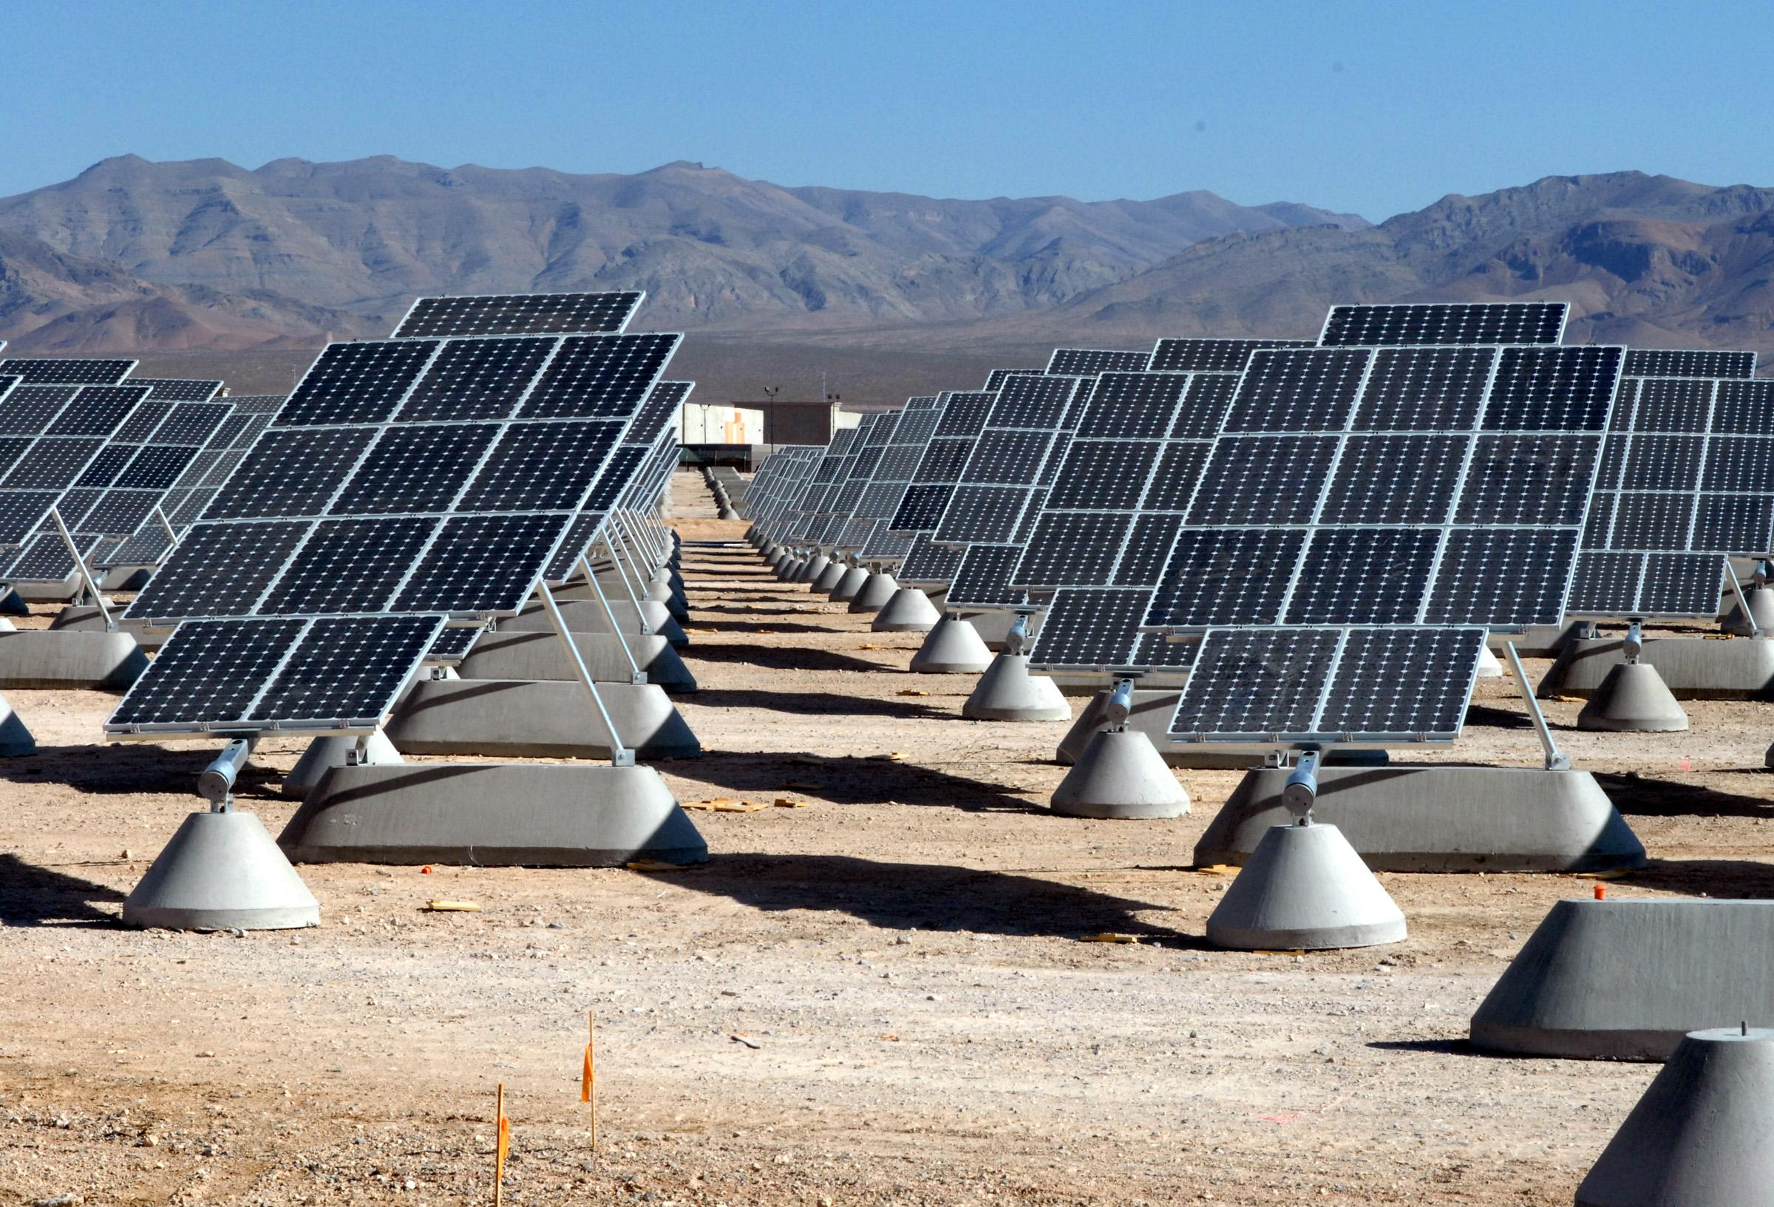
Serving Layer
Audience
Primary: Grid managers, energy tech investors/analysts
Secondary: Regulators, energy traders
Target Queries
Net Electricity Generation
Net Generation vs Total Capacity
Fluctuation
Best Weather Locations
Benefit from Technology Updates
Benefit from Storage Solutions
Possible Output
Map with Overlays
Sortable Tables
Aggregate Insights (ex. Low net/cap in Good Weather)
Notes:
Boris

