Slide 1
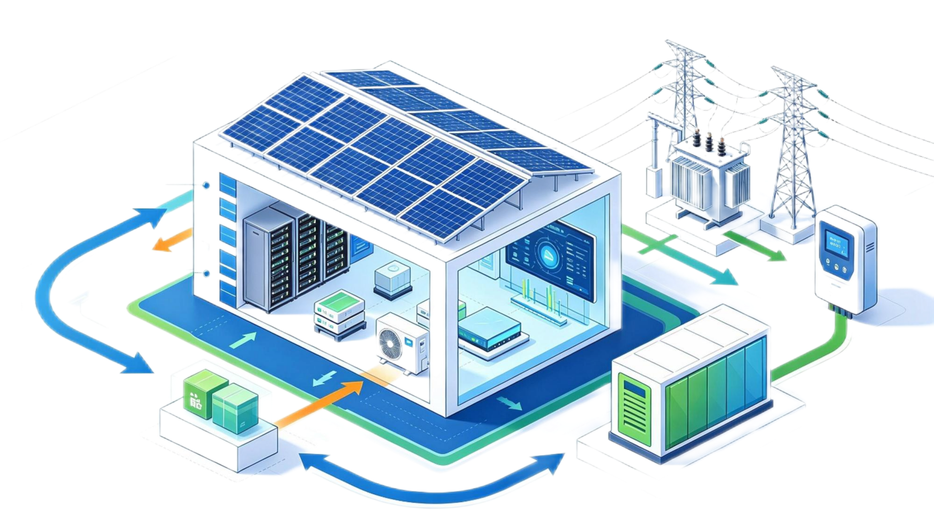
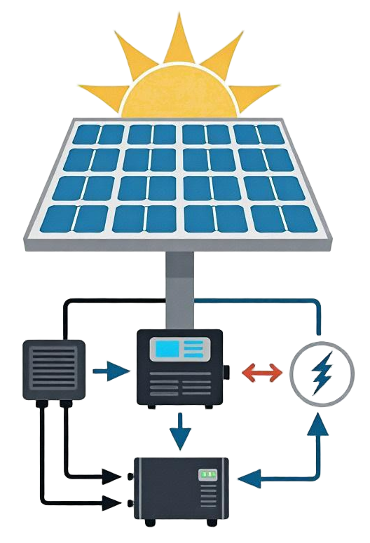
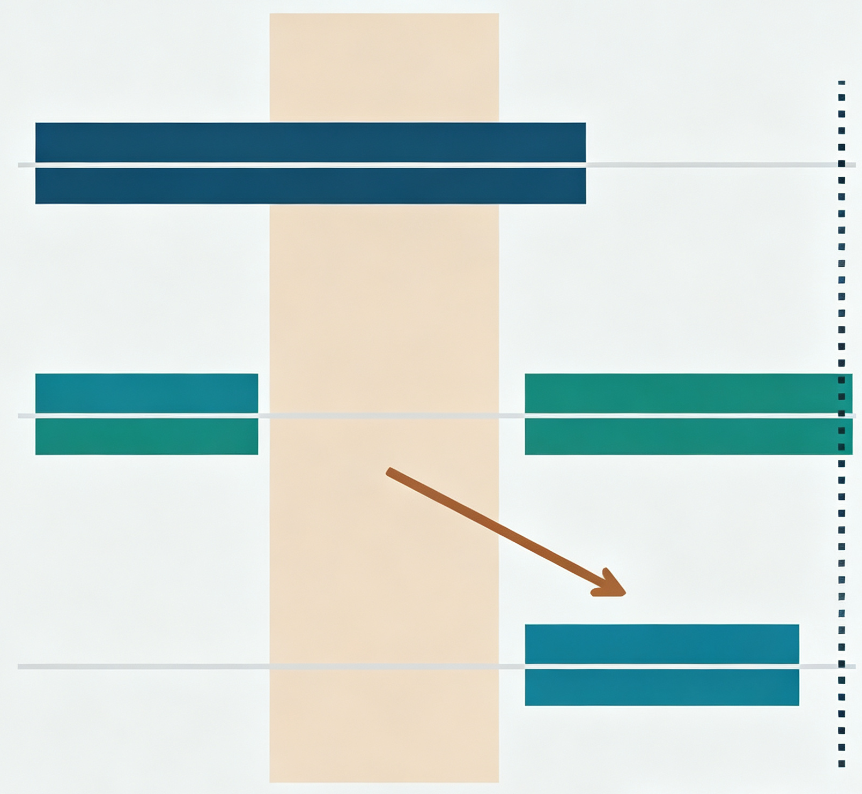





a From computing workloads to a grid commitment
① Workload representation
② Job-derived scheduling
③ Reliable grid commitment
Which tasks may wait?
When can they be completed?
What can the operator promise?
DR call
Before
During
Data centre
576 GPUs in the reference model
Capacity · duration
· call spacing
Online inference: immediate service
Later
Permitted training / offline inference
Delivery + deadlines
+ recovery
Deferred work→recovery
PV/ storage
Deadline
Task size · duration · arrival time
Illustrative time axis; no numeric scale
Independent qualification →pricing
b Observed work composition
c
From evidence to a commitment decision
1 Available supply
Shortage→ reduce request
2 Task feasibility
Infeasible - revise terms
3 Causal qualification
Feasible schedule - test control
4 Participation value
Qualified compare prices
a,c: conceptual overview and decision sequence. b: all 40,522,321 released execution spans; resource-time shares.
The five eligibility settings are defined in Supplementary Table 2. Online jobs are never deferred.

Slide 2
a Selected single-event offers
b Facility-scale contribution
5 10 20 40* 60+
5 10 20 40* 60+
c Notice control: identical paired outcomes at 0, 2 and 6 hours
4 h
295/300 successes
8 h
292/300 successes
lower bound 0.9662
lower bound 0.9533
Five eligibility settings; 300 independent confirmation scenarios per duration and notice condition. Target success 95%.
P comparison: aggregate relaxation, 100 scenarios; no guarantee of individual-task feasibility. * /t: see Supplementary Table 2

Slide 3
a Independent confirmation
b Development grid (n = 100 / point)
kW
Submission counts·300/300
kW
Task resource-time· 300/300
2.0 x selected-offer ratio
c Diagnose the binding constraint
2
1
2
1
d Separate weighting and hourly order
2
1
Zero missed work
2
1
1% missed work
3
e Week-level outcomes under the original order
Counts
Resource-time
 | Week 1 | Week 2 | Week 3 | Week 4 | Week 5 | Week 6 | Week 7 | Week 8
10 /10 | 10 /10 | 10 /10 | 10 /10 | 10 /10 | 10 /10 | 10 /10 | 10 /10
1 /10 | 6 /10 | 1 /10 | 0 /10 | 3 /10 | 0 /10 | 10 /10 | 10 /10
 | 1
 | 0.8
 | 0.6
 | 0.4
 | 0.2
 | 0

Slide 4
a Paired supply margins
b Supply troughs during calls
29
26
20
5
Reference products: aligned response and recovery
c Power reduction and subsequent recovery
5.6kW
4.42kW
①
②
③
④
Clearance
d Accumulation and clearance of deferred work
①
②
③
④
Clearance
a: all 80 pairs at 2.95 kW. b: protocol seed 990000, first 168 h. c,d: reference seed 989000, all 216 h.
Shaded calls show eight-hour windows; four-hour calls share their start times. Dotted curves: requests.
Panels a,b and c,d use different workload distributions; the selected examples illustrate operation, not reliability.

Slide 5
a Allocation: unchanged DR response
b Rigid power: paired-baseline response
Peaks: 153.63, 173.53, 193.44 kW
c Cost of the same four-hour request
d Cost of the same four-hour request
e The same allocation has a different value for solar hosting
10% eligible work throughout. Fixed 5.90-kW DR request: 295/300 successes at 4 h and 292/300 at 8 h in every control.
a,b: relaxed-PI statistics, n = 100. c,d: single-event costs, 50 calls/year, USD 25,000 site fee, 1-MW accounting
e: difference of minimum hosting capacities across 100 paired scenarios; full-information PV planning.

Slide 6
a Waiting across all confirmed sequences
b Operating costs and delivery credit
330.11
4h Mean: 16.49kW
183.30
8h Mean: 24.51kW
c Value assigned to waiting changes entry
d Choose among qualified services
Eight-hour product
Four-hour product
No entry
Reference workload only: four calls, 16-h starts, 300 sequences/product including falilures. a: empirical distributions; dotted means.
b-d: 12 independent series/year, 2,000 annual draws, 1-MW accounting, no site fee. Waiting price 0.005 in b,d.
Electricity USD 0.10/kWh; delivery credit USD 50/MWh; missed-work price zero. d: fifth-percentile net-value choice.

