Slide 1
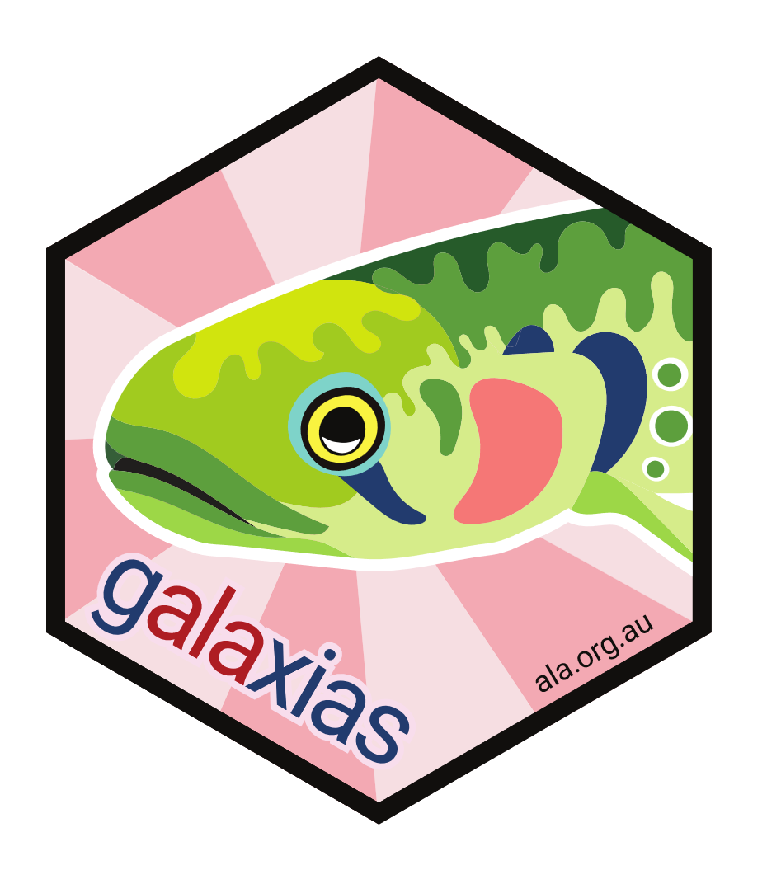













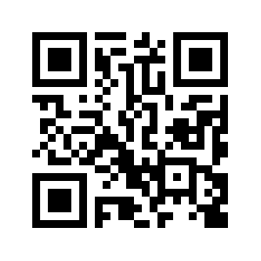

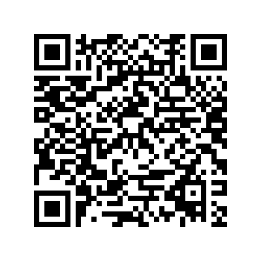


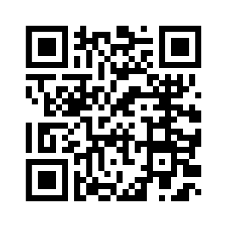
galaxias
An R and Python interface designed to simplify the process of converting biodiversity data into Darwin Core Archives, the accepted format to submit data to data infrastructures like the Atlas of Living Australia (ALA) or the Global Biodiversity Information Facility (GBIF).
What’s a Darwin Core Archive?
Poster design by Dax Kellie
data
(csv format)
The Process
metadata
(eml format)
to bundle and share biodiversity data with galaxias
data
metadata
archive
validate
submit
schema
Darwin Core Archive
(xml format)
These formats are easy for machines to ingest, but difficult for a user to make
library(galaxias)
my_data_dwc <- df |>
set_occurrences(occurrenceID = composite_id(location_id,
sequential_id()),
basisOfRecord = "humanObservation") |>
set_coordinates(decimalLatitude = latitude,
decimalLongitude = longitude) |>
set_locality(country = "Australia",
locality = "Canberra") |>
set_datetime(eventDate = lubridate::dmy(date)) |>
set_scientific_name(scientificName = species,
taxonRank = "species") |>
set_taxonomy(kingdom = "Animalia",
family = "Cacatuidae")
use_data(my_data_dwc) # add data to directory
use_metadata_template("metadata.Rmd")
use_metadata("metadata.Rmd") # add metadata to directory
# (auto-builds schema)
build_archive("my_dwca.zip") # convert to Darwin Core Archive
check_directory() # local quality checks
check_archive("my_dwca.zip") # GBIF quality checks
# open submission page
submit_archive()
Standardise data
galaxias
website
ALA
blog post
Write metadata
Scan QR code to go to webpage
Package for sharing
Intro video
Quality check
Share

