Slide 1




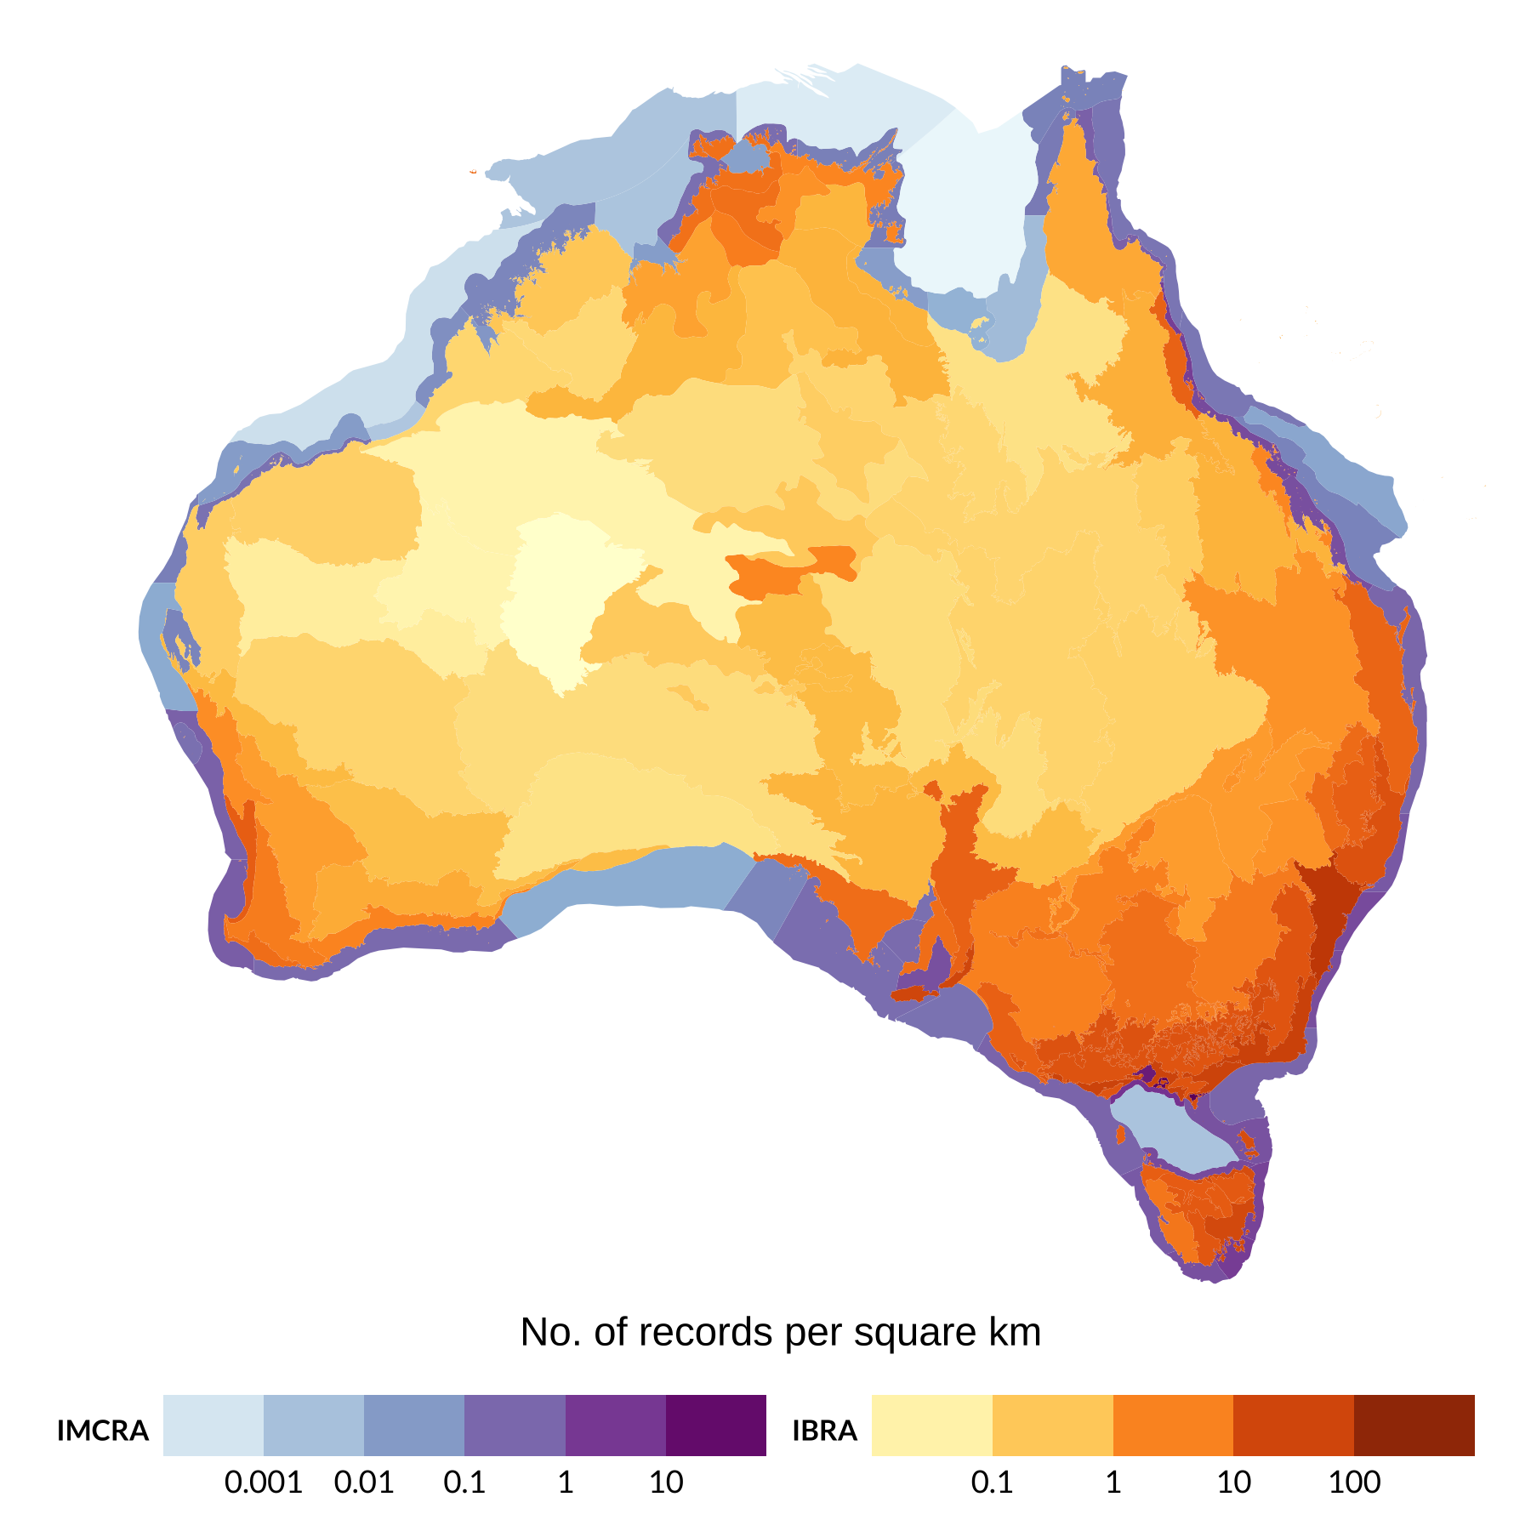
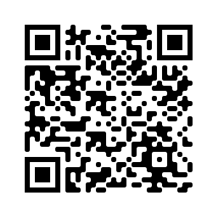
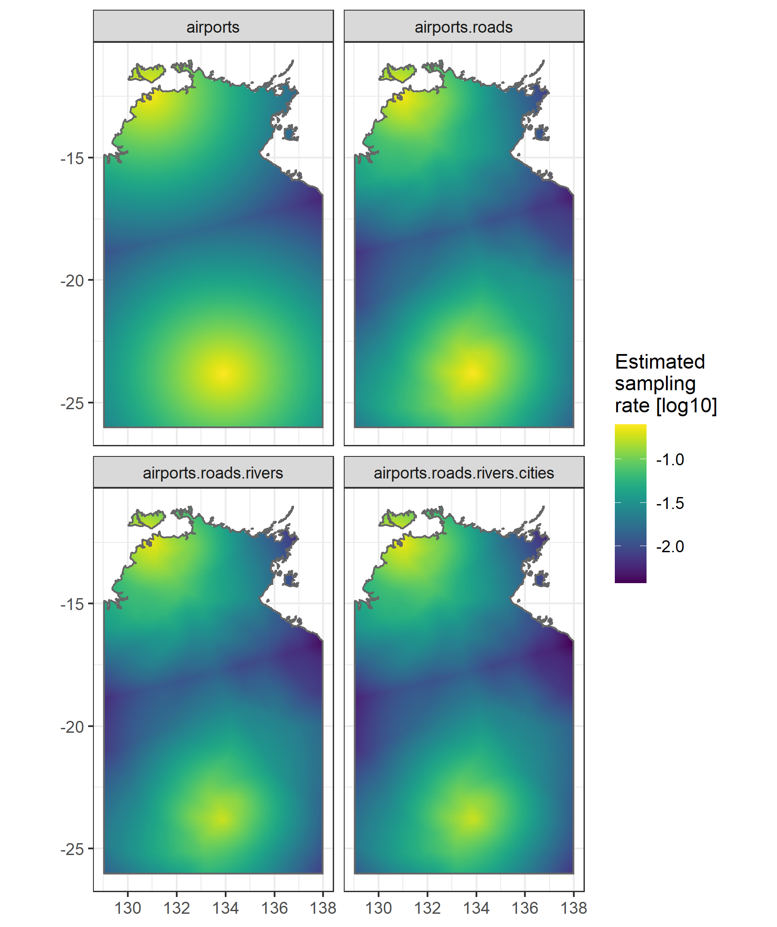
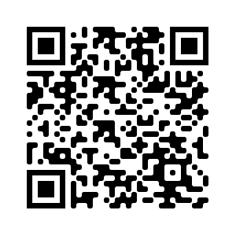
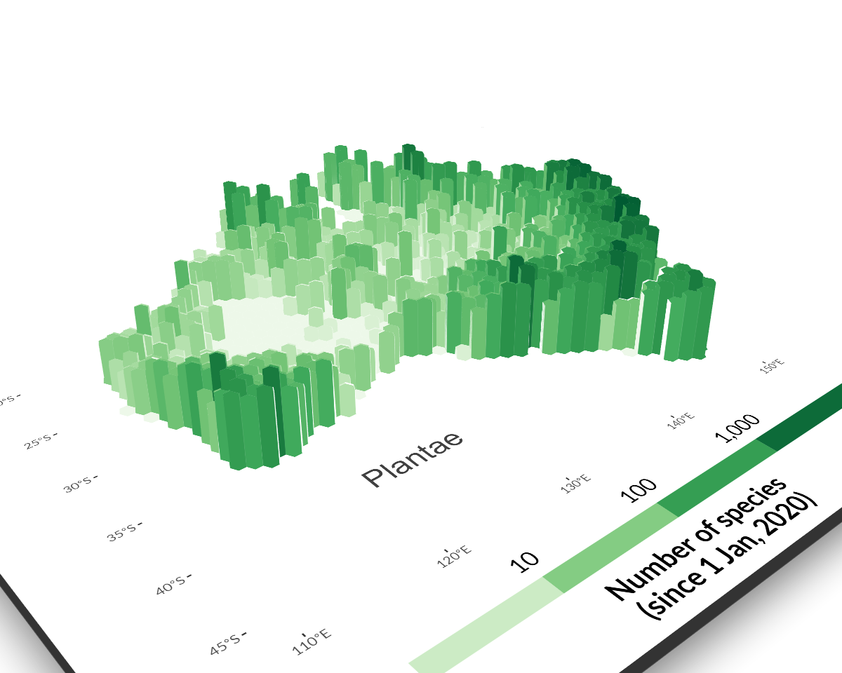

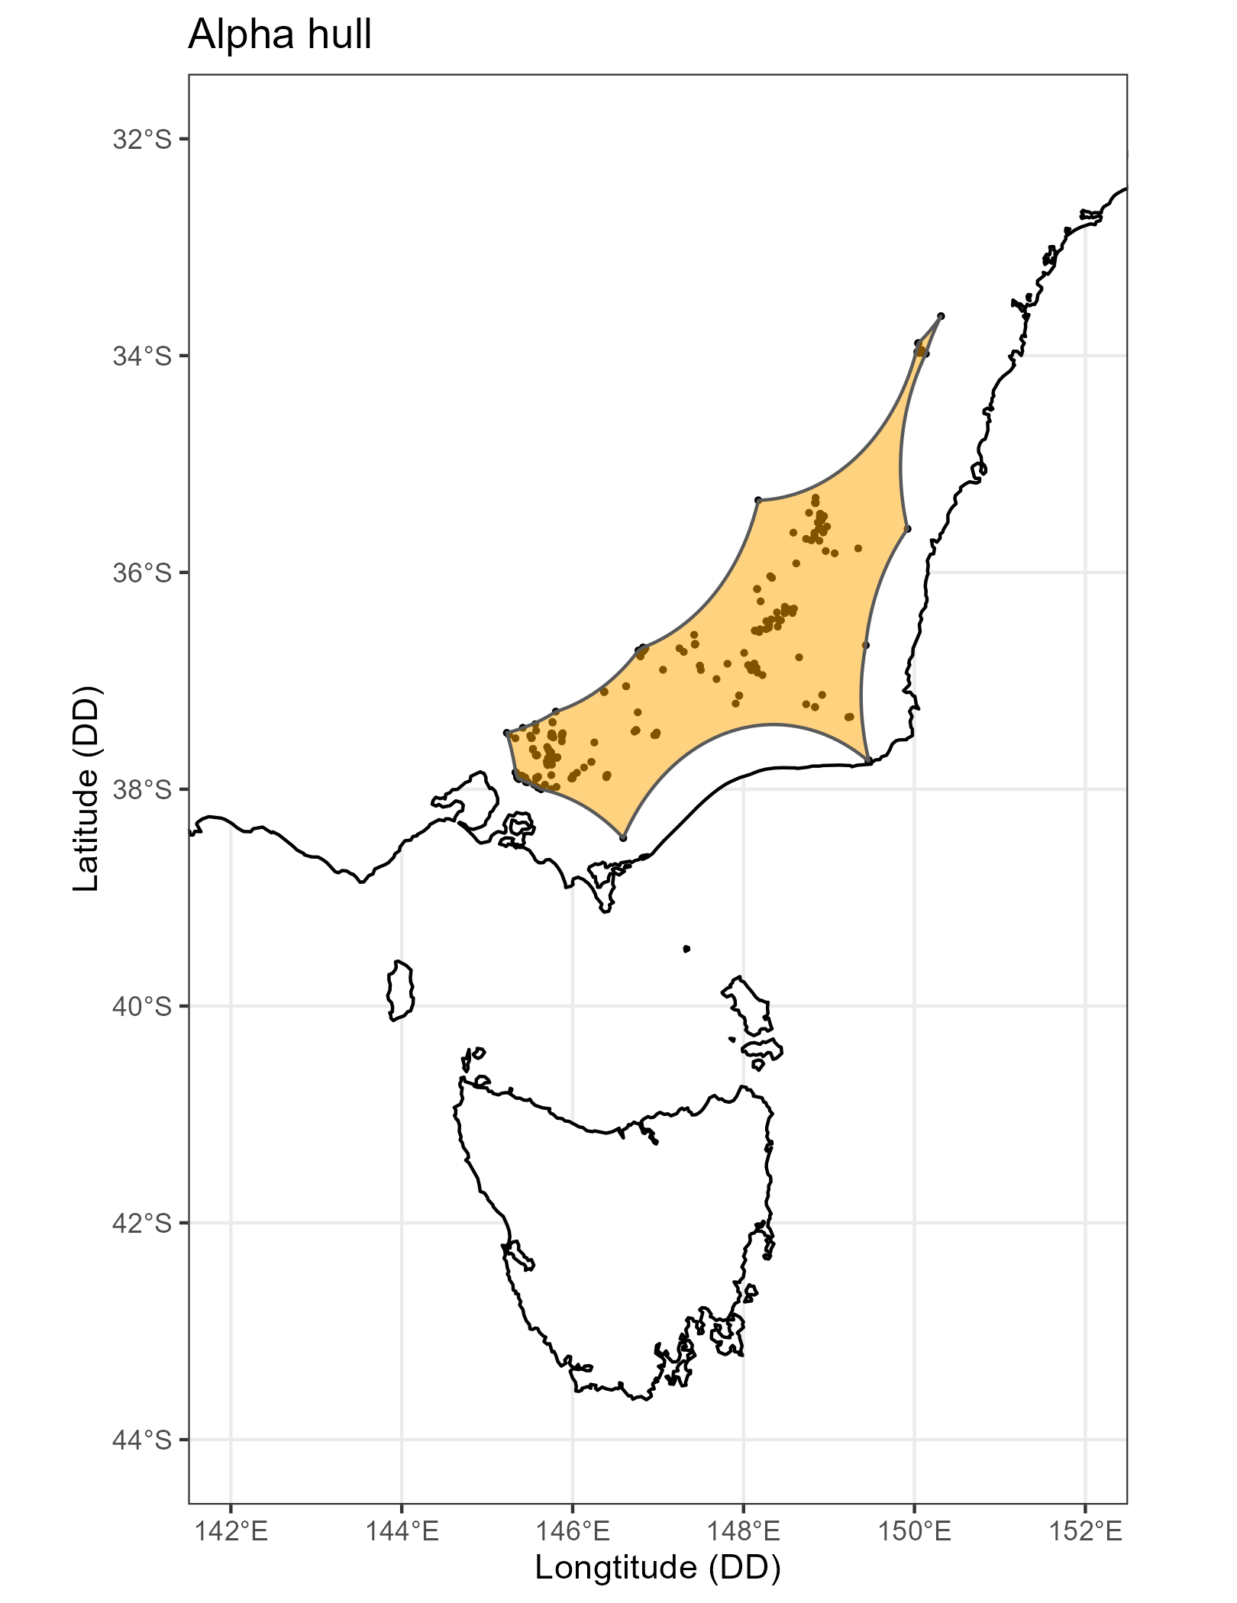
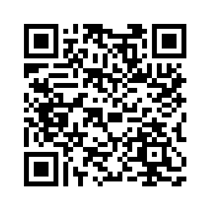
galah
An interface to biodiversity data hosted by the Living Atlases.
galah enables users to locate and download species occurrence records (observations, specimens, eDNA records), taxonomic information, or associated media
such as images or sounds, and to restrict their
queries to particular taxa and locations.
Download & filter data
Counts
galah_call() |>
galah_identify("litoria") |>
galah_group_by(species) |>
galah_apply_profile("ALA") |> # group of data quality filters
atlas_counts() |> print(n = 5)
#> # A tibble: 74 × 2
#> species count
#> <chr> <int>
#> 1 Litoria peronii 51123
#> 2 Litoria fallax 44840
#> 3 Litoria ewingii 38752
#> 4 Litoria aurea 34944
#> 5 Litoria verreauxii 22641
#> # … with 69 more rows
Learn how to use galah
for analyses & dataviz
ALA
LABS
Multiple colour scales in choropleth maps with {ggnewscale}
Occurrences
galah_config(email = “your-email-here") # ALA-registered email
galah_call() |>
galah_identify("eolophus") |>
galah_filter(year == 2022) |>
galah_select(scientificName, decimalLongitude,
decimalLatitude, eventDate) |>
atlas_occurrences() |> print(n = 5)
#> # A tibble: 2,463 × 4
#> scientificName decimalLongitude decimalLatitude eventDate
#> <chr> <dbl> <dbl> <chr>
#> 1 Eolophus roseicapilla 151. -32.9 2022-06-01T01:38:00Z
#> 2 Eolophus roseicapilla 139. -34.9 2022-09-10T21:08:00Z
#> 3 Eolophus roseicapilla 142. -34.3 2022-06-29T02:10:17Z
#> 4 Eolophus roseicapilla 139. -35 2022-09-18T11:42:00Z
#> 5 Eolophus roseicapilla 139. -34.9 2022-06-28T14:30:00Z
#> # … with 2,458 more rows
Scan QR code
to read
Quantify geographic sampling bias with {sampbias}
Species lists
Scan QR code
to read
galah_call() |>
galah_identify(“orchidaceae") |>
galah_filter(year > 2020) |>
atlas_species() |> print(n = 5)
#> # A tibble: 1,003 × 10
#> kingdom phylum class order family genus species author speci…¹ verna…²
#> <chr> <chr> <chr> <chr> <chr> <chr> <chr> <chr> <chr> <chr>
#> 1 Plantae Charophyta Equiseto… Aspa… Orchi… Glos… Glosso… R.Br. https:… Parson…
#> 2 Plantae Charophyta Equiseto… Aspa… Orchi… Pter… Pteros… R.Br. https:… Noddin…
#> 3 Plantae Charophyta Equiseto… Aspa… Orchi… Cala… Calade… R.Br. https:… Pink F…
#> 4 Plantae Charophyta Equiseto… Aspa… Orchi… Diur… Diuris… D.L.J… https:… Wallfl…
#> 5 Plantae Charophyta Equiseto… Aspa… Orchi… Diur… Diuris… Lindl. https:… Leopar…
#> # … with 998 more rows, and abbreviated variable names ¹​species_guid,
#> # ²​vernacular_name
Download plant species data by hexagon to make a 3D hex map
Images & media
Scan QR code
to read
galah_config(email = “your-email-here") # ALA-registered email
galah_call() |>
galah_identify("ceyx pusillus") |>
galah_filter(multimedia == "Image") |>
atlas_media() |>
collect_media(type = "thumbnail",
path = “path-to-folder") |>
dplyr::select(scientificName, eventDate, recordID,
multimedia, size_in_bytes, license) |> print(n = 5)
#> # A tibble: 145 × 5
#> scientificName multimedia license size_…¹ recor…²
#> <chr> <chr> <chr> <int> <chr>
#> 1 Ceyx pusillus Image "" 251821 7e58db…
#> 2 Ceyx pusillus Image "http://creativecommons.org/license… 1269060 0d249f…
#> 3 Ceyx pusillus Image "http://creativecommons.org/license… 311986 c4b290…
#> 4 Ceyx pusillus Image "http://creativecommons.org/license… 972214 9eda4c…
#> 5 Ceyx pusillus Image "http://creativecommons.org/license… 1380563 8032a3…
#> # … with 140 more rows, and abbreviated variable names ¹​size_in_bytes,
#> # ²​recordID
Convex and alpha hulls for conservation mapping
Scan QR code
to read

