Slide 1
Smart Traffic Management
Enhancing Urban Mobility with Real-Time Signal Optimization
Welcome to presentation on Smart Traffic Management. This innovative solution leverages real-time data to reduce congestion, optimize traffic flow, and enhance public transportation efficiency in urban areas. Join us as we explore how our advanced signal management system transforms urban mobility for a smoother, more efficient commute.

Slide 2
Urban Traffic Congestion Urban areas often face significant traffic congestion, especially at intersections where multiple routes converge. Traditional traffic management systems rely on pre-set traffic light timings, which may not adapt well to fluctuating traffic conditions. This can lead to increased waiting times, fuel consumption, and emissions.
Problem Statement and Description
Smart AI-Based Traffic Management System
An AI-based traffic management system can dynamically adjust traffic light timings based on real-time traffic data, improving traffic flow and reducing congestion.
Expected Solution:
Develop a smart, AI-based traffic management system that monitors traffic conditions in real-time and adapts traffic light timings accordingly.
Handle heavy traffic from multiple directions and optimize traffic flow to minimize delays and enhance overall efficiency.

Slide 3
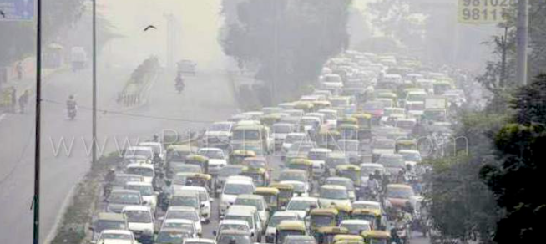
Understanding Trafﬁc Congestion
Urban areas often face significant traffic congestion, especially at intersections where multiple routes converge. This results in increased waiting times and delays.
Traditional traffic management systems rely on pre-set traffic light timings that do not adapt well to fluctuating traffic conditions, leading to inefficient flow.
Extended waiting times at red lights contribute to higher fuel consumption and increased emissions, negatively impacting the environment.

Slide 4

Proposed Solution
Our system utilizes advanced AI algorithms to monitor and adjust traffic light timings in real-time. This approach dynamically adapts to current traffic conditions, optimizing flow and reducing congestion.
The system continuously gathers data from sensors and cameras, analyzing traffic patterns to make timely adjustments to traffic light schedules. This helps in accommodating varying traffic volumes and improving overall traffic efficiency.
Key benefits of our solution include reduced waiting times, lower fuel consumption, decreased emissions, and enhanced safety at intersections.

Slide 5
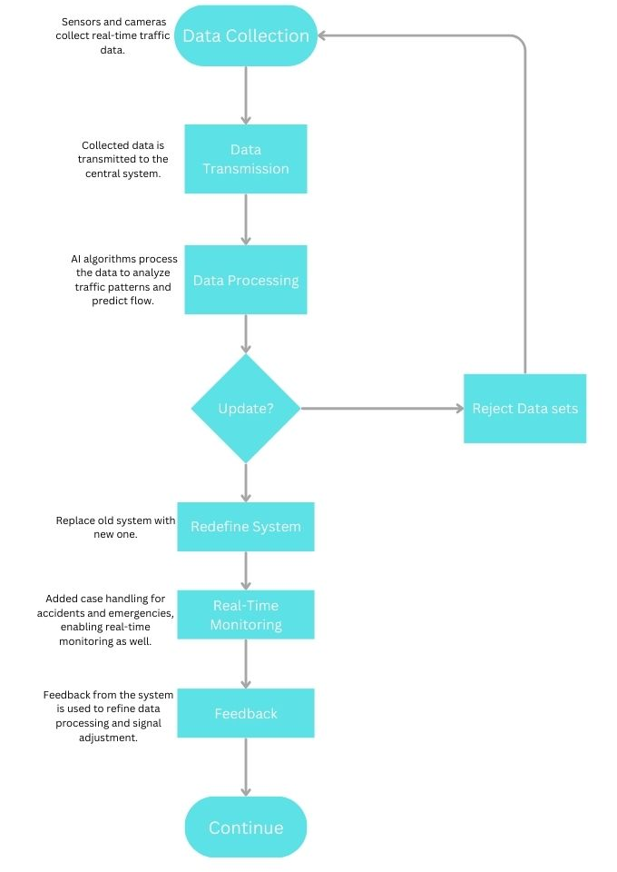
System Flow
Data Collection: Sensors and cameras collect real-time traffic data.
Data Transmission: Collected data is transmitted to the central system.
Data Processing : AI algorithms process the data to analyze traffic patterns and predict flow.
If(Update==true):
continue
Else: Reject dataset
Redefine System : Replace old system with new one.
Real-Time Monitoring : Added case handling for accidents and emergencies, enabling real-time monitoring as well.
Feedback : Feedback from the system is used to refine data processing and signal adjustment.

Slide 6
AI based Traffic Solution
Main Components of the AI Traffic Control System:
TrafficSimulation Class:
Simulates traffic conditions by calculating travel times and comparing them with green light timings.
Adjusts signals based on traffic volumes and vehicle speeds to avoid congestion and delays.
In cases of emergencies, the system adjusts the signals to prioritize emergency vehicles.
SignalOptimizer Class:
This module acts as the real-time brain of the system, analyzing incoming traffic data and predicting the best signal timings.
Handles various traffic scenarios, optimizing signal timings for both regular traffic conditions and emergencies.
Key Features
Emergency Vehicle Prioritization: Detects emergencies and adjusts signals to provide uninterrupted routes for emergency vehicles.
Real-Time Adaptation: The system continuously monitors and reacts to live data, making traffic management more responsive and efficient.

Slide 7

Challenges
Data Accuracy: Ensuring the accuracy of satellite images and GPS data for precise distance and travel time measurements.
Scalability: Managing and scaling the system to handle varying traffic conditions and road networks.
ML Model Training: Developing and training ML models to handle diverse traffic scenarios and adapt to new data.
System Reliability: Ensuring the system remains reliable and performs well under different conditions and scenarios.
User Acceptance: Ensuring that the system is user-friendly and accepted by traffic management authorities and the public.

Slide 8

Effective Policy and Regulation for AI in Traffic Management Effective policy and regulation are crucial for the successful implementation of AI in traffic management. Policymakers must tackle key issues such as: Data Usage: Establish guidelines for the collection, storage, and use of traffic data to ensure it is used responsibly and efficiently. Privacy: Develop regulations to protect the privacy of individuals, particularly with respect to GPS and other personal data collected from vehicles.

Slide 9

Conclusion
In conclusion, the integration of AI into traffic management systems represents a significant advancement towards optimizing urban mobility and enhancing road safety. By leveraging satellite imagery, GPS data, and machine learning algorithms, we can achieve more accurate and real-time traffic management solutions. However, the successful implementation of these technologies requires addressing key challenges, including data accuracy, real-time processing, integration, and scalability.

Slide 10
Thank you for your attention!
Present by Dax Patel

