Slide 1
<FlowMaster> <Title>
Enhancing Urban Mobility with Smart Traffic Signal Management

Slide 2

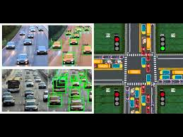
<FlowMaster> <Overview>
Welcome To <Presentation> #Hello, I’m Dax;
How long have you waited at a red light with no cars in sight? What if we could eliminate that frustration?

Slide 3
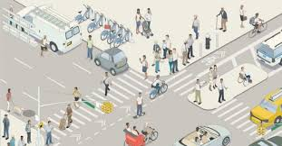

<FlowMaster> <Problem>
<?php
$text = "Traditional traffic signal systems often contribute to congestion, delays, and safety concerns due to their static nature. These systems are not designed to adapt to real-time traffic conditions, resulting in fixed timings that can lead to extended waiting periods and increased emissions. The lack of flexibility in responding to fluctuating traffic volumes means that vehicles .can experience unnecessary delays, affecting overall traffic flow and contributing to environmental impacts.";
echo $text;
?>
}
}
Individuals’
}
}
{City Planners}
<?php
$text = "Experience longer travel times, frustration, and increased fuel consumption.";
echo $text;
?>
<?php
$text = "Struggle with outdated systems that can’t reduce congestion effectively.";
echo $text;
?>

Slide 4
<FlowMaster> <Solution>
Smarter Traffic Signals
}
01
}
}
02
}
Adaptive Signal
“Green Wave”
const text = "Our traffic signal management system currently operates using a sophisticated algorithm that optimizes signal timings based on static data inputs such as distances, speeds, and traffic volumes.";
console.log(text);
const text = "The system calculates and adjusts green times for each traffic signal to ensure smooth vehicle flow, reducing congestion and wait times.";
console.log(text);
}
04
}
}
03
}
///Problem Mitigation
{Environment }
const text = "The algorithm identifies and manages scenarios such as accidents and emergencies, ensuring that traffic flow is adjusted accordingly to minimize disruptions.";
console.log(text);
const text = "By reducing idle time, we lower fuel consumption and emissions.";
console.log(text);

Slide 5
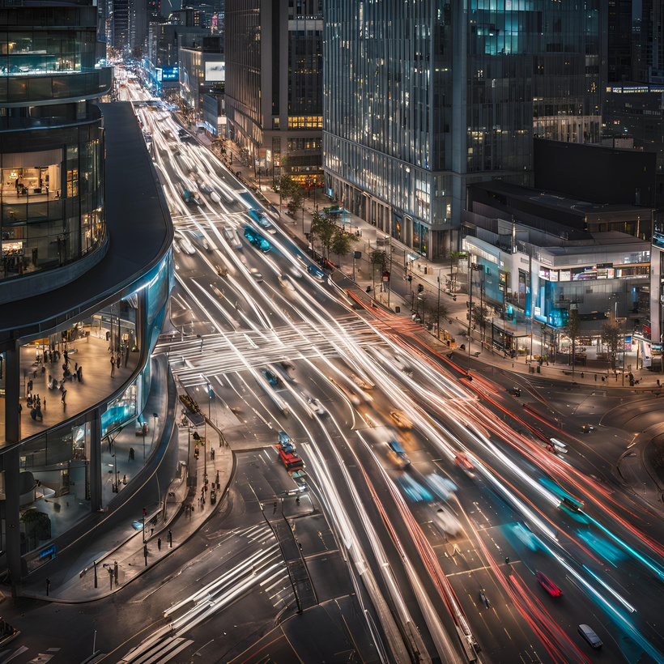
<FlowMaster> <Innovation>
Features of ‘the Topic’ {
public class TrafficManagement {
public static void main(String[] args) {
String text = "Our traffic signal management system distinguishes itself through an advanced algorithm that optimizes traffic flow and reduces congestion. Unlike traditional fixed-timing systems, which operate with static timings, our approach utilizes an intelligent algorithm that adjusts signal timings based on real-time traffic data. This ensures smoother transitions between signals and significantly reduces waiting times for vehicles.";
System.out.println(text);
}
}

Slide 6



<FlowMaster> <Market>
}
}
const text = "The global market for smart traffic management solutions is experiencing rapid expansion, driven by the growing demand for efficient urban mobility and sustainable city planning. Industry projections indicate significant growth over the coming decade, with billions of dollars in potential revenue as cities invest heavily in modernizing their traffic infrastructure.";
console.log(text);
}
}
const text = "Growth Potential: The smart traffic management market is set to thrive, fueled by increasing urban populations and the pressing need for more intelligent and adaptable infrastructure solutions.
const text_1= “Government Focus: Governments are increasingly prioritizing advanced traffic management solutions that provide immediate improvements and scalability. This focus makes them prime candidates for early adoption and investment in cutting-edge technologies.";
console.log(text,text_1);

Slide 7

<FlowMaster> <Model>
data _gathered
{
data=[sensors] ,[cameras];
}
printf(Ans);
Data Collection
Data Transmission
Data Processing
Processed Data
process(data)
{
//Algo
}
process(data);

Slide 8


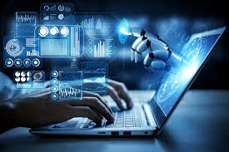
<Company> <Technology>
}
}
def prototype:
Technology Readiness Level (TRL): Our traffic signal management solution is currently at Technology Readiness Level (TRL) 4, which indicates that the technology has been validated through controlled experiments and is at the prototype stage. To progress further, it will require extensive real-world testing and refinement.
}
}
def technology:
Our solution leverages a Machine Learning (ML) model to enhance traffic signal management. By analyzing real-time traffic data, this model dynamically adjusts signal timings to optimize traffic flow and reduce congestion. The use of advanced ML techniques allows the system to continuously improve and adapt, making it a powerful tool for modern traffic management.

Slide 9

<Company> <Competition>
‘Potential Competitors{]
<html>
<head>
<title>Traffic Management Solutions</title>
</head>
<body>
<h2>Competitors</h2>
<p>Siemens Mobility: Provides advanced traffic management systems and smart city solutions.Cubic Transportation Systems Known for adaptive traffic control and integrated traffic management solutions.</p>
<p>Wavetronix:Specializes in traffic sensors and systems that optimize signal timings and manage real-time traffic conditions.</p>
<h2>Barriers to Entry</h2>
<p>Regulatory Approvals: Navigating and obtaining necessary regulatory approvals can be challenging but is essential for widespread adoption.</p>
</body>
</html>

Slide 10












<FlowMaster> <Canvas>
The Lean Canvas
Version:1.O
Designed by:FlowMAster
Problem
Solution
Unique Value Prop.
Unfair Advantage
Customer Segments
Static traffic signals cause congestion and delays.
Lack of real-time adaptability leads to inefficient traffic management.
Environmental Impact
Machine Learning model adjusts signal timings based on real-time data.
Prototype stage validated through experiments.
Future enhancements will enable real-time adaptability.
Real-time traffic data integration for dynamic signal management.
Optimized green times reduce congestion and waiting times.
Potential for future dynamic adjustments and scalability.
Unique algorithm with potential for dynamic real-time adjustments.
Early adoption and partnerships with local governments.
Proven prototype and validation through experiments.
Local Governments: Need for efficient traffic management.
Urban Planners: Require scalable and modern traffic solutions.
Commuters
Existing Alternatives
Key Metrics
High-Level Concept
Channels
Early Adopters
Adaptive Traffic Signal Control Systems
Traffic Signal Coordination
Remote Traffic Management
Traffic flow improvements and reduced congestion.
Feedback and performance data from pilot implementations.
User satisfaction and system reliability in real-world conditions.
Smart Traffic Management = Adaptive Cruise Control for Urban Traffic
Dynamic Traffic Signals = Netflix for Traffic Management
eal-Time Signal Optimization = Google Maps for Traffic Lights
Direct partnerships with local governments.
Collaborations with smart city and traffic management initiatives.
Demonstrations and pilot projects in targeted urban areas.
Urban Planners and Local Governments
Description: Responsible for city infrastructure and traffic management.
Needs: Effective solutions for reducing congestion, improving traffic flow, and managing urban mobility.
Public Safety Officials
Description: Departments concerned with emergency response and traffic safety.
Needs: Systems that can adapt to emergencies and improve overall traffic safety.
Cost Structure
Revenue Streams
Development and testing of the ML model.
Implementation and maintenance of prototype systems.
Operational costs for pilot projects and customer support.
Initially offered free to local governments for pilot testing.
Future revenue through licensing or subscription models.
Potential for partnerships and long-term contracts.

Slide 11
<Company> <Business MOdel>
BEGIN
INITIAL_INVESTMENT = "Funding required for system development, regulatory compliance, and initial operational costs."
PRINT "Initial Investment: " + INITIAL_INVESTMENT
IF seeking_local_government_support THEN
PRINT "Seek local government support for initial deployment and data collection."
PRINT "Support will help validate the system and build a case for future funding and expansion."
ENDIF
IF system_established_and_validated THEN
PRINT "Explore expansion opportunities to other municipalities and regions."
PRINT "Consider adding new features and developing additional revenue-generating products."
ENDIF
IF forging_partnerships THEN
PRINT "Forge partnerships with technology providers and smart city initiatives."
PRINT "Enhance the system's capabilities and market reach through these partnerships."
ENDIF
END

Slide 12

<Company> <Lesson>
Thank You!}`
BEGIN
PRINT "Thank you for attending the presentation."
IF everyone_follows_traffic_signals THEN
PRINT "Traffic signals work effectively."
ENDIF
IF audience_engagement AND support THEN
PRINT "Our ideas succeed."
ENDIF
PRINT "Your involvement is appreciated."
END

