Slide 1
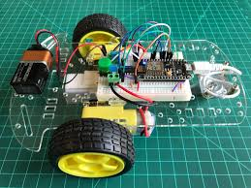
PROJECT NAME: Wi-Fi Controlled Car
PREPARED BY: GUIDED BY:
DAX PATEL (18CE070) ARPITA MA’M
SHAIL PATEL (18CE086) PROF. CHINTAN SIR

Slide 2
DEFINITION
Wifi Controlled Based Car

Slide 3
Why We Choose IOT Based Project?
Now a days Robots are used in many manufacturing industries.
The reason is that the cost per hour to operate a robot is a fraction of the cost of the human labour needed to perform the same function.
More than this, once programmed, robots repeatedly perform functions with a high accuracy than experienced human operator.
Considering all of this we have decide to do project based on IOT, that’s why we are making WI-FI controlled car.

Slide 4
OVERVIEW
We have develop an android application using blynk, through which our entire car model is operated.
Through our android app we can transmit command using wi-fi to the car by giving various commands, so that it can move in the required directions like…
In our project we have made small car model like Structure.

Slide 5
FORWARD: It is the command to move the robot straight forward unless a new command is sent.
Right: It is the command which turns the robot right unless a new command is sent.
Left: It is the command which turns the robot left unless a new command is sent.
BACKWARD: It is the command to move the robot straight backward unless a new command is sent.
Commands

Slide 6
STEPS:
Materials Required
Structure of Model
Finding the IP Address of the ESP8266
Making of Circuit
Programming
Installing the Control App
Controlling the Model

Slide 7
Software Components Required
Arduino Language/IDE/Compiler
Blynk
Android Studio 3.3

Slide 8
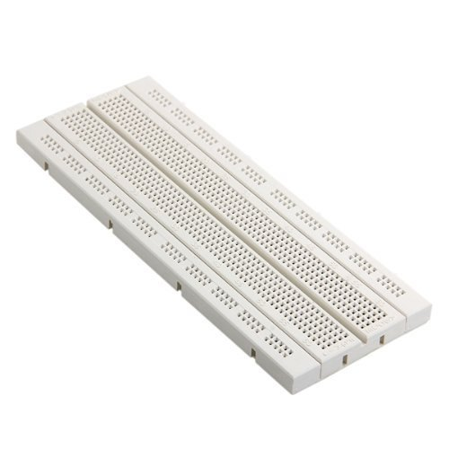
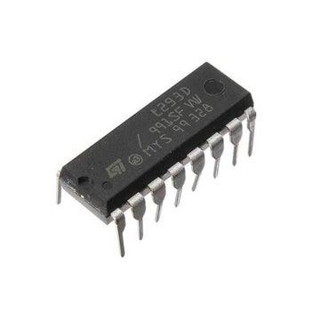
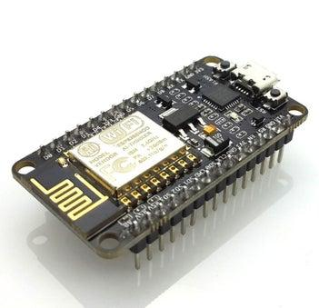

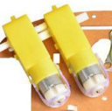
Hardware Components Required
Breadboard
Motor I.C
Node-MCU ESP8266 wi-fi module
Battery
D.C. Motor

Slide 9
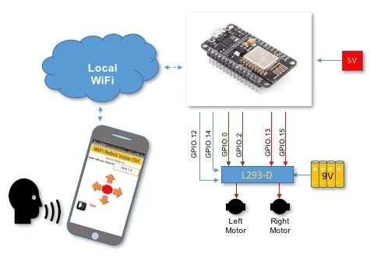
Graphical representation

Slide 10
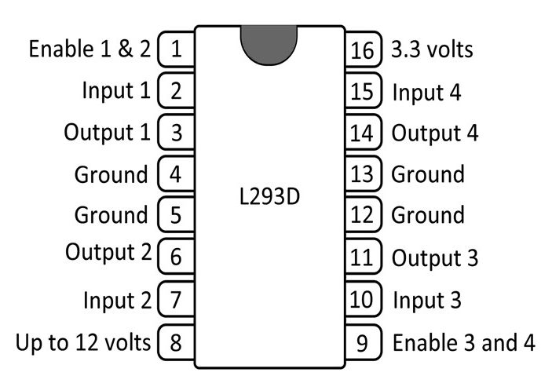
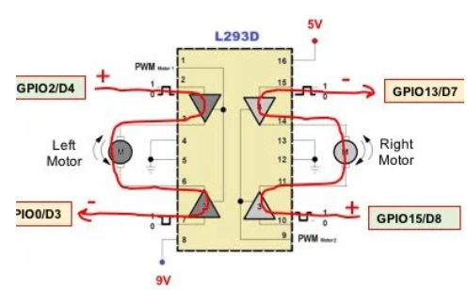
L293D [MOTOR DRIVER I.C.] Diagram

Slide 11
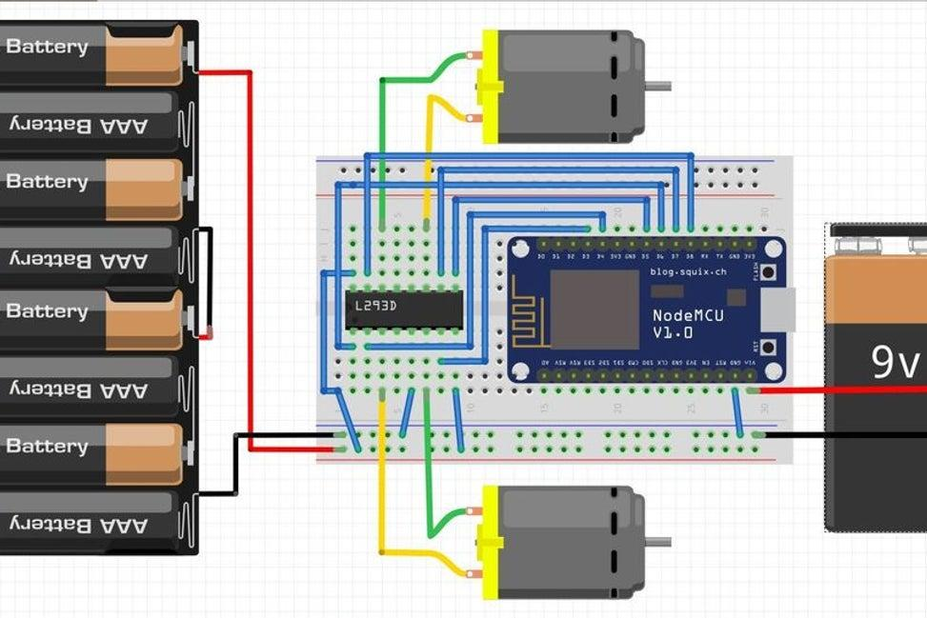


Circuit looks like

Slide 12
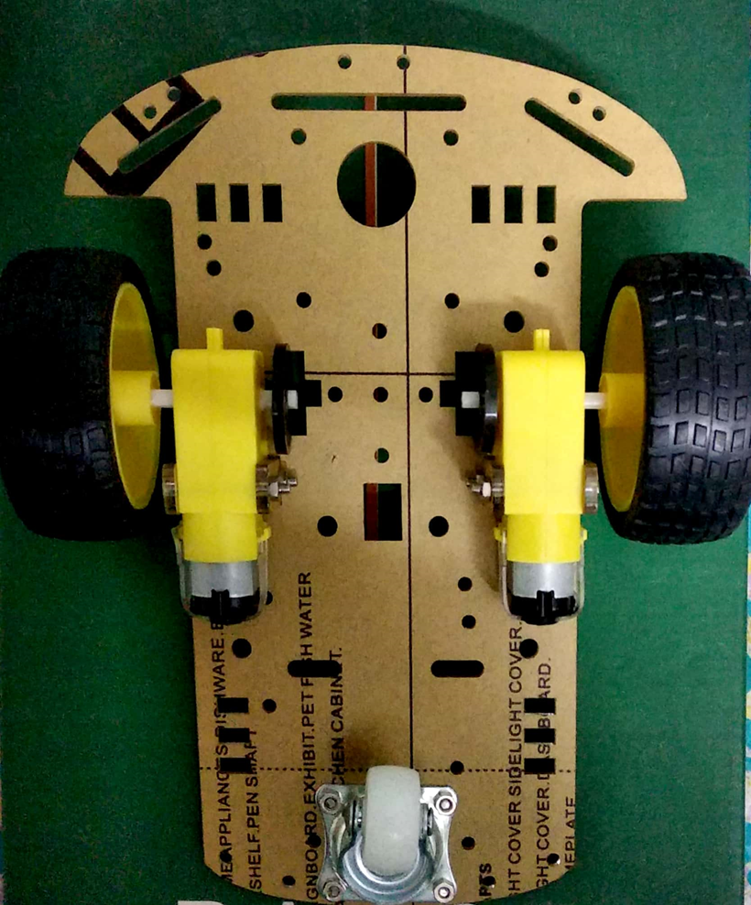
Car chassis looks like

Slide 13
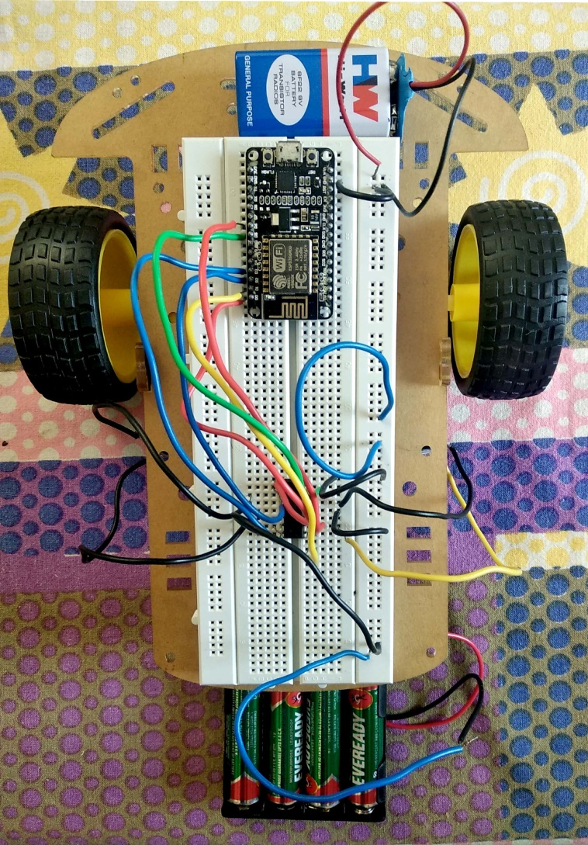
Car Model looks like

Slide 14
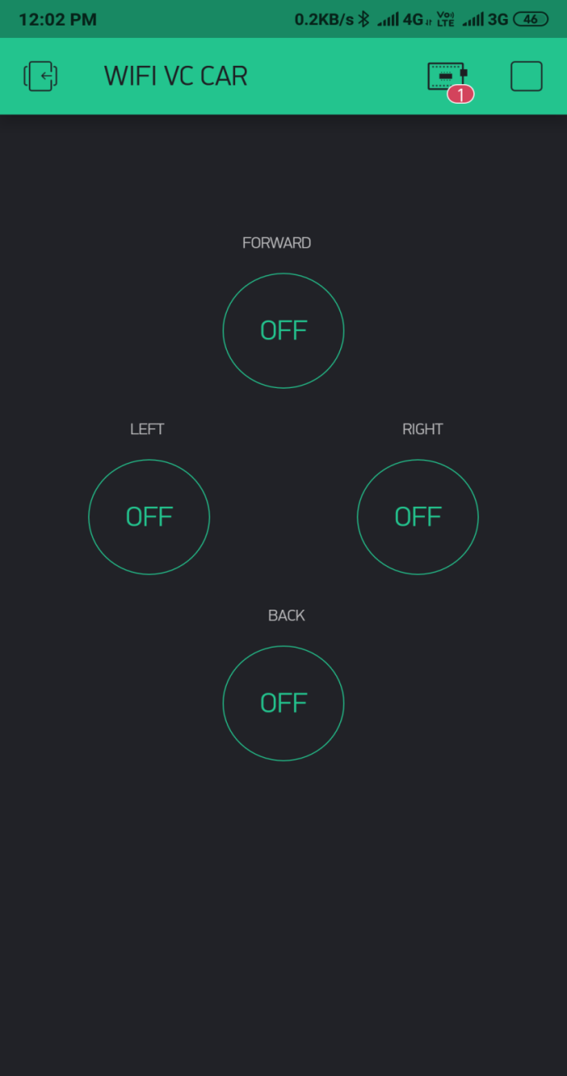
We have make two types of Android application to operate our car. 1.Using Blynk 2.Using Android Application
Using button in Blynk:

Slide 15
In our project coding is divided into three parts
1.Wifi and car connection code
2.Car movement code
3.Android application code through which we can operate our car.

Slide 16
References:
Web Link
https://www.instructables.com/id/WiFi-Voice-Controlled-Robot-With-NodeMCU/
https://www.pantechsolutions.net/wi-fi-controlled-robot-car-using-nodemcu
https://randomnerdtutorials.com/esp8266-controlled-with-android-app-mit-app-inventor/
Video Link
https://www.youtube.com/watch?v=UFJzQH3G1Ko&list=PLVrieKUj5RceFRq5MKy-f-EHdumStFPLt
https://www.youtube.com/watch?v=-TH9s7Y9_b4
Data Sheet
https://www.alldatasheet.com/view.jsp?Searchword=Esp8266&gclid=EAIaIQobChMI39GRqeWs5AIVi4BwCh2l8AcQEAMYASAAEgJSIvD_BwE
https://www.alldatasheet.com/view.jsp?Searchword=L293d%2520datasheet&gclid=EAIaIQobChMI_sD2pOas5AIVkYRwCh1yIQUIEAAYASAAEgLnQ_D_BwE

Slide 17
Thank You

