Slide 1
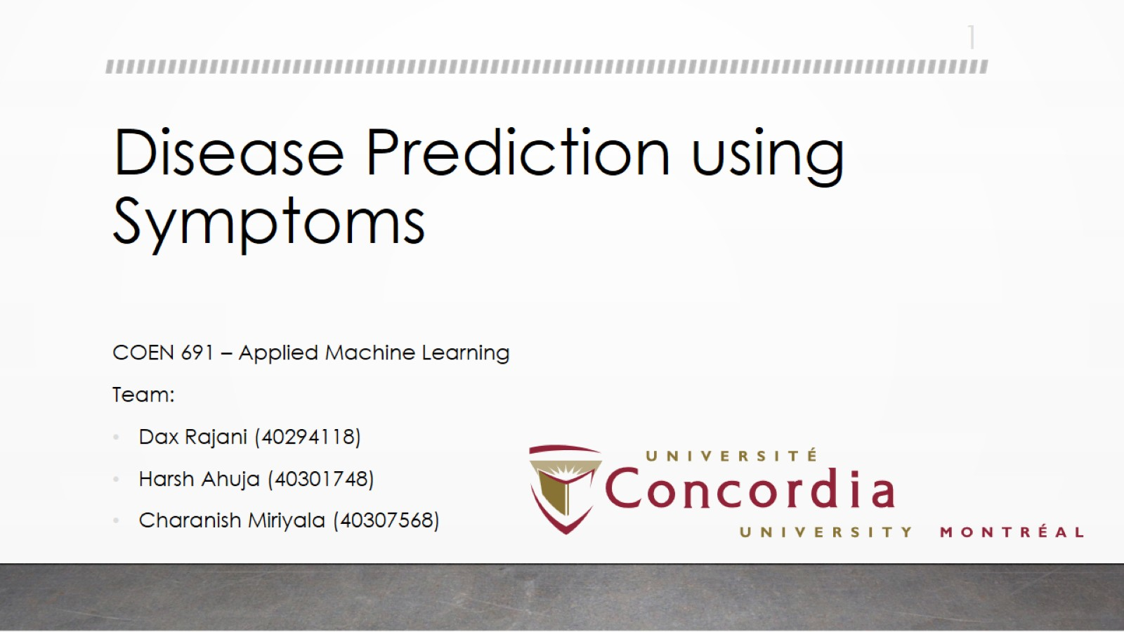
Disease Prediction using Symptoms

Slide 2
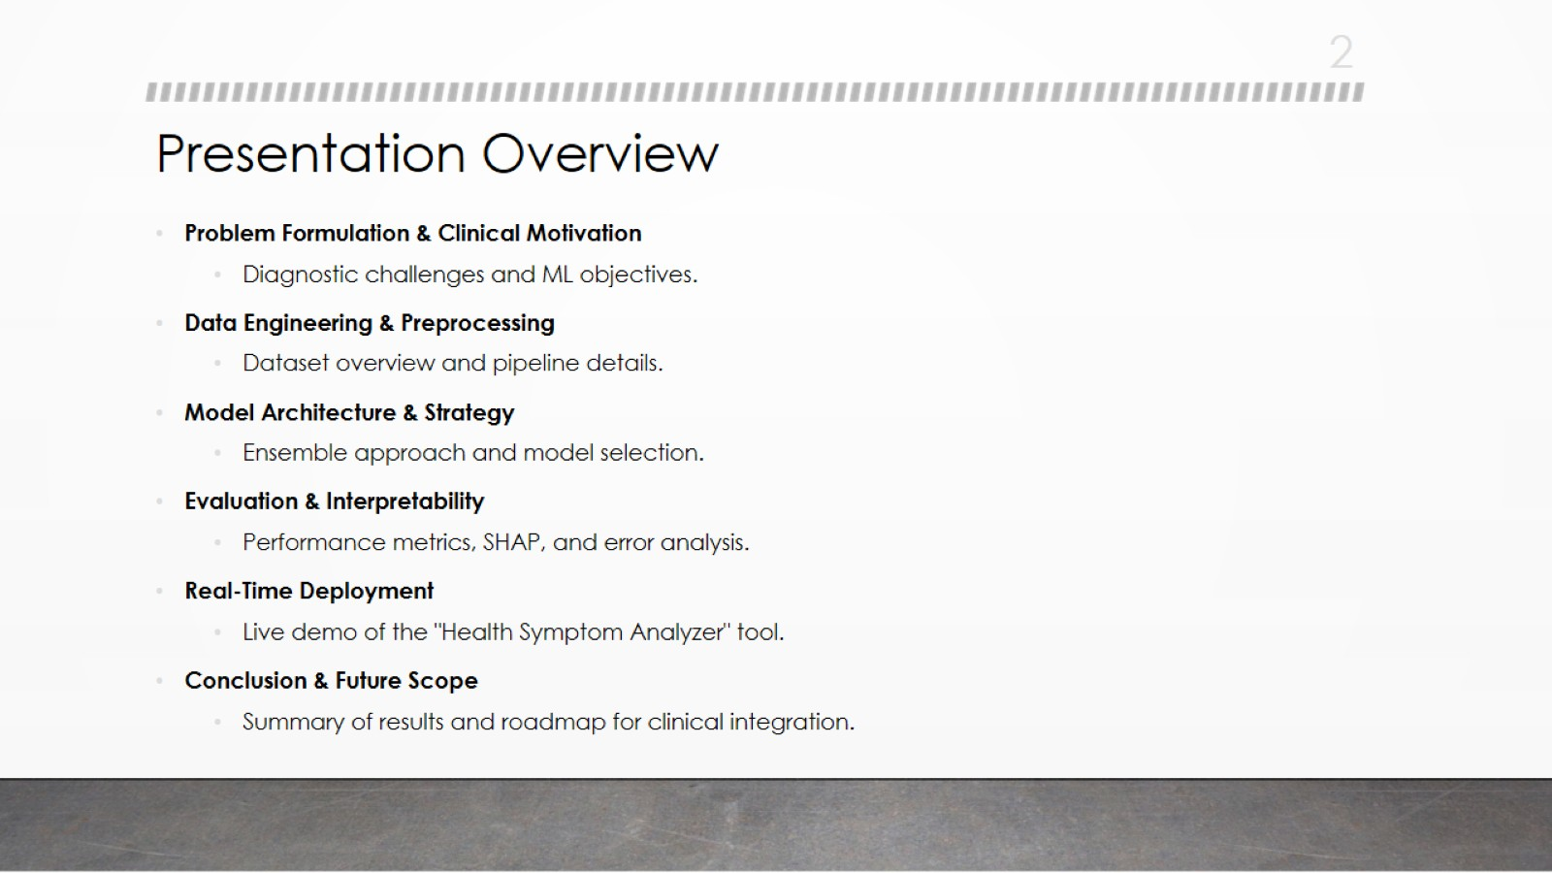
Presentation Overview

Slide 3
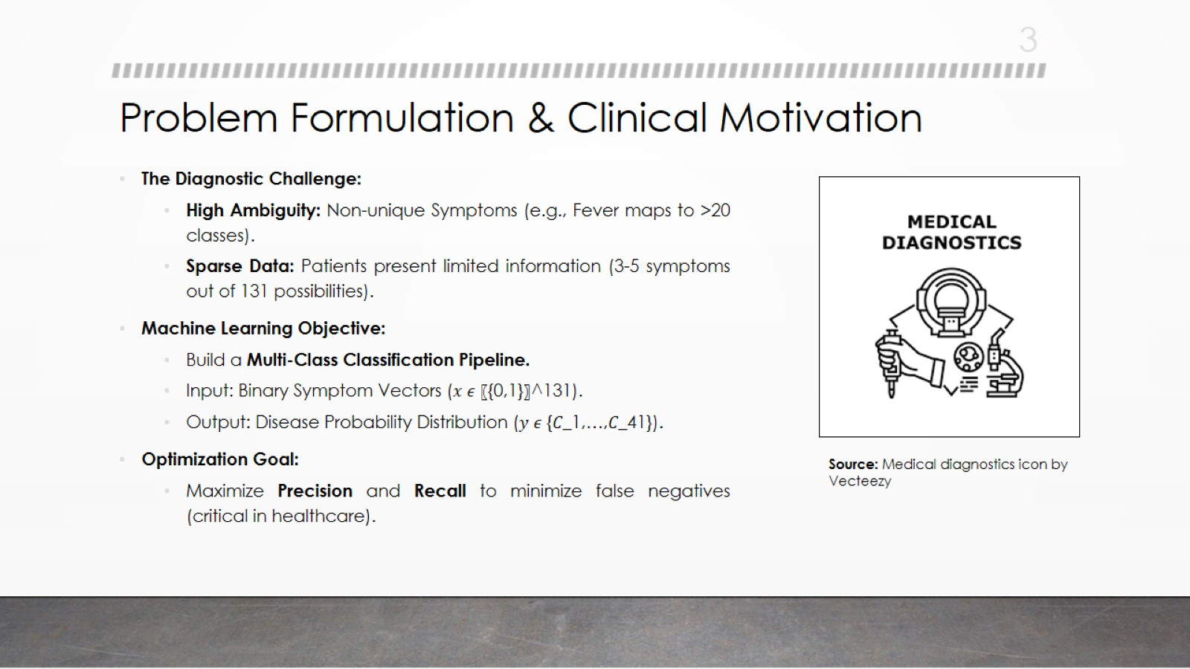
Problem Formulation & Clinical Motivation

Slide 4
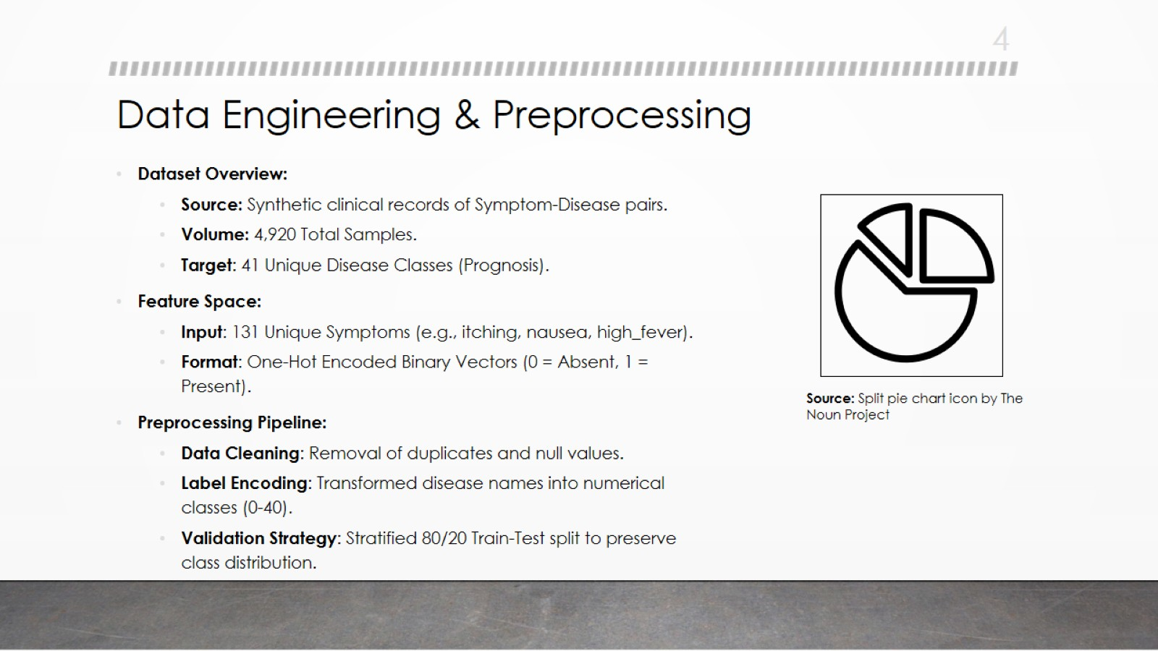
Data Engineering & Preprocessing

Slide 5
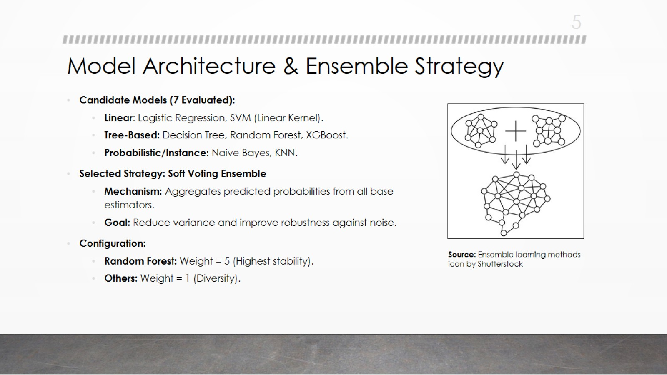
Model Architecture & Ensemble Strategy

Slide 6
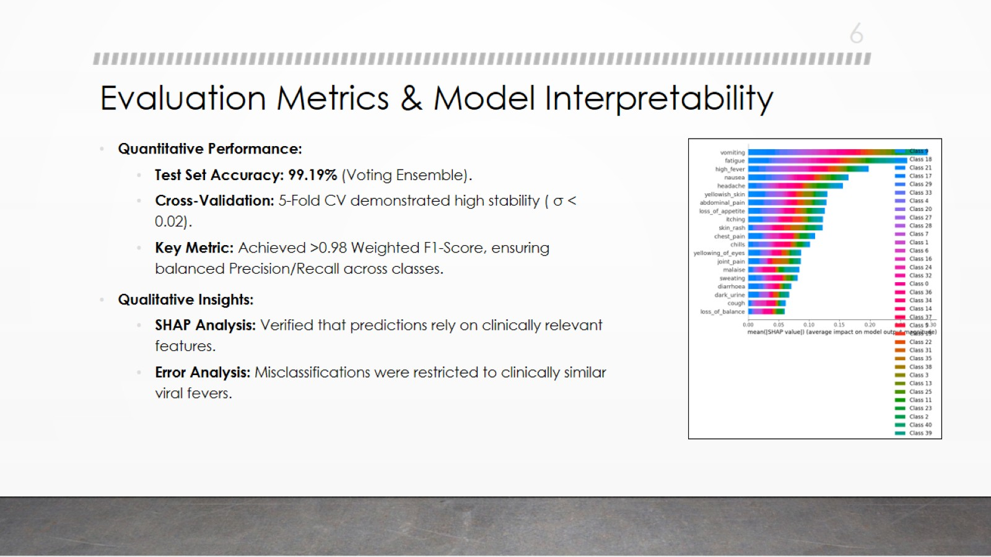
Evaluation Metrics & Model Interpretability

Slide 7
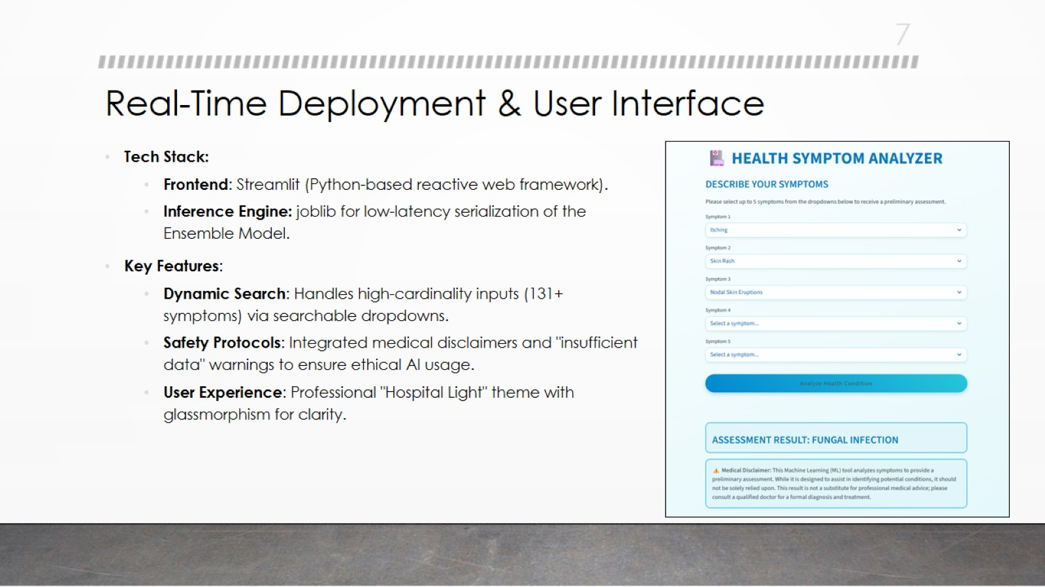
Real-Time Deployment & User Interface

Slide 8
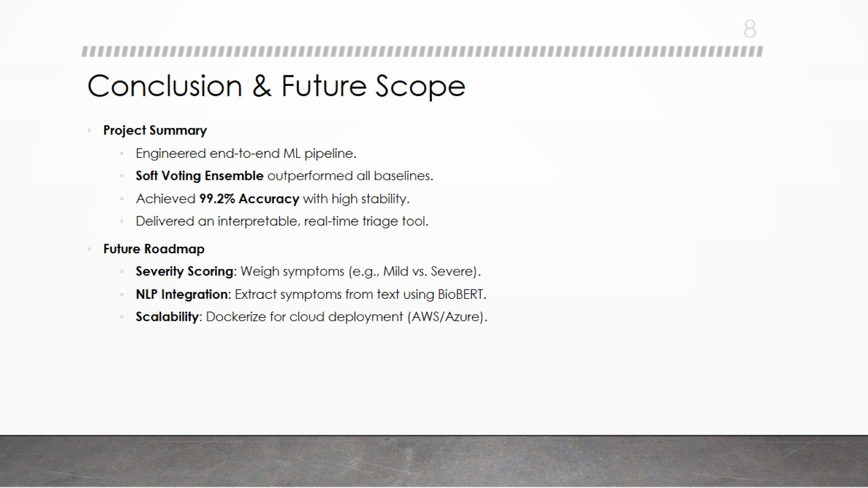
Conclusion & Future Scope

Slide 9
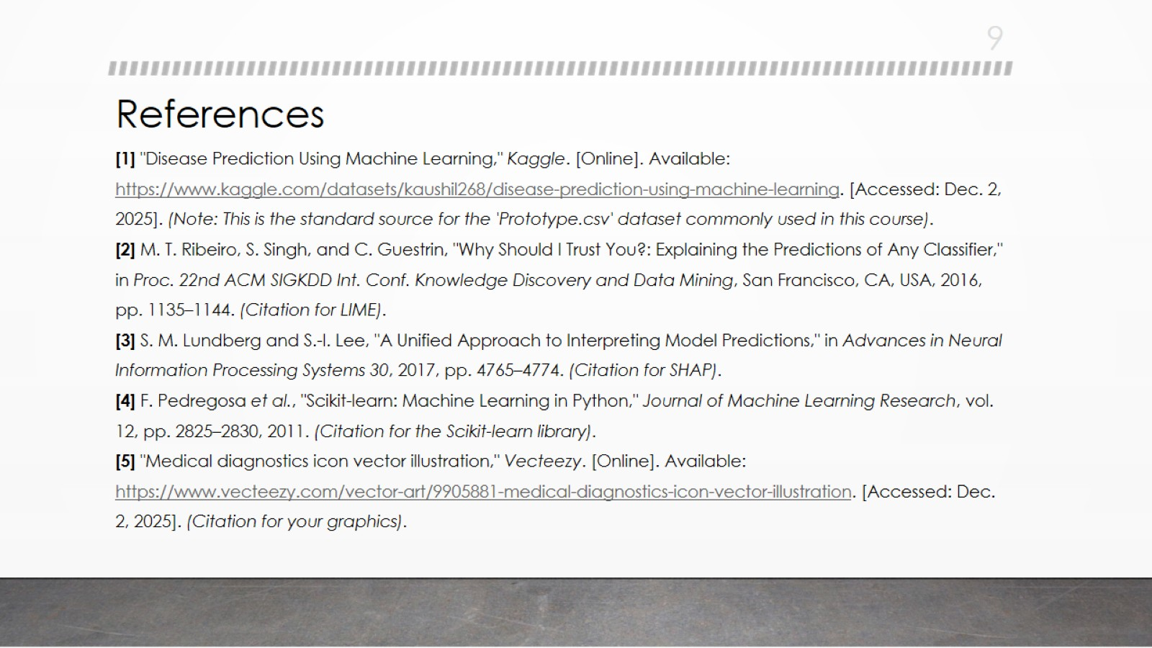
References

Slide 10

Thank You!

