Slide 1
Scalable E-Commerce Analytics Pipeline
PySpark on GCP Dataproc · 42M+ Events · 5-Stage Distributed Pipeline
Dax Rajani (40294118) · Harsh Ahuja (40301748)
COEN 6731 — Distributed Software Systems · Concordia University, Winter 2026
42.4 M
742 K
166 K
5
9
events
orders
products
pipeline stages
benchmark runs

Slide 2
Problem Statement
Slide 1 / 7
The Challenge
Dataset & Research Questions
Scale:
REES46 eCommerce Behavior Data (Kaggle, Oct 2019)
42M+ events: pandas times out. Need distributed Spark to process in minutes.
42,448,764 events · 742,849 orders · 166,794 products Columns: event_time · event_type · product_id · category_code brand · price · user_id · user_session Synthesized: device (mobile / desktop / tablet) · referrer channel
Missing Features:
Raw data lacks device & referrer columns — synthesized via deterministic CRC32 hash on user_session.
Q1
What is the view → cart → purchase conversion funnel by category & channel?
Multi-Stage Logic:
Q2
Which referrer channel drives the most revenue? (last-touch attribution)
Sessionization → Funnel → Attribution → Anomaly must form a reproducible, timed pipeline.
Q3
Are there anomalous SPIKE / DROP days in daily purchases? (z-score)
Cost vs. Performance:
Q4
How does throughput scale with cluster size and data volume?
Is adding more workers worth the GCP cost? Quantify actual speedup vs. ideal scaling.

Slide 3
System Architecture
Slide 2 / 7
GCP Dataproc Cluster (1 Master + 2 / 4 / 5 Workers, n1-standard-4, us-central1)
1 ETL & Enrichment
2 Session- ization
3 Funnel Analysis
4 Attribution Last-Touch
5 Anomaly Detection
GCS Input CSV (42M rows)
GCS Output Parquet (results)
CRC32 → device & referrer Parquet write
30-min inactivity lag() window session_id
view→cart→buy by category device/referrer
24-hr join row_number() non-direct ref
7-day z-score |z|>2 → SPIKE per-category
5w / 10GB
224s
185s
incl.
64s
16s
Cluster Topology
Master Node SparkContext / YARN RM
Worker 1 n1-std-4 4 vCPU / 15GB
Worker 2 n1-std-4 4 vCPU / 15GB
Worker 3 n1-std-4 4 vCPU / 15GB
Worker 4 n1-std-4 4 vCPU / 15GB
Worker 5 n1-std-4 4 vCPU / 15GB
↕ GCS (gs://dss-project-dax) — Parquet read/write
GCS
ETL
Sessionize
Funnel
Attribution
Anomaly

Slide 4
Implementation Structure
Slide 3 / 7
DATA LAYER
CORE PIPELINE
OPTIMIZATIONS
CLOUD / INFRA
REES46 CSV
etl_enrichment.py
broadcast_join_opt.py
cloud_pipeline.py
42M rows / 5.3 GB
CRC32 hash · Parquet write · 229 lines
Shuffle vs broadcast join · 213 lines
Full Dataproc pipeline · 554 lines
enriched_events/
benchmark_job.py
partition_analysis.py
cloud_submit.sh
Parquet (device + referrer)
Orchestrator · Sessionization · Funnel · 259 lines
Date-partitioned Parquet · 177 lines
Parameterized job submission
orders / catalog
attribution.py
skew_analysis.py
demo.sh
(derived tables)
Last-touch join · row_number() · 285 lines
Hot-key detection · salting · 315 lines
Live demo entry point
funnel_metrics/
anomaly_detection.py
streaming_job.py
attribution/ anomalies/
7-day z-score · SPIKE/DROP text · 279 lines
Structured streaming demo
Raw → Processed
Reads Parquet
Uses Parquet
Runs on GCP
Total codebase: ~4,080 lines of Python · 17 scripts · Local (PySpark local[*]) + Cloud (GCP Dataproc)

Slide 5
Pipeline Deep Dive — 5 Stages
Slide 4 / 7
Stage 1
Stage 2
Stage 3
Stage 4
Stage 5
ETL & Enrichment
Session- ization
Funnel Analysis
Attribution (Last-Touch)
Anomaly Detection
Read 42M-row CSV via spark.read.csv
lag(event_time) per user_id window
view → cart → purchase events
Join orders ⊲⊳ sessions on user_id
Daily purchase counts (system + per-cat)
CRC32(user_session) → device, referrer
Gap > 30 min → new session flag
Group by category / device / referrer
Filter: referrer ≠ 'direct'
7-day rolling avg + stddev window
Filter purchases → orders table
cumsum() → session index
Daily and weekly granularity
24-hour lookback window
Flag |z-score| > 2 as SPIKE / DROP
Write Parquet to GCS
session_id = user_id + '_' + idx
28,460 funnel rows (1GB run)
row_number() → most recent ref.
8 system / 305 category anomalies
224s write (5w / 10GB)
185s write (5w / 10GB)
28,460 funnel rows
14.2s join (5w / 1GB)
8 sys. 305 cat.

Slide 6
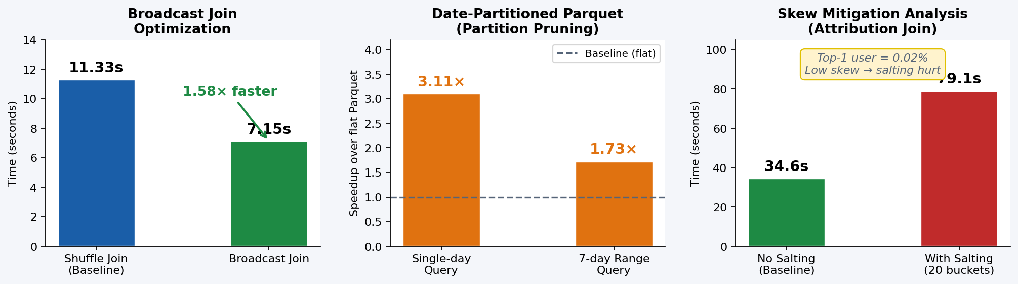
Performance Optimizations
Slide 5 / 7
Broadcast Join
Partition Pruning
Skew Analysis
1.58× faster 11.33s → 7.15s
3.11× single-day 1.73× 7-day range
Salting was 2.28× SLOWER 34.6s → 79.1s
Orders (153K rows) broadcast to all workers, eliminating cross-node shuffle entirely.
Date-partitioned Parquet lets Spark skip entire date directories — pure I/O reduction.
Top-1 user = 0.02% of events — no real skew. Salting crossJoin overhead outweighed benefit.

Slide 7
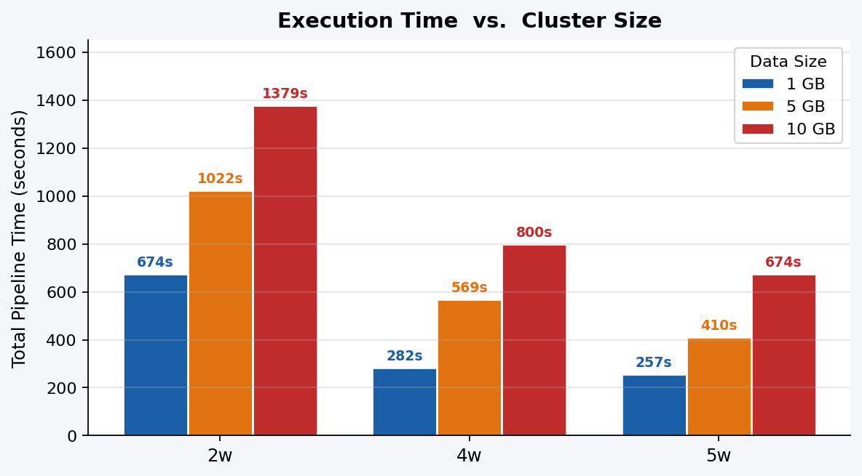
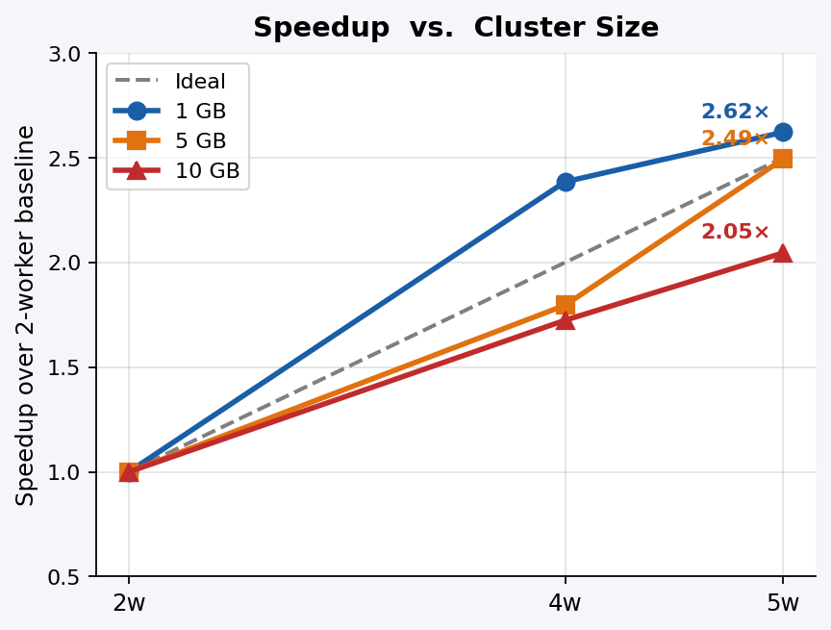
Evaluation Results — Scaling Benchmarks
Slide 6 / 7
Full Benchmark Summary (Total Pipeline Time in Seconds)
Config
1 GB (~8.5M rows)
5 GB (~42.5M rows)
10 GB (~85M rows)
Throughput (10 GB)
2 Workers
673.6 s
1,021.8 s
1,378.9 s
61,569 rows/s
4 Workers
282.4 s
569.0 s
799.8 s
106,148 rows/s
5 Workers
256.9 s
409.7 s
674.0 s
125,961 rows/s
★ 5 workers vs. 2 workers on 10 GB: 2.05× speedup (674s → 1379s baseline)

Slide 8
Lessons Learned & Conclusion
Slide 7 / 7
ETL I/O Dominates at Scale
Salting Hurts on Low-Skew Data
At 10 GB, ETL Parquet write consumed 477 s out of 1,379 s total (35% of pipeline runtime). Distributed I/O is the primary bottleneck — not computation. Profile write strategies before tuning CPU-bound stages.
Applying 20-bucket salting to the attribution join was 2.28× slower (34.6 s → 79.1 s). The dataset had no meaningful hot key (top-1 user = 0.02%). Always measure skew before applying mitigation.
L1
L2
ETL write: 477 s / Total: 1,379 s = 35%
No salting: 34.6 s → With salting: 79.1 s (0.44× speedup)
Broadcast Join Eliminates Network Shuffle
Storage Layout Beats Raw Compute Scaling
Broadcasting the smaller orders table (153 K rows) gave a 1.58× speedup by avoiding cross-node data transfer. The benefit grows with cluster size as more network hops are eliminated.
Date-partitioned Parquet gave a 3.11× speedup on a single-day query — exceeding the 2.05× gained by growing the cluster from 2 → 5 workers. Data layout decisions often have larger impact than adding hardware.
L3
L4
Shuffle join: 11.33 s → Broadcast: 7.15 s (1.58×)
Flat query: 4.25 s → Partitioned: 1.37 s (3.11×)

