Slide 1
SentryOps
Autonomous Multi-Agent Production Incident Response & Root Cause Analysis Platform
OPERATIONAL DOMAIN
• Site Reliability Engineering (SRE): Autonomous incident triage and dynamic mitigation.
• Unified Observability: Tri-modal correlation across metrics, logs, and traces.
• Enterprise Safety: Rigorous human-in-the-loop approvals before infrastructure change.
CORE ARCHITECTURE
• Agent Orchestration: Python 3.11+ with LangGraph state graph coordination.
• Frontend & Storage: React 19, TypeScript, PostgreSQL 15 + pgvector for RAG.
• Infrastructure: Kubernetes cluster (Kind) with Prometheus, Loki, Jaeger & Grafana.
GOVERNING PRINCIPLE
• Empowered AI Investigation: Parallel investigative reasoning across telemetry stores.
• Strict Deterministic Guardrails: Hardcoded safety rules, zero direct cluster actuation.
• Anti-Hallucination Gate: Evidence IDs verified against ground truth before RCA generation.

Slide 2
The Modern Production Incident Dilemma
Operational Bottlenecks in Modern Cloud-Native Microservices
FRAGMENTED TELEMETRY
• Alert Storms & Noise: High-severity incidents trigger cascading alerts across dozens of decoupled microservices.
• Context Switching: On-call engineers waste critical minutes manually correlating logs across Loki, metrics across Prometheus, and traces across Jaeger.
• Siloed Insights: Lack of unified causality mapping delays diagnosis.
PROLONGED MTTR
• 80%+ Diagnosis Overhead: In complex distributed architectures, identifying the root cause consumes the majority of incident recovery time.
• Runbook Retrieval Latency: Relevant operational runbooks and historical postmortems are rarely surfaced when outages strike.
• Cognitive Burnout: High-stress manual triage increases operator mistakes under severe SLA pressure.
UNCONSTRAINED AI RISKS
• Hallucinated Commands: Giving an LLM direct shell access or raw kubectl execution creates catastrophic reliability risks.
• Cascading Outages: Unbounded autonomous remediation can accidentally delete databases or terminate healthy services.
• Missing Auditability: Autonomous black-box actions violate compliance, governance, and organizational change controls.

Slide 3
The SentryOps Solution
End-to-End Autonomous Incident Lifecycle with Deterministic Safety Guardrails
• Simulated Production Architecture:
– 5 FastAPI microservices (`order`, `payment`, `notification`, `user`, `api-gateway`).
– Dynamic fault-injection API running inside the Kubernetes cluster on port 8005.
• End-to-End Observability Pipeline:
– Full OpenTelemetry instrumentation across all routes.
– Real-time Prometheus metrics, Loki structured log streaming, and Jaeger distributed traces visualized in Grafana.
• Parallel Multi-Agent Orchestration:
– LangGraph manages specialized agents with structured fan-in synthesis.
• Deterministic Safety Guardrails:
– Strict Allowlist: Remediations limited exclusively to `RESTART_SERVICE`, `SCALE_SERVICE`, and `ROLLBACK_SERVICE`.
– Non-LLM Risk Engine: Deterministic rules classify actions (`LOW`, `MEDIUM`, `HIGH`) independently of LLM reasoning.
– Mandatory Human Approval Gate: All medium and high-risk proposals halt at `PENDING_APPROVAL`.
– Zero Cluster Actuation: Agents operate against `SIMULATED_INFRA_STATE` without direct `kubectl` privilege.
• Automated Verification & Postmortem:
– Post-remediation health checks verify recovery and compile structured postmortems.

Slide 4
Multi-Agent Parallel Investigation
LangGraph Fan-Out / Fan-In Investigative Workflow & Anti-Hallucination Gates
• Incident Trigger & Dispatch:
– Outage detected via error-rate threshold or synthetic fault API.
– `IncidentManager` spawns parallel investigation across 6 specialized agents.
• Parallel Specialized Agents (Fan-Out):
– LogAgent: Queries Loki for error stacks, 5xx status codes, and exceptions.
– MetricAgent: Queries Prometheus for error rate spikes and P95 latency.
– TraceAgent: Queries Jaeger for error spans, tags, and trace waterfalls.
– DeploymentAgent: Checks recent config changes, releases, and fault flags.
– InfraAgent: Scrapes node memory, CPU, and pod restart health.
– KnowledgeAgent: Retrieves relevant historical runbooks via pgvector RAG.
• Structured Synthesis (Fan-In):
– Specialized agents populate a centralized incident evidence store.
• RCA Agent & Anti-Hallucination Gate:
– Performs evidence linkage and cross-source causal synthesis.
– Strict Validation Gate: The RCA Agent algorithmically validates that all cited evidence IDs exist in the evidence store before conclusions are finalized.
• RemediationAgent & Risk Policy:
– Formulates structured mitigation action matching the RCA hypothesis.
– Enforces deterministic risk assessment before any action can proceed.

Slide 5
Deterministic Risk Policy & Approval Gate
Human-in-the-Loop Operational Safety Classification
LOW RISK POLICY
• Policy Rule: Restarting a single unhealthy microservice instance.
• Autonomous Execution: Allowed (Simulated).
• Operator Action: None required (automatically advances to post-remediation verification).
MEDIUM RISK POLICY
• Policy Rule: Scaling service replica counts (`SCALE_SERVICE`).
• Autonomous Execution: Prohibited.
• Operator Action: Mandatory Operator Approval required via dashboard before execution.
HIGH RISK POLICY
• Policy Rule: Multi-instance restarts or configuration rollbacks (`ROLLBACK_SERVICE`).
• Autonomous Execution: Prohibited.
• Operator Action: Mandatory Operator Approval required.
• State Machine Enforcement:
– Any proposal classified as `MEDIUM` or `HIGH` automatically transitions to `PENDING_APPROVAL` and halts execution.
• Operator Approval API (`POST /incidents/{id}/approve`):
– Records approval audit trail, transitions status to `APPROVED`, and triggers deterministic simulated execution.
• Operator Rejection API (`POST /incidents/{id}/reject`):
– Transitions status to `REJECTED`, cancels remediation execution, and returns incident to `INVESTIGATING`.

Slide 6
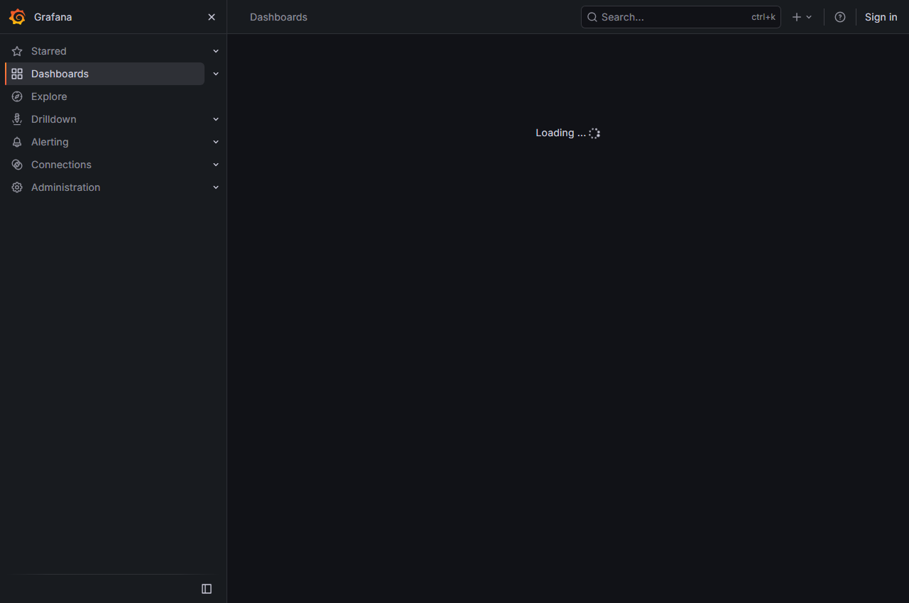
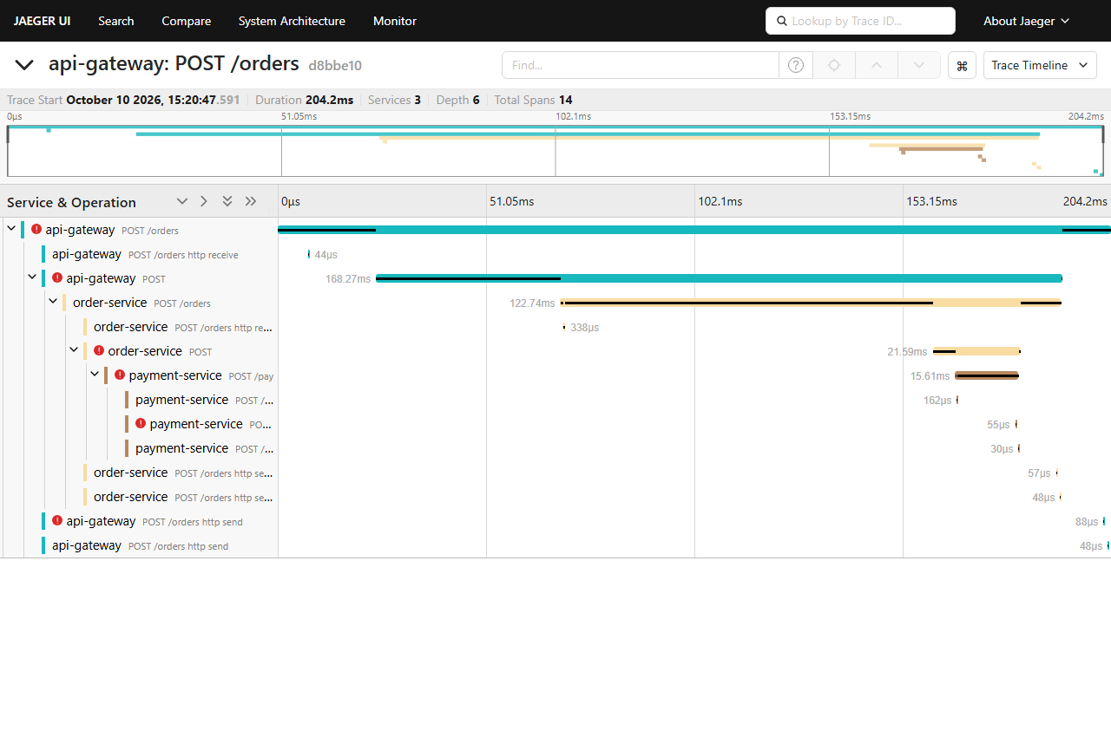
Observable Telemetry & Operator Dashboard
Real-Time Telemetry Visibility Across Prometheus, Loki, Jaeger & React 19
• Grafana Observability Dashboard:
– Service Health Status: Real-time status panel tracking health across all 5 microservices (`order`, `payment`, `notification`, `user`, `api-gateway`).
– Request Rate: Per-second throughput across services.
– Error Rate (5xx): Instant visibility into error spikes during active faults; returns deterministically to 0 upon recovery.
– P95 Latency: Histogram quantiles tracking delays.
– Live Service Logs: Real-time Loki log streaming filtered by `service_name`.
• Jaeger Distributed Tracing:
– End-to-end trace waterfalls capturing cross-service HTTP calls and pinpointing error spans.
• React 19 SRE Incident Dashboard:
– Interactive incident timeline, evidence inventory, RCA summary, human approval card, and postmortem view.
Grafana: Error Rate (5xx) Spike During Active Fault
Jaeger: Distributed Trace Waterfall Pinpointing Error Span

Slide 7
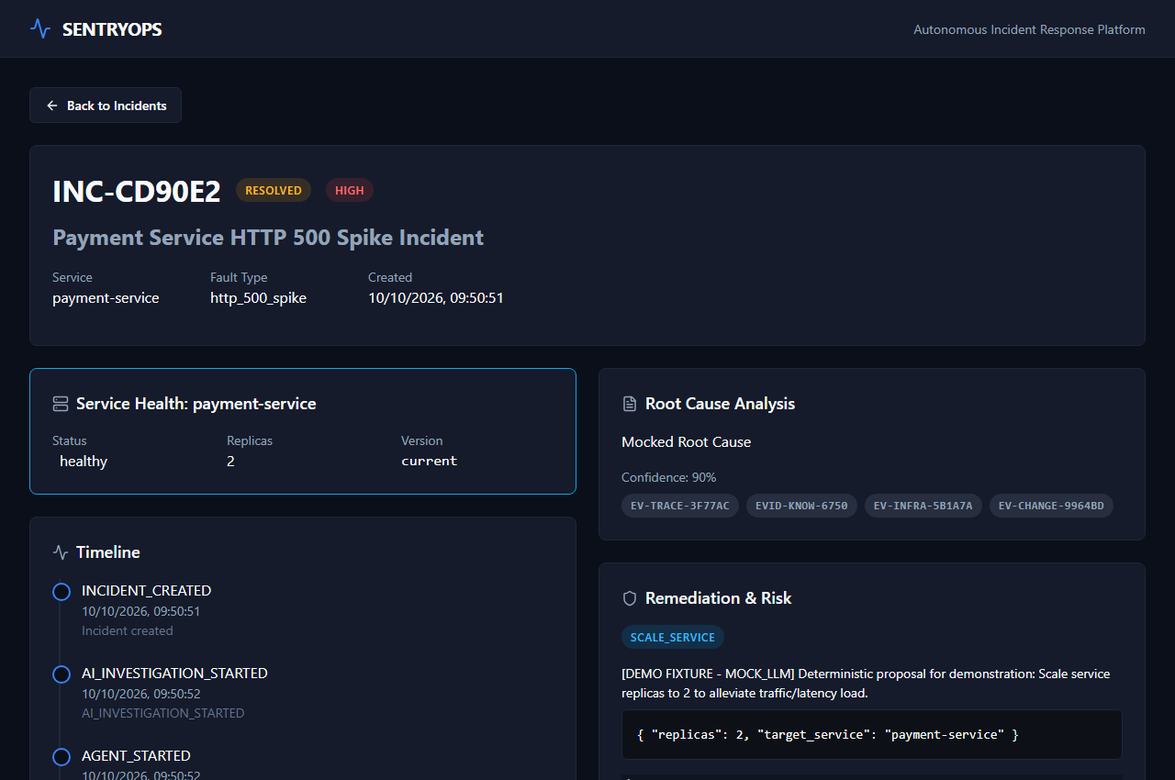
Live Demonstration Walkthrough
Validated End-to-End Scenario: http_500_spike on payment-service
• Incident & Fault Identifiers:
– Incident ID: `INC-CD90E2` | Fault Injection ID: `FAULT-1D8A4DA5`.
• Quantitative HTTP Traffic Verification:
– Baseline: 10/10 OK (100% success, avg latency: 1.116s).
– Fault Active: 0/10 OK, 10/10 500s (100% failure, avg latency: 1.008s).
– Fault Cleanup: 10/10 OK (100% recovered, avg latency: 1.051s).
• Harvested Telemetry Evidence:
– `EV-TRACE-3F77AC`: 10 Jaeger traces analyzed (7 error spans identified).
– `EV-CHANGE-9964BD`: Active synthetic fault metadata detected.
– `EV-INFRA-5B1A7A`: Prometheus node/pod infrastructure health verified.
– `EVID-KNOW-6750`: 3 relevant historical runbooks retrieved from pgvector.
• Remediation Proposal & Risk Gate:
– Proposal: `SCALE_SERVICE` for `payment-service` (`replicas: 2`).
– Labeled: `[DEMO FIXTURE - MOCK_LLM]`.
– Safety Gate: Classified as `MEDIUM` risk -> Halts at `PENDING_APPROVAL`.
React 19 SRE Dashboard: Remediation Proposal & Risk Assessment

Slide 8
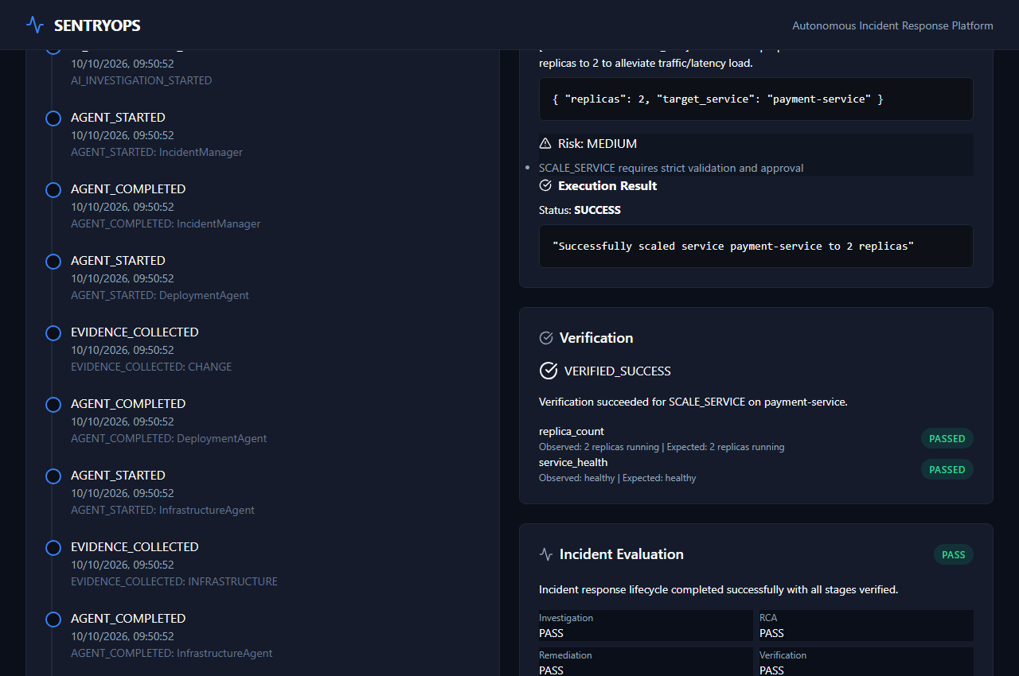
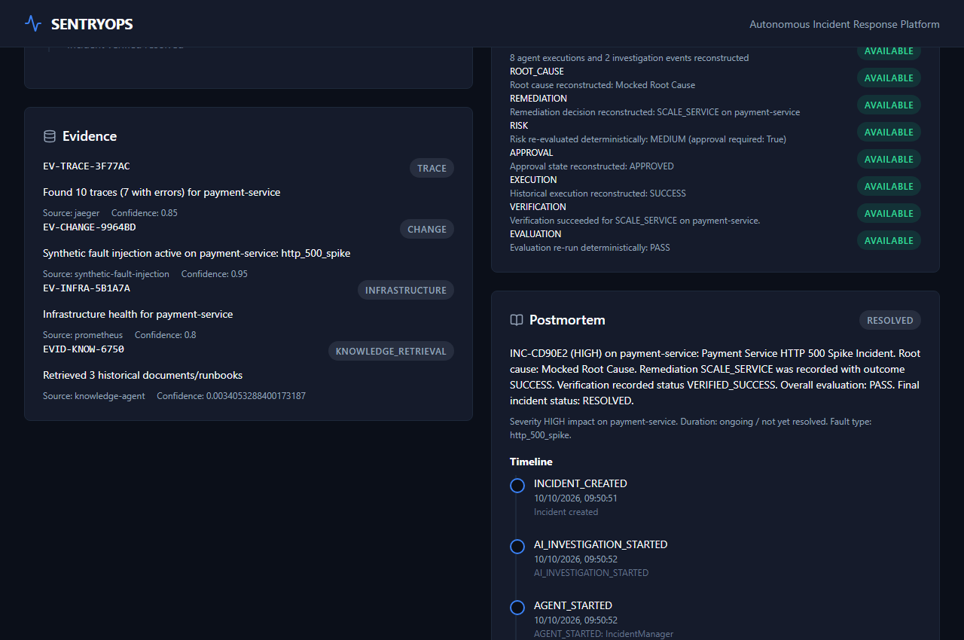
Execution, Verification & Postmortem
Deterministic Lifecycle Completion & Evidence Verification
• Human Operator Approval Gate:
– Operator submitted approval via dashboard (`POST /incidents/{id}/approve`).
• Simulated Execution Safety Boundary:
– Execution status: `SUCCESS` against in-memory `SIMULATED_INFRA_STATE`.
– Zero Kubernetes cluster mutation: `kubectl get deployment payment-service` remained strictly at 1 replica.
• Deterministic Post-Remediation Verification:
– Check 1 (`replica_count`): 2 replicas verified (Passed).
– Check 2 (`service_health`): Healthy status verified (Passed).
– Outcome: Marked `VERIFIED_SUCCESS` -> Incident resolved.
• Incident Replay & Evaluation:
– Evaluation Framework: `PASS` across all 4 dimensions (Investigation, RCA, Remediation, Verification).
– Replay Consistency: `MATCH` (verified without historical re-execution).
– Postmortem: 9 structured sections generated deterministically.
Approval Gate & Deterministic Health Verification
Automated 9-Section SRE Incident Postmortem View

Slide 9
Technical Testing & Metric Disclosure
Evidence-Based Verification Across Test Suites & Build Pipelines
• Kubernetes-Compatible Test Suites:
– 152 / 152 PASSED (100% Pass Rate) in 27.78 seconds.
– Covers Phase 7 Knowledge Agent, Phase 8 Workflow Demo, Phase 8 Remediation, Phase 9 Verification, Phase 11 Evaluation, Phase 12 Replay/Postmortem, and Phase 13 Kubernetes architecture.
– Zero Failures, Zero Skipped.
• Frontend Production Build:
– `npm run build` completed cleanly in 1.96s with zero errors or warnings.
• Full Repository Test Suite Disclosure:
– 169 Passed, 15 Failed out of 184 total tests.
– Root Cause of 15 Failures: Exclusively legacy Docker Compose integration tests asserting obsolete host port mappings (`BACKEND_API = 8080` vs `8000`, and direct host ports `8001-8004` which are internal Kubernetes ClusterIPs).
– Zero Code Regressions across all core application logic and agent orchestration workflows.

Slide 10
Security Architecture & Operational Boundaries
Hardened Production Guardrails & Local Prototype Disclosures
• Hardened Production Constraints:
– No Pod Privilege Escalation: All application pods configure `automountServiceAccountToken: false`.
– Zero RBAC Abuse: No Kubernetes cluster-admin or service account permissions granted to application pods.
– No Real Cluster Actuation: LLM agents have zero access to shell commands or live Kubernetes APIs.
– Allowlist Enforcement: Actions strictly restricted to 3 deterministic operations (`RESTART`, `SCALE`, `ROLLBACK`).
• Disclosed Local Development Boundaries:
– Authentication / Authorization: FastAPI backend has no token-based authentication middleware (scoped for local prototype demonstration).
– Default Credentials: Development manifests configure default database passwords (`sentryops:sentryops`).
– Insecure Metrics TLS: Kind Metrics Server configured with `--kubelet-insecure-tls` for local container scraping.

Slide 11
Summary & Future Roadmap
Key Achievements & Next Steps for Production Evolution
• Key Project Achievements:
– Complete, observable, multi-agent incident response lifecycle from alert to postmortem.
– 100% passing Kubernetes-compatible test suites (152/152).
– Deterministic safety gates preventing AI hallucination and unauthorized actuation.
– Full-stack integration with Prometheus, Loki, Jaeger, Grafana, and React 19 UI.
• Future Strategic Roadmap:
– Production LLM Integration: Connecting live models (Claude 3.5 Sonnet / GPT-4o) under the same deterministic safety gates.
– Enterprise Security: Multi-tenant RBAC and API key authentication on incident management endpoints.
– GitOps-Driven Actuation: PR-based remediation proposals via ArgoCD or Flux.
– Cloud Observability: Persistent storage provisioned on AWS EKS or GCP GKE.

