Slide 1
BugFuzzXAll
Chen Xuanxin

Slide 2
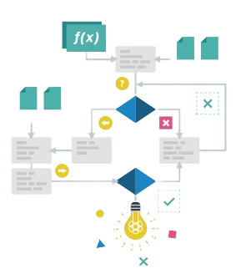


Background
What is Fuzzing?
Input generation
Testing method
Bugs searching
What are Large Language Models?
Advanced AI models
Trained on vast data
Multiple applications

Slide 3



Challenges for traditional fuzzers
Target Properties Reliability
Most traditional fuzzing frameworks specialize in single PL and depend on target systems or environments.
Non-universal fuzzers fail to complete multiple testing tasks in one time.
Php
C/C++
Java
Python
Rust
Go
Nodejs
Traditional fuzzer

Slide 4


Challenges for traditional fuzzers
Mutation Gap
The mutated examples often follow a rigid, single direction due to applying combination of program segments with fixed structures.
Generation Limit
These fuzzrs mainly rely on fixed dataset grammars, which restricts the
flexibility of inputs.
Single mutation
def function(number):
### single direction
number = sqrt(R)
…
Target grammar
Traditional fuzzer
Code snippet

Slide 5




Solution
Why choose Large Language Models as the assistant?
Excellent Understanding of program and nature languages
Strong Generation capability
Versatile adaptability of multiple inputs

Slide 6
Solution
Adaptive Strategy
Integrating LLMs into fuzzing tools enables dynamic adaptation across diverse PLs and environments.
LLMs’ base knowledge allows for test cases that satisfy provided requirements.
Expands fuzzing applicability across various software ecosystems.

Slide 7
Solution
Diversity Enhancement
LLMs enhance input diversity, generating a wider array of varied and unpredictable input mutations.
This diversity improves test coverage, increasing the likelihood of discovering hidden vulnerabilities.
LLM-generated inputs expand the input space and mimic real-world usage patterns, leading to more examples.

