Slide 1

DocMaster
Team AI-Generated

Slide 2
Student’s school assignment
Student wants to quick check if given criteria of assignment are met
They are looking for criteria given by teacher (length, structure, given topic)

Slide 3
Teacher reviewing assignment
Teacher wants to check student’s assignment
They are looking for length, grammar, mentioned topics, structure

Slide 4
Secretary checking documents
They are looking for inconsistencies in document (inconsistent naming, grammar, missing parts, etc..)

Slide 5
Customer sending document
Customer wants to see if they met the criteria in provided document

Slide 6
What am I?
I am an easily configurable AI assistant that helps with reviewing documents and suggesting corrections to it
Instructions on how to review and what to look at are provided to me by user or organization
Once I review documents, I suggest corrections and can discuss about given document with you

Slide 7
How to interact with me?
Via longer, prepared text files with specific instructions and descriptions
Via chat for quick responses and back-to-back communication

Slide 8
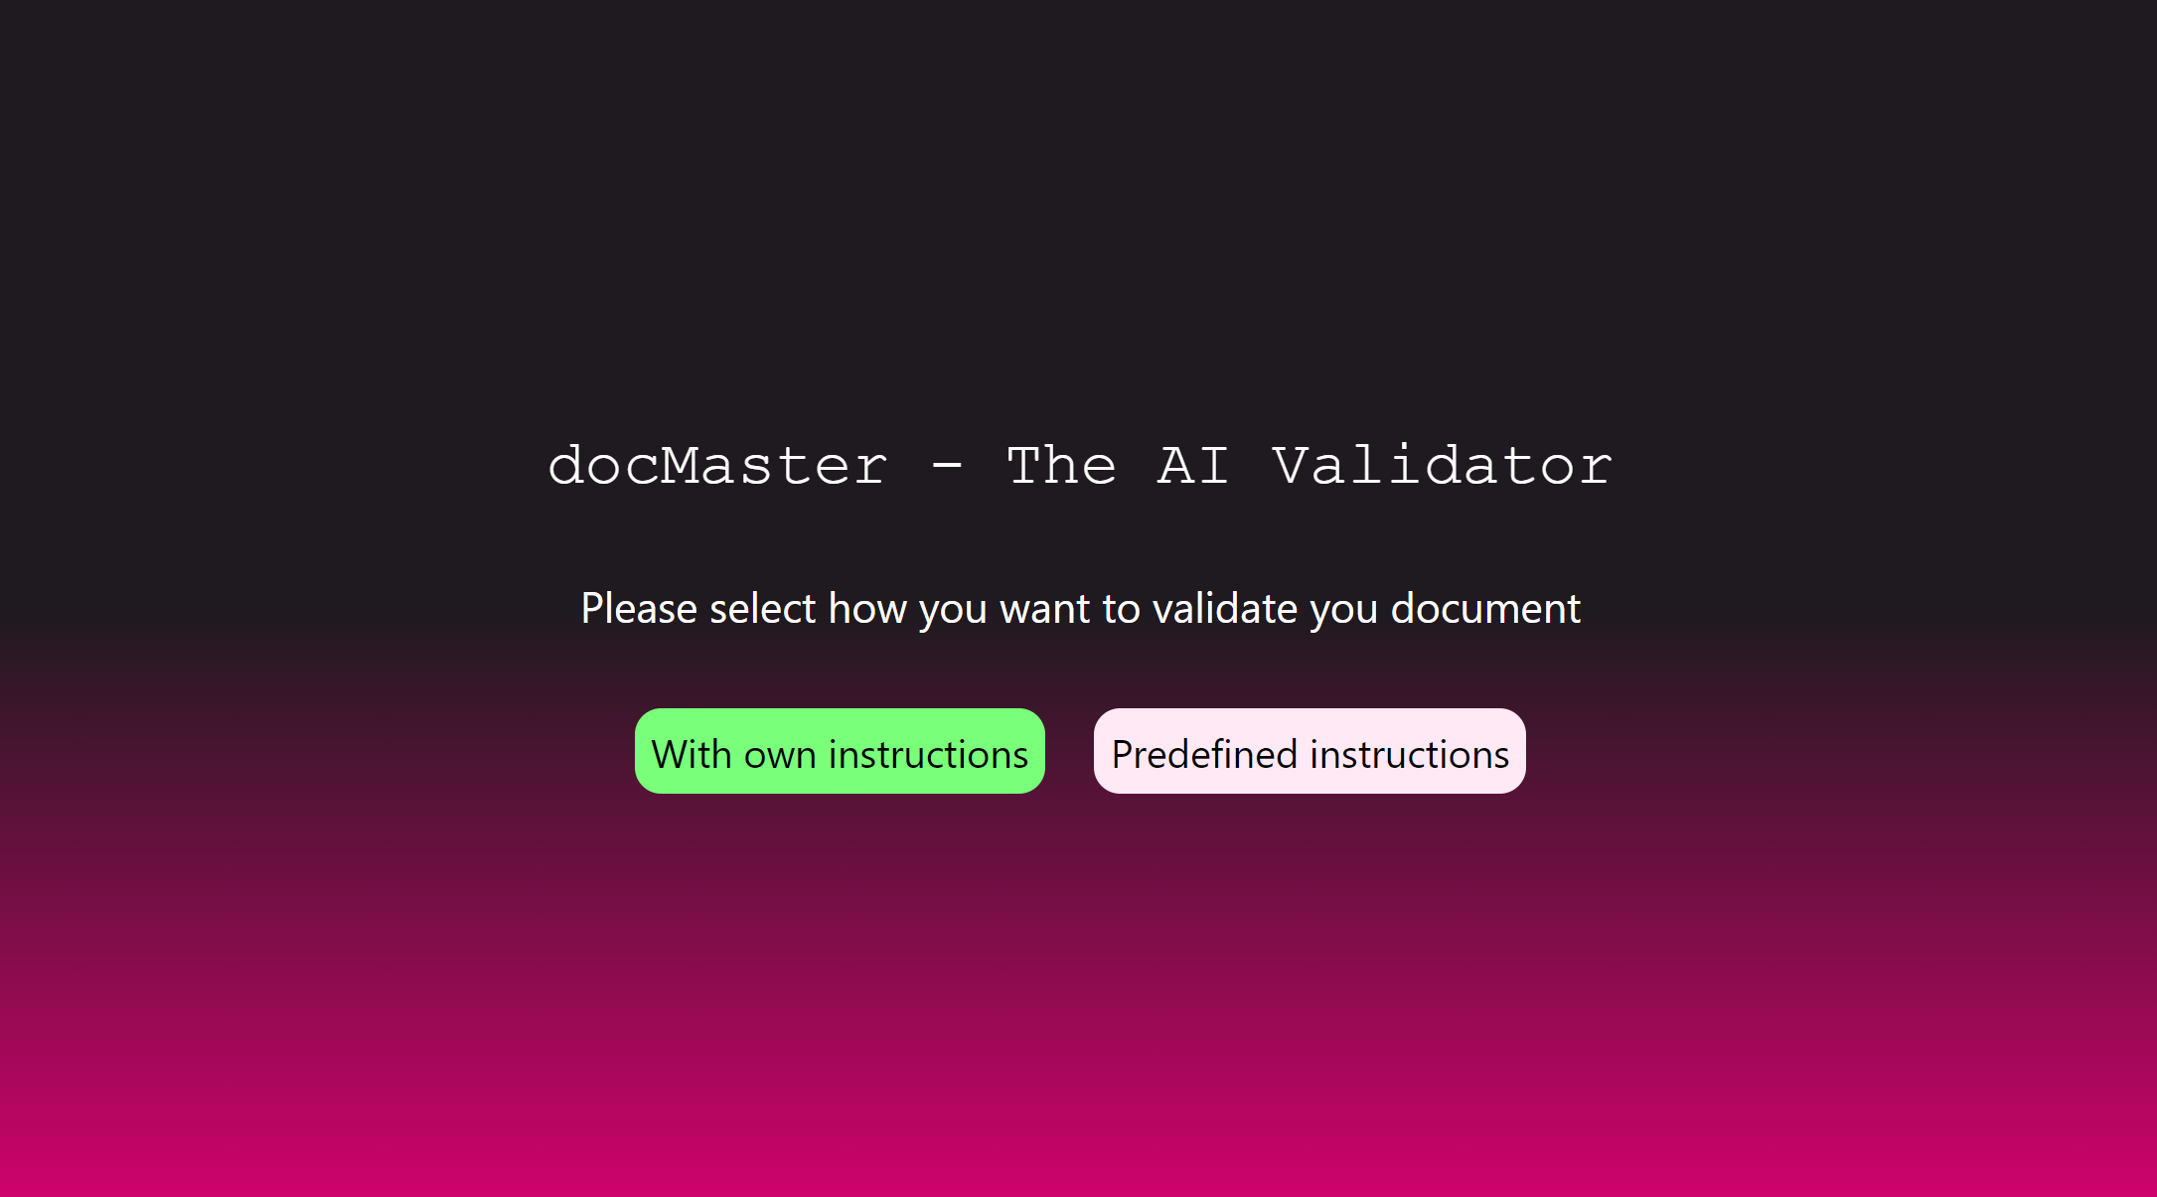

Slide 9
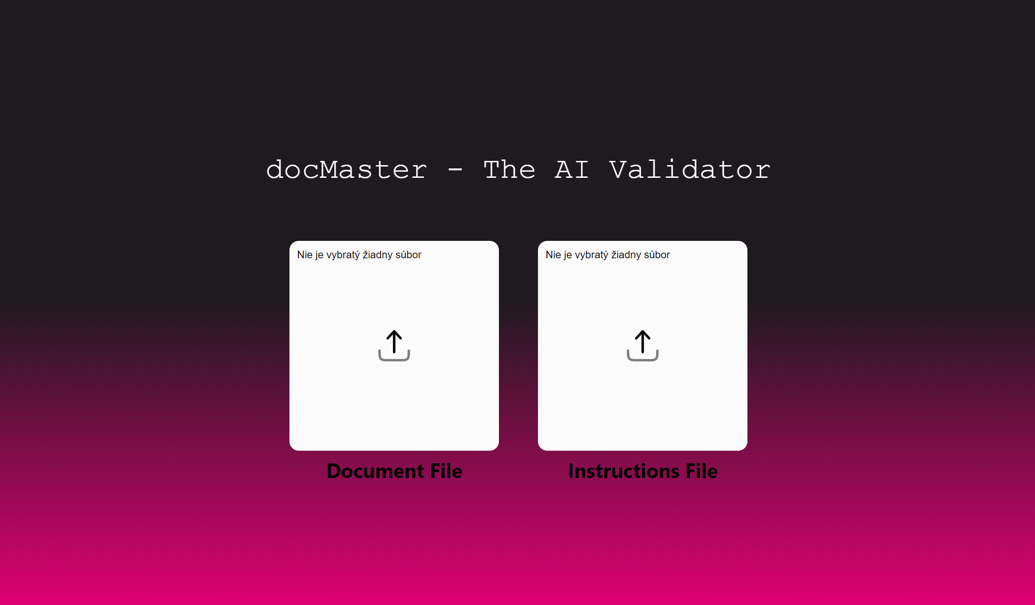

Slide 10
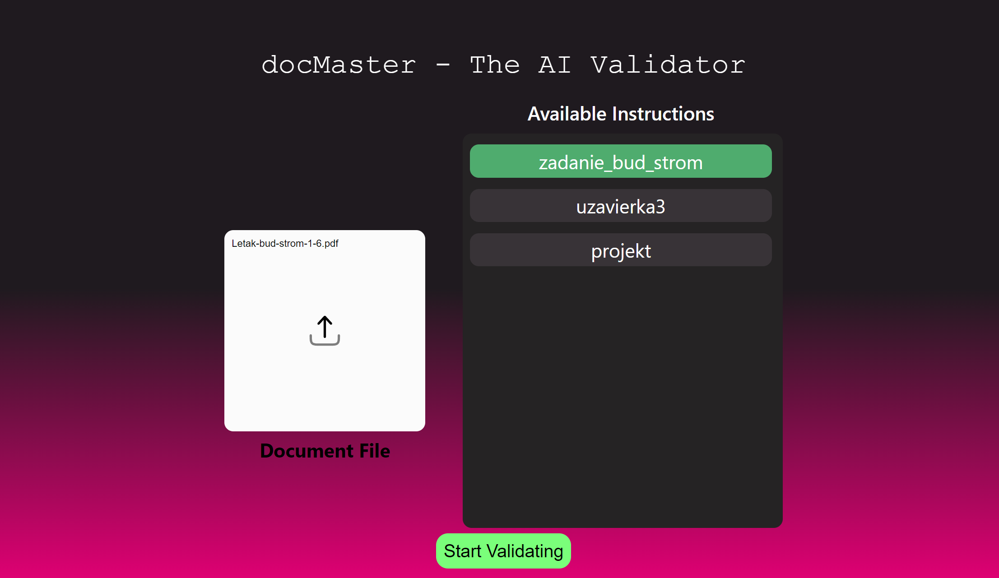

Slide 11
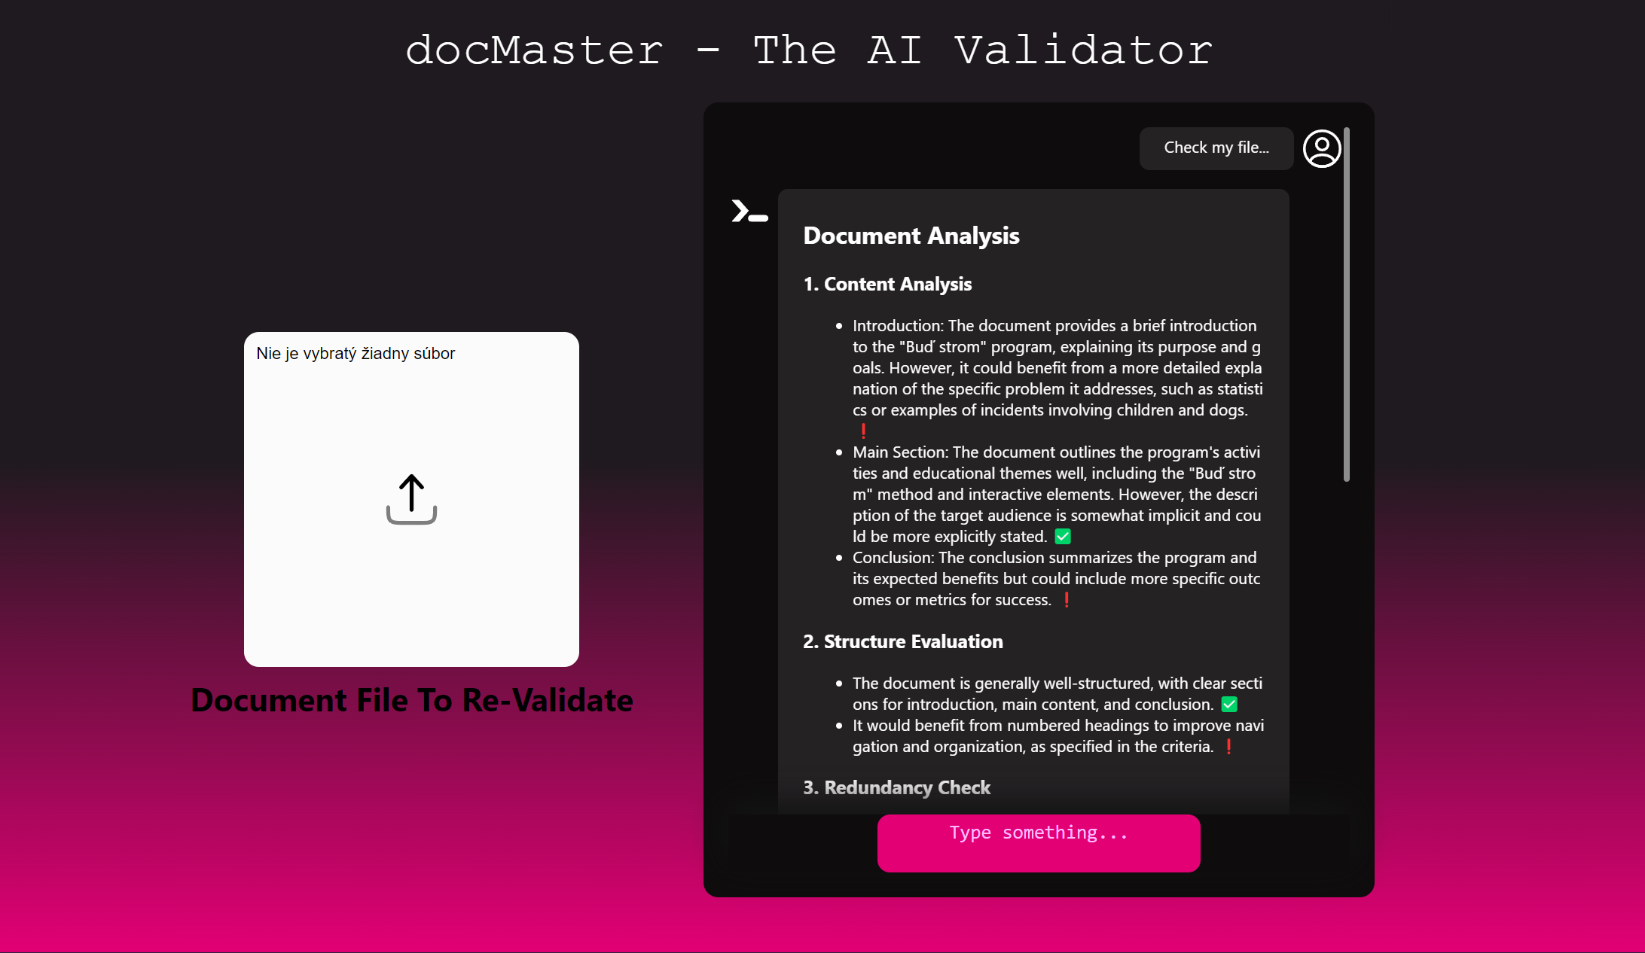

Slide 12
My future plans
Generate templates for desired document
Edit user’s instructions
Organizing instructions into folders
Making ”public API”, so I could be implemented into different applications

Slide 13




What am I made of?

Slide 14
Thank you for your time!

