Slide 1
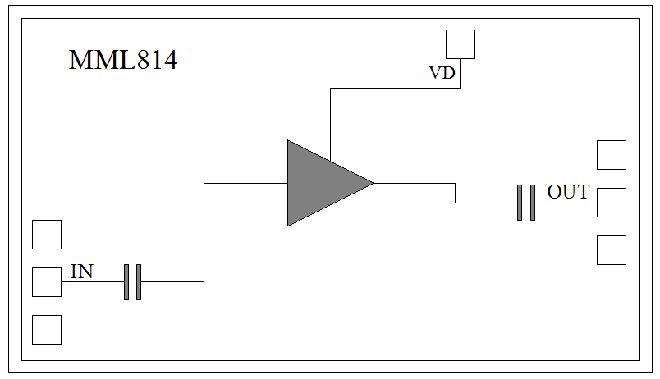
Features
Single Biasing Voltage (Self Biased)
Ultra Low Current 16mA
Frequency: 9-20GHz
Small Signal Gain: 23dB Typical
Gain Flatness: ±0.25dB Typical
Noise Figure:1.7dB Typical
P1dB: 9dBm Typical
Power Supply: +5V@16mA
Input/Output: 50Ω
Chip Size: 2.03 x 1.16 x 0.1mm
Functional Block Diagram
Typical Applications
Test Instrumentation
Microwave Radio & VSAT
Military & Space
Telecom Infrastructure
Fiber Optics
Electrical Specifications
TA = +25⁰C, VD = +5V, IDD = 16mA Typical
Parameters | Min. | Typ. | Max. | Units
Frequency | 9 |  | 20 | GHz
Small Signal Gain | 21 | 23 |  | dB
Gain Flatness |  | ±0.25 |  | dB
Noise Figure |  | 1.7 | 2.2 | dB
P1dB - Output 1dB Compression | 6 | 8 |  | dBm
Psat - Saturated Output Power |  | 10 |  | dBm
OIP3 - Output Third Order Intercept |  | 18 |  | dBm
Input Return Loss |  | -11 |  | dB
Output Return Loss |  | -15 |  | dB

Slide 2
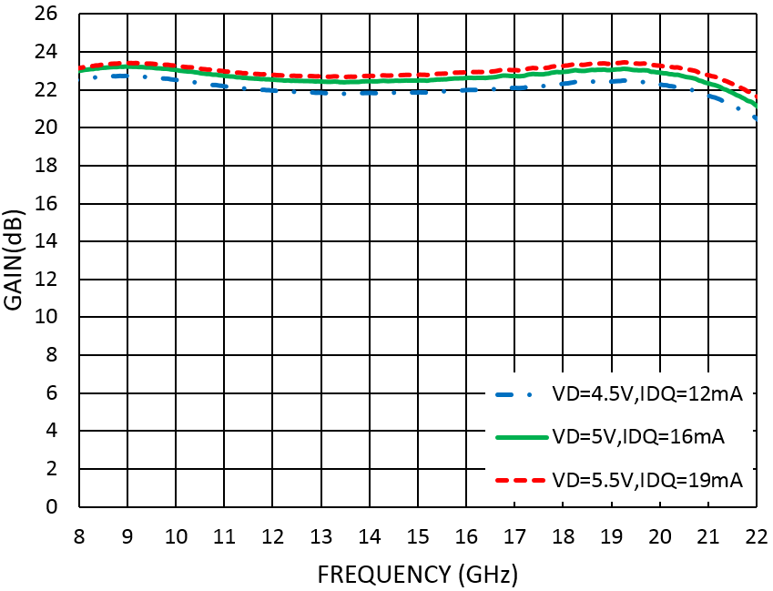
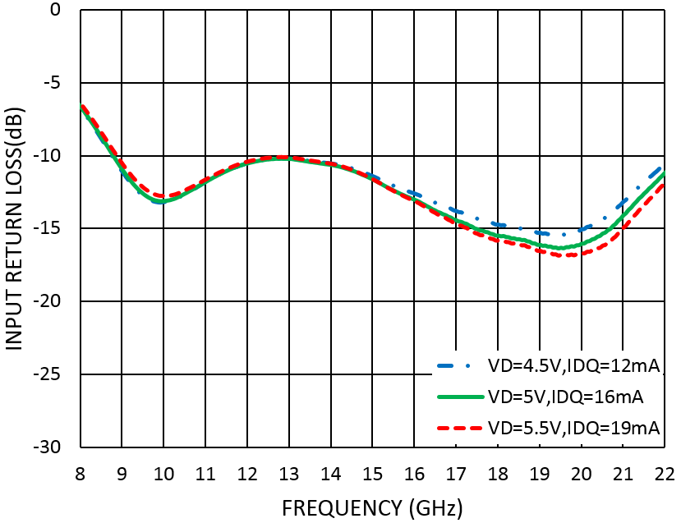
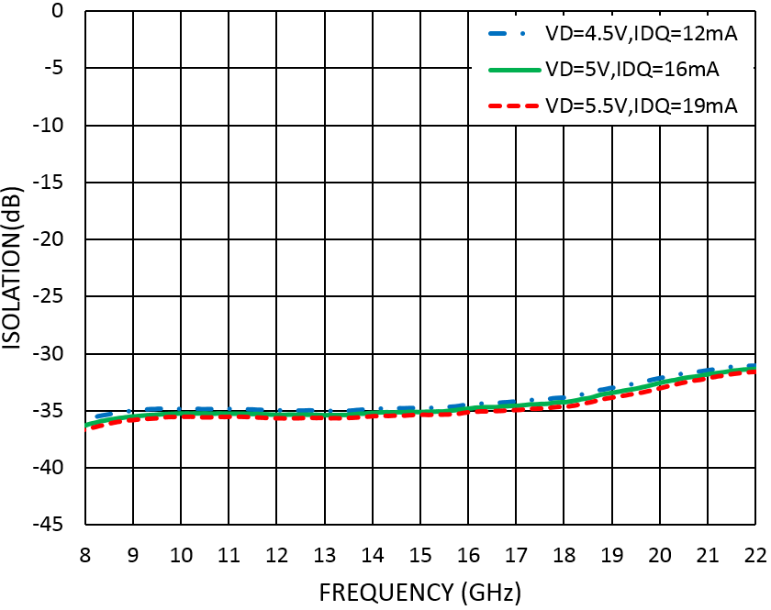
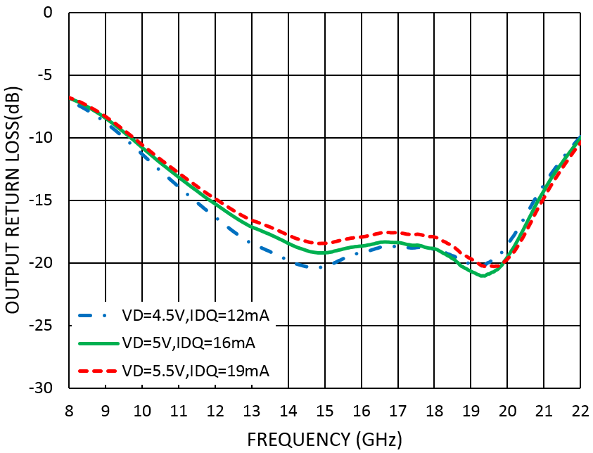
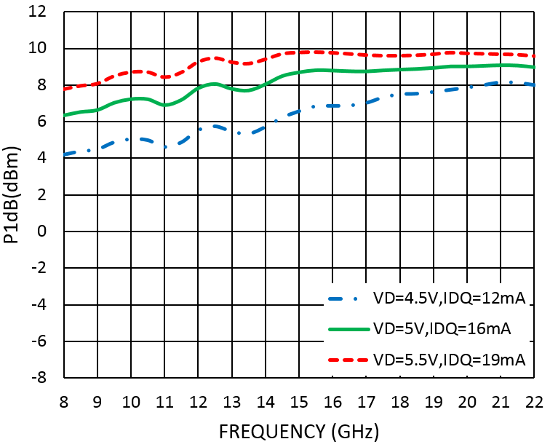
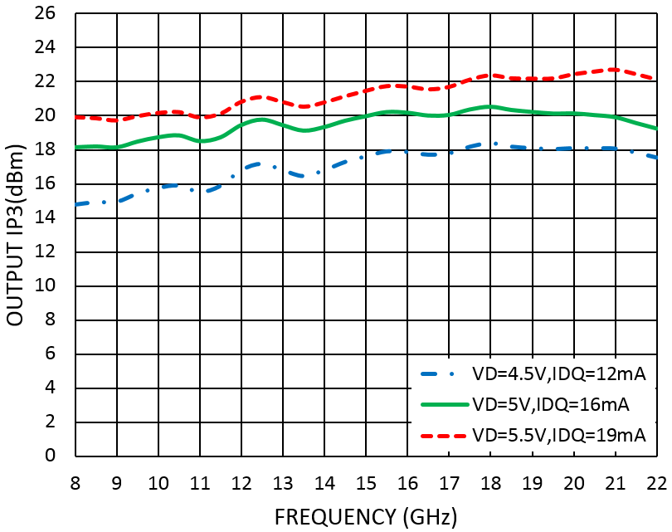
Measurement Plots: S-parameters
TA = +25⁰C
Measurement Plots: P1dB
TA = +25⁰C
Measurement Plots: OIP3
TA = +25⁰C

Slide 3
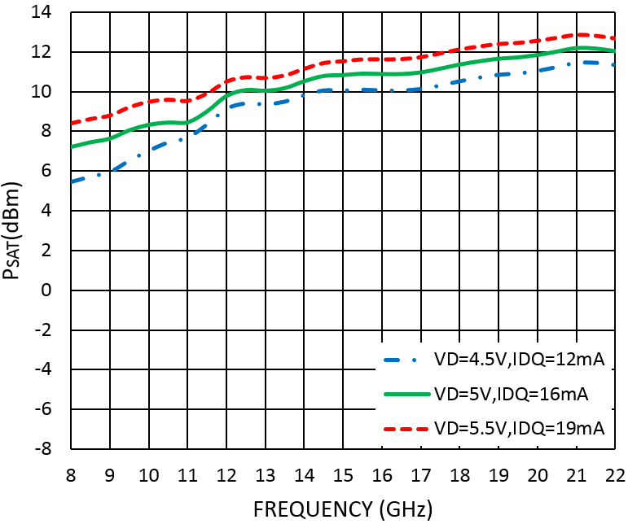
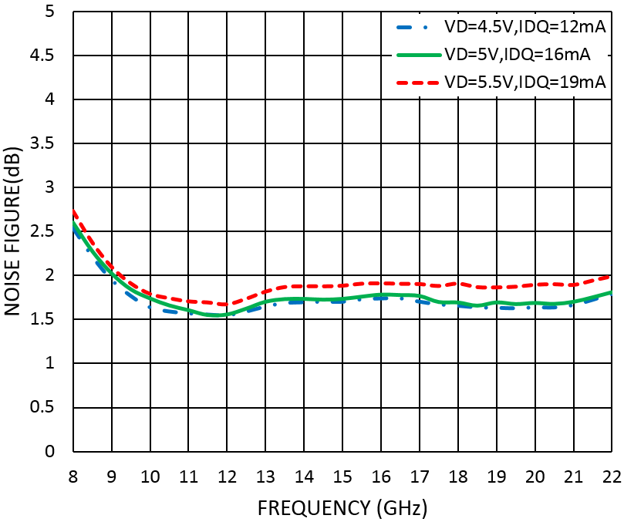
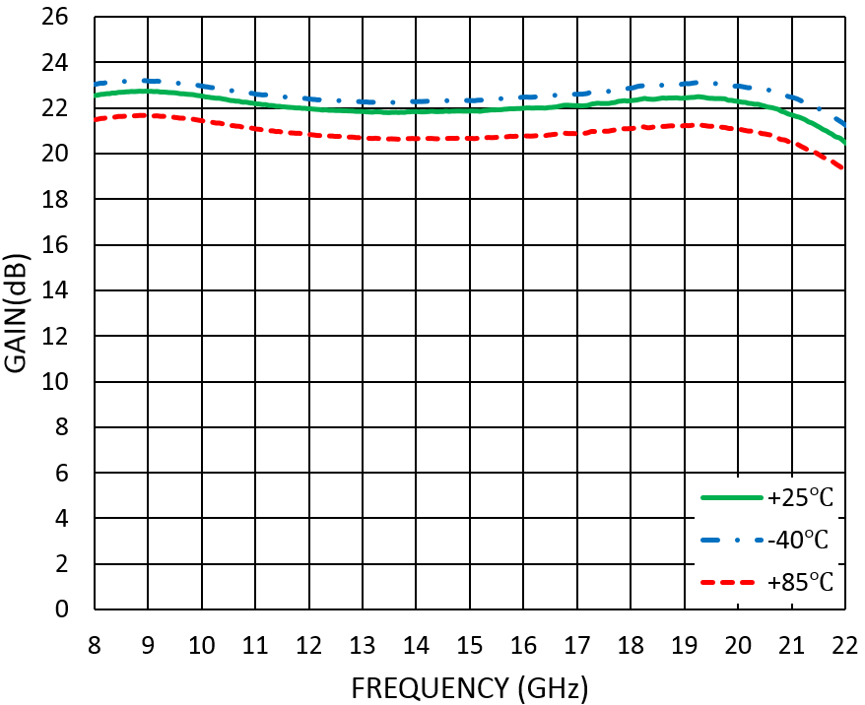
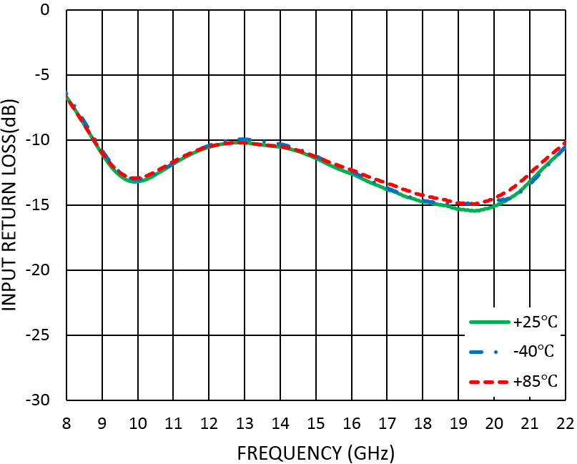
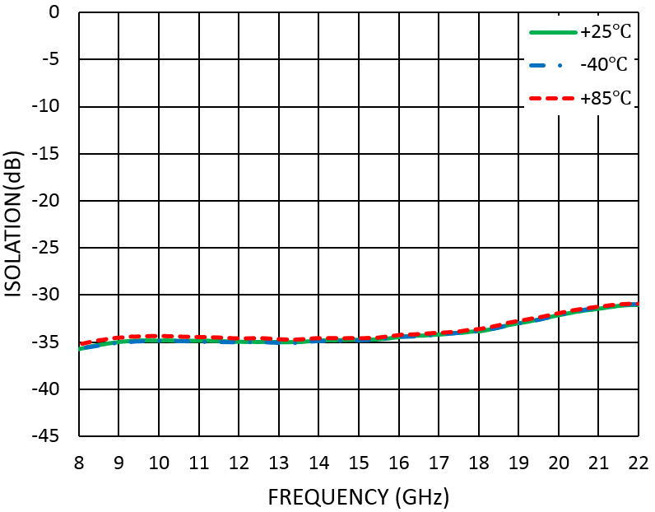
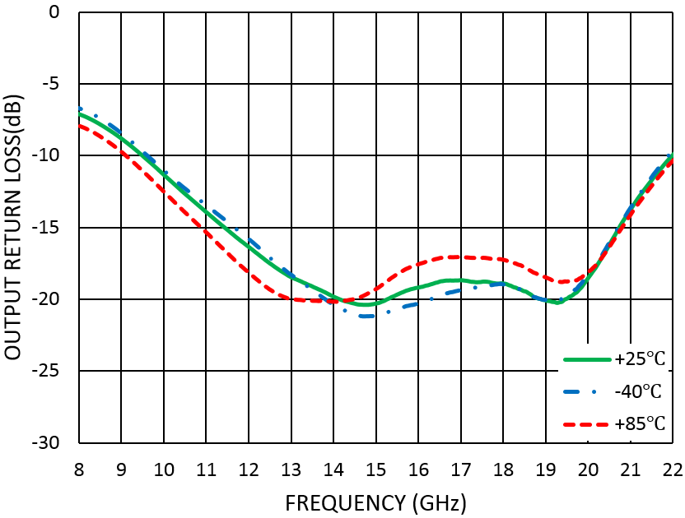
Measurement Plots: PSAT
TA = +25⁰C
Measurement Plots: Noise Figure
TA = +25⁰C
Measurement Plots: S-parameters
VD=4.5V

Slide 4
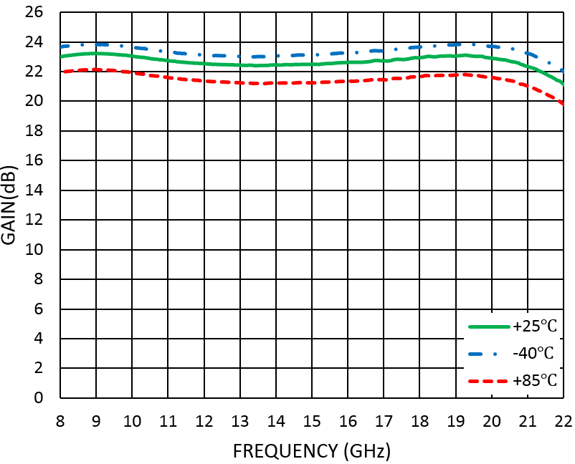
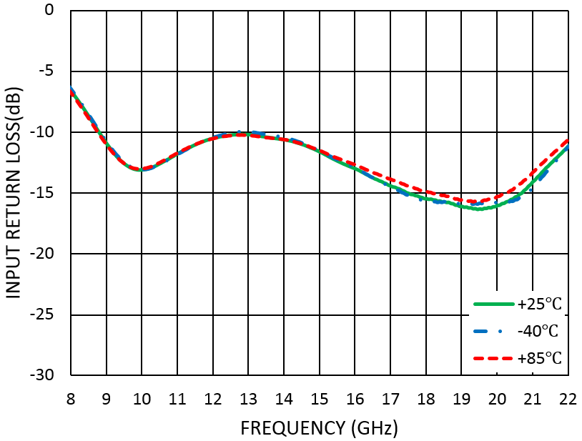
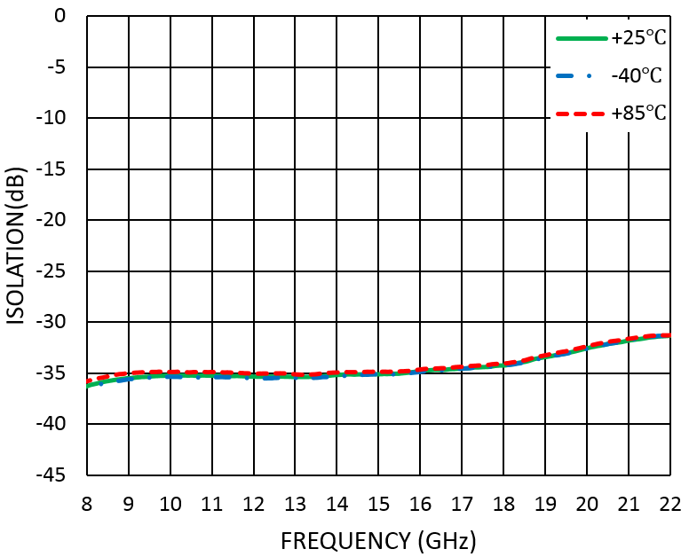
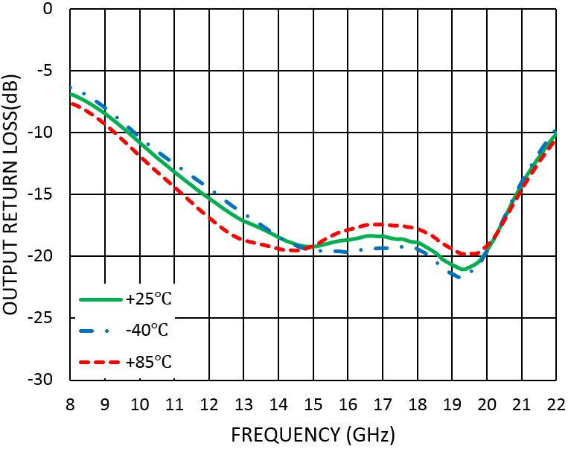
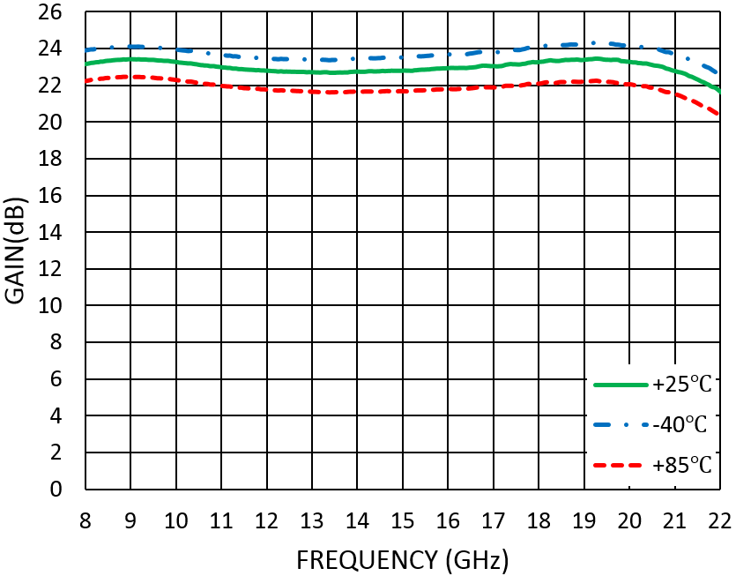
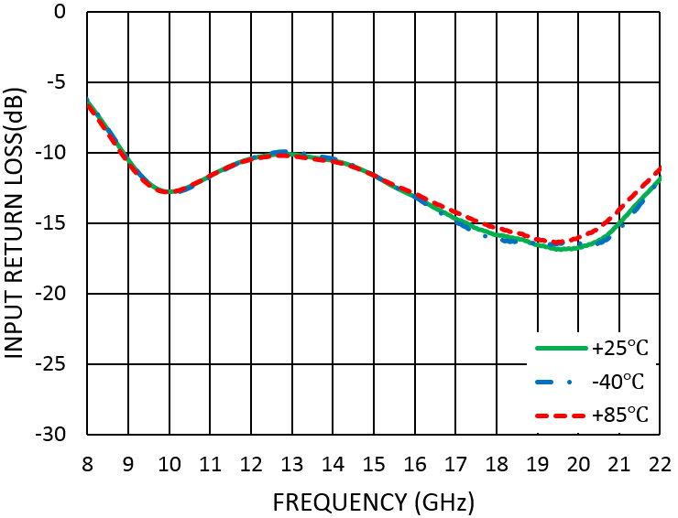
Measurement Plots: S-parameters
VD=5V
Measurement Plots: S-parameters
VD=5.5V

Slide 5
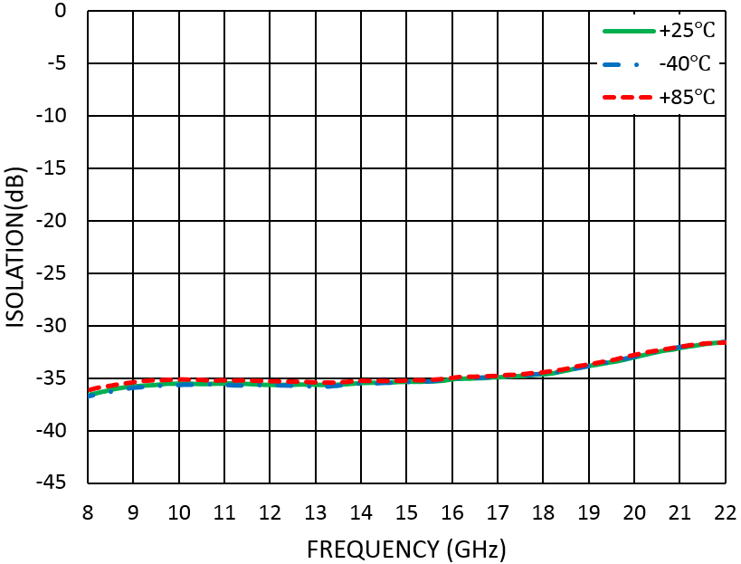
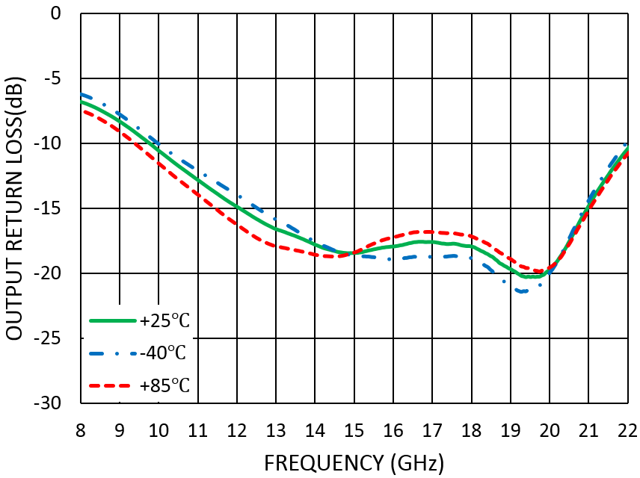
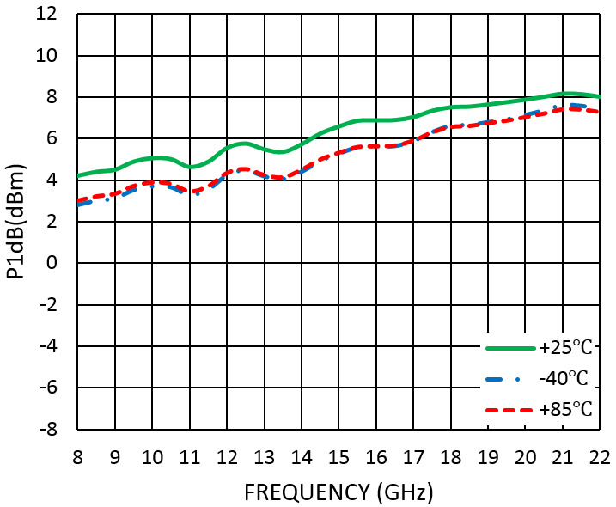
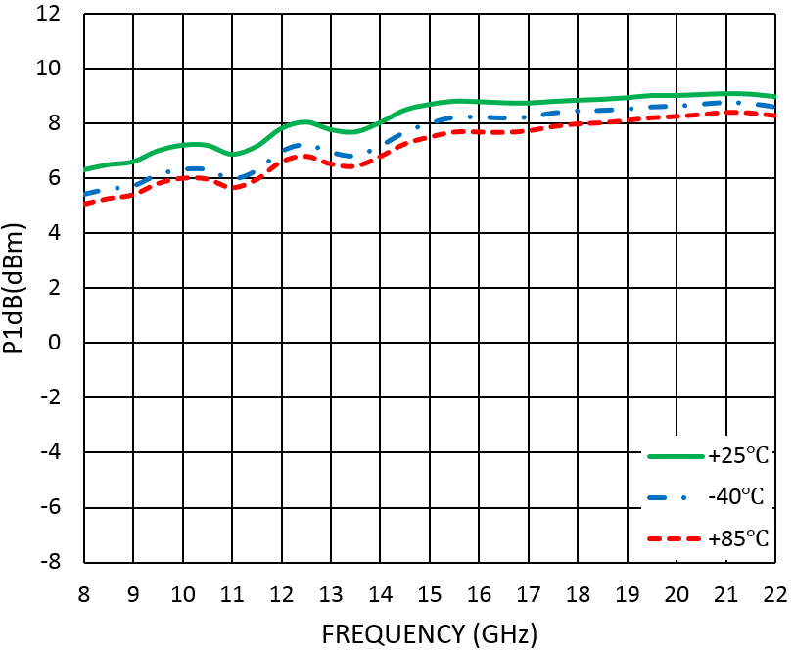
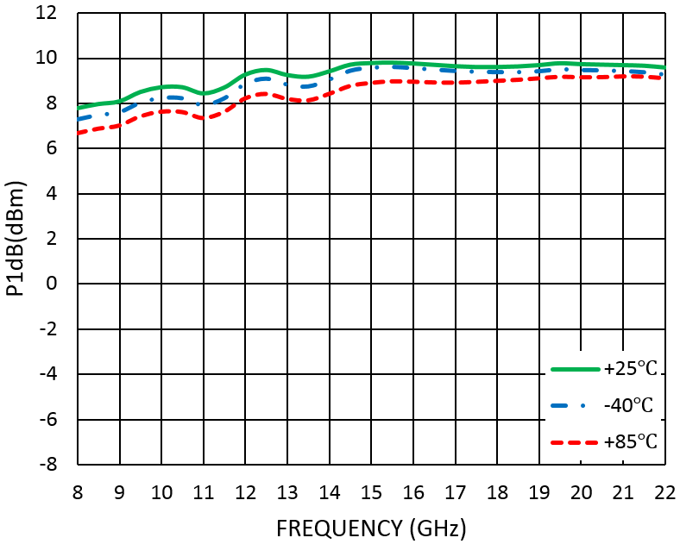
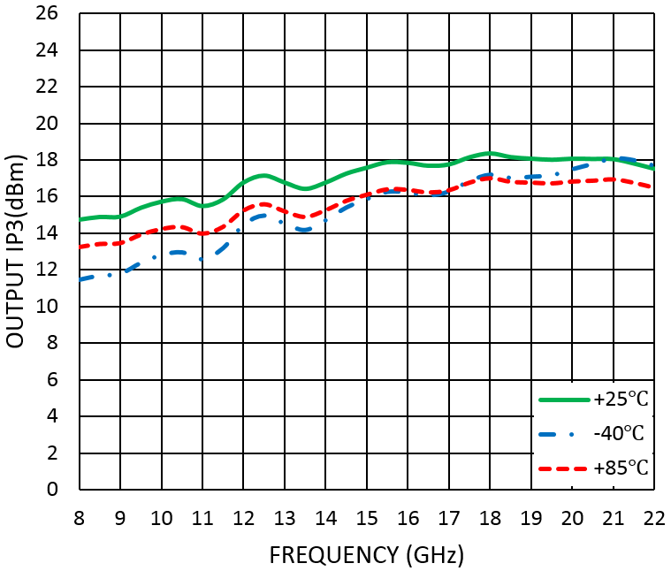
Measurement Plots: P1dB
VD=4.5V
Measurement Plots: P1dB
VD=5V
Measurement Plots: P1dB
VD=5.5V
Measurement Plots: OIP3
VD=4.5V

Slide 6
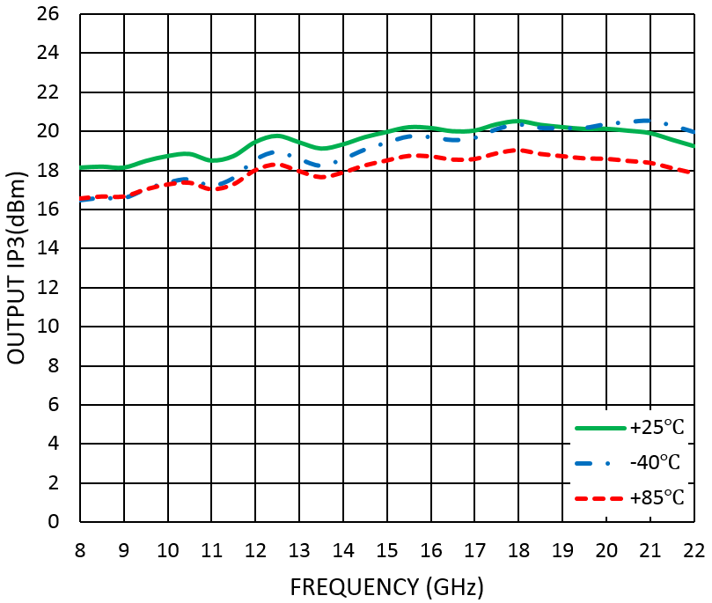
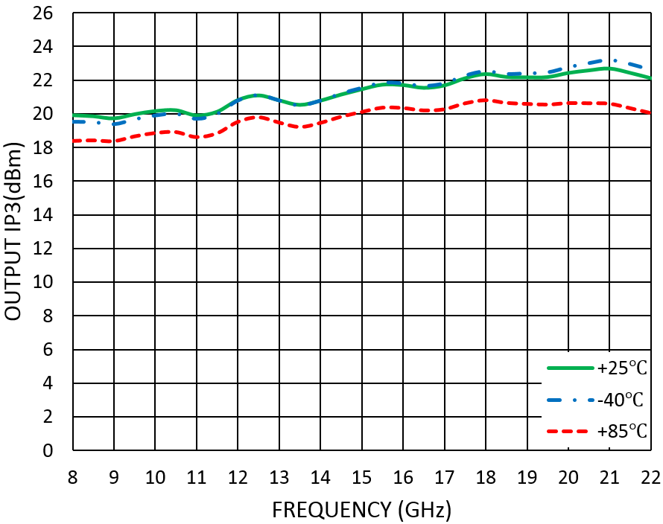
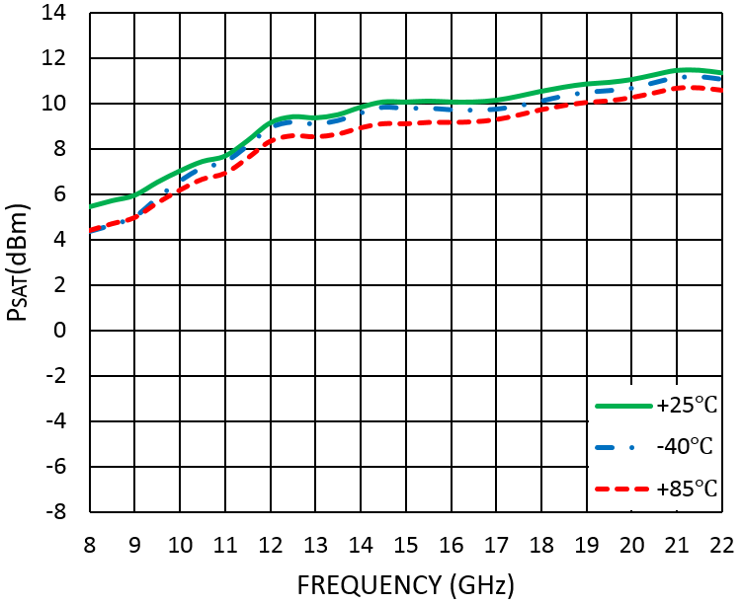
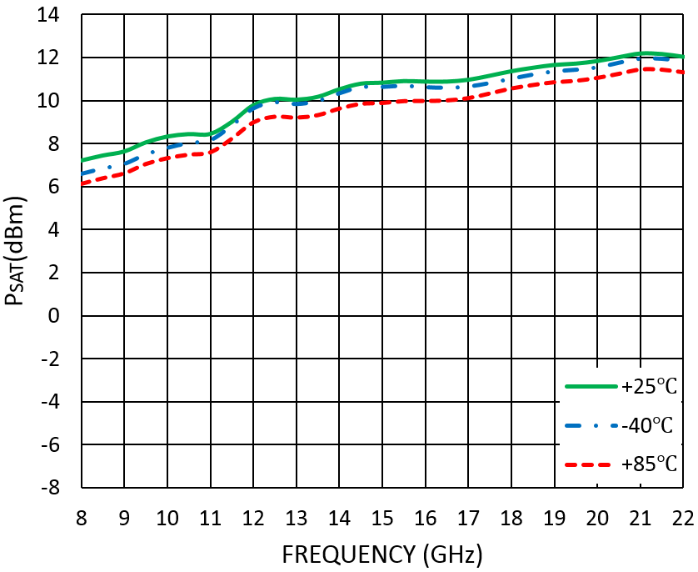
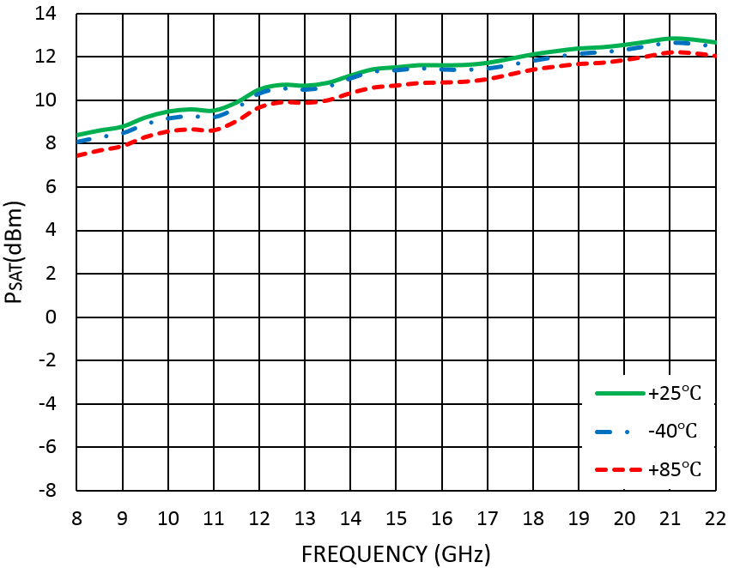
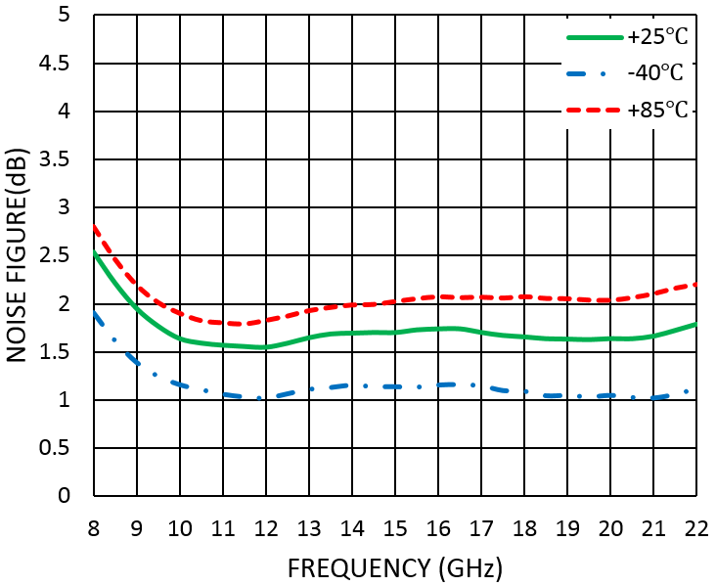
Measurement Plots: OIP3
VD=5V
Measurement Plots: OIP3
VD=5.5V
Measurement Plots: PSAT
VD=4.5V
Measurement Plots: PSAT
VD=5V
Measurement Plots: PSAT
VD=5.5V
Measurement Plots: Noise Figure
VD=4.5V

Slide 7
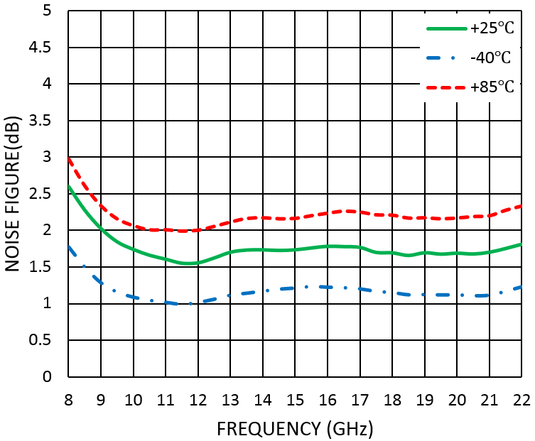
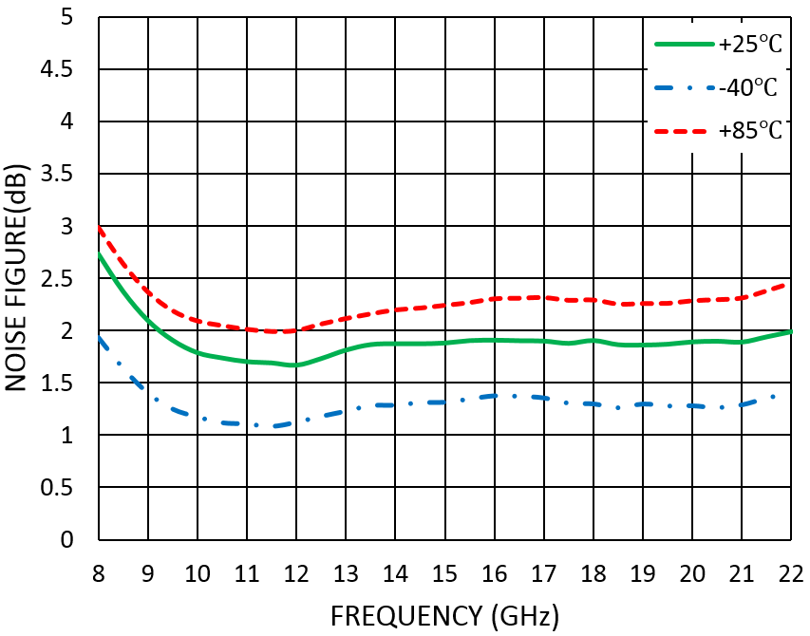
Measurement Plots: Noise Figure
VD=5V
Measurement Plots: Noise Figure
VD=5.5V
Absolute Maximum Ratings
Typical Supply Current vs. VD
Drain Bias Voltage (VD) | +6.5V
RF Input Power (RFIN)@(+5V) | +15dBm
Channel Temperature | 175°C
Continuous Pdiss (T = 85 °C) (derate 1.9mW/°C above 85 °C) | 0.17W
Thermal Resistance (channel to die bottom) | 50°C/W
Operating Temperature | -40°C to +85 °C
Storage Temperature | -65°C to +150 °C
VD (V) | IDD (mA)
+4.5 | 12
+5.0 | 16
+5.5 | 19
ELECTROSTATIC SENSITIVE DEVICE OBSERVE HANDLING PRECAUTIONS

Slide 8
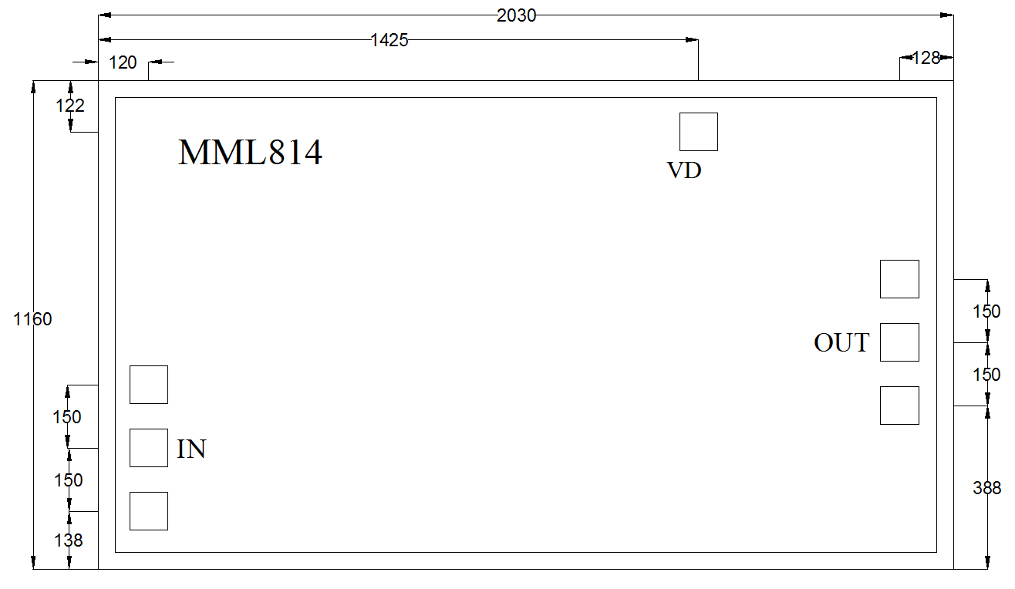
Outline Drawing:
All Dimensions in μm
Notes: 1. Die thickness: 100μm 2. VD bond pad is 90*90μm² 3. RF IN/OUT bond pad is 90*90μm² 4. Bond pad metalization: Gold 5. Backside metalization: Gold

Slide 9
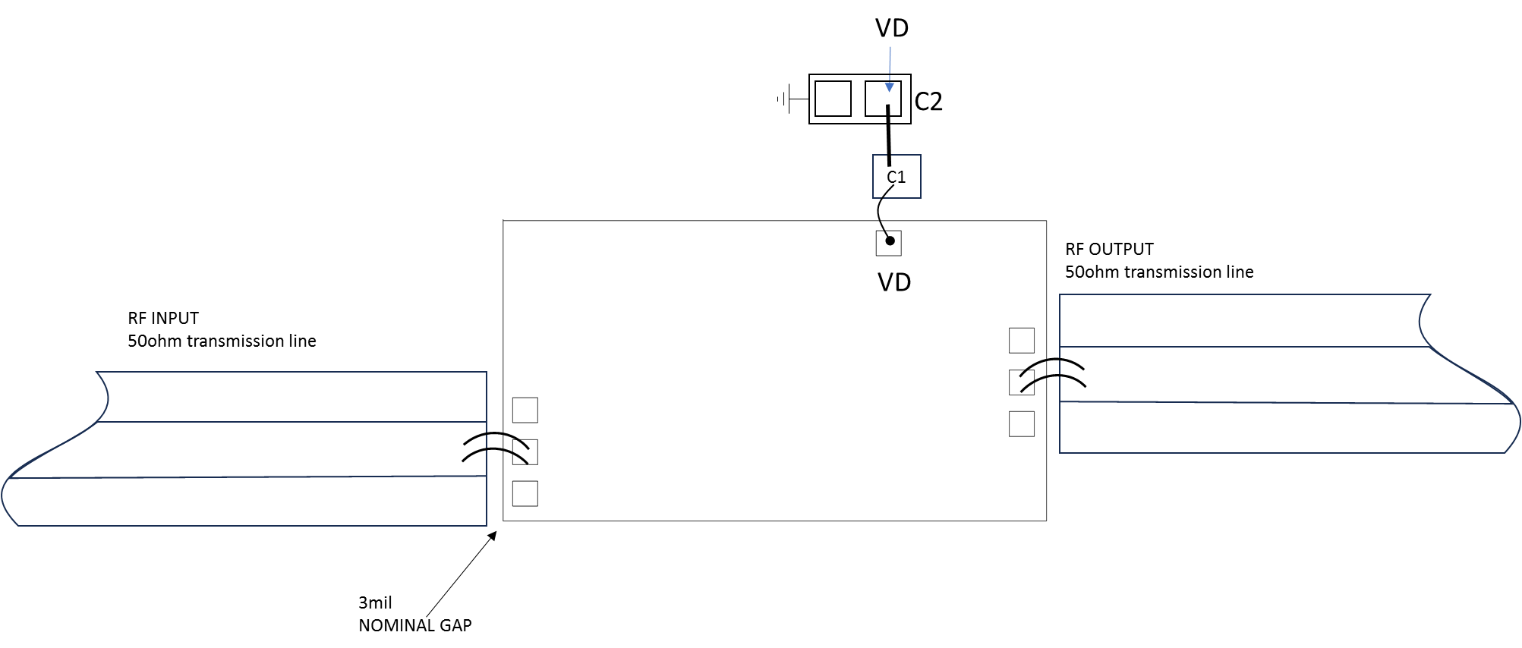
Assembly Drawing
Item | Description
C1 | 100pF Example: Skyworks Part: SC10002430
C2 | 1µF Example : TDK Part:C1005X7S1A105K050BC (0402)
No | Function | Description
1 | RF IN | RF signal input terminal; no blocking capacitor required.
2 | RF OUT | RF signal output terminal; no blocking capacitor required.
3 | VD | Drain Biases for the Amplifier; An external biasing circuit is required.
4 | Die Bottom | Die bottom must be connected to RF and dc ground.

Slide 10
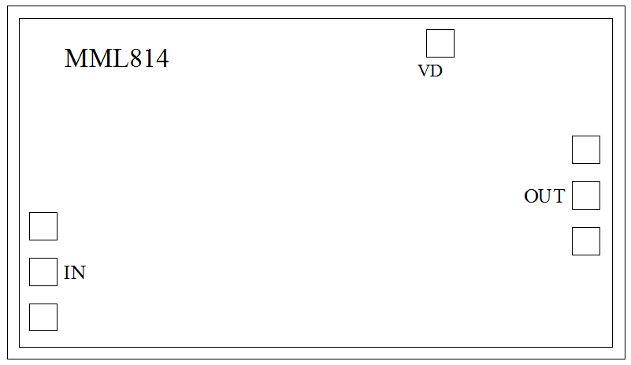
Biasing and Operation
Turn ON procedure:
Connect GND to RF and dc ground.
Apply positive drain voltage VD and set to +5V .
Apply RF signal.
Turn OFF procedure:
Turn off the RF signal.
Turn off the positive drain voltage VD.
Miller MMIC Inc. All rights reserved
Miller MMIC, Inc. holds exclusive rights to the information presented in its Data Sheet and any accompanying materials. As a premier supplier of cutting-edge RF solutions, Miller MMIC has made this information easily accessible to its clients.
Although Miller MMIC believes the information provided in its Data Sheet to be trustworthy, the company does not offer any guarantees as to its accuracy. Therefore, Miller MMIC bears no responsibility for the use of this information. It is worth mentioning that the information within the Data Sheet may be altered without prior notification.
Customers are encouraged to obtain and verify the most recent and pertinent information before placing any orders for Miller MMIC products. The information in the Data Sheet does not confer, either explicitly or implicitly, any rights or licenses with regards to patents or other forms of intellectual property to any third party.
The information provided in the Data Sheet, or its utilization, does not bestow any patent rights, licenses, or other forms of intellectual property rights to any individual or entity, whether in regards to the information itself or anything described by such information. Furthermore, Miller MMIC products are not intended for use as critical components in applications where failure could result in severe injury or death, such as medical or life-saving equipment, or life-sustaining applications, or in any situation where failure could cause serious personal injury or death.

