Slide 1
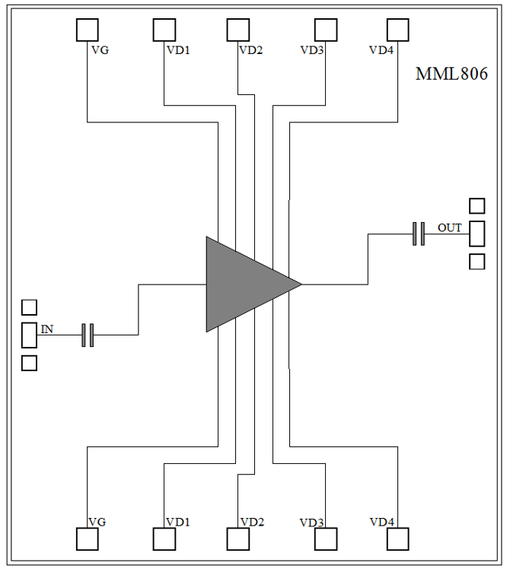
Features
• Frequency : 0-10GHz
• Small Signal Gain : 15dB Typical
• Gain Flatness : ±2.5dB Typical
• Noise Figure : 4.5dB Typical
• P1dB : 12dBm Typical
• Power Supply : VD=+4V@119mA ,VG=-0.4V
• Input/Output : 50Ω
• Chip Size : 1.766 x 2.0 x 0.05mm
Functional Block Diagram
Typical Applications
• Test Instrumentation
• Microwave Radio & VSAT
• Military & Space
• Telecom Infrastructure
• Fiber Optics
Electrical Specifications
TA = +25℃, VD=4V,ID=67mA Typical
Parameter | Min. | Type. | Max. | Min. | Type. | Max. | Unit
Frequency |  | 0 - 5 |  |  | 5 - 10 |  | GHz
Small Signal Gain | -51.7 | -11.3 | 29.2 | 24.5 | 26.7 | 29.0 | dB
Gain Flatness |  | ±45.0 |  |  | ±1.9 |  | dB
Noise Figure | 0.6 | 1.0 | 1.4 | 0.7 | 0.9 | 1.1 | dB
P1dB - Output 1dB Compression | 9.4 | 13.8 | 18.3 | 15.5 | 16.5 | 17.6 | dBm
Psat - Saturated Output Power | 16.7 | 17.7 | 18.6 | 18.5 | 19.0 | 19.5 | dBm
OIP3 - Output Third Order Intercept | 20.5 | 25.2 | 29.9 | 26.9 | 28.4 | 29.9 | dBm
Input Return Loss | -19.1 | -9.8 | -0.5 | -21.1 | -16.6 | -12.2 | dB
Output Return Loss | -13.1 | -6.6 | -0.1 | -20.0 | -12.9 | -5.9 | dB

Slide 2
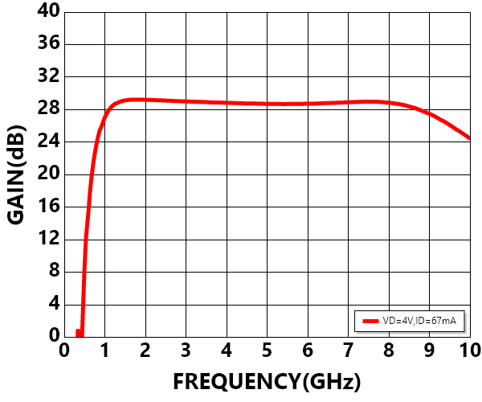
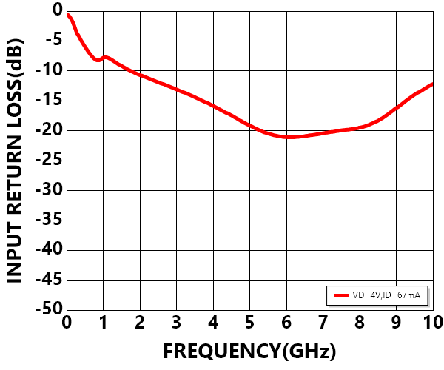
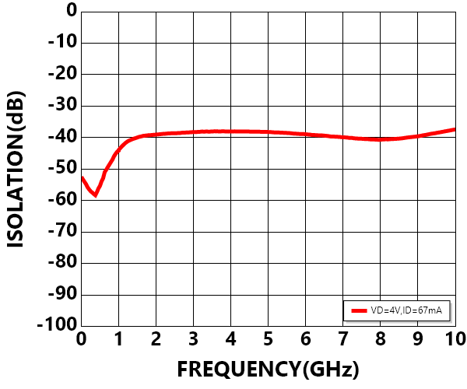
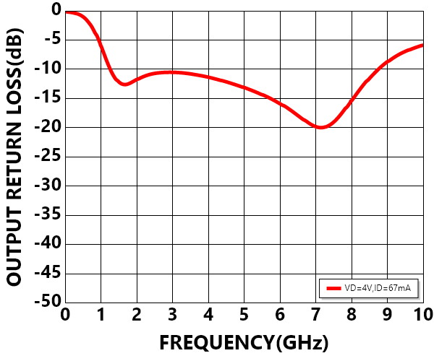
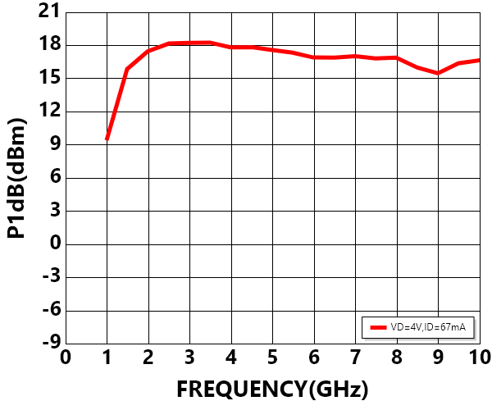
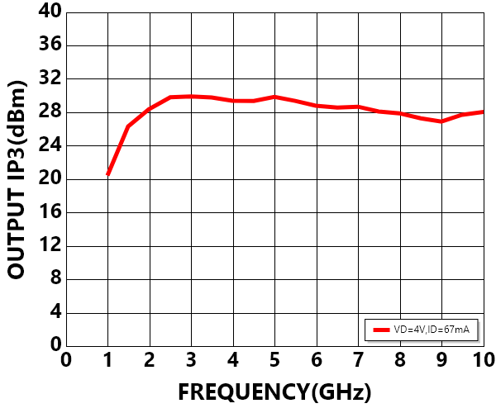
Measurement Plots: S-parameters
TA = +25℃
Measurement Plots: P1dB
TA = +25℃
Measurement Plots: OIP3
TA = +25℃

Slide 3
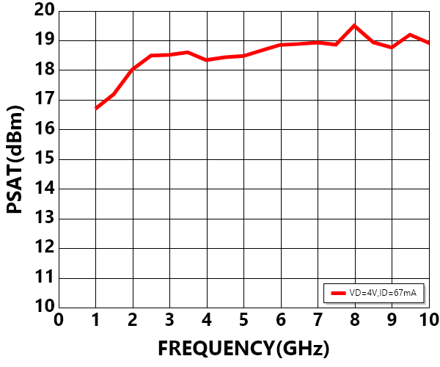
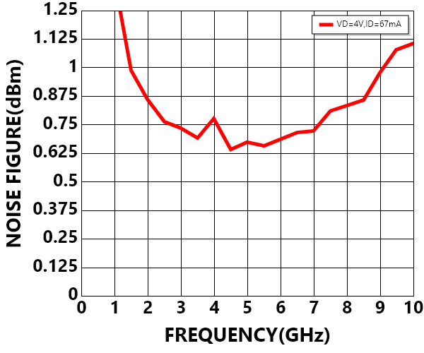
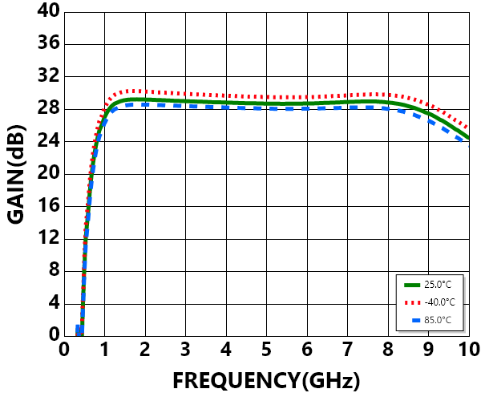
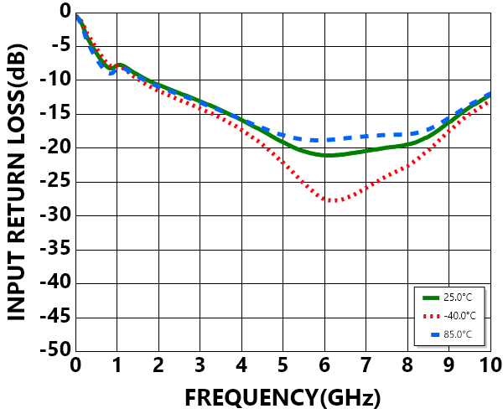
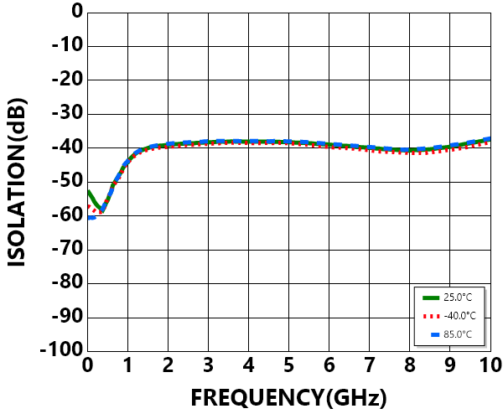
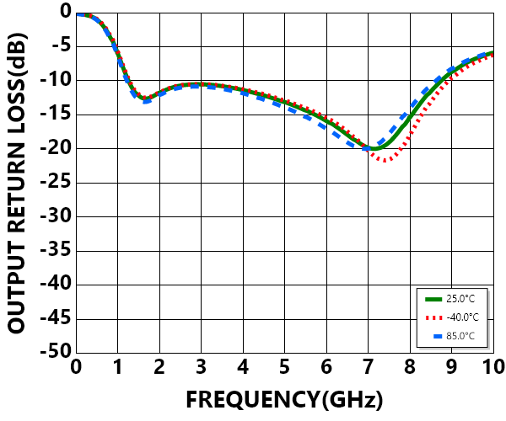
Measurement Plots: Psat
TA = +25℃
Measurement Plots: Noise Figure
TA = +25℃
Measurement Plots: S-parameters
VD=4V,ID=67mA

Slide 4
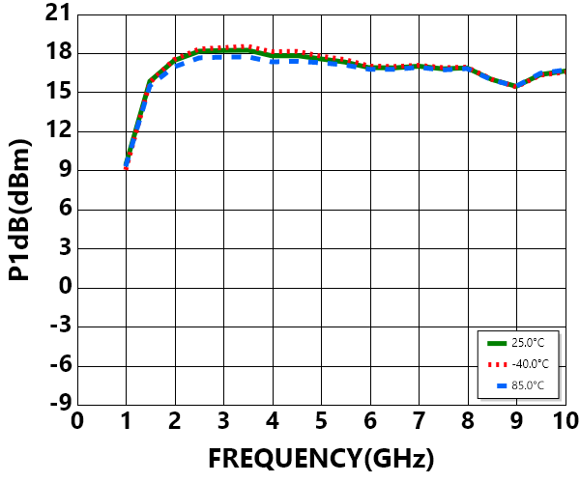
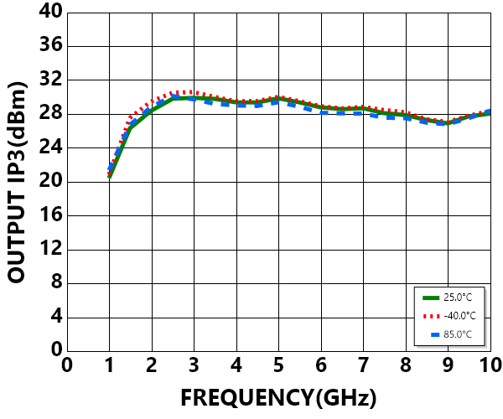
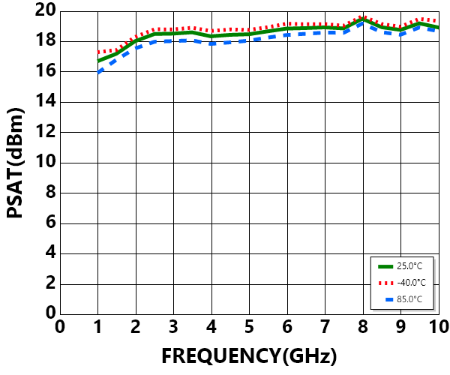
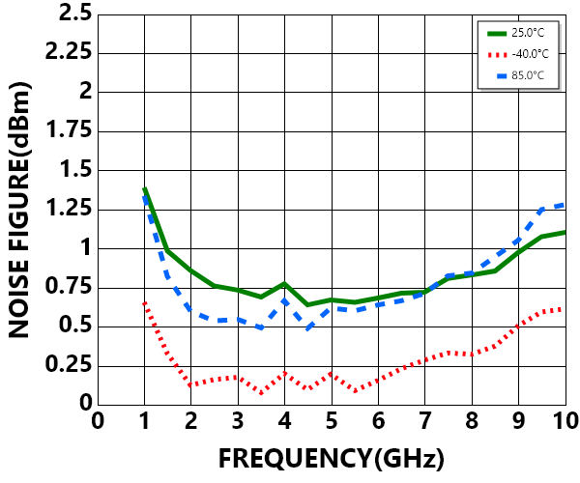
Measurement Plots: P1dB
VD=4V,ID=67mA
Measurement Plots: OIP3
VD=4V,ID=67mA
Measurement Plots: Psat
VD=4V,ID=67mA
Measurement Plots: Noise Figure
VD=4V,ID=67mA

Slide 5

Absolute Maximum Ratings
Typical Supply Current
Drain Bias Voltage (VD) | +4.5V
Gate Bias Voltage (VG) | -2V to 0V
RF Input Power (RFIN) | +15dBm
Continuous Pdiss (T = 85 °C) (derate 6.1mW/°C above 85 °C) | 175°C
Thermal Resistance (channel to die bottom) | 0.55W
Operating Temperature | -55°C to +85 °C
Storage Temperature | -65°C to +150 °C
VD(V) | VG(V) | IDQ(mA)
+3.5 | -0.38 | 118
4.0 | -0.40 | 119
4.0 | -0.50 | 71
ELECTROSTATIC SENSITIVE DEVICE
OBSERVE HANDLING PRECAUTIONS

Slide 6
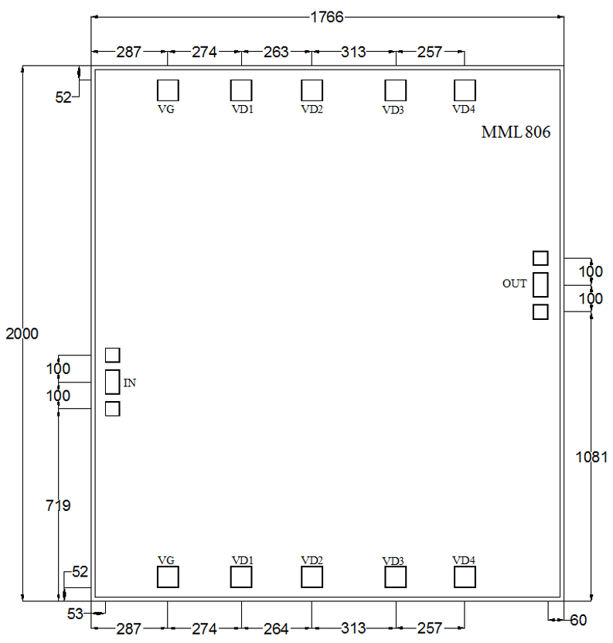
Outline Drawing:
All Dimensions in μm
Notes:
1. Die thickness: 50μm
2. VD bond pad is 75*75μm²
3. VG bond pad is 75*75μm²
4. RF IN/OUT bond pad is 50*86μm²
5. Bond pad metalization: Gold
6. Backside metalization: Gold

Slide 7
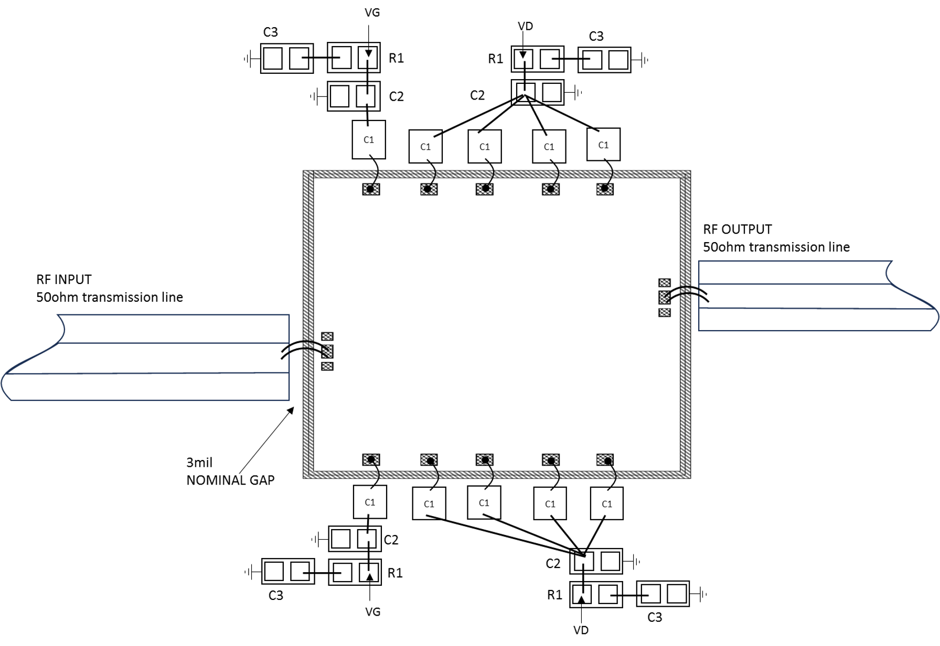
Assembly Drawing
Item | Description
C1 | 100pF Example: Skyworks Part: SC10002430
C2 | 0.01μF Example: TDK Part:C1005X7R1H103K050BB (0402)
C3 | 0.1μF Example: TDK Part:C1005X7R1H104K050BB (0402)
R1 | 100Ω Example: Yageo Part:SR0402FR-7T10RL
Item | Funciton | Description
1 | RF IN | RF signal input terminal; no blocking capacitor required.
2 | RF OUT | RF signal output terminal; no blocking capacitor required.
3 | VD | Drain Biases for the Amplifier ; An external biasing circuit is required.
4 | VG | Gate Biases for the Amplifier ; An external biasing circuit is required.
5 | Die Bottom | Die bottom must be connected to RF and dc ground.

Slide 8
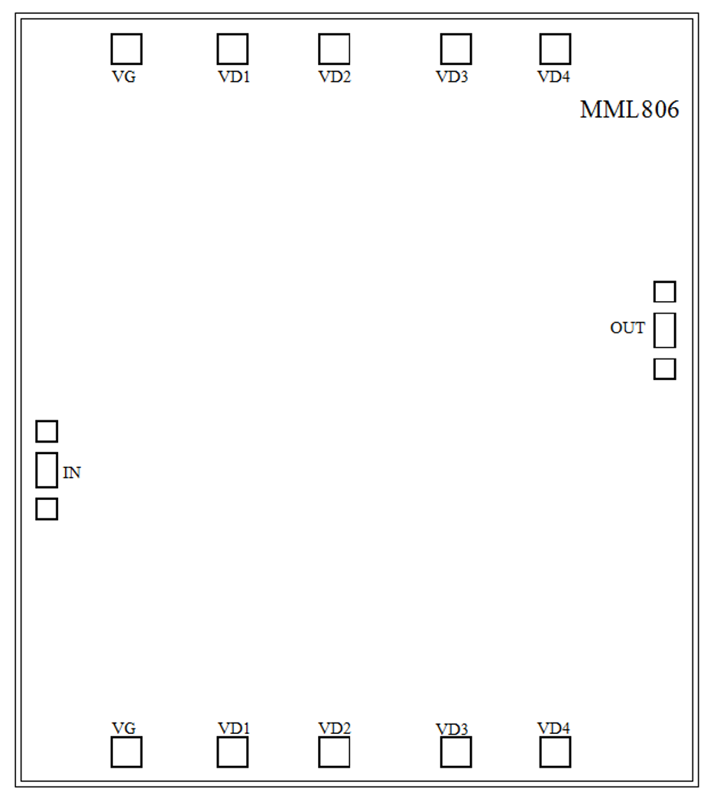
Biasing and Operation
Turn ON procedure:
1. Connect GND to RF and dc ground.
2. Set the gate bias voltages VG to -2V.
3. Set the drain bias voltages VD to +4V.
4. Apply RF signal.
Turn OFF procedure:
1. Turn off the RF signal.
2. Decrease the gate bias voltages, VG to -2V to achieve a IDQ = 0 mA (approximately).
3. Decrease the drain bias voltages to 0 V.
4. Increase the gate bias voltages to achieve a quiescent supply current of 82 mA.
5. Increase the all gate bias voltages to 0 V.

Slide 9
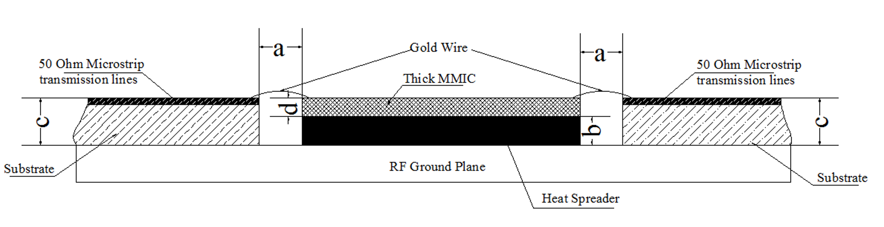
Mounting & Bonding Techniques for MMICs
Direct Mounting
1.Typically, the die is mounted directly on the ground plane.
2.If the thickness difference between the substrate (thickness c) and the die (thickness d) exceeds 0.05 mm (i.e., c – d > 0.05 mm), it is recommended to first mount the die on a heat spreader, then attach the heat spreader to the ground plane.
3.Heat Spreader Material: Molybdenum-copper (MoCu) alloy is commonly used.
4.Heat Sink Thickness (b): Should be within the range of (c – d – 0.05 mm) to (c –d + 0.05 mm).
5.Spacing (a): The gap between the bare die and the 50Ω transmission line should typically be 0.05 mm to 0.1 mm. If the application frequency is higher than 40GHz, then this gap is recommended to be 0.05mm
Wire Bonding Interconnection
The connection between the die and the 50Ω transmission line is usually made using 25 μm diameter gold (Au) wires, bonded via wedge bonding or ball bonding processes.
Die Attachment Methods
1.Conductive Epoxy:
After adhesive application, cure according to the manufacturer’s recommended temperature profile.
2.Au-Sn80/20 Eutectic Bonding:
Use preformed Au-Sn80/20 solder preforms.
Perform bonding in an inert atmosphere (N₂ or forming gas: 90% N₂ + 10% H₂).
Keep the time above 320℃ to less than 20 seconds to prevent excessive intermetallic formation.
Miller MMIC Inc. All rights reserved
Miller MMIC, Inc. holds exclusive rights to the information presented in its Data Sheet and any accompanying materials. As a premier supplier of cutting-edge RF solutions, Miller MMIC has made this information easily accessible to its clients.
Although Miller MMIC believes the information provided in its Data Sheet to be trustworthy, the company does not offer any guarantees as to its accuracy. Therefore, Miller MMIC bears no responsibility for the use of this information. It is worth mentioning that the information within the Data Sheet may be altered without prior notification.
Customers are encouraged to obtain and verify the most recent and pertinent information before placing any orders for Miller MMIC products. The information in the Data Sheet does not confer, either explicitly or implicitly, any rights or licenses with regards to patents or other forms of intellectual property to any third party.
The information provided in the Data Sheet, or its utilization, does not bestow any patent rights, licenses, or other forms of intellectual property rights to any individual or entity, whether in regards to the information itself or anything described by such information. Furthermore, Miller MMIC products are not intended for use as critical components in applications where failure could result in severe injury or death, such as medical or life-saving equipment, or life-sustaining applications, or in any situation where failure could cause serious personal injury or death.

