Slide 1
CMPS 451 PA3 Progress Report
DK Crew: Zachary Gros, Stephen Legnon

Slide 2
WINDOWING DATA
In order to generate the desired features from DataSmall.zip, we must window the streams from each file and calculate the mean and standard deviation of the windows for each channel. To do so, we must iterate through each file in each of the 4 folders and window all three required channels (F8, F4, Fz).

Slide 3
FEATURE GENERATION
Once the mean and standard deviation for each window is calculated, we can use these values to calculate the features for each channel. We used the numpy library for calculating the mean and standard deviation, and we used the scipy library to calculated skewedness and kurtosis. Once each of these features are calculated, we add them to a new row in a pandas DataFrame containing the generated features for each of the 3 channels in all of the files in DataSmall.zip. This DataFrame is then sent to Data.csv using the built-in to_csv function in pandas.

Slide 4
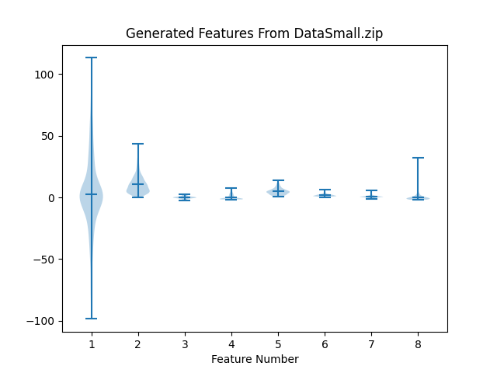
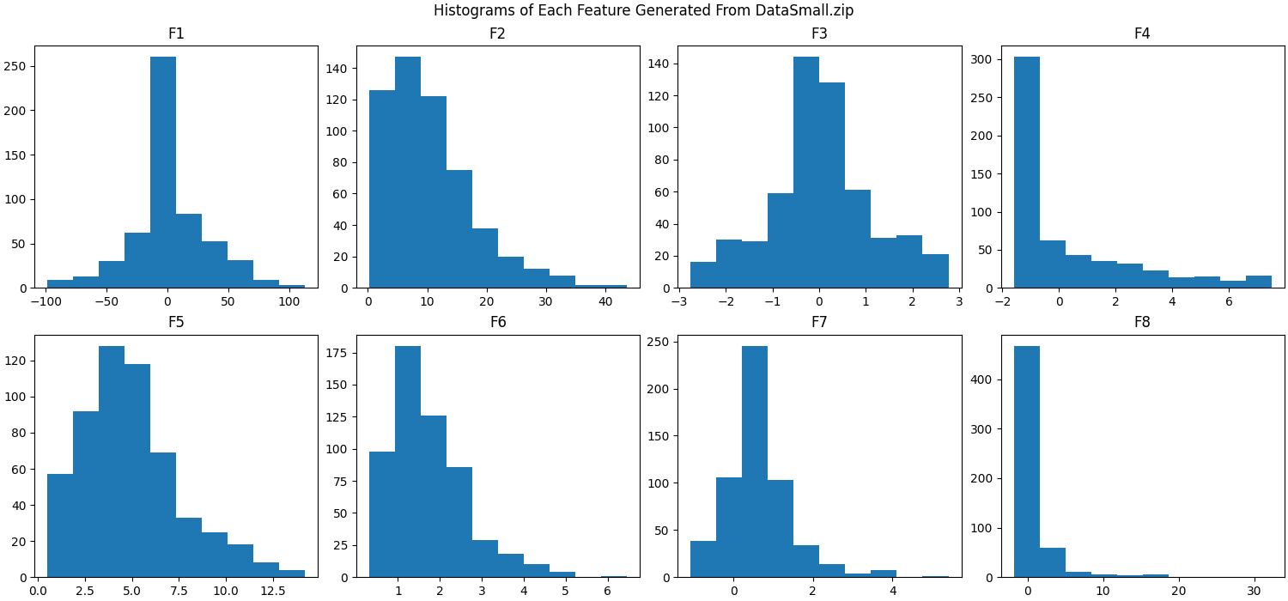
GRAPHING FEATURES
Upon the completion of generation the features for the final file in DataSmall.zip, we plotted the features together on a violin plot and separately on histograms in order to properly show the trends in the generated features.

Slide 5
EVALUATION
Looking at the plots on the previous slide, we can see that F1 (the mean of the window means) is a lot more spread out than the rest of the features in the dataset, making it hard to visually see trends in the other 7 features. By plotting them in individual histograms, however, we can clearly see the trends of each individual feature. For instance, F1 and F3 look to be distributed mostly in the center of the data while the other 6 featured have a negative skewness of varying degrees. Furthermore, F3, F4, F5, F6, and F7 appear to fall within a much smaller range than F2 and F8 which both have a significantly smaller range than F1.

