Slide 1





Cloud Native AI Summit APAC · Melbourne · October 2026
Why Can’t I Have More Tokens, Rob?
Using agentgateway to Keep Your AI Usage Under Control
Attribute every token. Price every request. Enforce every budget.
Akshay Adsul
Kasun Talwatta
APAC Lead CS Engineering, Solo.io
Principal Solutions Architect, Solo.io

Slide 2





HOW WE USED TO CODE
2000 to 2020: same tools, same struggle
2000
2010
2015
2020
Manuals, floppy disks and forums
Google the error message
Copy from Stack Overflow, paste, pray
The same thing, from home
20 years. Same workflow. Still typing it all by hand.
Notes:
“ Hello everyone my name is Akshay .. And I am a developer.. I first started coding in my school in the 2000’s.. BASIC was the first language i learnt to code in.. In college I did my Computer Engineering .. Learnt C C++ Java.. we coded using reference books , manuals and used floppy disks I don’t know how many of u remember that.. Fast forward a decade I started coding professionally at work.. And Google was our source of truth.. We Googled everything.. If we were stuck we’d post things on Stack Overflow… Get insulted.. Then copy paste the answer and pray.” Mime two-finger typing, squinting. “For almost 20 years, nothing really changed.. I wrote code by hand .. like an animal… But then 2020 came along.. And we all know what happened then.. COVID!! Things changed dramatically.. Well not really we still did exact same thing.. from home.. . Just without pants.. Pants had become extinct from my life…
fast forward to 2026

Slide 3
THEN AI HAPPENED
akshay@home-office: ~/everything
I don’t write code anymore. I write vibes.
TOKENMAXXING FTW !
agent-1 writing the code
agent-2 reviewing agent-1
agent-3 writing the README
agent-4 arguing with agent-3
fulfillment-agent retrying… attempt 4,812
tokens today 18,402,113 ↑
Notes:
. “Then AI changed everything. In 2026 I dont write code anymore. I write vibes. ‘Make it better.’ ‘Make it enterprise.’ I’m managing dozens of agents, and none of them sleep.” “One kept failing, so it suggested: ‘Just keep retrying until it works.’ Genius. Merged.” TOKENMAXXING FTW Sound cue 2: fast-forward, 8–10 seconds of fast-motion work, freeze. “Productivity: off the charts. Tokens: also off the charts.”

Slide 4
R
Rob (CFO)
Direct message · 7:02 AM
Akshay. Who is fulfillment-agent and why did it make 40,000 requests last night?
Anthropic · API usage
INVOICE
$22,917.40
Top user:
akshay
Notes:
Scene 4 (2:15–3:00). And then I got a ping from Rob .. our CFO…
Sound cue 3: Slack knock. Read it out: “Who is ‘fulfillment-agent’ and why did it make forty thousand requests last night?” Beat. “…I don’t know her.”

Slide 5
R
Rob (CFO)
Direct message · 7:03 AM
Effective immediately: no more tokens.
Rob has never seen a token. Only the invoice.
Notes:
Sound cue 4: second Slack knock. Read: “Effective immediately: no more tokens.” To the audience: “Rob had seen the invoice and taken the one things that mattered the most to me in my life.. TOKENS”

Slide 6
akshay@home-office:~/everything$ claude "finish the feature"
Thinking…
401 invalid_api_key: key revoked
akshay@home-office:~/everything$
Notes:
He types on the laptop. “No no no. I was this close. ” Claude was just finishing a feature for me and my keys were revoked… To the sky: “WHY.. WHY CAN’T I HAVE MORE TOKENS, ROB?!” Advance to the title slide and collapse into the chair.

Slide 7
Why can’t I have more tokens, Rob?!
Using agentgateway to keep your AI usage under control
Notes:
The title line lands here. Akshay collapses. Handoff (3:00–3:30): Kas walks over, picks up the laptop. Kas: “Rob sent me.” Akshay (from the floor): “Is he going to give me my tokens back?” Kas: “He’s going to give you a budget.” Akshay: “That’s worse.” Kas, to the audience: “Rob’s fix was to revoke the key. Now nobody can work, including the people who weren’t burning money. Let’s do this properly.”

Slide 8
QUICK QUESTION
Anthropic
INVOICE
Who spent all the tokens last month?
API usage · September 2026
Amount due
$22,917.40
For most teams, the invoice is the first place they find out.
Breakdown by team
?
Breakdown by agent
?
Which team?
Which agent?
Which model?
Breakdown by model
?
agentgateway.dev
Notes:
Kas takes over: Who spent all the tokens last month? For most teams the invoice is the first place they find out..
Akshay points at the invoice: “That’s the one Rob sent me.” Kas: shared keys, nobody knows who spent what, and finance finds out from the invoice a month later.

Slide 9

WITH AGENTGATEWAY
One front door for every token
PEOPLE AND AGENTS
LLM PROVIDERS
Akshay · developer
Attribute
Anthropic
Support team
Price
OpenAI
fulfillment-agent
Enforce
Gemini · Bedrock
agentgateway.dev
Notes:
Kas: Without a gateway, provider keys live in every tool and nothing stops a runaway loop. With agentgateway, every person and agent gets one key, every request is owned and priced, and budgets are enforced in one place.
Akshay: What is the agentgateway that you speak of?

Slide 10
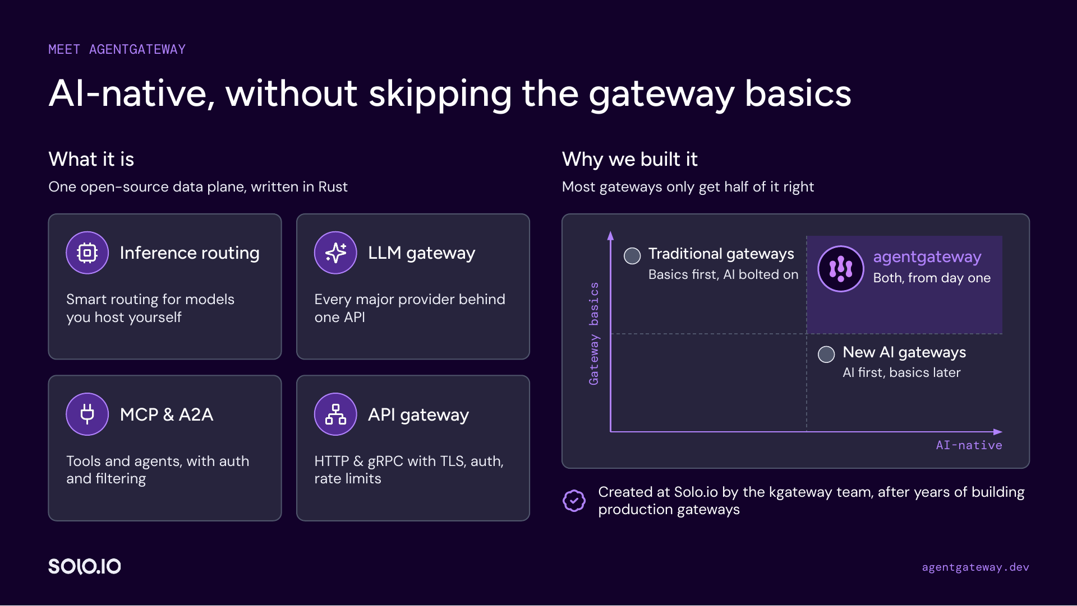
Notes:
Kas: Agentgateway is an open-source LLM MCP A2A gateway, written in Rust. It does inference routing for models you host, an LLM gateway with every major provider behind one API, MCP and A2A for tools and agents with auth and filtering, and a regular API gateway for HTTP and gRPC. Why it was built: traditional gateways put the basics first and bolted AI on; the new AI gateways put AI first and left the basics for later. agentgateway does both from day one, built by the kgateway team at Solo.io.
Akshay: Interesting.. But why should i use agentgateway ? There are so many other gateways out there ?

Slide 11
WHY AGENTGATEWAY
Three reasons to put it in front of your AI
01
02
03
One control point for all AI traffic
Built like a production gateway
Open and vendor-neutral
LLMs, MCP, A2A and regular APIs share one set of security, observability and governance controls.
A Rust data plane from the kgateway team. TLS, auth and rate limits come standard.
Open source, and hosted by the Agentic AI Foundation under the Linux Foundation.
agentgateway.dev
Notes:
Kas:. One: one control point for every kind of AI traffic, so you don’t run separate stacks for LLMs, MCP, agents and APIs. Two: it’s built like a production gateway, in Rust, by the team behind kgateway. Three, and pointing at the highlighted card: it’s open and vendor-neutral. Right now we have over 500 contributors.. From over 130 different companies contributing to the project.. That is the power of open source.. Then turn to Akshay: “Akshay, do you know about the AAIF?”

Slide 12
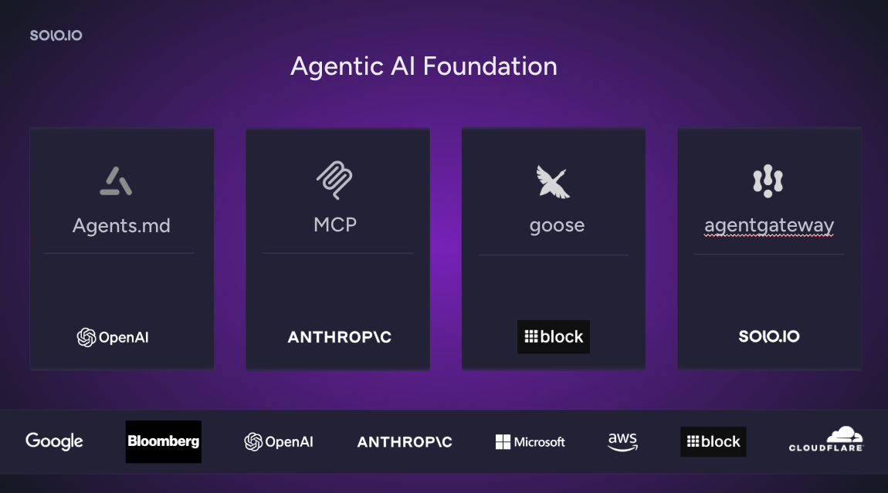
Notes:
Akshay: Oh yes I do know about the Agentic AI Foundation. The Linux Foundation launched it in December 2025 as a neutral home for agentic AI. Founding projects: Anthropic’s MCP, OpenAI’s AGENTS.md, Block’s goose. So is agw part of it too?
Kas: Yes this year agentgateway joined as its fourth hosted project. Why it matters: one, it’s neutral, governed in the open, so nobody can change the license on you. Two, it sits next to the standards it handles: MCP, A2A and every provider API run through the gateway. Three, look who’s in the room: AWS, Google, Microsoft, Anthropic, OpenAI, Cloudflare and Bloomberg.
Akshay: “Rob would love this. Neutral governance means no vendor lock-in. That’s the only open-source sentence he understands.
Enough with the slides. Talk is cheap.. Can you pls show me this in action and also to the folks sitting here.. “

Slide 13

FOLLOW ALONG
Run today’s demo on your own machine
Demo code
Every step from today’s demo, ready to run
github.com/day0ops/
agentgateway-rogue-agent-demo
Notes:
Kas introduces the demo.. . Kas: “Everything you’re about to see is in this repo. It runs on a local Kubernetes cluster with a mock LLM, so it costs nothing.” Then: “Let’s look at the agents.”

Slide 14
LIVE DEMO
The agents, reined in
1
2
3
4
5
Run it direct
Route it
Set a budget
Get a 429
See it
The retry loop runs away until the provider cuts it off
Same code, now through agentgateway with its own key
Attached to the key, live, with no restart
Blocked at the budget. Only this agent, nobody else
Who, which model, how many tokens, what it cost
Demo code · github.com/day0ops/agentgateway-rogue-agent-demo
agentgateway.dev
Notes:
Demo (7:00–17:00). Kas drives Acme Agent and Mission Control; Akshay reacts. Beat 1: show the retry-forever commit (“Mine. The AI wrote it. I just approved it.”). Beat 2: Run locally, direct; fast-forward sound cue 5; Kill process. Beat 3: Route through agentgateway. Beat 4: Apply budget policy. Beat 5: Run again, 429; Akshay repeats “WHY CAN’T I HAVE MORE TOKENS, ROB?!” then “…that’s actually fair.” Beat 6: open the dashboard. “Can I see who spent the most?” “You.” Don’t click the Rob · CFO badge on stage: it opens the operator panel.

Slide 15
WHY I CAME AROUND
I still get my agents. Just with a ceiling.
BEFORE
WITH AGENTGATEWAY
One rogue agent, everyone gets cut off
Just me, and only when I’m the problem
A provider key in every tool
One endpoint, one key, every provider
Rob finds out from the invoice, a month late
The dashboard tells him the same day
agentgateway.dev
Notes:
Akshay,: “Look, I came in here angry. I’ll be honest, I’m still a little angry. But here’s what changed for me.” Read the three before/after rows in your own words. “And I still get my agents. I just get them with a ceiling.” Kas: “That’s the developer’s side. Here’s Rob’s.”

Slide 16




ROB’S SIDE
What else Rob gets
Analytics
Model allow-lists
Spend by user, model and provider
Wrong model: 403 model_not_allowed, before the provider
Audit mode
Routing, Security, Observability
Log overages before you start blocking
agentgateway.dev
Notes:
Kas talks about what else agw can provide.. The demo showed routing and budgets; this names the rest. Akshay on allow-lists: “Rob put me on the mini models.” Then Akshay: “So Rob gets the receipts, I keep my agents, and the 2 a.m. loop gets stopped before the invoice shows up.”

Slide 17
AGENTGATEWAY · PART OF THE AGENTIC AI FOUNDATION
Your gateway should know your bill before your CFO does
Notes:
Kas: “Your gateway should know your bill before your CFO does.” Then Akshay starts to wrap up: “So the lesson is: route through the gateway, get a budget, and never run out of tokens again.” Kas: “Actually, Akshay, you can use zero tokens.” Akshay: “Zero? How?” Advance on Kas’s answer.

Slide 18





TRY IT YOURSELF
github.com/day0ops/
agentgateway-rogue-agent-demo
Use your brain.
agentgateway.dev
0 tokens. Unlimited budget. Rob approved.
github.com/agentgateway/agentgateway
discord.gg/y9efgEmppm
Thank you. Questions?
Notes:
Kas taps own head: “Use your brain.” Akshay looks at the audience, horrified. “…Thank you, we’ll take questions.” Q&A runs 20:00–25:00.

Slide 19
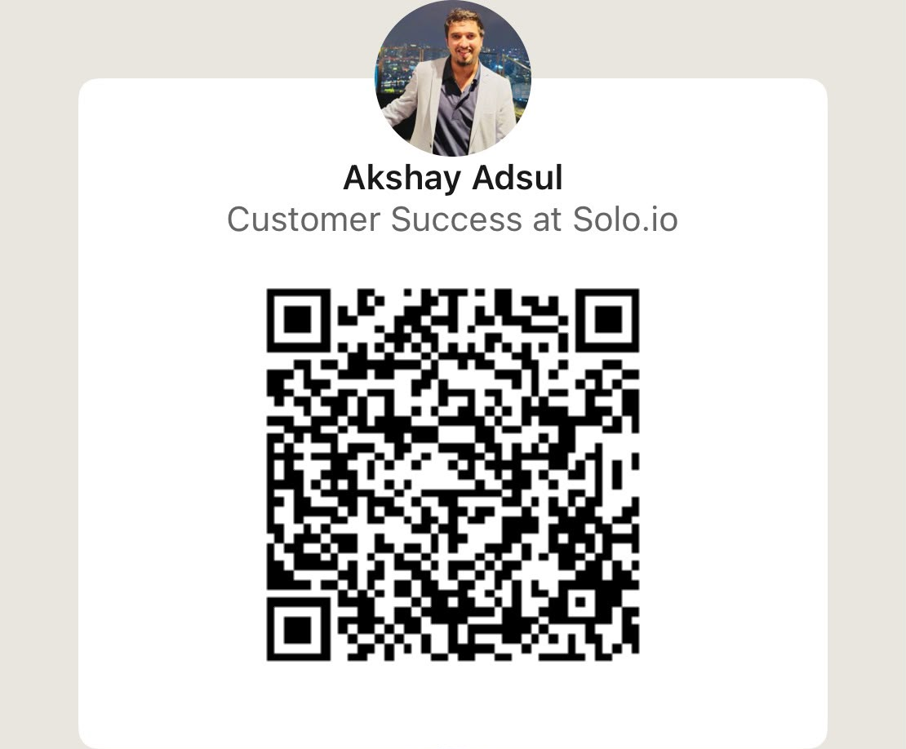
CONNECT WITH US
Akshay Adsul · Kasun Talwatta · Solo.io
Notes:
Leave this up during Q&A so people can scan it. Ask the audience to fill in the feedback form before they leave.

Slide 20
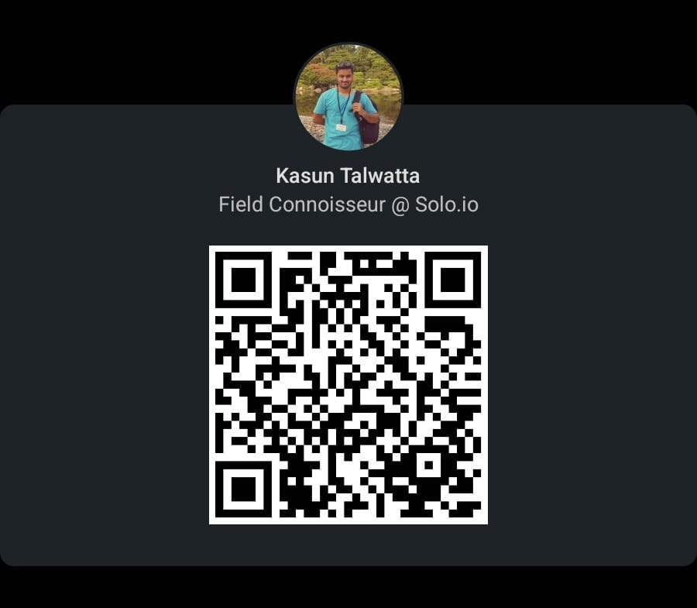
CONNECT WITH US
Akshay Adsul · Kasun Talwatta · Solo.io
Notes:
Leave this up during Q&A so people can scan it. Ask the audience to fill in the feedback form before they leave.

Slide 21

FEEDBACK
How did we do?
Scan the code and tell us. It takes a minute and costs zero tokens.
Akshay Adsul · Kasun Talwatta · Solo.io
Scan to rate this talk
Notes:
Leave this up during Q&A so people can scan it. Ask the audience to fill in the feedback form before they leave.

