Slide 1
COS3302 Applied Data Science
Week 5 : Adult Dataset
Jutharat Pooamorn
6405003317

Slide 2
Storytelling with Data
Source : 1994 U.S. Census Database
Number of Data : 32,561 people
Collecting agency : US Census Bureau
Data contain 15 features
Target field : Income
-- divide into two classes : <=50K and >50K
Other attributes : 14
-- describe a person

Slide 3
Data Features
Categorical |  | Numerical
Nominal | Ordinal | Interval | Ratio
work-class | education | income | age
marital-status |  |  | fnlwgt
occupation |  |  | education-num
relationship |  |  | capital-gain
race |  |  | capital-loss
sex |  |  | hours-per-week
native-country

Slide 4
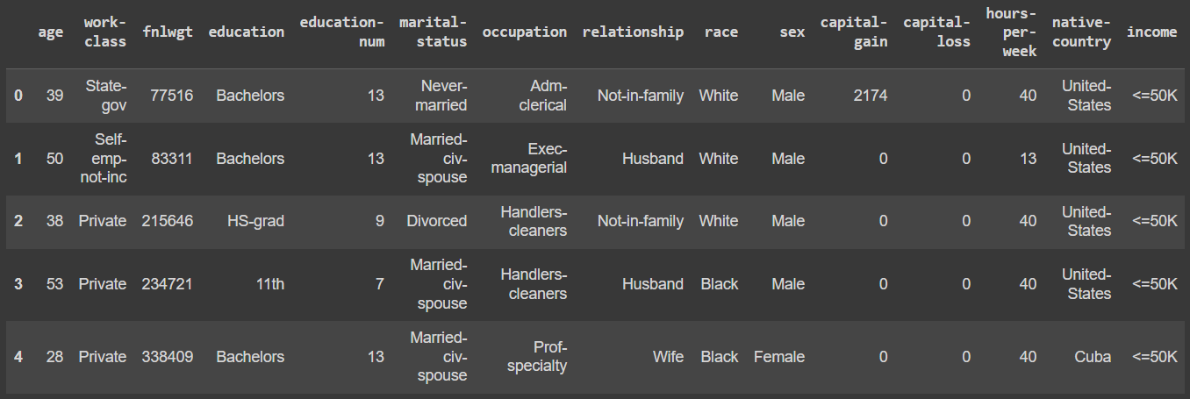
Data Example

Slide 5
Statistics of Ratio Data
 | age | fnlwgt | education-num | capital-gain | capital-loss | hours-per-week
count | 32,561.00 | 32,561.00 | 32,561.00 | 32,561.00 | 32,561.00 | 32,561.00
mean | 38.58 | 189,778.37 | 10.00 | 1,077.65 | 87.30 | 40.44
std | 13.64 | 105,549.98 | 2.57 | 7,385.29 | 402.96 | 12.35
min | 17.00 | 12,285.00 | 1.00 | 0.00 | 0.00 | 1.00
max | 90.00 | 1,484,705.00 | 16.00 | 99,999.00 | 4,356.00 | 99.00
25% | 28.00 | 117,827.00 | 9.00 | 0.00 | 0.00 | 40.00
50% | 37.00 | 178,356.00 | 10.00 | 0.00 | 0.00 | 40.00
75% | 48.00 | 237,051.00 | 12.00 | 0.00 | 0.00 | 45.00

Slide 6
Work-Class
Private
Self-emp-not-inc
(Self employed not incorporated)
Local-gov
State-gov
Self-emp-inc
(Self employed incorporated)
Federal-gov
Without-pay
Never-worked
Type of Data : Nominal

Slide 7
Education
Preschool (Nursery School)
1st-4th , 5th-6th ,
7th-8th , 9th , 10th , 11th , 12th
HS-grad (High School Graduates)
Some-college
Assoc-voc
(Associate's Degree in Vocational Education)
Assoc-acdm
(Associate’s Degree in Academic)
Bachelors
Masters
Prof-school (Professional school)
Doctorate
Type of Data : Ordinal

Slide 8
Marital-Status
Married-civ-spouse
(Married, civilian spouse)
Never-married
Divorced
Separated
Widowed
Married-spouse-absent
Married-AF-spouse
(Married, armed forces spouse)
Type of Data : Nominal

Slide 9
Occupation
Prof-specialty (Professional specialty)
Craft-repair
Exec-managerial (Executive-Managerial)
Adm-clerical (Administrative-Clerical)
Sales
Other-service
Machine-op-inspct
(Machine Operator Inspector)
Transport-moving
Handlers-cleaners
Farming-fishing
Tech-support (Technical support)
Protective-serv (Protective service)
Priv-house-serv (Private household service)
Armed-Forces
Type of Data : Nominal

Slide 10
Relationship
Husband
Not-in-family
Own-child
Unmarried
Wife
Other-relative
Type of Data : Nominal

Slide 11
Race
White
Black
Asian-Pac-Islander
(Asian Pacific Islander)
Amer-Indian-Eskimo
(American Indian and Alaska Native)
Other
Type of Data : Nominal

Slide 12
Sex
Income
Male
Female
Type of Data : Nominal
<=50K (<= 50,000 usd)
>50K (>50,000 usd)
Type of Data : Interval

Slide 13
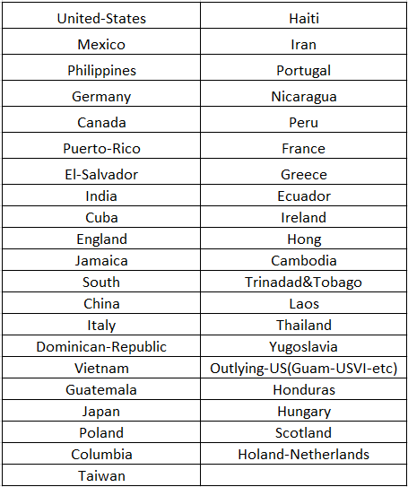
Native-Country
Type of Data : Nominal

Slide 14
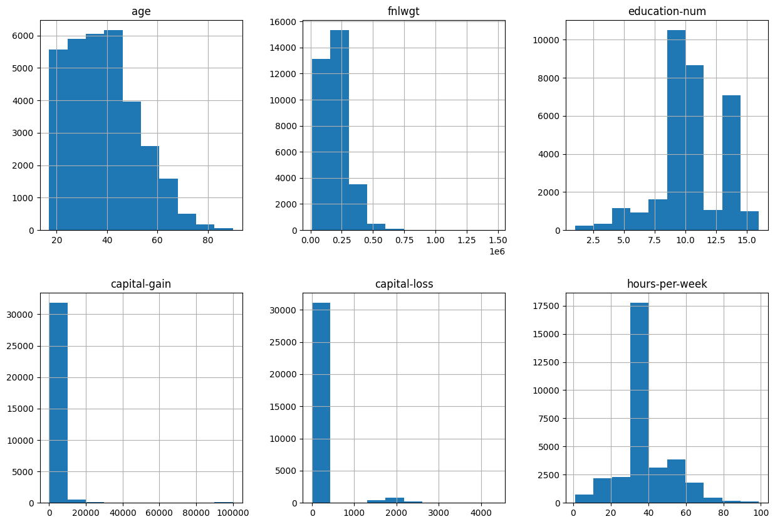
Histograms

Slide 15
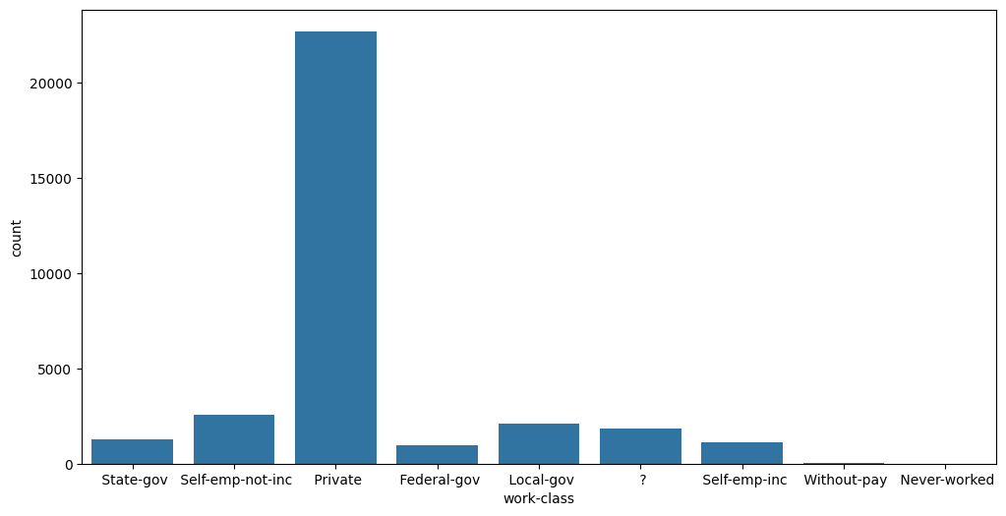
Work-Class

Slide 16
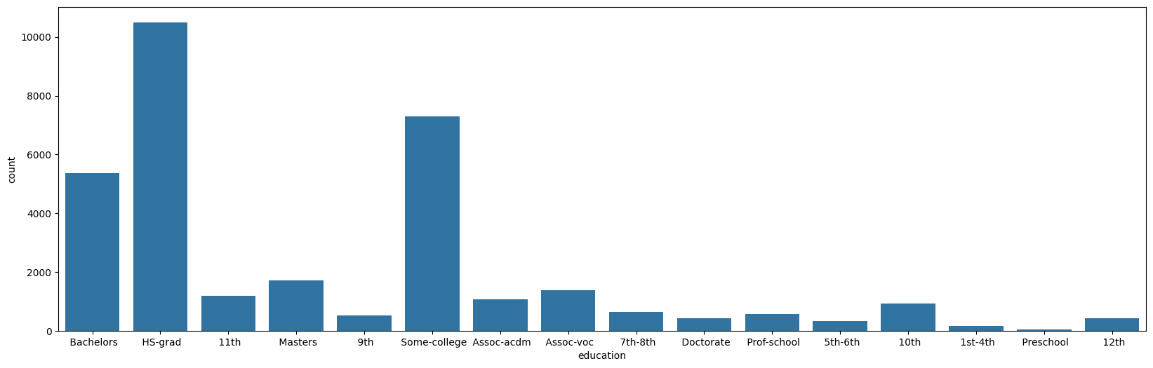
Education

Slide 17
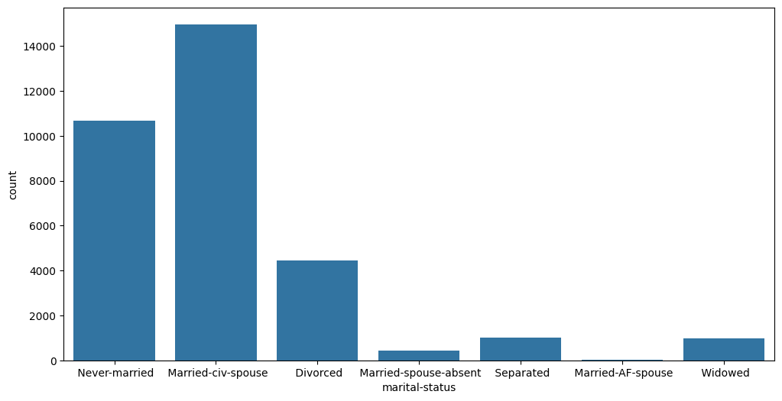
Marital-Status

Slide 18
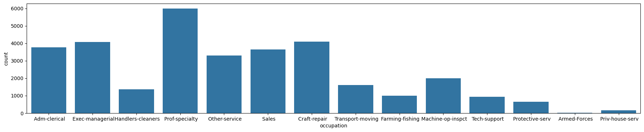
Occupation

Slide 19
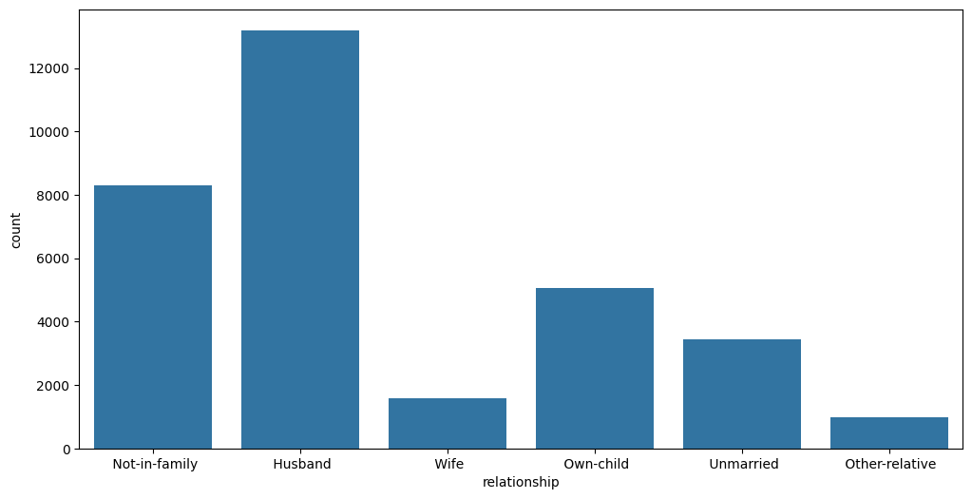
Relationship

Slide 20
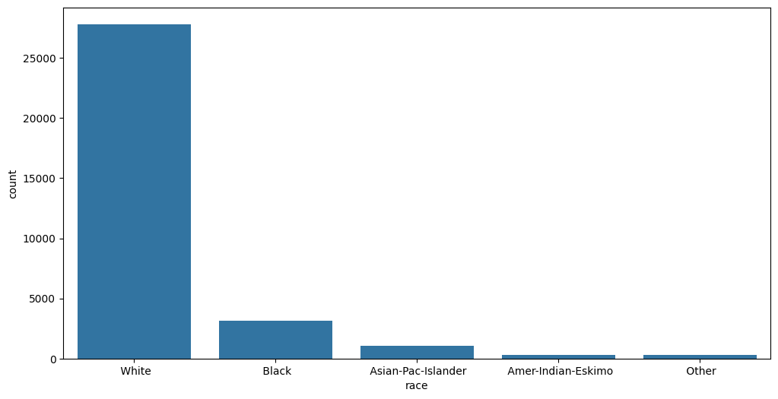
Race

Slide 21
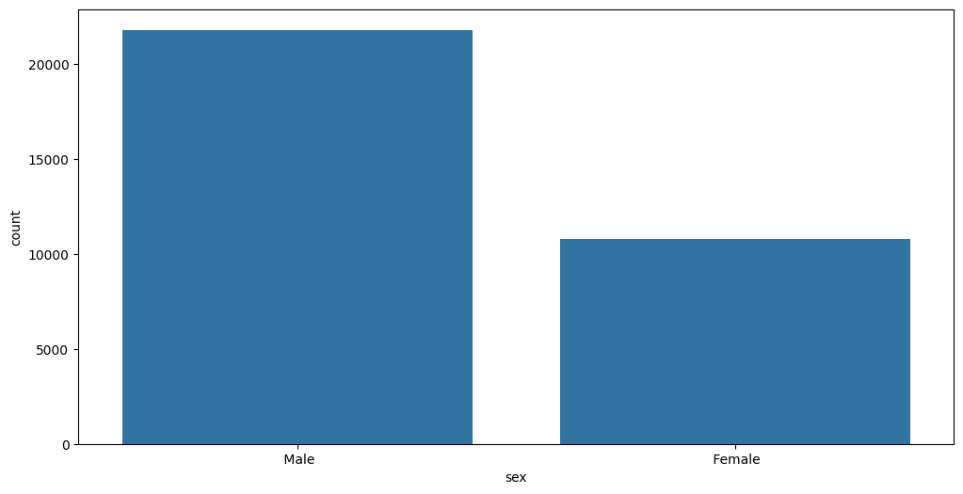
Sex

Slide 22
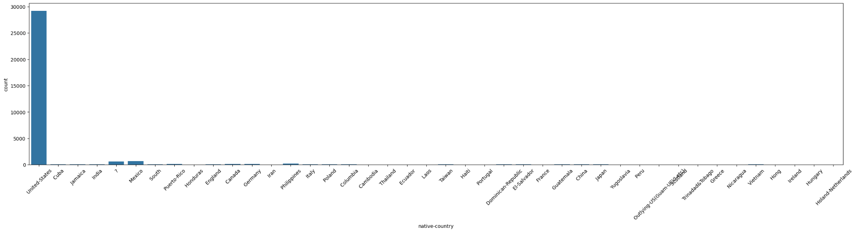
Native-Country

Slide 23
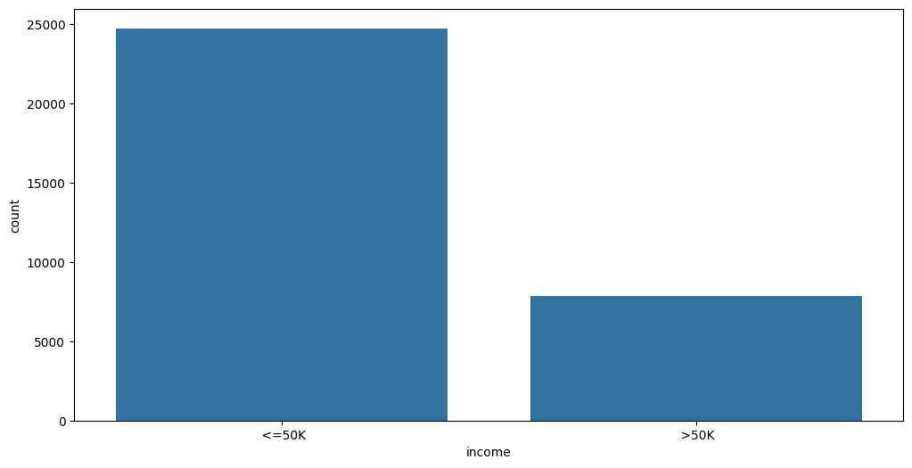
Income

Slide 24
Thank You

