Slide 1
COS3302 Applied Data Science
Week 6 : Adult Dataset
Jutharat Pooamorn
6405003317

Slide 2
Objectives
Use the Adult Dataset as a case study to enhance data analytics, including techniques for data visualization
Apply analytic tools such as Cross Tabulation, Box Plots, Pair Plots, Correlation Matrix, and Grouping to explore the dataset

Slide 3
Storytelling with Data
Source : 1994 U.S. Census Database
Number of Data : 32,561 people
Collecting agency : US Census Bureau
Data contain 15 features
Target field : Income
-- divide into two classes : <=50K and >50K
Other attributes : 14
-- describe a person

Slide 4
Data Features
Categorical |  | Numerical
Nominal | Ordinal | Interval | Ratio
work-class | education | income | age
marital-status |  |  | fnlwgt
occupation |  |  | education-num
relationship |  |  | capital-gain
race |  |  | capital-loss
sex |  |  | hours-per-week
native-country

Slide 5
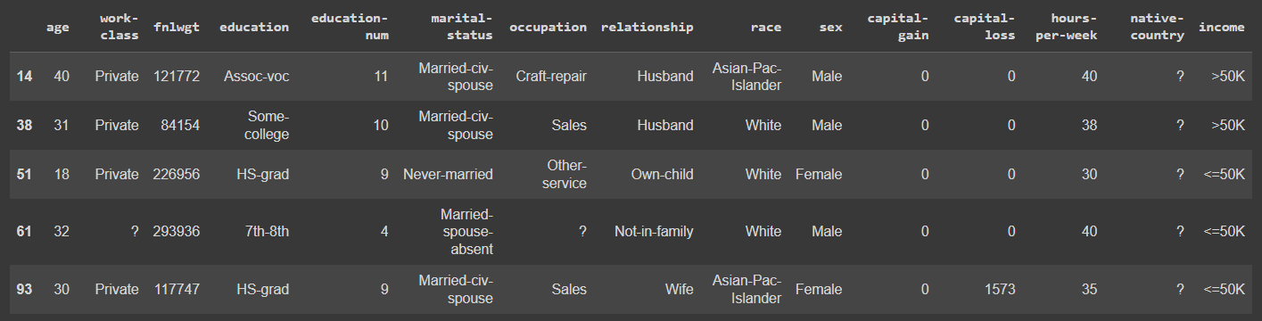
Data Example with Missing Value (?)

Slide 6
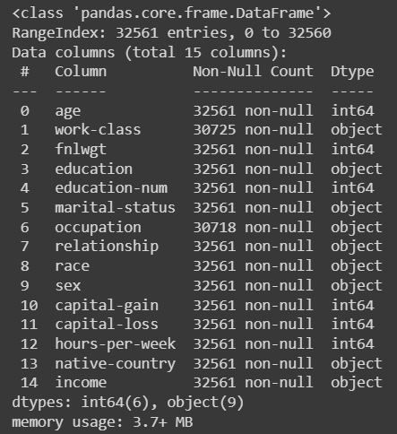

Before Data Preprocessing
Check missing value
Clean data

Slide 7
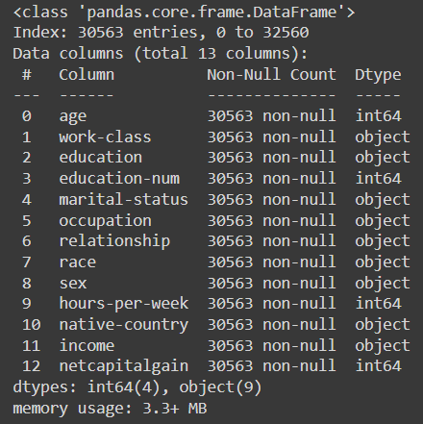
After Data Preprocessing
Dropping Missing Values
Dropping Outliers
Dropping the Column ‘fnlwgt’
Combining 'capital-gain' and 'capital-loss' into One Column('netcapitalgain')
Dropping 'capital-gain' and 'capital-loss' Columns

Slide 8
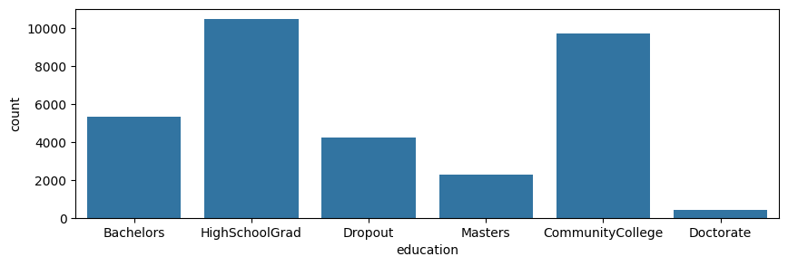
Grouping Education
Dropout | HighSchoolGrad | CommunityCollege | Master
Preschool , 1st - 12th | HS-Grad , HS-grad | Some-college , Assoc-acdm , Assoc-voc | Prof-school

Slide 9
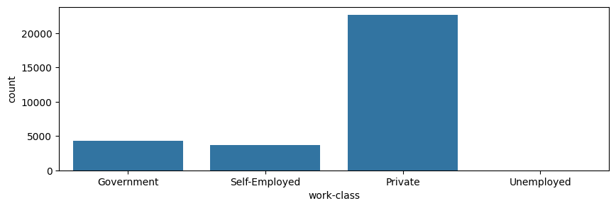
Grouping Work-Class (Skip missing value)
Private | Government | Self-Employed | Unemployed
Private | Local-gov , State-gov , Federal-gov | Self-emp-not-inc , Self-emp-inc | Without-pay , Never-worked

Slide 10
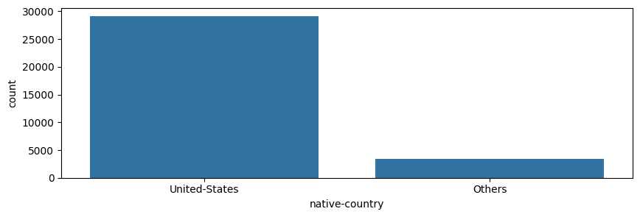
Grouping Native-Country (Skip missing value)

Slide 11
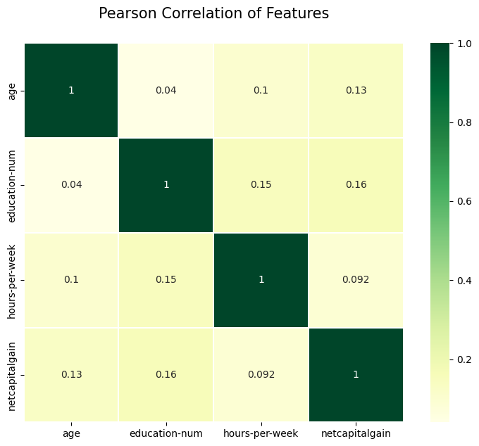
Correlation Matrix
correlation coefficients range from -1 to 1
correlation coefficient values below
0.3 are considered to be weak
0.3–0.7 are moderate
> 0.7 are strong

Slide 12
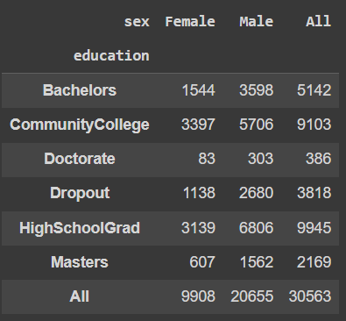
Cross Tabulation
To analyze the relationship between two or more categorical variables by displaying their frequency distribution

Slide 13
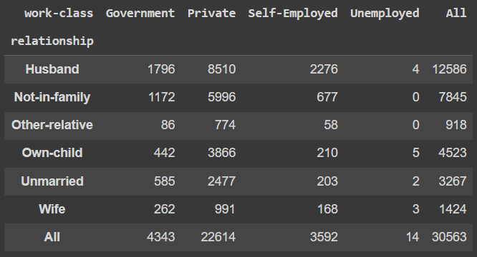
Cross Tabulation

Slide 14
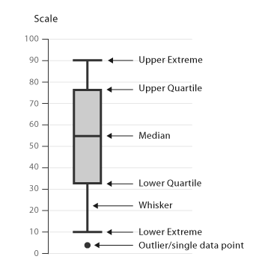
Box Plot
Spread of Data: The length of the box and whiskers shows how spread out the data is. A long box indicates high variability.
Symmetry: If the median is centered in the box and the whiskers are of equal length, the data is roughly symmetrical.
Outliers: Points plotted outside the whiskers are potential outliers.
Comparison Across Groups: Box plots allow for easy comparison of distributions between different categories or groups.
Ref - https://datavizcatalogue.com/methods/box_plot.html

Slide 15
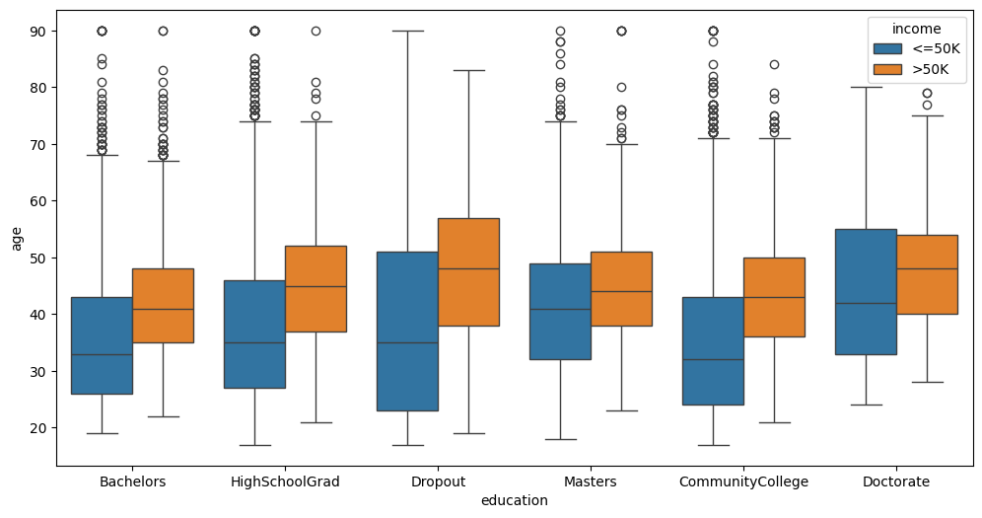
Box Plot

Slide 16
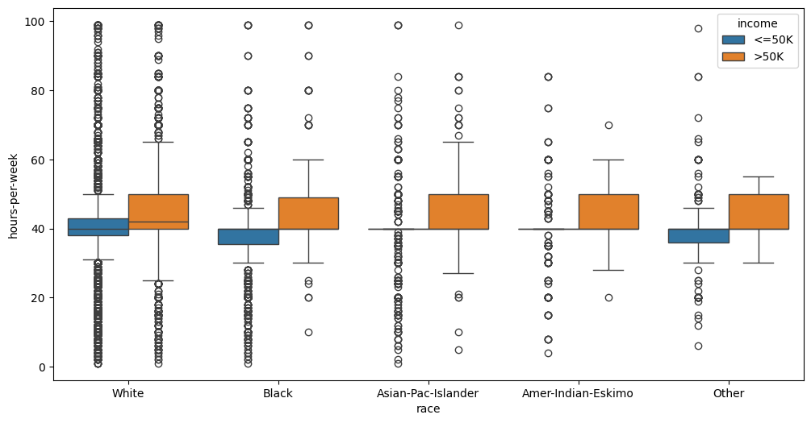
Box Plot

Slide 17
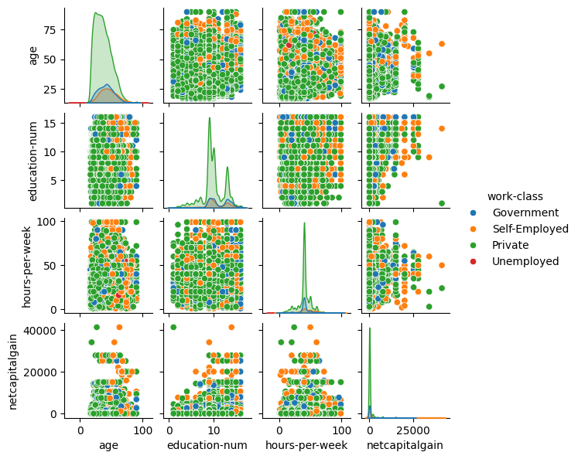
Pair Plot

Slide 18
Thank You

