Slide 1
COS3302 Applied Data Science
Week 10 : Hierarchical Clustering
Jutharat Pooamorn
6405003317

Slide 2
Objectives
Analyze Digit Dataset to develop data analytics and data visualization
Determine the appropriate number of clusters by interpreting the dendrogram
Apply PCA with Digit Dataset to reduce features

Slide 3
Storytelling with Digit Dataset
Source : scikit-learn library
Digit Dataset contains images of handwritten digits from 0-9
Sample Total : 1797
Samples per class : ~180
Dimensionality : 64 (Each datapoint is a 8x8)
Features (X) : integers 0-16
Targets (Y) : integer 0-9
Format : grayscale
https://datasets.activeloop.ai/docs/ml/datasets/mnist/

Slide 4
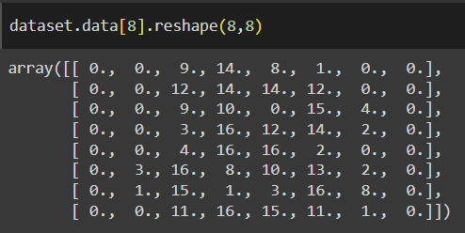
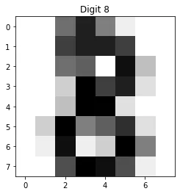
Features and Targets in The Digit Dataset
https://medium.com/@mohammed97ashraf/how-good-is-the-digits-dataset-from-the-scikit-learn-library-to-recognizing-handwritten-digits-recog-997dc2f26c79

Slide 5
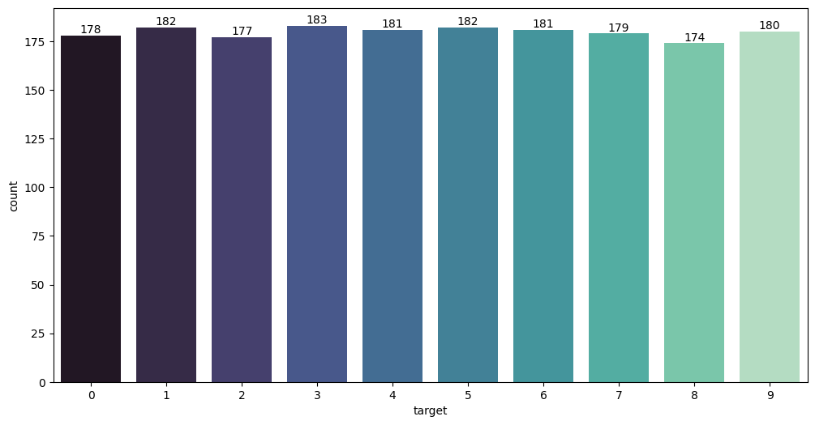
Targets in The Digit Dataset

Slide 6
Hierarchical Clustering

Slide 7
What is Hierarchical Clustering?
Hierarchical clustering is an unsupervised machine learning algorithm that groups data into a tree of nested clusters. The main types include agglomerative and divisive. Hierarchical cluster analysis helps find patterns and connections in datasets. Results are presented in a dendrogram diagram showing the distance relationships between clusters
There are two types of hierarchical clustering:
Agglomerative or bottom-up approach that repeatedly merges clusters into larger ones until a single cluster emerges.
Divisive or top-down approach that starts with all data in a single cluster and continues to split out successive clusters until all clusters are singletons.
https://www.ibm.com/think/topics/hierarchical-clustering

Slide 8
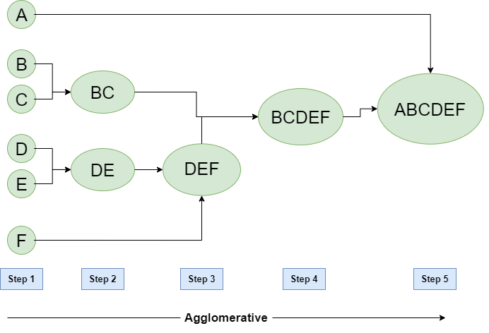
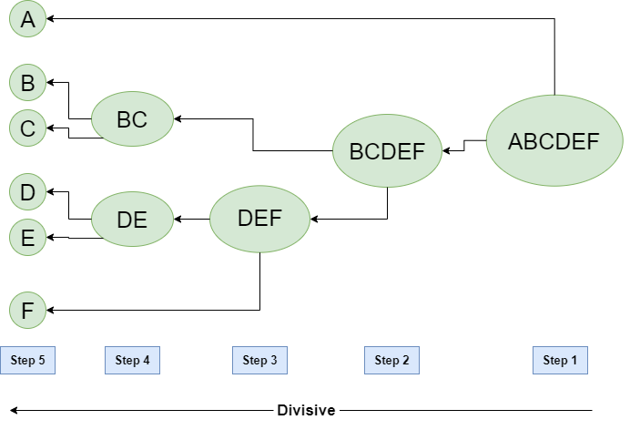
https://www.geeksforgeeks.org/hierarchical-clustering/

Slide 9
Different Linkage Methods
Single linkage — shortest distance between any two points in the two clusters, sensitive to outliers and noise in the data
Average linkage — average distance between all pairs of points in the two clusters
Complete linkage — longest distance between any two points in the two clusters, less sensitive to outliers and noise in the data
Ward linkage — determines the distance between two clusters by minimising the increase in variance when the two clusters are merged, have similar variances and sizes.
https://medium.com/@iqra.bismi/different-linkage-methods-used-in-hierarchical-clustering-627bde3787e8

Slide 10
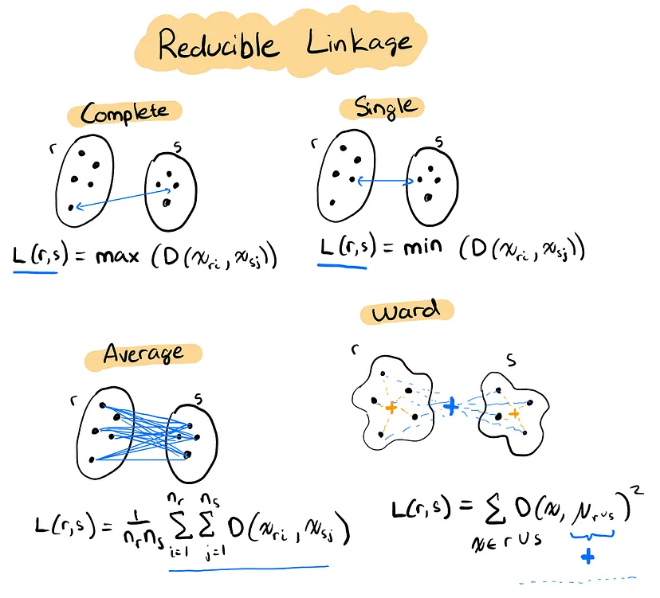
https://towardsdatascience.com/scaling-agglomerative-clustering-for-big-data-an-introduction-to-rac-fb26a6b326ad

Slide 11


Algorithm of Hierarchical Clustering
Both are Bottom-Up
https://en.wikipedia.org/wiki/Scikit-learn
https://studyopedia.com/python-libraries/scipy-library/

Slide 12
Scipy Linkage

Slide 13
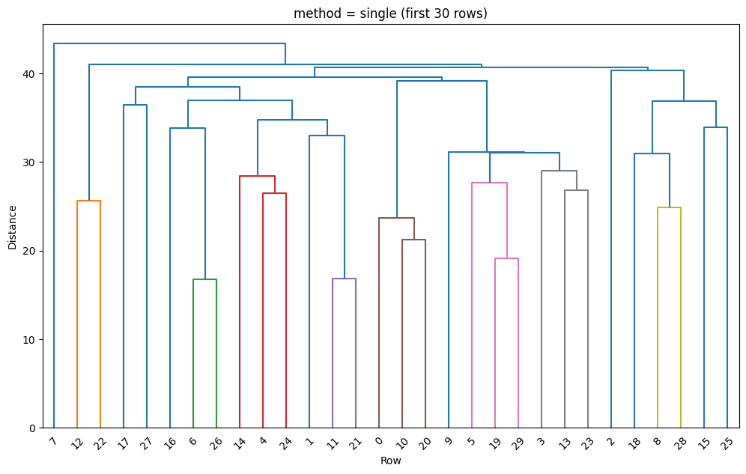

Slide 14
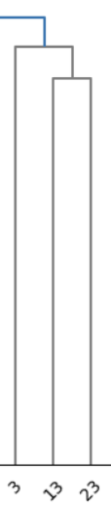
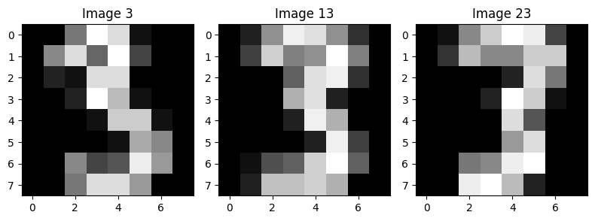

Slide 15
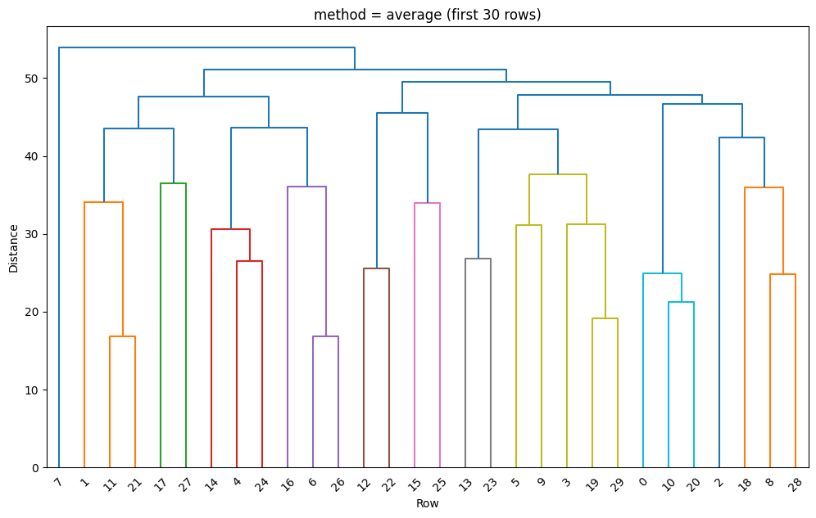

Slide 16
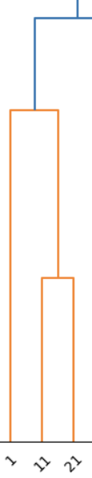
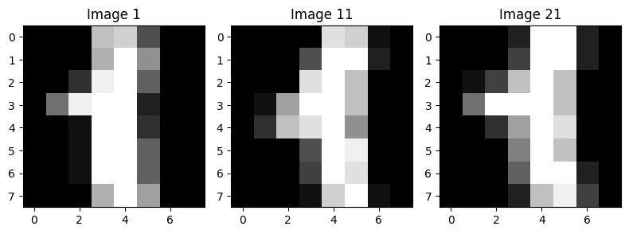

Slide 17
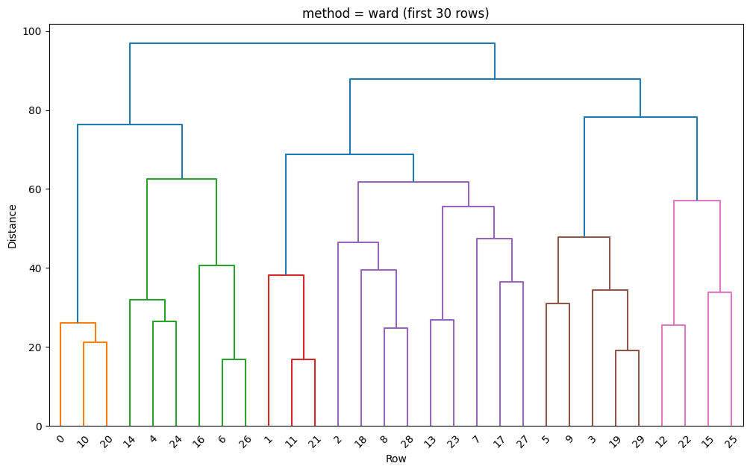

Slide 18
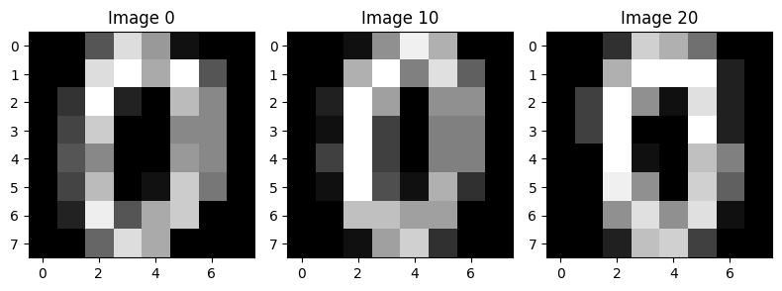
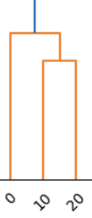

Slide 19
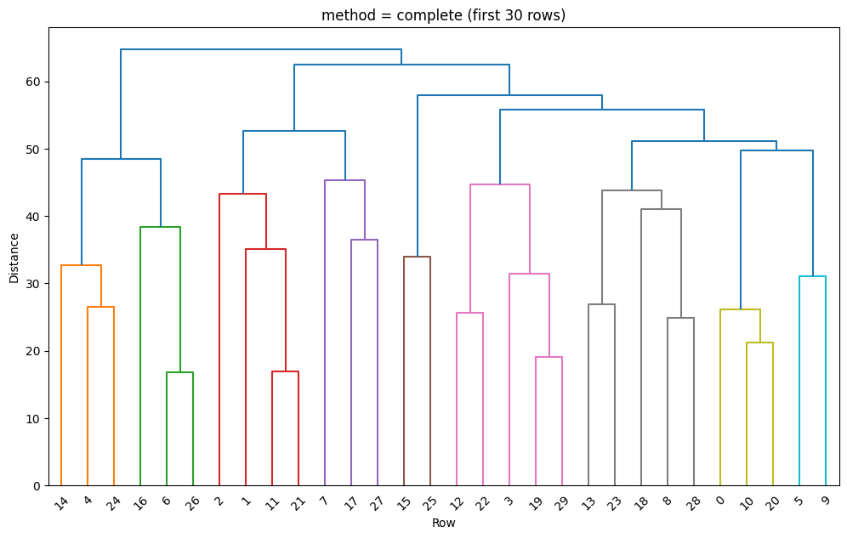

Slide 20
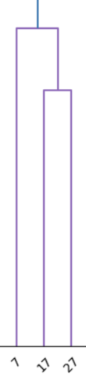
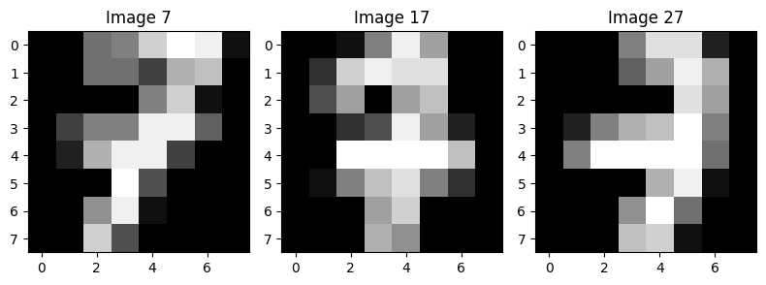

Slide 21
Compare with
Single Linkage
Complete Linkage
Average Linkage
Ward Linkage

Slide 22
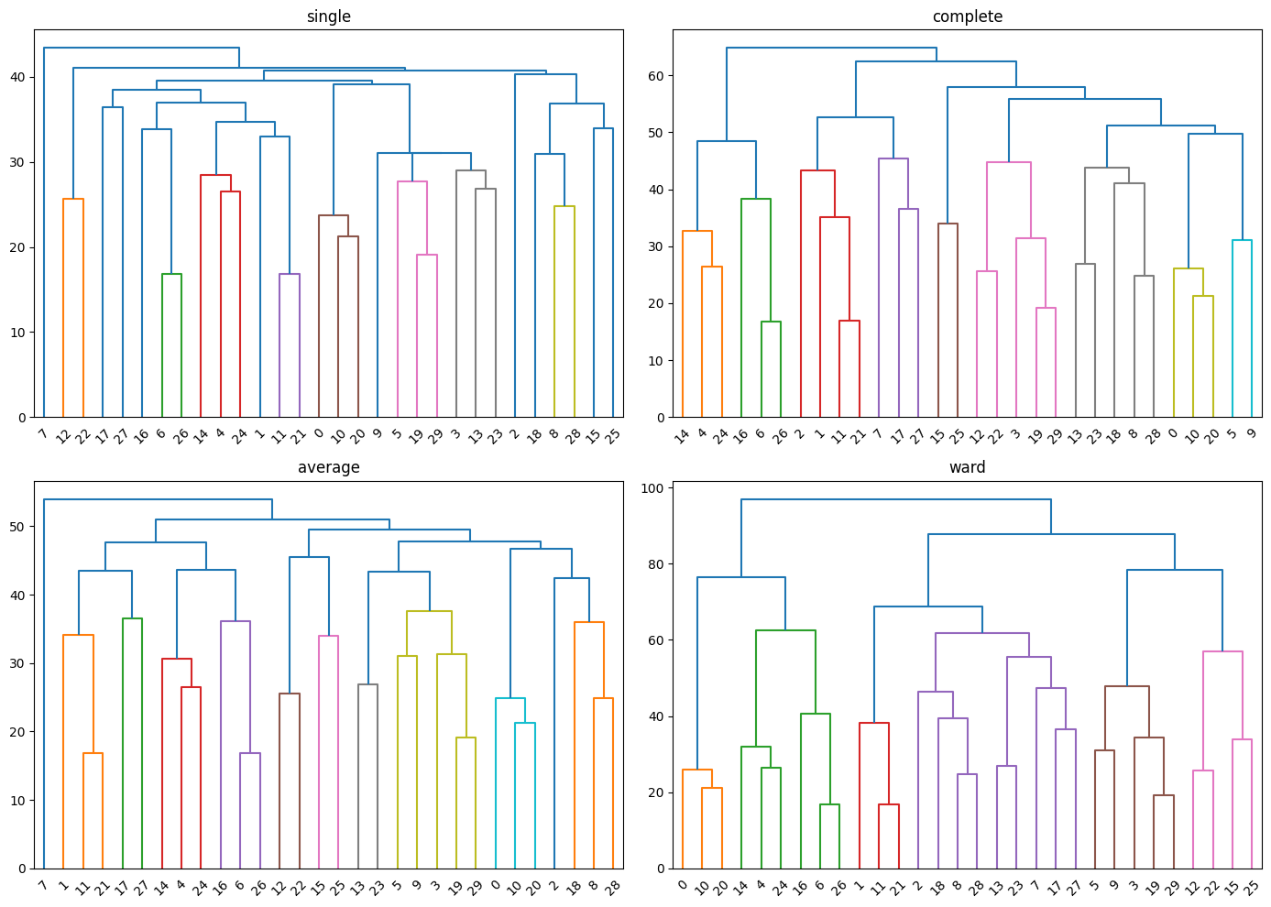

Slide 23
Sklearn Linkage

Slide 24
Apply PCA
n_components = 2
PCA features 2 from 64

Slide 25
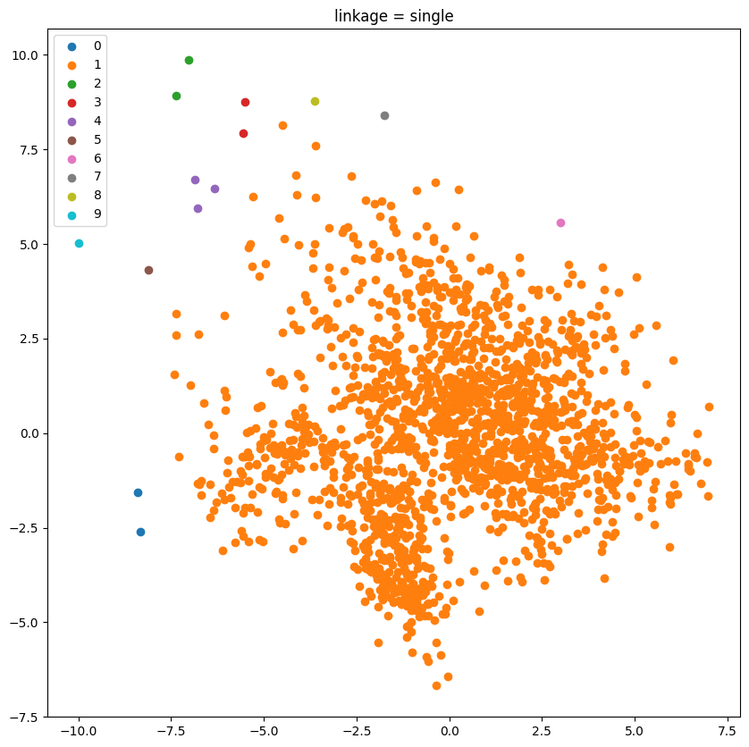

Slide 26
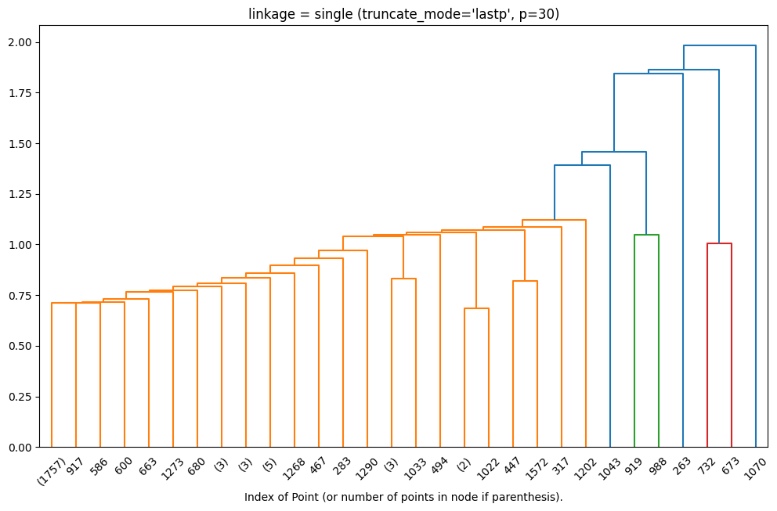

Slide 27
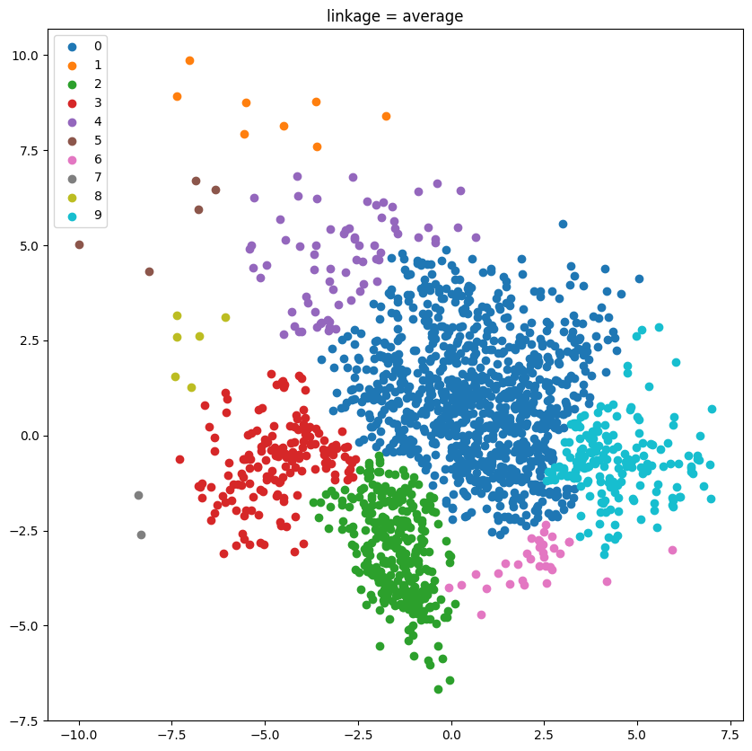

Slide 28
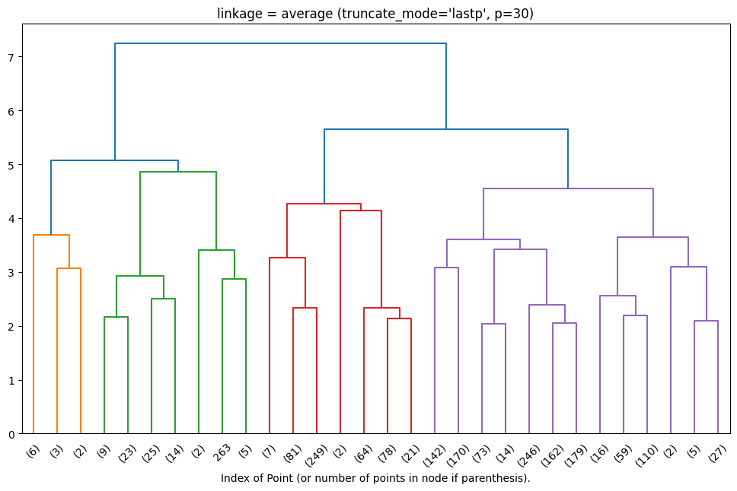

Slide 29
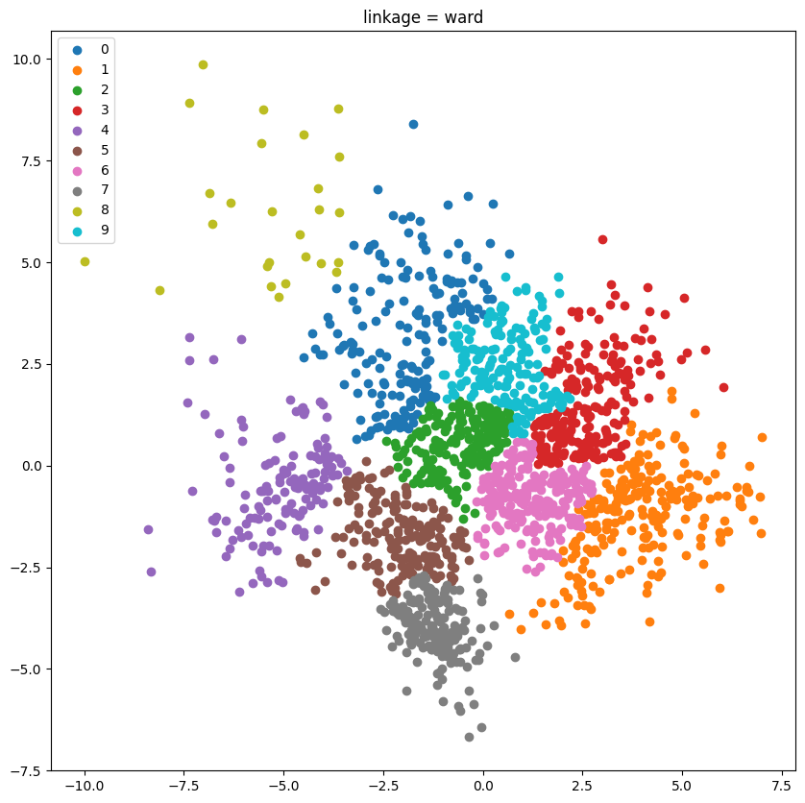

Slide 30
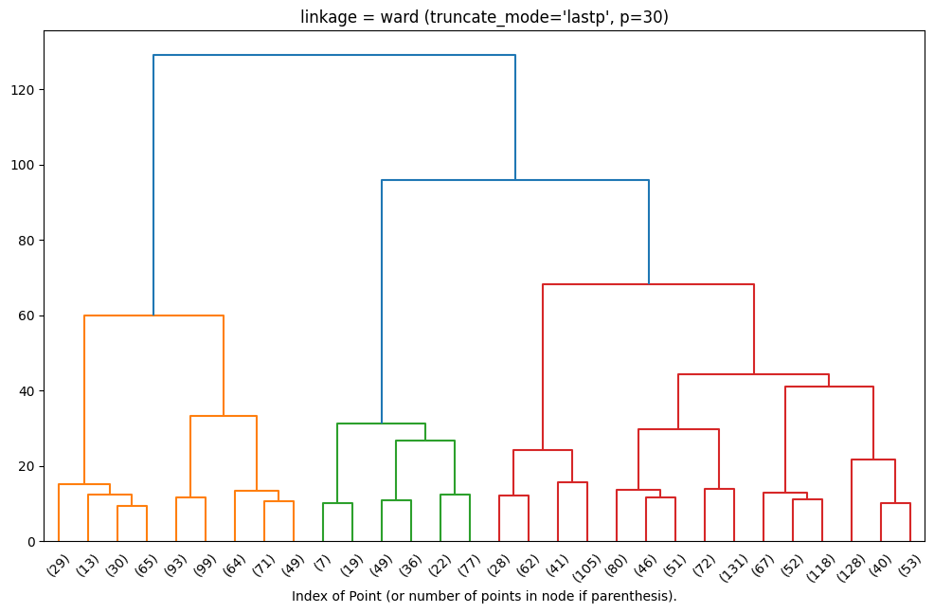

Slide 31
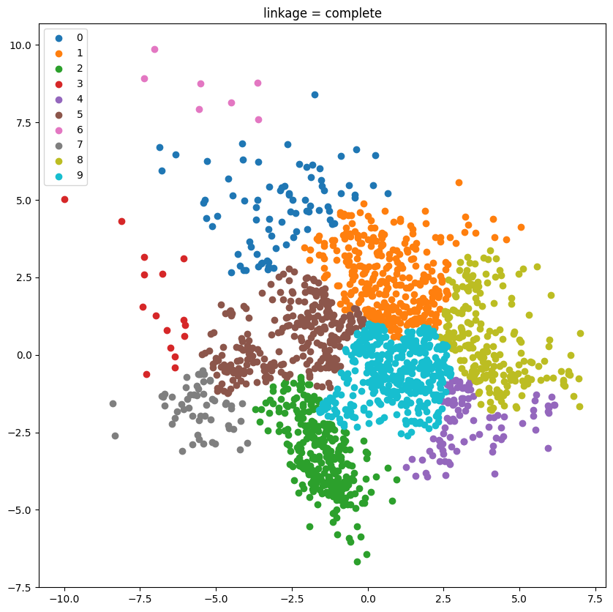

Slide 32
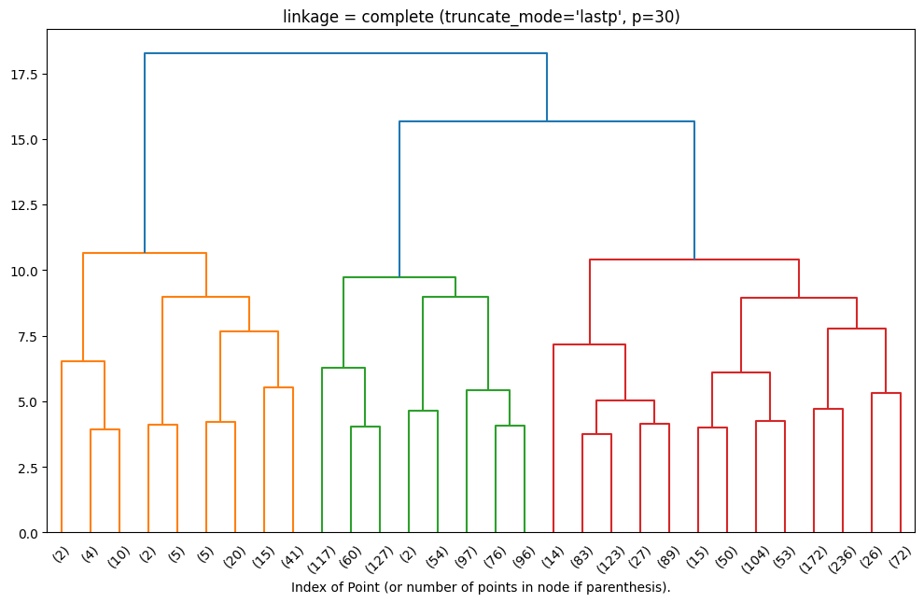

Slide 33
Thank You

