Slide 1
COS3302 Applied Data Science
Week 7 : Iris Dataset
Jutharat Pooamorn
6405003317

Slide 2
Objectives
Use the Iris Dataset as a case study to enhance data analytics and data visualization
Tools such as Histogram, Cross Tabulation, Box Plots, Pair Plots and Correlation Matrix
Experience KNN algorithm which uses proximity to make classifications or predictions about the grouping of an individual data point

Slide 3
Storytelling with Data
Source : 1936 Sir Ronald Aylmer Fisher’s Paper
Number of Data : 150 samples
Data Collector : Edgar Shannon Anderson
Data contain 5 features
Target field : class(label)
Iris-setosa(50), Iris-versicolor(50), Iris-virginica(50)
Other attributes : 4
sepal-length, sepal-width, petal-length, petal-width

Slide 4
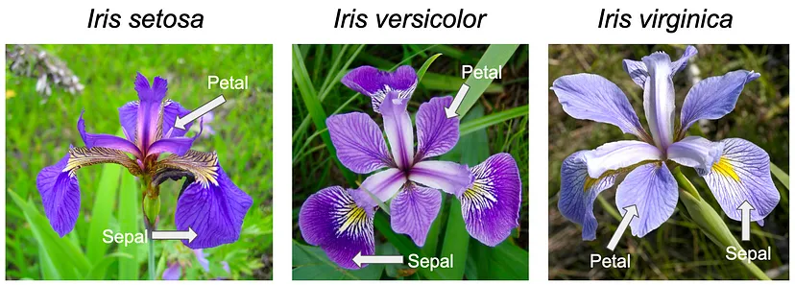
Pictures of the Three Flowers Species
https://ai.plainenglish.io/tackling-the-iris-classification-problem-with-k-nearest-neighbors-knn-b7d67afc9451

Slide 5
Statistics of Ratio Data
Stat / Features | sepal-length | sepal-width | petal-length | petal-width
count | 150.00 | 150.00 | 150.00 | 150.00
mean | 5.84 | 3.05 | 3.76 | 1.20
std | 0.82 | 0.43 | 1.76 | 0.76
min | 4.30 | 2.00 | 1.00 | 0.10
max | 7.90 | 4.40 | 6.90 | 2.50
25% | 5.10 | 2.80 | 1.60 | 0.30
50% | 5.80 | 3.00 | 4.35 | 1.30
75% | 6.40 | 3.30 | 5.10 | 1.80

Slide 6
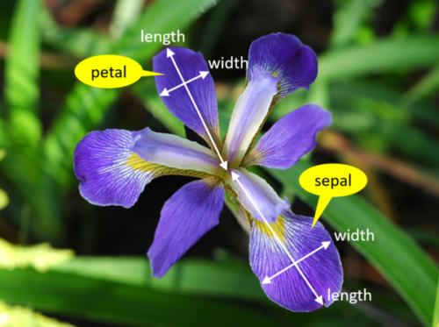
Data Features with Details of Iris Flowers
Numerical
Ratio | Definition | Range (cm.)
sepal-length | ความยาวกลีบเลี้ยง | 4.30 - 7.90
sepal-width | ความกว้างกลีบเลี้ยง | 2.00 - 4.40
petal-length | ความยาวกลีบดอก | 1.00 - 6.90
petal-width | ความกว้างกลีบดอก | 0.10 - 2.50
Categorical
Nominal | Consist Of
class | Iris-setosa, Iris-versicolor, Iris-virginica
https://www.integratedots.com/determine-number-of-iris-species-with-k-means/

Slide 7
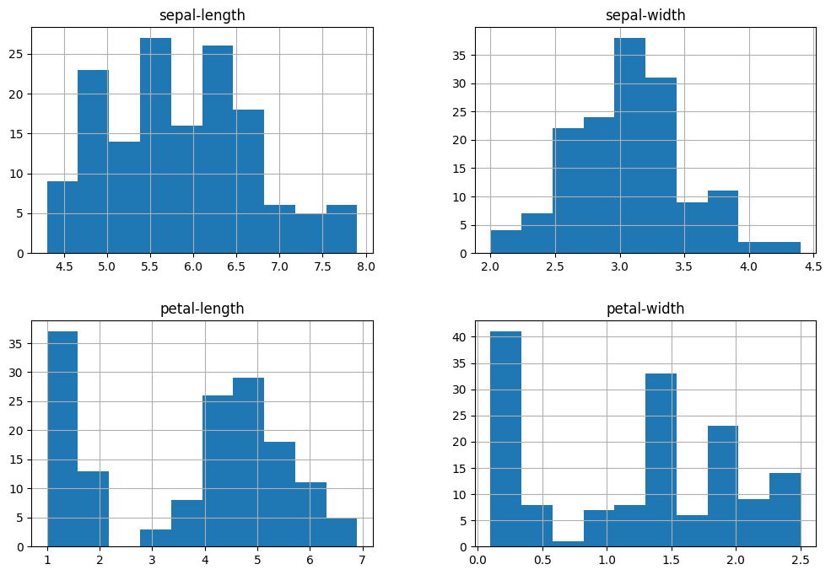
Histogram

Slide 8
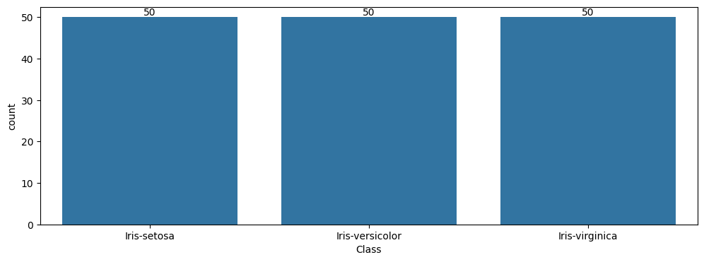
Histogram

Slide 9
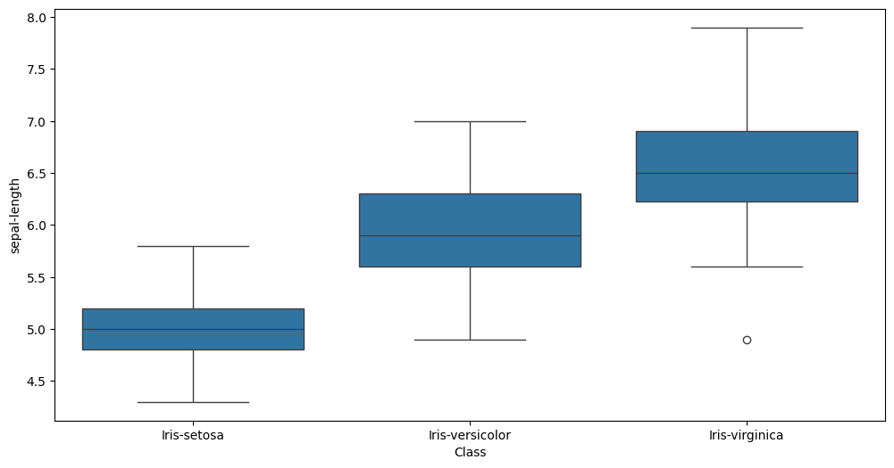
Box Plot (sepal-length)

Slide 10
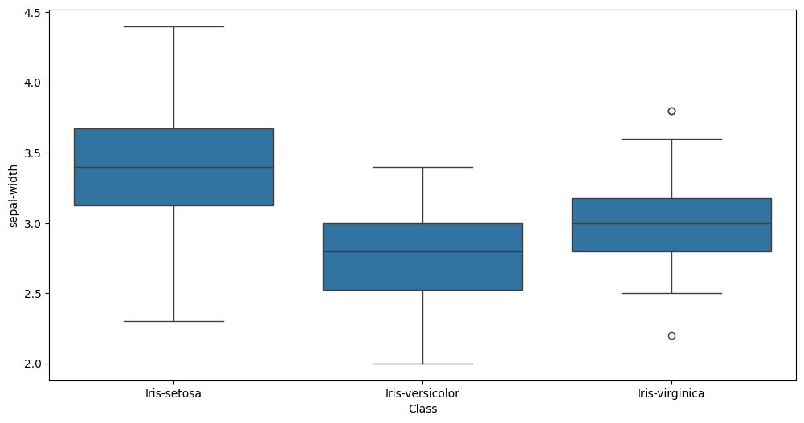
Box Plot (sepal-width)

Slide 11
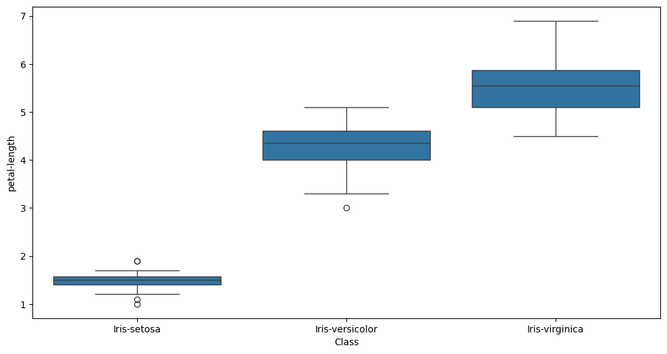
Box Plot (petal-length)

Slide 12
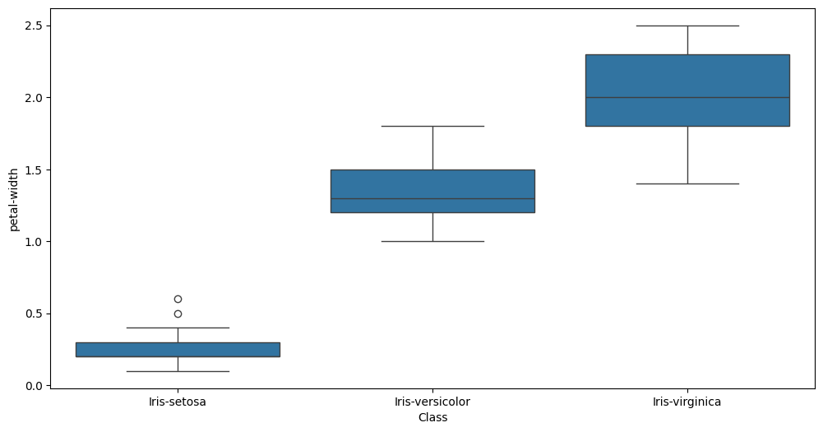
Box Plot (petal-width)

Slide 13
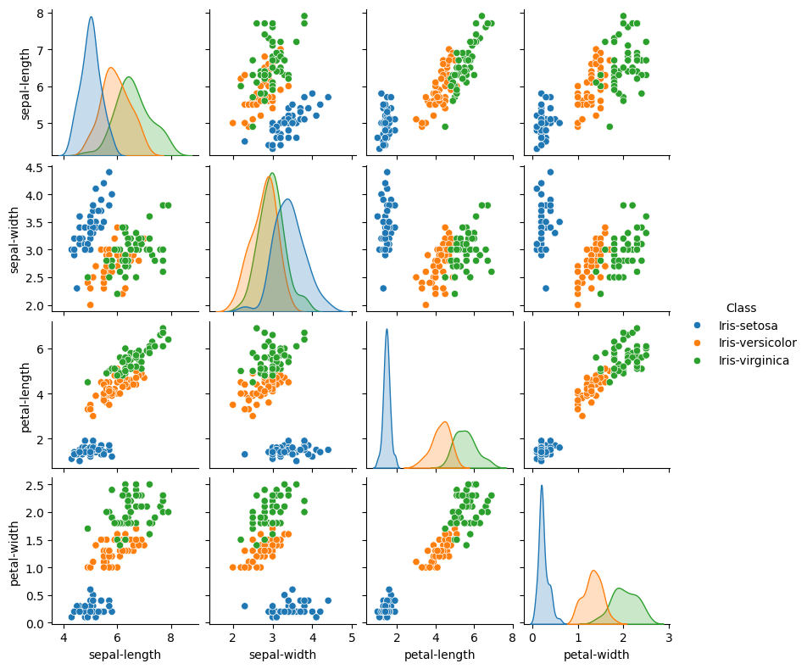
Pair Plot

Slide 14
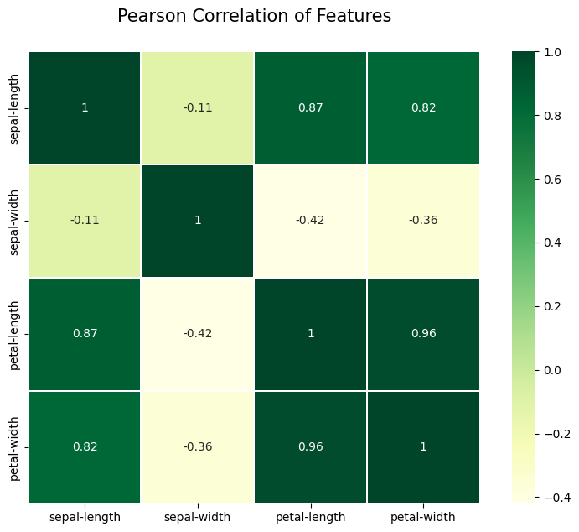
Correlation Matrix

Slide 15
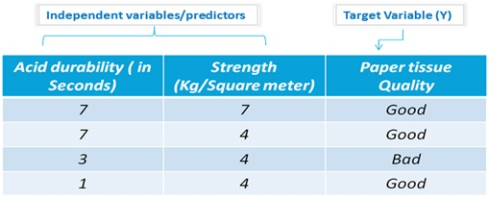
K-Nearest Neighbor(KNN) Algorithm
The KNN (K Nearest Neighbors) algorithm analyzes all available data points and classifies this data, then classifies new cases based on these established categories. It is useful for recognizing patterns and for estimating. Let’s say we want to determine the likelihood of two predictors, with target.
https://www.smarten.com/blog/knn-classification-analysis-enterprise/

Slide 16
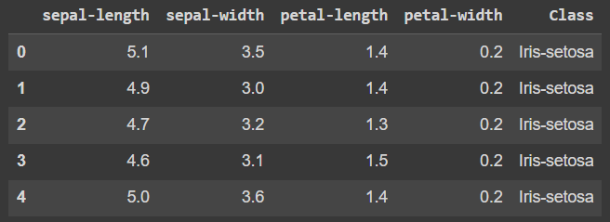
KNN Classification

Slide 17
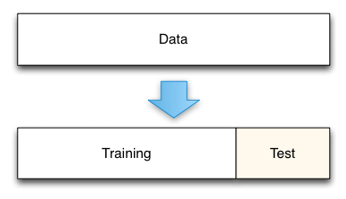
Split Data into Training and Test Set
80%
20%
https://medium.com/@rathinavel.mph/how-the-train-and-test-samples-are-split-d7e46a8e2361

Slide 18
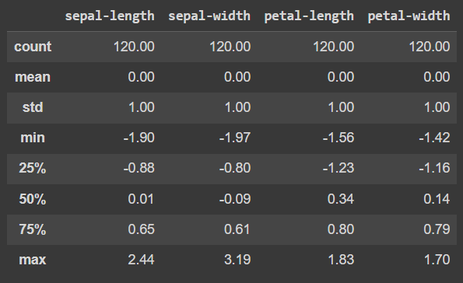
Training Set Before Scaling by StandardScaler

Slide 19
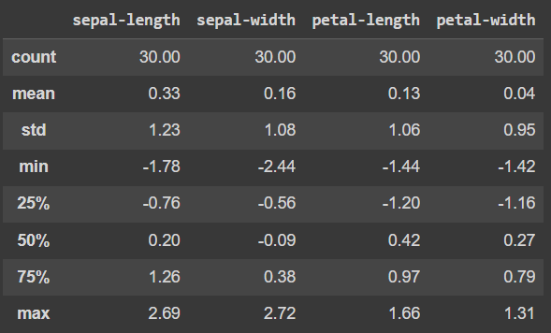
Test Set After Scaling by StandardScaler

Slide 20
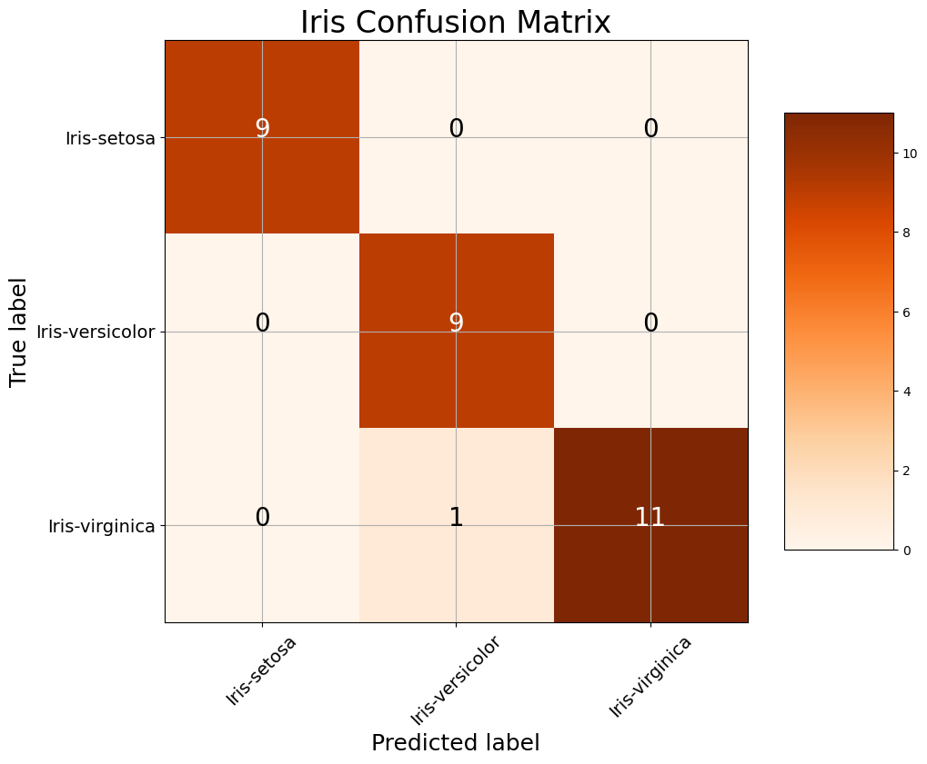
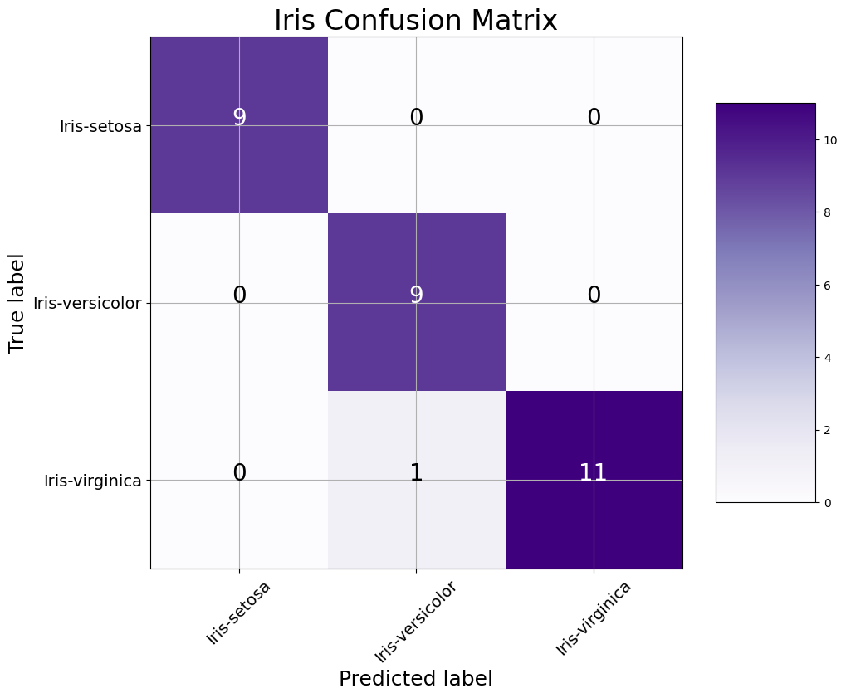
Confusion Matrix
#1 : N=30
#2 : N=30

Slide 21
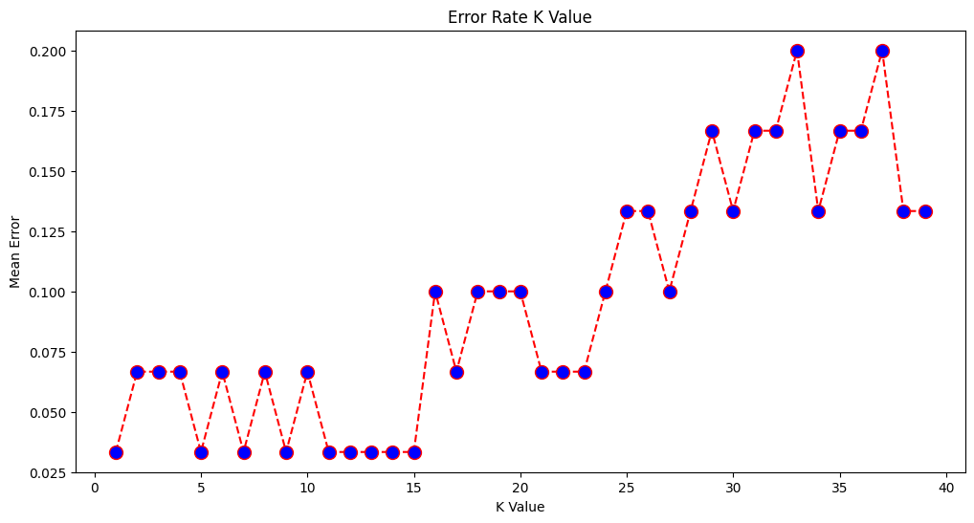
Error # 1 ( k = 5)

Slide 22
Error # 2 (k = 7)

Slide 23
Thank You

