Slide 1
COS3302 Applied Data Science
Week 10 : K-means Clustering
Jutharat Pooamorn
6405003317

Slide 2
Objectives
Analyze Digit Dataset to develop data analytics and data visualization
Determine the optimal number of cluster (k) in K-means by elbow plot and visualize the clusters
Apply PCA with Digit Dataset to reduce features

Slide 3
Storytelling with Digit Dataset
Source : scikit-learn library
Digit Dataset contains images of handwritten digits from 0-9
Sample Total : 1797
Samples per class : ~180
Dimensionality : 64 (Each datapoint is a 8x8)
Features (X) : integers 0-16
Targets (Y) : integer 0-9
Format : grayscale
https://datasets.activeloop.ai/docs/ml/datasets/mnist/

Slide 4
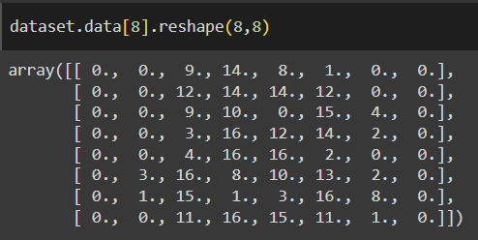
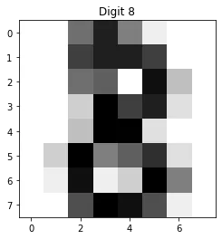
Features and Targets in The Digit Dataset
https://medium.com/@mohammed97ashraf/how-good-is-the-digits-dataset-from-the-scikit-learn-library-to-recognizing-handwritten-digits-recog-997dc2f26c79

Slide 5
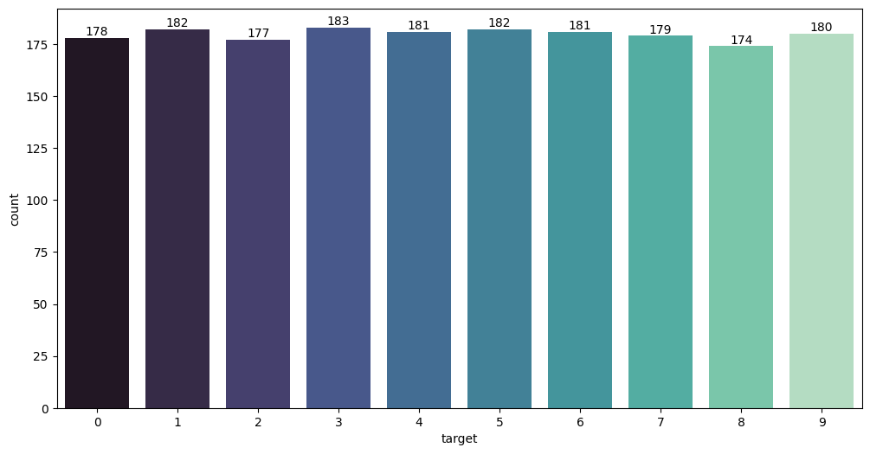
Targets in The Digit Dataset

Slide 6
K-means Clustering

Slide 7
What is K-means Clustering?
K-means clustering is an unsupervised learning algorithm used for data clustering, which groups unlabeled data points into groups or clusters.
Initialization: randomly select K points from the dataset as the initial cluster centroids.
Assignment: for each data point, calculate its distance to each of the K centroids and assign it to the nearest centroid (cluster).
Update Centroids: recalculate the centroids by taking the mean of all the points assigned to each cluster.
Repeat: repeat steps 2 and 3 until the centroids stabilize (i.e., no significant changes) or after a predefined number of iterations.
How does k-means clustering work?
K-means clustering is an iterative process to minimize the sum of distances between the data points and their cluster centroids.
https://www.ibm.com/topics/k-means-clustering
https://www.analyticsvidhya.com/blog/2019/08/comprehensive-guide-k-means-clustering/

Slide 8
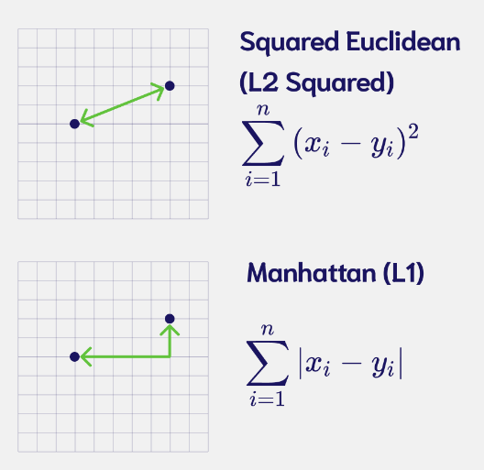
Compute Distance
https://weaviate.io/blog/distance-metrics-in-vector-search
https://towardsdatascience.com/clear-and-visual-explanation-of-the-k-means-algorithm-applied-to-image-compression-b7fdc547e410

Slide 9
K-means Parameters
n_clusters: number of clusters to form as well as the number of centroids to generate (10)
init: method for initialization
k-means++ : select initial cluster centroids using sampling and choose the best centroid
random : choose n_clusters observations (rows) at random from data for the initial centroids
PCA-based : set first rows of standardized data (pca) are used as the initial centroids for the clusters
max_iter: maximum number of iterations of the k-means algorithm for a single run
n_init: number of times the k-means algorithm is run with different centroid seeds
random_state: determines random number generation for centroid initialization

Slide 10
init = k-means++

Slide 11
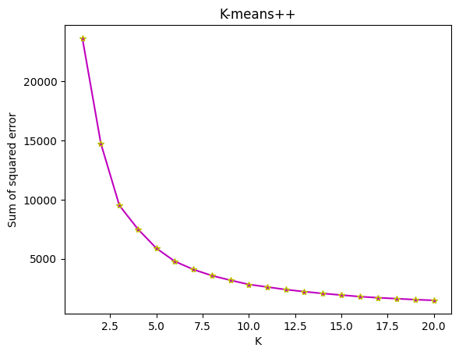

Slide 12
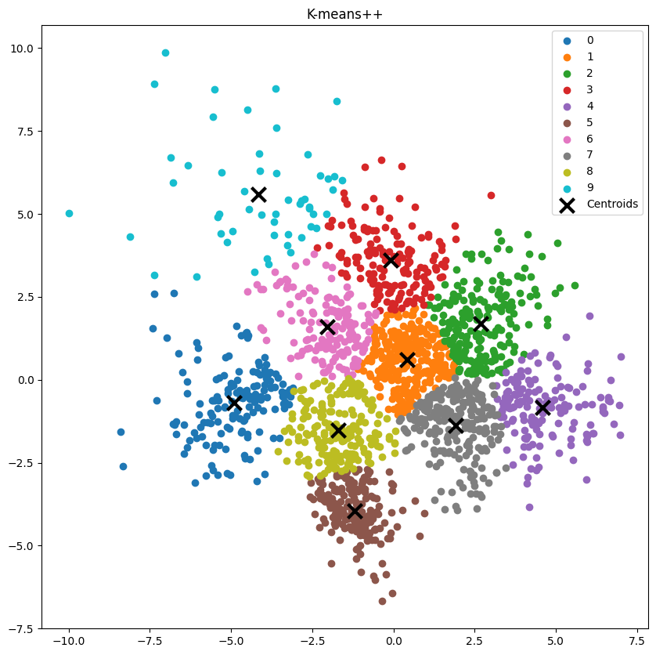
n_clusters = 10 (k)
inertia = 2815.3202

Slide 13
init = random

Slide 14
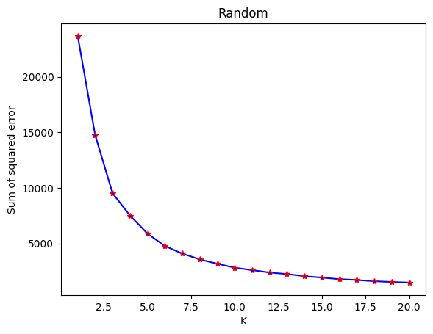

Slide 15
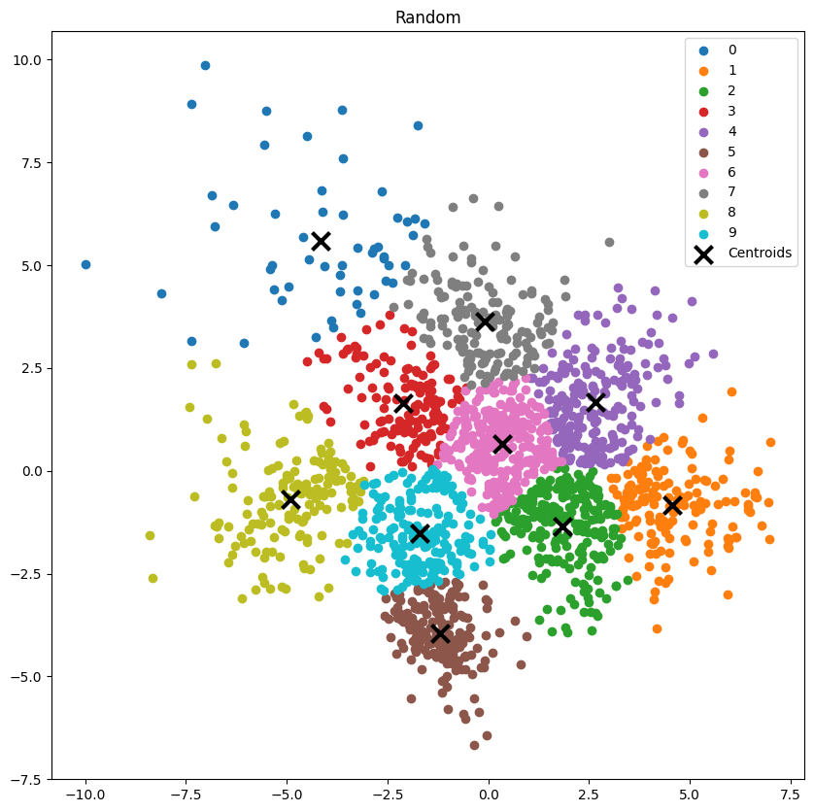
n_clusters = 10 (k)
inertia = 2816.5067

Slide 16
init = PCA-based
n_components = 2
PCA features 2 from 64

Slide 17
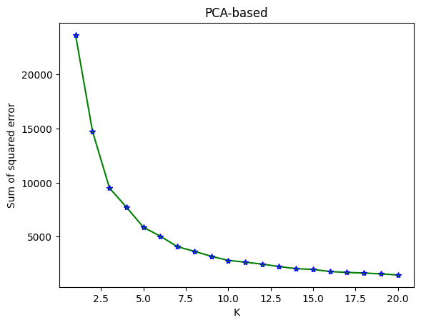

Slide 18
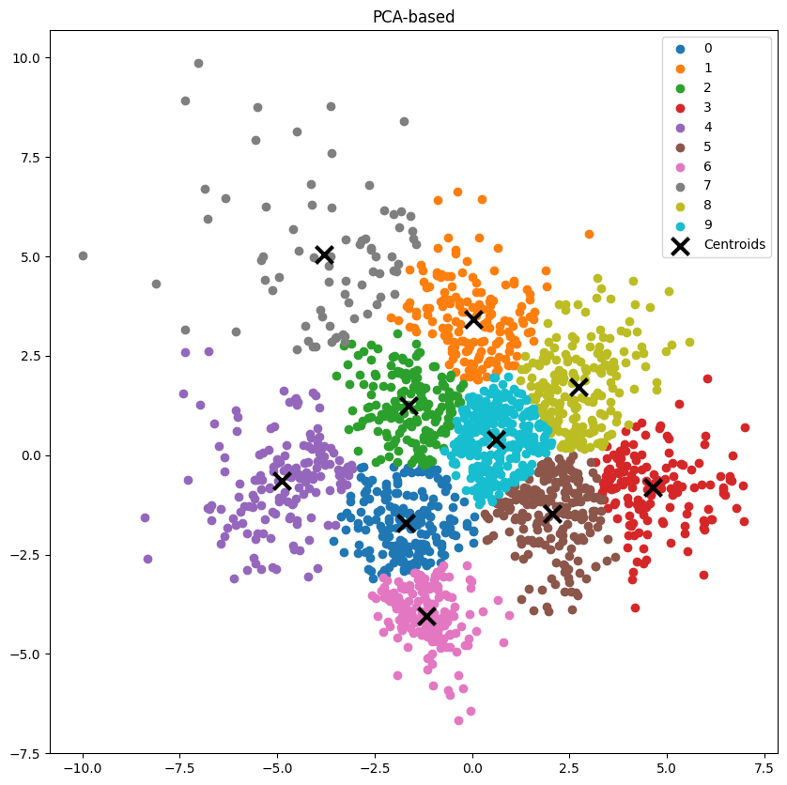
n_clusters = 10 (k)
inertia = 2817.6156

Slide 19
Compare with
init = k-means++
init = random
init = PCA-based

Slide 20
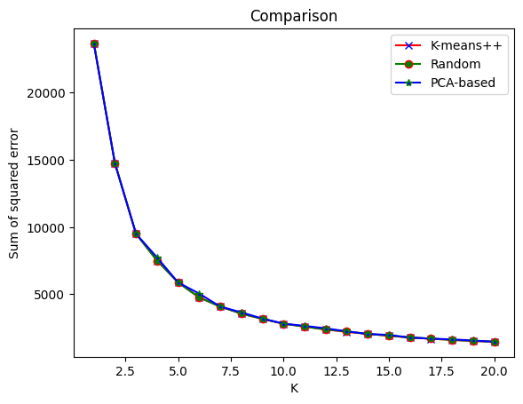

Slide 21
n_clusters = 10 (k)
inertia = 2815.3202
inertia = 2816.5067
inertia = 2817.6156

Slide 22
Thank You

