Slide 1
COS3302 Applied Data Science
Week 9 : Principal Component Analysis
Jutharat Pooamorn
6405003317

Slide 2
Objectives
Inquire for details of MNIST Dataset as a case study to develop data analytics and data visualization
Tools : Correlation Matrix, Pair Plot
Apply PCA with Digit Dataset and Iris Dataset by tuning parameters

Slide 3
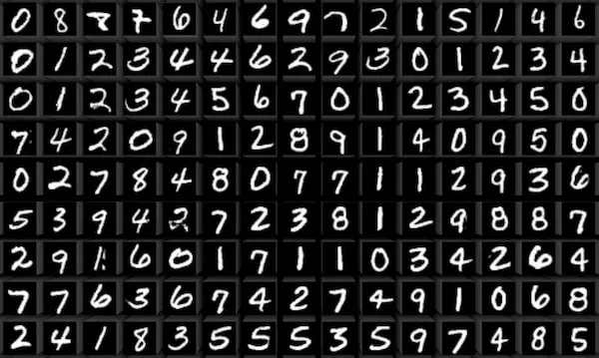
Storytelling with The MNIST Database
Modified National Institute of Standards and Technology (The MNIST Dataset) contains images of handwritten single digits from 0-9
Paper : Gradient-Based Learning Applied to Document Recognition 1998
Format : grayscale
Number of Data : 70,000 images
a training set of 60,000 images
a test set of 10,000 images
Size : fixed size of 28×28 pixels square image
https://datasets.activeloop.ai/docs/ml/datasets/mnist/

Slide 4
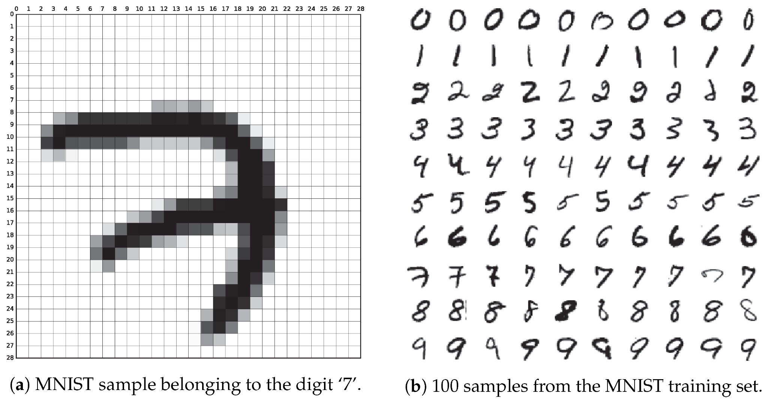
Example of The MNIST Database
https://www.mdpi.com/2076-3417/9/15/3169

Slide 5
Storytelling with Digit Dataset
Source : scikit-learn library
Digit Dataset contains images of handwritten digits from 0-9
Sample Total : 1797
Samples per class : ~180
Dimensionality : 64 (Each datapoint is a 8x8)
Features (X) : integers 0-16
Targets (Y) : integer 0-9
Format : grayscale
https://datasets.activeloop.ai/docs/ml/datasets/mnist/

Slide 6
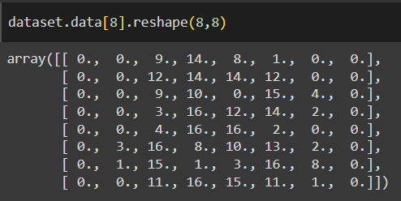
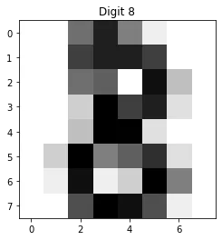
Features and Targets in The Digit Dataset
https://medium.com/@mohammed97ashraf/how-good-is-the-digits-dataset-from-the-scikit-learn-library-to-recognizing-handwritten-digits-recog-997dc2f26c79

Slide 7
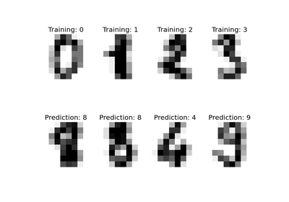
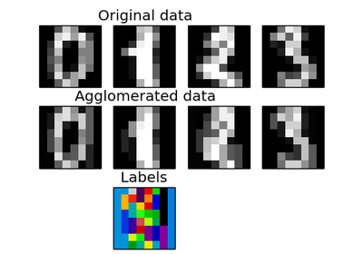
Example of The Digit Dataset
https://scikit-learn.org/0.15/modules/generated/sklearn.datasets.load_digits.html

Slide 8
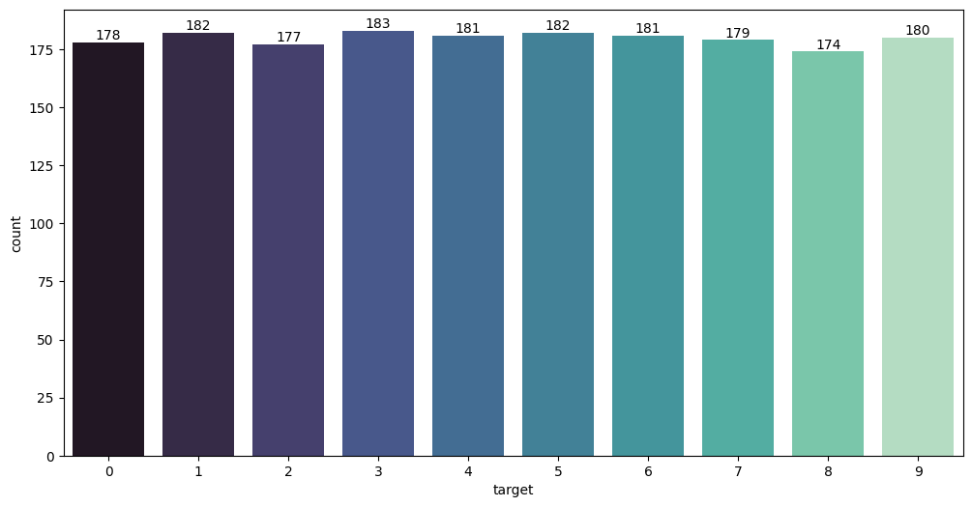
Targets in The Digit Dataset

Slide 9
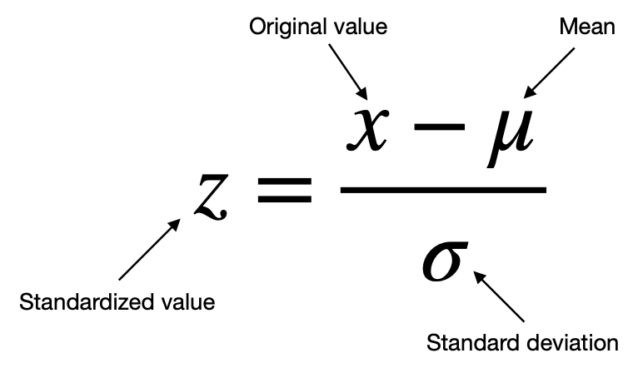
Standardization
Standardization
perform standardization prior to PCA
all the variables will be transformed to the same scale (- 1 to 1) by rescaling standard deviation of 1 and a mean of 0
to prevent variables with larger ranges will dominate over those with small ranges
https://builtin.com/data-science/step-step-explanation-principal-component-analysis
https://towardsdatascience.com/pca-principal-component-analysis-how-to-get-superior-results-with-fewer-dimensions-7a70e8ab798c

Slide 10
What Is Principal Component Analysis?
Principal Component Analysis (PCA)
an unsupervised dimensionality reduction and visualization technique
reducing the number of variables of a data set naturally comes at the expense of accuracy, but the trick in dimensionality reduction is to trade a little accuracy for simplicity to maintain significant patterns and trends
smaller data sets are easier to explore and visualize, and thus make analyzing data points much easier and faster for machine learning algorithms without extraneous variables to process
https://www.geeksforgeeks.org/python-variations-of-principal-component-analysis/?ref=oin_asr2
https://builtin.com/data-science/step-step-explanation-principal-component-analysis

Slide 11
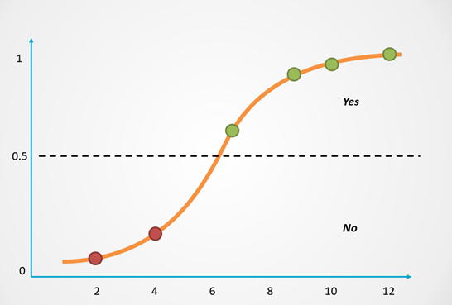
Logistic Regression
Logistic Regression
predicts the probability of an
event taking place, it is used to solve classification problems
to remove multicollinearity and improve model performance
https://towardsdatascience.com/logistic-regression-explained-in-7-minutes-f648bf44d53e
https://www.geeksforgeeks.org/applying-pca-to-logistic-regression-to-remove-multicollinearity/

Slide 12
Principal Component Analysis
With Digit Dataset

Slide 13
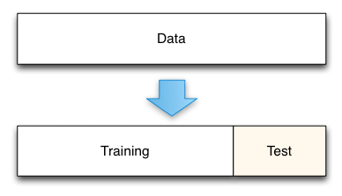
Split Ratio
80%
20%
https://medium.com/@rathinavel.mph/how-the-train-and-test-samples-are-split-d7e46a8e2361

Slide 14
Train Model
# | Dimensionality Reduction by PCA | Parameter(s) | PCA features (from 64 features) | Accuracy Score
1 | not apply | no parameter | 64 | ≈ 97.22%
2 | apply | variance 95% | 29 | ≈ 96.94%
3 | apply | n_components = 2 | 2 | ≈ 60.83%
4 | apply | n_components = 20 svd_solver='arpack' | 20 | ≈ 96.66%
5 | apply | n_components = 50, whiten = True | 50 | ≈ 96.38%

Slide 15
Principal Component Analysis
With Iris Dataset

Slide 16
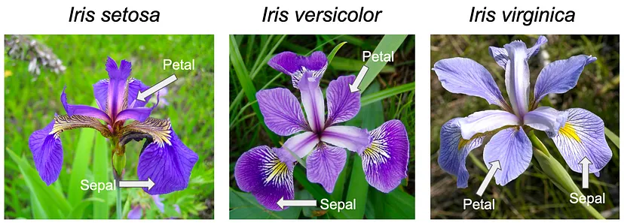
Pictures of the Three Flowers Species
https://ai.plainenglish.io/tackling-the-iris-classification-problem-with-k-nearest-neighbors-knn-b7d67afc9451

Slide 17
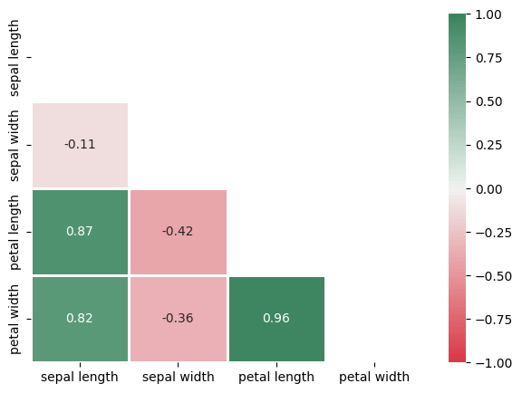

Slide 18
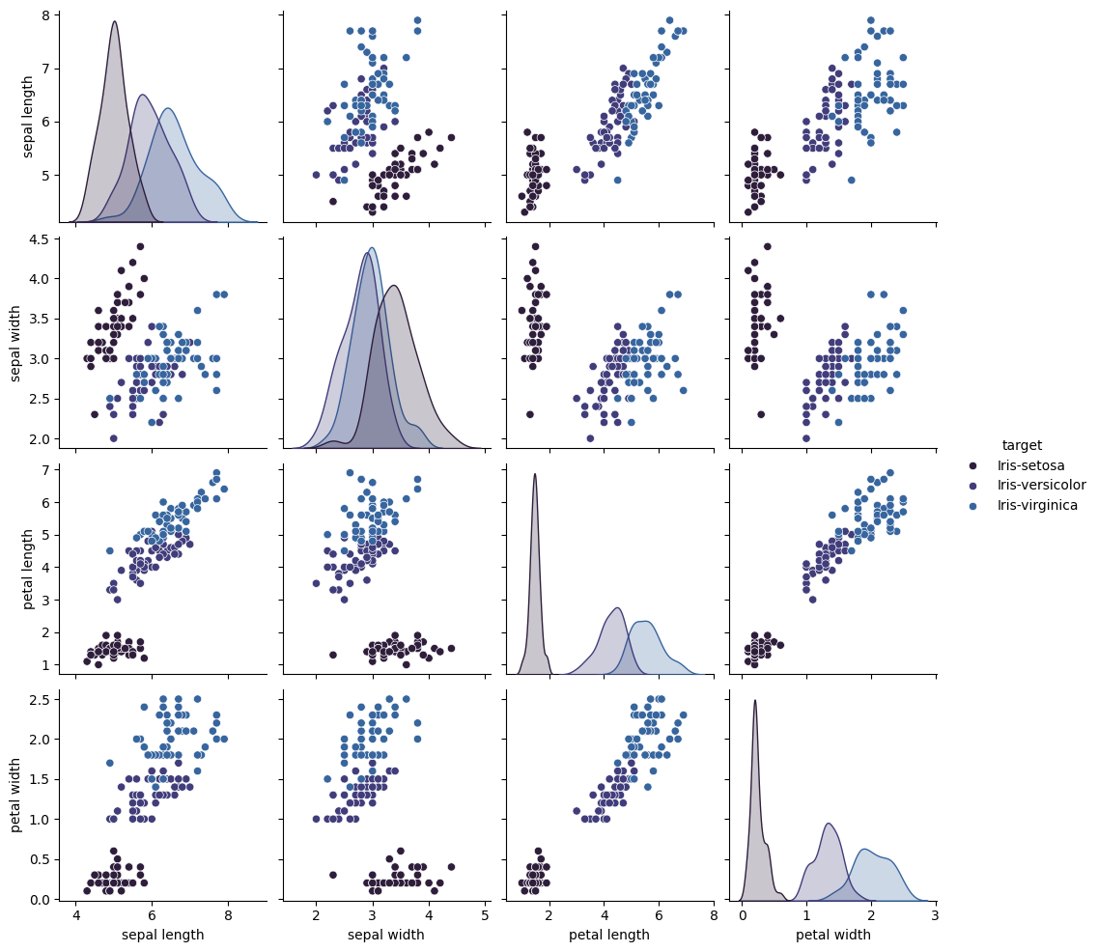

Slide 19
Train Model
# | Dimensionality Reduction by PCA | Parameter(s) | PCA features (from 64 features) | Accuracy Score
1 | not apply | no parameter | 64 | ≈ 93.33%
2 | apply | variance 95% | 29 | ≈ 93.33%
3 | apply | n_components = 2 | 2 | ≈ 93.33%
4 | apply | n_components = 20 copy=False | 20 | ≈ 93.33%
5 | apply | n_components = 64, whiten = True | 64 | ≈ 93.33%

Slide 20
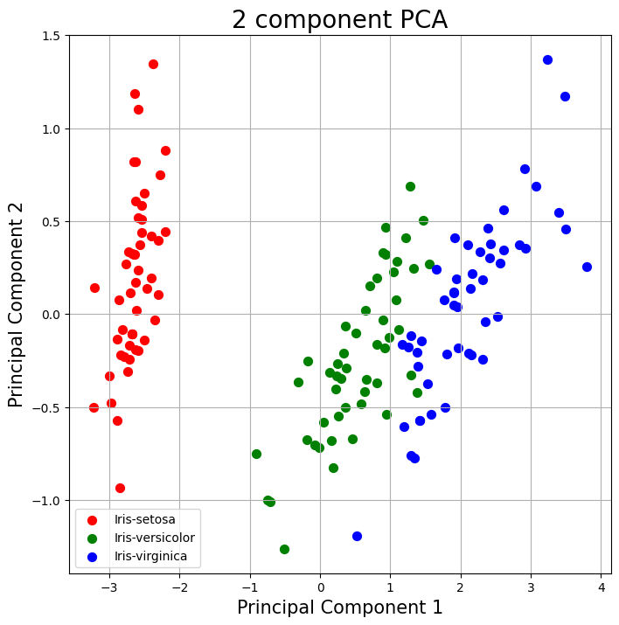
#3 n_components = 2

Slide 21
Thank You

