Slide 1
COS3302 Applied Data Science
Final Examination
Churn Modelling
6405003317 Jutharat Pooamorn

Slide 2
Machine Learning Algorithm
Supervised Learning
K-Nearest Neighbor(KNN)
Unsupervised Learning
K-means clustering

Slide 3
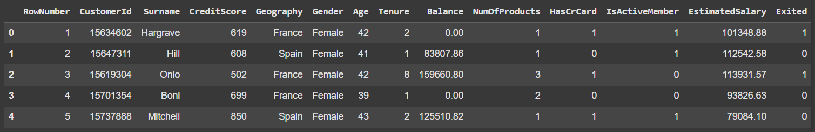
Example Data

Slide 4
Details of Churn Modelling Dataset
Total Data : 10000 entries
No missing values
14 features
Drop unnecessary features
RowNumber
CustomerId
Surname
Amend some features
HasCrCard
IsActiveMember
Exited
Categorical Features | Numerical Features
Geography | CreditScore
Gender | Age
HasCrCard | Tenure
IsActiveMember | Balance
Exited | NumOfProducts
 | EstimatedSalary

Slide 5
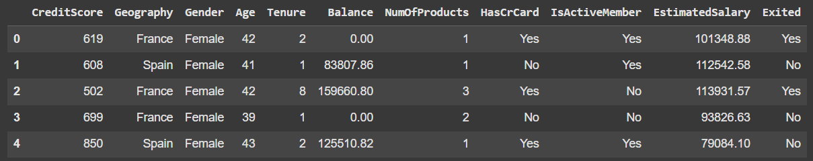
Data Preprocessing

Slide 6
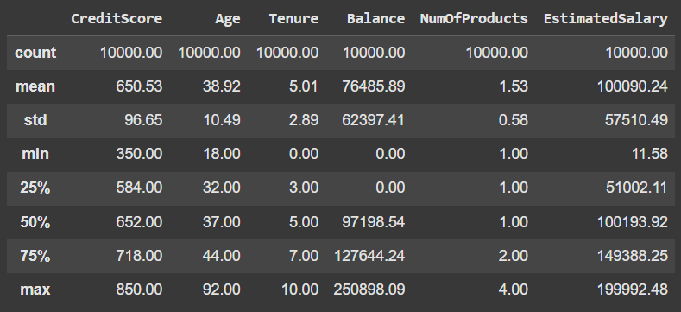
Statistics of Ratio Data

Slide 7
Range of Ratio Data
Ratio | Definition | Range
CreditScore | คะแนนเครดิต | 350 - 850 points
Age | อายุของลูกค้า | 18 - 92 years
Tenure | จำนวนปีที่ใช้บริการ | 0 - 10 years
Balance | ยอดเงินคงเหลือ | 0 - 250898.09 euro
NumOfProducts | จำนวนผลิตภัณฑ์ที่ใช้ | 1 - 4 products
EstimatedSalary | เงินเดือนเฉลี่ย | 11.58 - 199992.48 euro

Slide 8
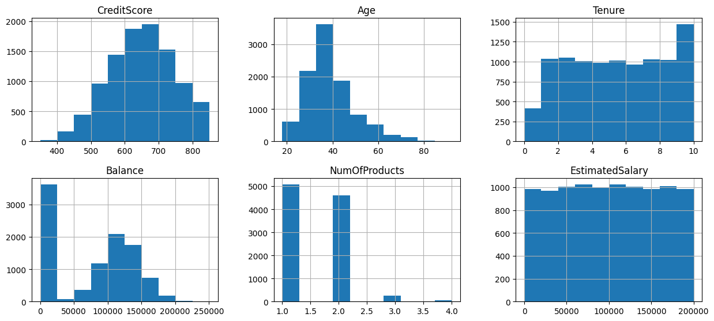
Histogram

Slide 9
Nominal Data
Nominal | Consist Of
Geography | France , Germany , Spain
Gender | Male , Female
HasCrCard | 0 (No) , 1 (Yes)
IsActiveMember | 0 (No) , 1 (Yes)
Exited | 0 (No) , 1 (Yes)

Slide 10
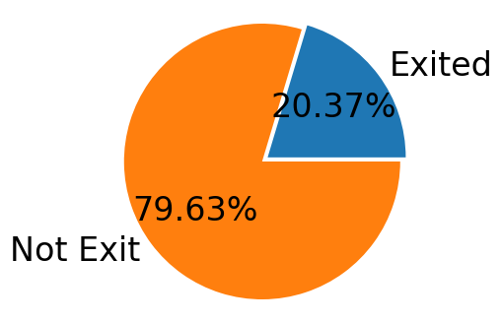
Target Exited

Slide 11
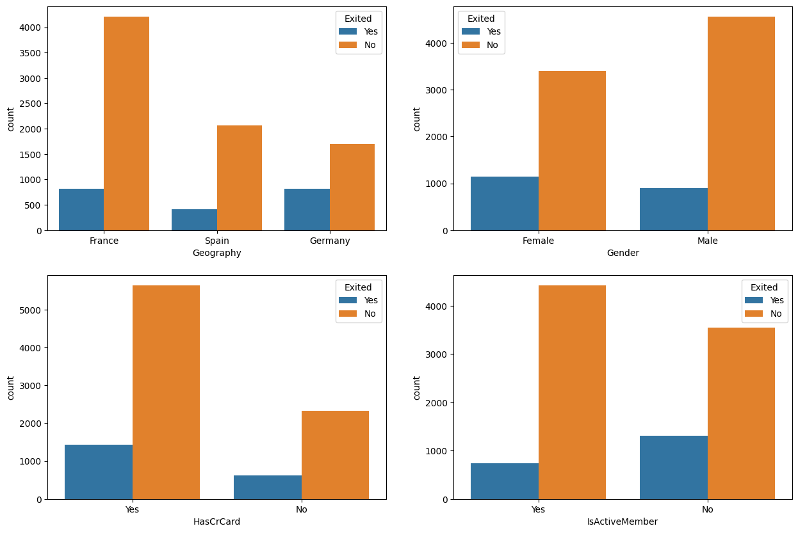
Histogram

Slide 12
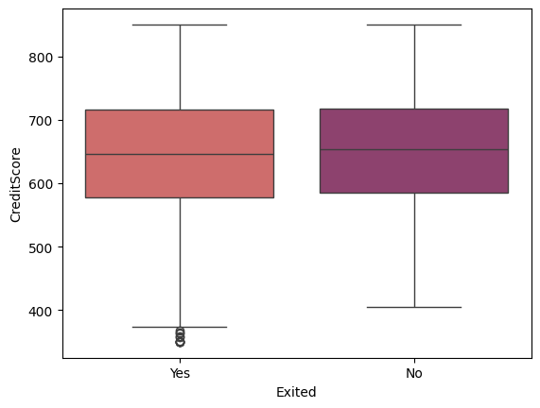
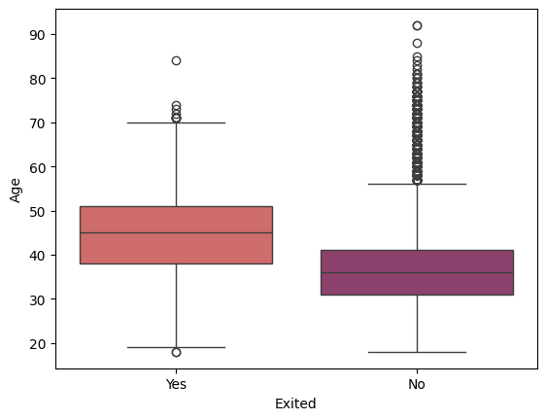
Box Plot

Slide 13
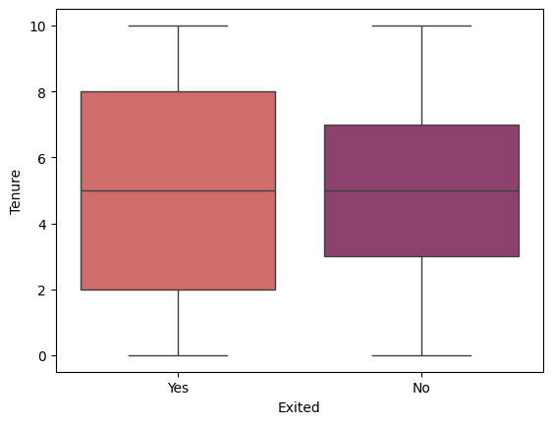
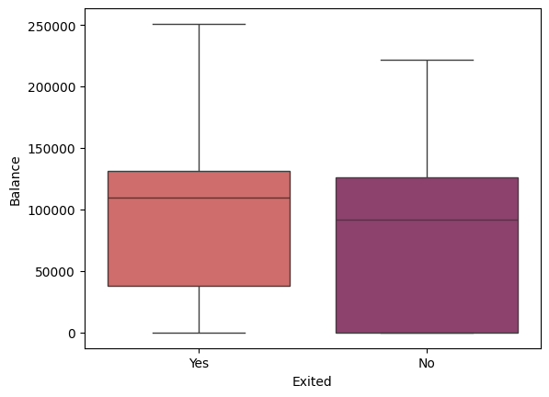
Box Plot

Slide 14
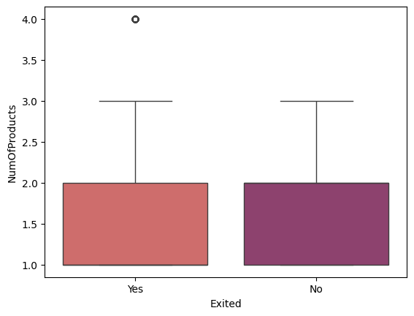
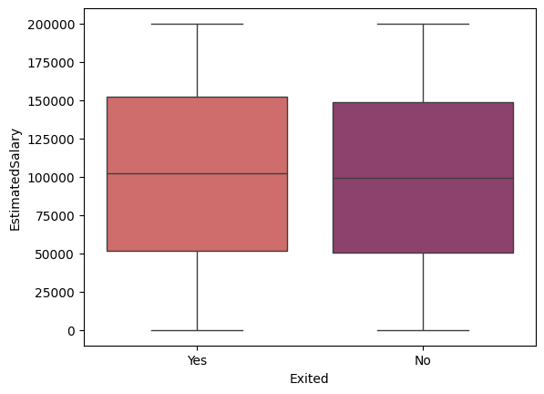
Box Plot

Slide 15
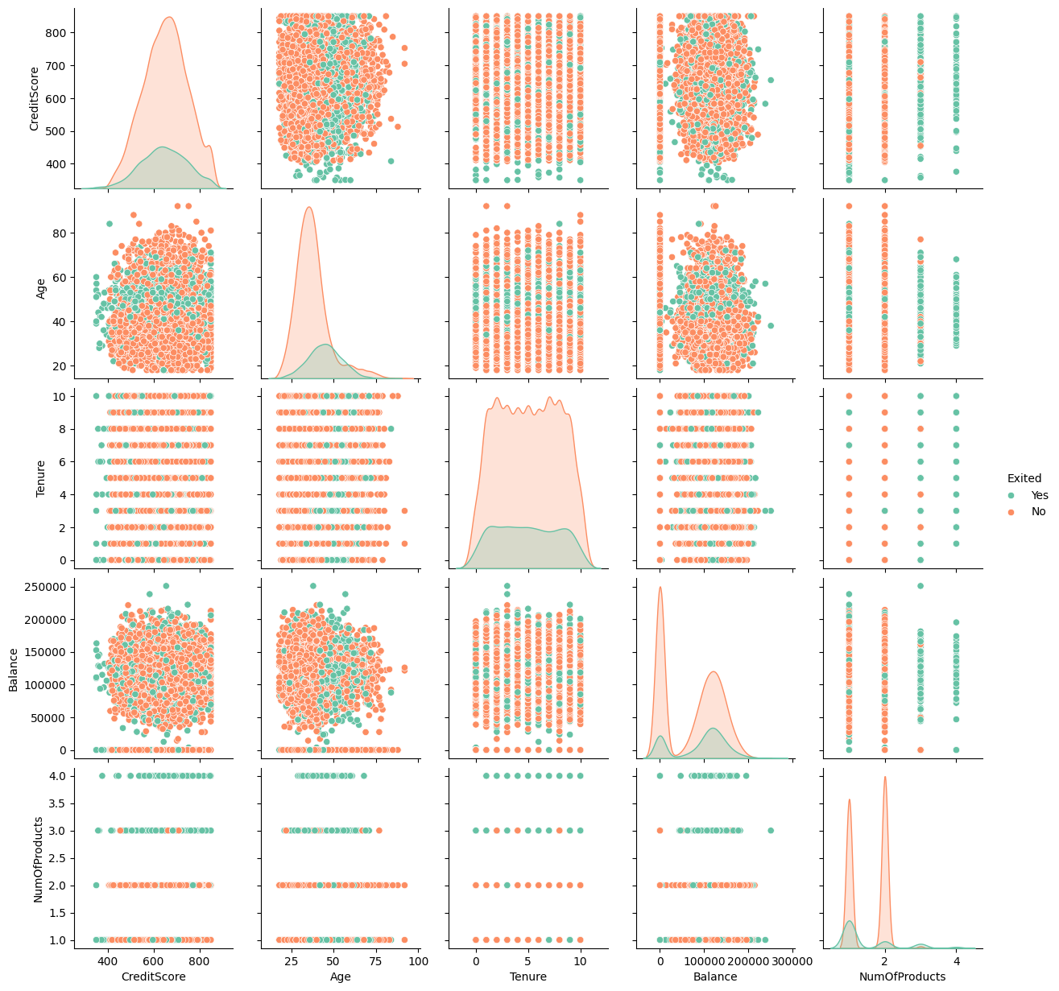
Pair Plot

Slide 16
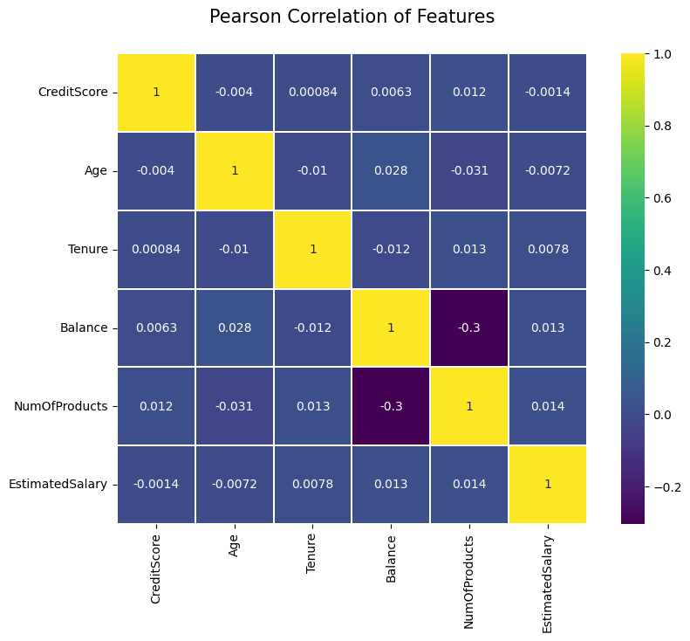
Correlation Matrix

Slide 17
K-Nearest Neighbor (KNN)

Slide 18
Example Data

Slide 19
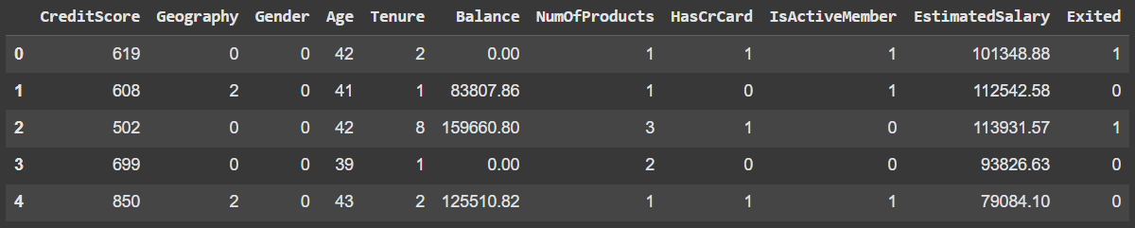
Example Data (After Data Processing)
X
Y

Slide 20
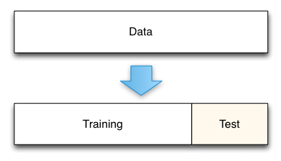
Split Ratio
Determine value for K
80%
20%
K = Sqrt(10000) = 100 ≈ 101
https://medium.com/@rathinavel.mph/how-the-train-and-test-samples-are-split-d7e46a8e2361

Slide 21
No PCA
K = 101

Slide 22
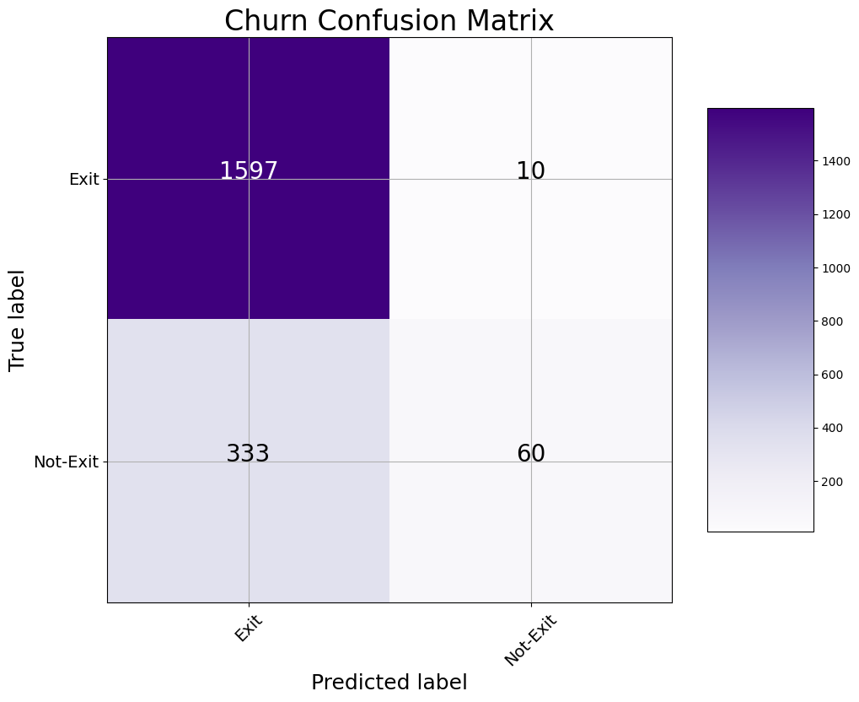
N = 2000

Slide 23
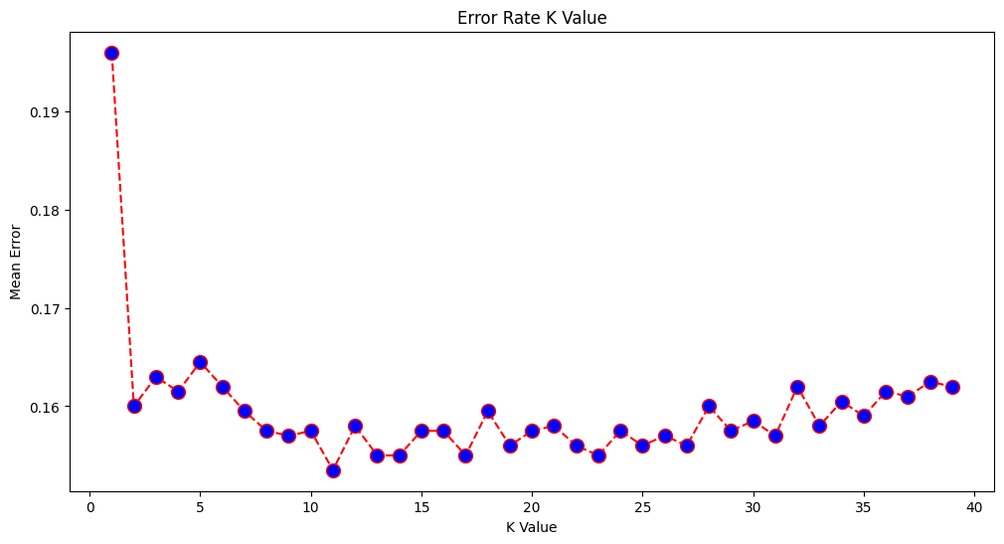
Accuracy = 82.23%

Slide 24
PCA
n_components = 2 (from 14 features)
Accuracy = 99.99%
K = 101

Slide 25
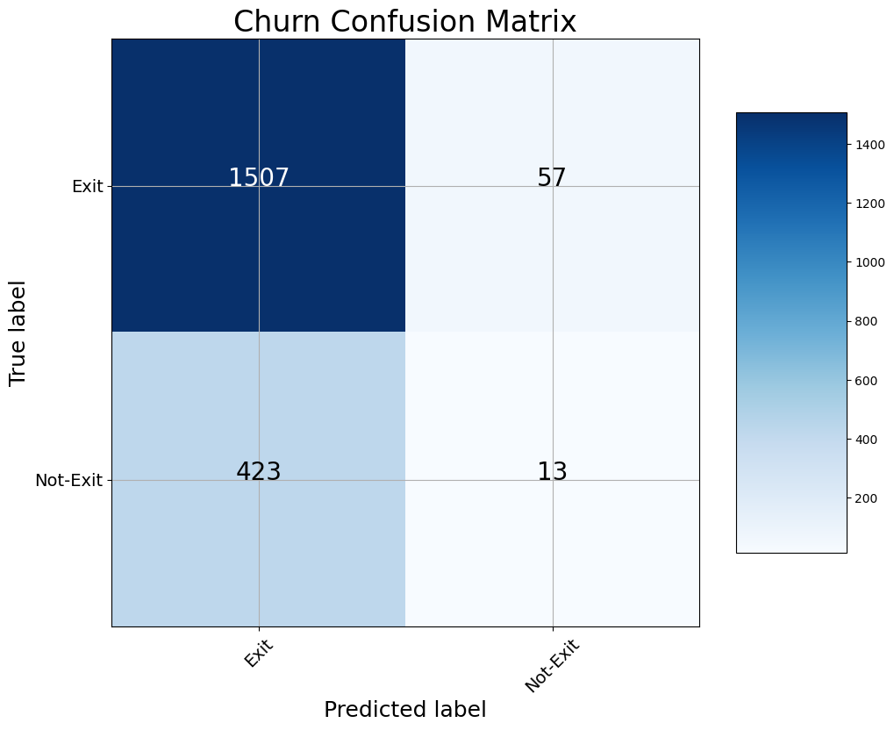
N = 2000

Slide 26
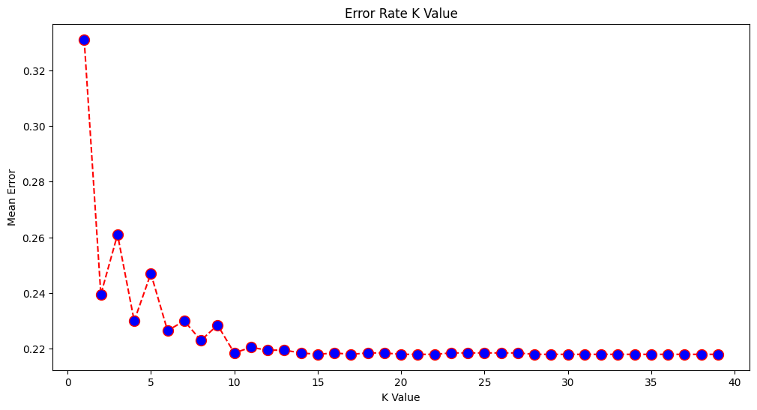
Accuracy = 78.20%

Slide 27
No PCA
PCA
N = 2000

Slide 28
K-means clustering

Slide 29
Example Data

Slide 30
Feature Engineering

Slide 32
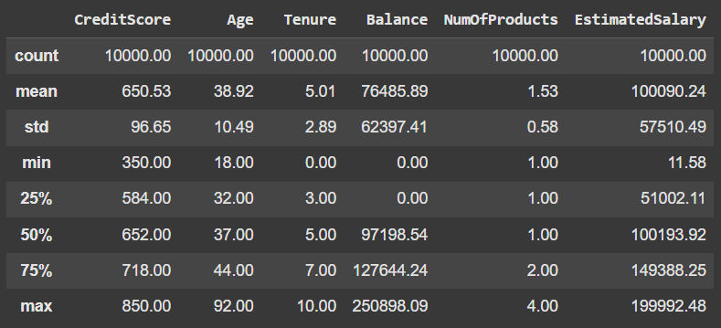
Ratio Data

Slide 33
Histogram

Slide 34
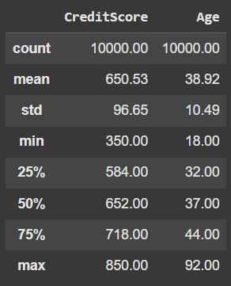
Feature Selection

Slide 35
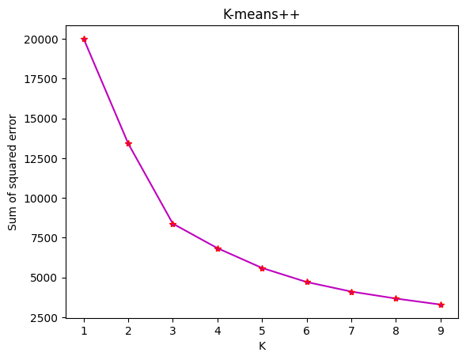

Slide 36
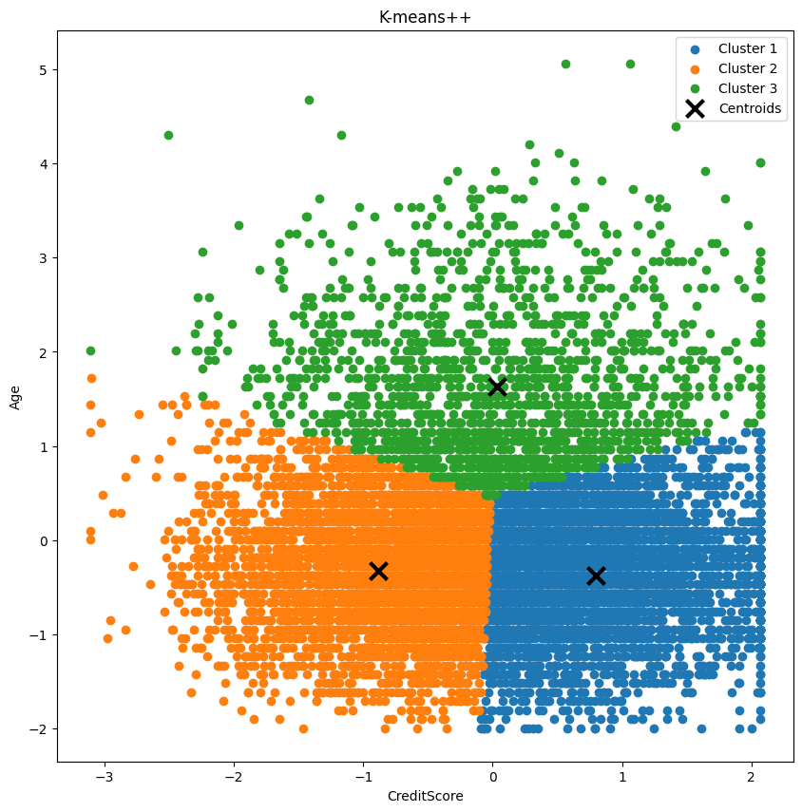
K = 3
Inertia = 8384
Clusters 1 = 82 instances
Clusters 2 = 62 instances
Clusters 3 = 66 instances

Slide 37
Analysis and Insights
cluster | CreditScore | Age
1 | 795.764950 | 35.114618
2 | 586.144976 | 29.778827
3 | 732.544879 | 48.636748
Customer Segmentation
Retention Strategies

Slide 38
Thank You

